Slide 1
Motivation
1. Previous studies using hypergraph to model EHR data treat each patient’ multiple encounter separately. However, the temporal relationship is ignored.
2. Disease code will not enjoy the rich information of patients’ disease evolution history.
3. Previous studies failed to use well-established code ontology structure to regularize the code representation such that their semantic distance is preserved.

Slide 2
Framework
Input: Patients’ disease history (disease codes, separated by encounters)
Output: Informative representations of patients and diagnose codes.
Training: Unsupervised hypergraph representation training.
Evaluation: Add a few outcome labels (mortality / AKI onset) to train a simple classifier, demonstrating better performance than other unsupervised graph learning methods (i.e. based on current patient representations to train a classifier), t-SNE to visualize disease clustering… Check more other papers to gather methods.

Slide 3


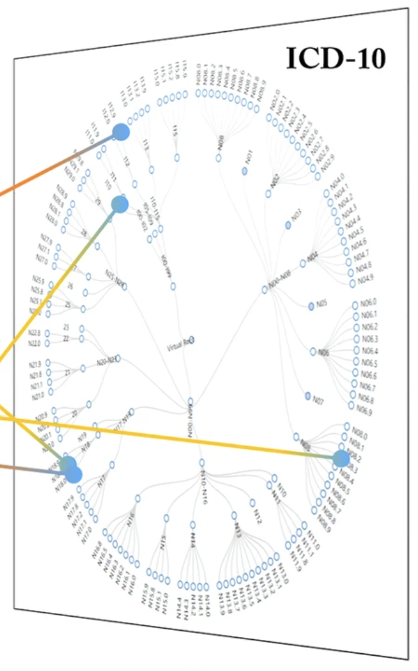
Hypergraph: Patients as nodes and diseases as hyperedges.
Stroke
Diabetes
Hyperedge-node message passing via Transformer
Cancer
CVD
Hypertension
Extract hyperedge (disease) representation
CKD
Sequence contrastive learning (contrastive loss)
View 1: Replace some codes by the codes from same encounter
Embed each patient’s disease code sequence in one vector
Regularization loss
Share-parameter Transformer
The most recent encounter’s disease codes are used to build the hypergraph!
Encounter index embedding
+
+
+
+
+
+
+
+
+
+
+
+
+
+
+
View 2: Mask some codes
Med-BERT encode disease code description into one vector
D₁¹
D₂¹
D₃¹
D₄¹
D₅¹
D₁²
D₂²
D₃²
D₄²
D₅²
D₁³
D₂³
D₃³
D₄³
D₅³
D₁⁴
D₂⁴
D₃⁴
D₄⁴
D₅⁴
Previous encounters, described by diagnose codes
Most recent encounter

Slide 4
CVD
CKD
D₁¹
D₂¹
D₃¹
D₄¹
D₅¹
D₁²
D₂²
D₃²
D₄²
D₅²
D₁³
D₂³
D₃³
D₄³
D₅³
D₁¹
D₂¹
D₃¹
D₄¹
D₅¹
D₁²
D₂²
D₃²
D₄²
D₅²
D₁³
D₂³
D₃³
D₄³
D₅³
D₁¹
D₂¹
D₃¹
D₄¹
D₅¹
D₁²
D₂²
D₃²
D₄²
D₅²
D₁³
D₂³
D₃³
D₄³
D₅³
D₁¹
D₂¹
D₃¹
D₄¹
D₅¹
D₁²
D₂²
D₃²
D₄²
D₅²
D₁³
D₂³
D₃³
D₄³
D₅³

Slide 5
Thoughts before implementation
1. We now want to use soft contrastive learning, but how to get the soft weight? (measure ICD-10 distance)
2. How to batch sampling be incorporated into hypergraph transformer
3. How does hypergraph transformer work?

Slide 6
Hypergraph: Patients as nodes and diseases as hyperedges.
Use every layer representation, not just the final one
Stroke
Diabetes
Attention guidance such that it focuses on ”pure patients”
Hyperedge-node message passing via Transformer
Cancer
CVD
Hypertension
Hypergraph Positional Encoding and Structure Encoding
Extract hyperedge (disease) representation
CKD
Sequence contrastive learning (soft contrastive loss)
View 1: Replace some codes by the codes from same encounter
Embed each patient’s disease code sequence in one vector
Regularization loss
Transformer
View 2: Mask some codes
The most recent encounter’s disease codes are used to build the hypergraph!
Encounter index embedding
+
+
+
+
+
+
+
+
+
+
+
+
+
+
+
Med-BERT encode disease code description into one vector + PPMI-SVD
Code similarity
KLD
D₁¹
D₂¹
D₃¹
D₄¹
D₅¹
D₁²
D₂²
D₃²
D₄²
D₅²
D₁³
D₂³
D₃³
D₄³
D₅³
D₁⁴
D₂⁴
D₃⁴
D₄⁴
D₅⁴
Previous encounters, described by diagnose codes
Most recent encounter

Slide 7
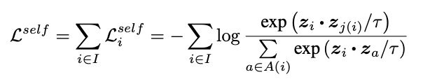
A Closer Look at Contrastive Loss
But not all negative pairs should be pushed far away.

Slide 8
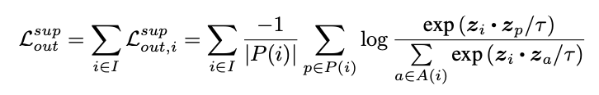
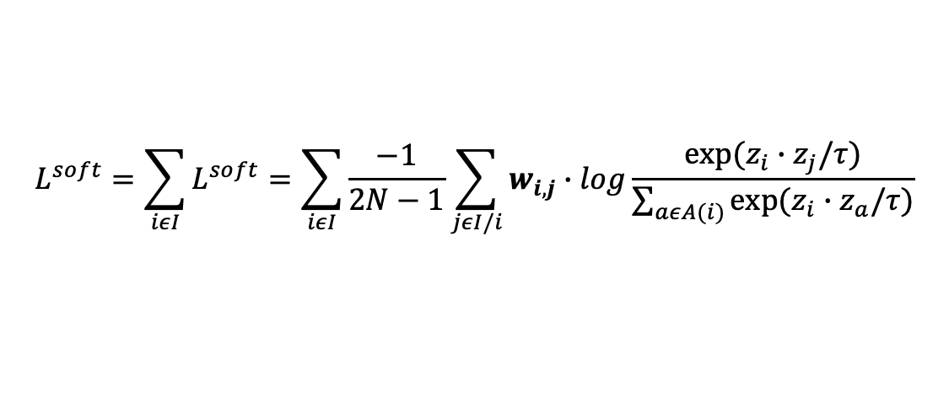
A Closer Look at Contrastive Loss
Self-supervised Contrastive Learning
Supervised Contrastive Learning
$$L^{soft}=\sum_{iεI}{L^{soft}=\sum_{iεI}{\frac{−1}{2N−1}\sum_{jεI/i}{w_{i,j}∙log\frac{exp⁡(z_{i}∙z_{j}/τ)}{\sum_{aεA(i)}{exp⁡(z_{i}∙z_{a}/τ)}}}}}$$
Supervised Soft Contrastive Learning

Slide 9
Design a Explainer

Slide 10
Soft Weights
Most recent encounter medical codes -> Use LLM to extract representation from their short descriptions -> pairwise cosine similarity.
The intuition is that for patients with similar most recent health condition, their medical history representation should not be push very far away!
This also helps the learning of hypergraph transformer, as nodes living on one hyperedge should not be far away in the latent space.

Slide 11
Project Progress

Slide 12
May 19
A. Choosing datasets:
1. Public Datasets: MIMIC-IV (follow Predictive Modeling with Temporal Graphical Representation on Electronic Health Records, using PyHealth)
2. Private Dataset: PCORI
B: Read PyHealth Tutorial
C. Choosing baselines:

Slide 13
Change to model
1. Pretrain then fine tune
2. Inject the code-wise similarity and code-time-interval at the attention score matrix, inject node type at the token level
3. Inject hypergraph structure information
4. Pretrain hypergraph transformer model on graph tasks (TBD)

Slide 14
Hypergraph: Patients as nodes and diseases as hyperedges.
Use every layer representation, not just the final one
Stroke
Diabetes
Attention guidance such that it focuses on ”pure patients”
Hyperedge-node message passing via Transformer
Cancer
CVD
Hypertension
Hypergraph Positional Encoding and Structure Encoding
Extract hyperedge (disease) representation
CKD
Sequence contrastive learning (soft contrastive loss)
View 1: Replace some codes by the codes from same encounter
Embed each patient’s disease code sequence in one vector
Regularization loss
Transformer
View 2: Mask some codes
The most recent encounter’s disease codes are used to build the hypergraph!
Encounter index embedding
+
+
+
+
+
+
+
+
+
+
+
+
+
+
+
Med-BERT encode disease code description into one vector + PPMI-SVD
Code similarity
KLD
D₁¹
D₂¹
D₃¹
D₄¹
D₅¹
D₁²
D₂²
D₃²
D₄²
D₅²
D₁³
D₂³
D₃³
D₄³
D₅³
D₁⁴
D₂⁴
D₃⁴
D₄⁴
D₅⁴
Previous encounters, described by diagnose codes
Most recent encounter

Slide 15
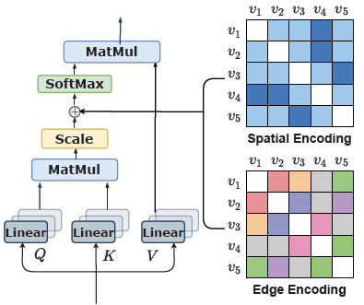
Using random walk to inject hypergraph structure information
<PAT>
=
Co-occurrence inductive bias
Step 1:
MLM pre-training
Step 2:
Hypergraph Contrastive Learning
Time –interval inductive bias
Code type embedding (trainable)
+
+
+
+
+
+
+
+
+
+
+
+
+
+
+
+
OpenAI API encode medical code description into embeddings (static)
<PAT>
D₁¹
D₂¹
D₃¹
D₄¹
D₅¹
D₁²
D₂²
D₃²
D₄²
D₅²
D₁³
D₂³
D₃³
D₄³
D₅³
D₁³
D₂³
D₃³
D₄³
D₅³
Most recent encounter

Slide 16
Recipe for a Powerful Graph Transformer for EHR Modeling

Slide 17
What information should be injected?
Code level: vanilla embedding, code type
If paired with other code, we have extra interaction information:
1. Time interval between 2 codes (a code in the distant past might not render a great effect)
2. Co-occurrence frequency between 2 codes (real-world pattern)
3. Same frequency, but different code type, should represent different meaning. E.g. medication – medication: 12 vs lab – medication: 12, should have different meanings.
Encounter level: encounter index, patient age, visit type (if any)
Patient level: sex, race (if any)

Slide 18
How information should be communicated?
1. It has been shown that code can benefit from message-passing in a graphical manner, rather than temporal manner (LSTM), though temporal information is important.
2. On the encounter level, I propose that allowing codes to have cross-encounter interaction can benefit the quality of the code representation (DeepJ).
3. On the patient level, it has been shown that allowing patient level embedding to communication in a hypergraph, connected through one patient’s last diagnosis, can capture high-order interaction information in a disease population (TACCO).

Slide 19


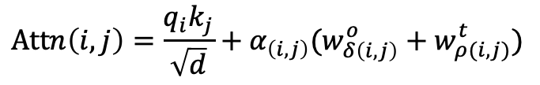


Pretraining Step 1
$$×N$$
<PAT>
$$[w_{1}^{o},w_{2}^{o},w_{3}^{o},…,w_{max}^{o}]$$
$$Attn\left(i,j\right)=\frac{q_{i}k_{j}}{\sqrt{d}}+α_{\left(i,j\right)}(w_{δ\left(i,j\right)}^{o}+w_{ρ(i,j)}^{t})$$
Co-occurrence inductive bias
$$[w_{1}^{t},w_{2}^{t},w_{3}^{t},…,w_{max}^{t}]$$
Time –interval inductive bias
$$×$$
Encounter index embedding
+
+
+
+
+
+
+
+
+
+
+
+
+
+
+
+
Code type embedding
+
+
+
+
+
+
+
+
+
+
+
+
+
+
+
+
Vanilla code embedding
<PAT>
Pretraining tasks:
1. Masked code prediction
2. Binary code order prediction
D₁¹
D₂¹
D₃¹
D₄¹
D₅¹
D₁²
D₂²
D₃²
D₄²
D₅²
D₁³
D₂³
D₃³
D₄³
D₅³

Slide 20
Pretraining Step 2
$$×N$$
<PAT>
Co-occurrence inductive bias
Time –interval inductive bias
Encounter index embedding
+
+
+
+
+
+
+
+
+
+
+
+
+
+
+
+
Code type embedding
Normalize to code group level
(otherwise graph too sparse)
+
+
+
+
+
+
+
+
+
+
+
+
+
+
+
+
Vanilla code embedding
<PAT>
D₁¹
D₂¹
D₃¹
D₄¹
D₅¹
D₁²
D₂²
D₃²
D₄²
D₅²
D₁³
D₂³
D₃³
D₄³
D₅³
Last encounter’s ICD-9 codes

Slide 21
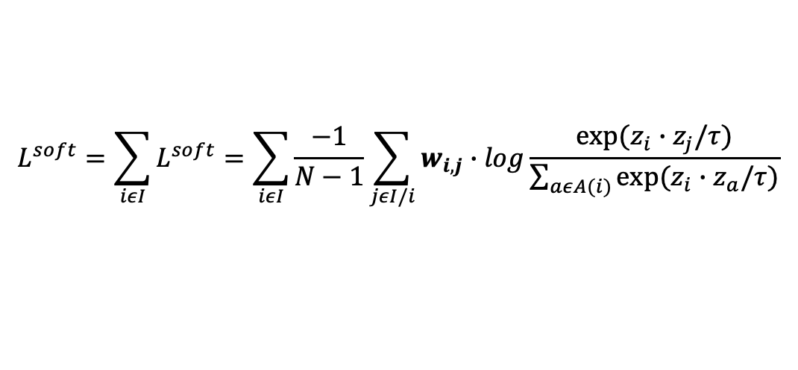


Pretraining Step 2
Patient embedding from pretrained graph transformer encoder
Embedding from hypergraph transformer encoder
A novel contrastive learning pretraining task:
close
$$W_{retain}$$
Orthogonal
$$W_{population}$$
$V_{population}$ should follow the soft contrastive loss
Normalize to code group level
(otherwise graph too sparse)
$$L^{soft}=\sum_{iεI}{L^{soft}=\sum_{iεI}{\frac{−1}{N−1}\sum_{jεI/i}{w_{i,j}∙log\frac{exp⁡(z_{i}∙z_{j}/τ)}{\sum_{aεA(i)}{exp⁡(z_{i}∙z_{a}/τ)}}}}}$$
D₁¹
D₂¹
D₃¹
D₄¹
D₅¹
D₁²
D₂²
D₃²
D₄²
D₅²
D₁³
D₂³
D₃³
D₄³
D₅³
Last encounter’s ICD-9 codes

Slide 22
Target
8.1 AAAI
9.24 ICLR
12.1 WWW
IEEE JBHI

Slide 23
June 27
1. Get all performance of HEART on MIMIC-III
2. Read code from preprocessing again and organize the flowchart
3. Download MIMIC-IV

Slide 24
June 30
What is the requirement for __get_item__ output of the Dataset?
1. The entire encounter sequence (input_tokens) should be in one 1d tensor, of structure:
[CLS, MASK_0, diag_1_1, diag_1_2, MASK_1, med_1_1, med_1_2, MASK_2, pro_1_1, pro_1_2, MASK_3, lab_1_1, lab_1_2, MASK_0, diag_2_1, diag_2_2,…] (tokenized)
2. token_types, same length as input_tokens:
[1, 2, 2, 3, 3, 4, 4, 5, 5, 2, 2, …]
3. adm_index: [1(for CLS), 2,2,2,2,2,2,2,2,3,3,…]
4. masked_labels: as the original structure in HEART
One core index idea is that 0 for [PAD], 1 for [CLS], 2 for diag and its [MASK_0], 3 for med and its [MASK_1], 4 for pro and its [MASK_2], 5 for lab its [MAKS_3].

Slide 25
June 30
Also make sure in a batch a patient will not see their future, thus no leakage in the hypergraph information passing.

Slide 26
July 2
1. Read PyG tutorial
2. Watch GNN video
https://www.youtube.com/watch?v=ZfCtFLS_os0
https://www.bilibili.com/video/BV1ez421Z7Dc/?spm_id_from=333.1387.upload.video_card.click&vd_source=360b613b645a44e642b8dee47b6f8205
https://www.youtube.com/watch?v=H8RsdeAiOBg
3. Read original model implementation

Slide 27
July 3
1. in the inductive bias matrix, how to process
[CLS] [MASK_0, 1, 2, 3] rows should all be 0
Cls should take the average
MASK should take type-specific average
Experiments:
1. MIMIC III and IV 5 tasks (at least compare GT-BEHRT, IJCAI, Heart)
2. Ablation study
3. Long records performance
4. Case study

Slide 28
July 5
1. Read PyG all tutorials
2. Download QQ group source code and read
3. Think about how to do hypergraph module
4. Read code from TACCO
The bottleneck is that large scale hypergraph learning.

Slide 29
July 6
1. Big idea: 2 patient trajectory view (modality), one local GT and one population level HyperGraph, use Dr.Fuse idea to fuse them
2. GT and hypergraph should all be pretrained by MLM and graph contrastive learning
3. Read HyperGraph EHR
4. Read contrastive learning package.
5. Final [h_local, h_pop], where h_local = h_GT_share + h_HG_share / 2
Hypergraph CL augmentation should MIMIC clinical data characteristics:

Slide 30
MASK_0
MASK_1
PAD
-1 | -1 | -1 | -1 | -1 | -1 | -1 | -1 | -1 | -1
-1 | -1 | -1 | -1 | -1 | -1 | -1 | -1 | -1 | -1
 | -1 |  |  | -1 |  |  |  |  | -1
 | -1 |  |  | -1 |  |  |  |  | -1
-1 | -1 | -1 | -1 | -1 | -1 | -1 | -1 | -1 | -1
 | -1 |  |  | -1 |  |  |  |  | -1
 | -1 |  |  | -1 |  |  |  |  | -1
 | -1 |  |  | -1 |  |  |  |  | -1
-1 | -1 | -1 | -1 | -1 | -1 | -1 | -1 | -1 | -1
CLS
MASK_0
MASK_1
PAD

Slide 31
Capture personalized information
Local: Graph transformer,
MLM pretrain
E_unique
Orthogonal
E_global
Output:
[ ,( + ) /2]
Capture this kind of patients’ prototype
Patient trajectory
Minimize JSD
Global: Hypergraph,
Contrastive learning pretrain + MLM pretrain
E_global
Capture this kind of patients’ prototype
via message passing
Consider adding an explainer

Slide 32
July 13
1. Enable finetuning simpleModel
2. enable not using inductive bias
3. code check
4. read Dr.fuse paper and code
5. journal club
6. args for whether use ent, type coff and inductive
7. whether use encounter index embedding, use code type embedding
8. Get formal HEART performance

Slide 33
July 14
1. Get formal HEART performance
2. Read VAE tutorial
3. Read Dr. Fuse paper and code
4. Journal club slides

Slide 34
July 15
Run GT part on cuda and get performance
Check code including occurrence and embedding
Run HyperGT on cuda
Upload to github new repo
Finish yesterday task
Modify masking logic for pretrain

Slide 35
July 16
Upload to github
如果您的模型 GT_model() 接收 pair_occur，确保它支持 list of [L, L] 矩阵 而非 batched [B, L, L] 或者在模型内部动态 pad 到当前样本最大 L，并堆叠为 [B, L_max, L_max] 后再输入
Enable all 4 code type pretrain or diagnose code only / new pretrain
Enable print all loss in finetune
Code check (reexamine the logic of occurrence, according to Grok)
Get the best on GT
Hypergraph contrastive learning + mask pretraining
Organize the complete protocol
E_global and E_personal consider using cross attention
Read Dr.Fuse

Slide 36
July 17
Run GT on current occurrence
Mask token type应该是这个type 的unique 70% 之后全部遮掉
Clear special token row inductive parametrization (在forward里，有行全为special index则清零， 注意是替换了w后因为0对应w)
Get back 4 MASK at the end
Age_sex 做nn embed 加到每一个token，CLS也用last-age _sex
加的MASK token的附加nn EMB 如incounter index 使用特殊index（max）
全面检查assert input
Check whether the df is time ordered
Fix cuda out of memory

Slide 37
CLS
Code
Code
Code
Code
Code
Code
MSK0
MSK1
MSK2
MSK3
PAD
Last_age_sex
Age_sex
Age_sex
Age_sex
Age_sex
Last_age_sex
Last_age_sex
Last_age_sex
Last_age_sex
Last_age_sex
Last_age_sex
Special age index
Type (1)
Type (2)
Type (2)
Type (3)
Type (3)
Type (4)
Type (5)
Type (2)
Type (3)
Type (4)
Type (5)
Type (0)

Slide 38
July 17
The problem is that the pretraining is not working. So try:
1. Remove CLS in the pretraining
2. Cancel visit embedding / edge embedding.
3. Cancel unique masking trick
4. Cancel pretrain at visit level, revert to patient level

Slide 39
July 21
Use MLM to pretrain (can switch between CL and MLM or both)
If have time, think about on the visit level hyperedge:
(1) for now, simply switch to the visit level and record each patient’s last visit index in the batch
(2) remove isolated nodes

Slide 40
July 27
1. Set up SetGNN finetine.
Start with the full graph full vocabulary. Regardless of UniqueID
2. It works for binary tasks.
(1) Still keep the diagnosis prediction
(2) keep the hyperparameter space clean
(3) Enable the switch between visit level and patient level
(4) enable code type embedding
(5) enable load pretrained Embedding from GT
3. Read Dr.fuse and code
4. Read

Slide 41
July 28
Treat HG as a help modality
When joint training, freeze HG, only get logits
Try Dr.Fuse like this:
(1) GT branch 2, 垂直
(2) global head 和HG logits用JSD
(3) cross atten

Slide 42
July 29
1. Think about sampling the hypergraph with
TF-IDF/BERT for patient sequence -> k-NN construct hyperedges -> sample hypergraph with random walk, implement long visit seq performance monitoring
2. Read modality fusion paper
3. Finish unfreeze version of current pipeline (SOTA)
4. Try minimizing MI and other interaction between GT and HG
5. Tune fuse model, HG warmup epochs, num HG layers to 3, patient -> visit
6. Read CLIP
7. Think about how to link hypergraph edges to simulate visit seq of a patient (e.g. enable hyperedge visit 1 -> hyperedge visit 2 when doing node -> edge ,trach those with > 1 visits)
8. Collect baseline models everyday

Slide 43
July 30
1. Expand results to MIMIC-IV
2. Finish running w/o pretraining results.
3. Decide baselines, get 1 more baseline performance: TACCO, GT-BEHRT
4. Add pretrain to HG?
5. Get all ablation study results on 2 datasets

Slide 44
MLM pretrain + warm-up
Single modality prediction loss
Local: Graph transformer,
MLM pretrain
Attention fuse
Patient trajectory
Contrastive loss
Fusion prediction loss
Warm-up
Global: Hypergraph,
Contrastive learning pretrain + MLM pretrain
Single modality prediction loss

Slide 45
 | MIMIC-III |  |  |  |  |  |  |  |  | MIMIC-IV
 | Mortality (27.42%) |  |  | Readmission (40.23%) |  |  | Prolonged stay (51.40%) |  |  | Mortality (9.88%) |  |  | Readmission (68.06%) |  |  | Prolonged stay (35.50%)
 | F1 | AUROC | AUPRC | F1 | AUROC | AUPRC | F1 | AUROC | AUPRC | F1 | AUROC | AUPRC | F1 | AUROC | AUPRC | F1 | AUROC | AUPRC
HEART (2024)
GT w/o pretrain | 71.20 ± 2.37 | 90.72 ± 0.72 | 81.47 ± 1.44 | 68.65 ± 1.08 | 79.81 ± 0.35 | 69.55 ± 0.27 | 75.98 ± 0.62 | 84.02 ± 0.33 | 85.75 ± 0.28 | 67.99 ± 0.99 | 95.23 ± 0.12 | 76.43 ± 0.44 | 81.69 ± 0.16 | 70.68 ± 0.19 | 82.21 ± 0.14 | 68.21 ± 1.86 | 85.68 ± 0.31 | 78.23 ± 0.43
GT w/ pretrain | 74.36 ± 0.50 | 91.74 ± 0.14 | 82.71 ± 0.22 | 67.84 ± 0.44 | 80.21 ± 0.08 | 69.55 ± 0.09 | 77.56 ± 0.18 | 84.52 ± 0.22 | 85.92 ± 0.25 | 65.75 ± 1.30 | 95.77 ± 0.08 | 78.18 ± 0.15 | 82.38 ± 0.05 | 71.98 ± 0.11 | 82.70 ± 0.08 | 70.35 ± 0.73 | 86.35 ± 0.13 | 79.06 ± 0.24
HG | 61.30 ± 2.28 | 82.26 ± 1.77 | 61.00 ± 2.76 | 63.52 ± 0.72 | 76.93 ± 0.22 | 65.45 ± 0.26 | 75.92 ± 0.73 | 84.41 ± 0.49 | 85.88 ± 0.49 | 46.44 ± 14.81 | 88.54 ± 8.44 | 53.79 ± 16.88 | 81.21 ± 0.39 | 70.21 ± 0.24 | 81.31 ± 0.13 | 65.30 ± 0.36 | 83.76 ± 0.81 | 74.89 ± 1.37
Ours full | 73.34 ± 1.35 | 91.50 ± 0.24 | 82.24 ± 0.42 | 67.87 ± 3.11 | 79.43 ± 0.37 | 68.54 ± 0.54 | 75.67 ± 1.38 | 83.73 ± 0.34 | 85.08 ± 0.37 | 67.74 ± 0.68 | 95.14 ± 0.16 | 75.70 ± 0.28 | 81.11 ± 0.92 | 70.90 ± 0.38 | 82.04 ± 0.18 | 64.15 ± 6.03 | 84.48 ± 0.34 | 76.12 ± 0.51

Slide 46
Aug 3
Read TRANS
Read FlexCare, TRANS codes
Think about alignment and redundancy (original code)
Read motimodal survey

Slide 47
Aug 4
Read TRANS
Read FlexCare, TRANS codes
Last chance for Hypergraph idea:
1. Get all performance for vanilla GT, HG and fuse
2. For fuse, prediction head should switch to warmup head, implement loss-based regularization fuse, flexibility of contrastive learning. HG switch to batch warm up.

Slide 48
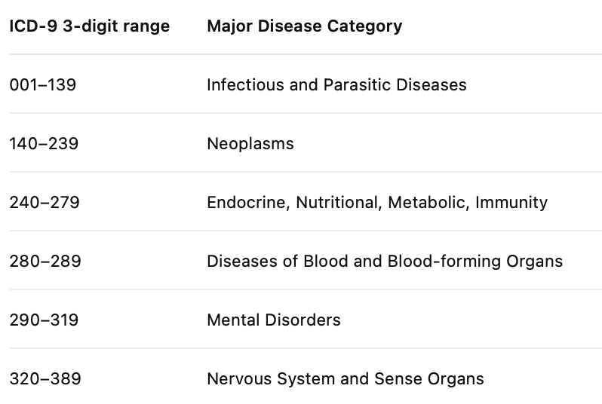
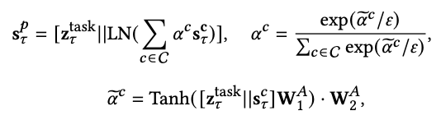
Diseases
Labs
Procedures
Medications
Visit 1
Visit 2
Same disease
LLM-enhanced HG
Virtual visit nodes (age, sex)
Disease code-based heterogeneous graph
Message passing
+
+
+
Task token
ICD-9 disease
group tokens
Enhanced disease tokens
Original lab, procedure and medication tokens
Task
Transformer layers
ICD-9 group
Diseases
Labs, procedures and medications

Slide 49
Aug 10
Add-ons:
1. Combine ICD-9 grouping as multi-system token
2. Think about meta path on disease graph and get semantic token.

Slide 50
Aug 12
1. link github
Add disease type embedding to graph
2. multilayer GNN
Rewrite attention mask
2. What about just patients with >=2 encounters
3. Try the idea of ICD-9 grouping
4. read papers (current idea medpath + LLM graph)
5. Optional, Graph use different embedding

