Slide 1
Biodiesel Pricing & Market Analysis
Research Methodology
Supply/Value Chain Analysis
Outlines the approach adopted to collect and analyze data, along with data validation techniques
Maps the complete biodiesel value chain from raw materials to manufacturing, distribution, and end-use
01
02
03
04
Introduction
Market Dynamics
Overview of the biodiesel market in the U.S., covering what biodiesel is, its relevance in renewable energy
Covers the key drivers, restraints, opportunities, and challenges shaping the U.S. biodiesel market.
Impact of US Tariff
Pricing Analysis
Details the timeline and scope of tariffs implemented in 2025 by the U.S. on countries like China, India, EU, Canada, and Japan.
Presents historical and current pricing (USD/gal, USD/MT), conversion factors, and policy influences
08
07
06
05
Sources & Data Justification
Regulatory Framework
Justifies the credibility and relevance of data sources used, discusses strategies for handling conflicting or incomplete data, and explains why the chosen data ensures reliability in price and trend analysis.
Examines key U.S. policies like the Renewable Fuel Standard (RFS), Biodiesel Tax Credit (BTC), and EPA blending mandates

Slide 2
INTRODUCTION
01
Market Definition
Biodiesel is an environmentally-friendly fuel used as a substitute for fossil-based fuels. It is a fuel made of mono-alkyl esters of long chain fatty acids derived from vegetable oils, animal fats, and greases. The pure form of biodiesel is designated as B100. It has applications in transportation, power generation, marine, agriculture, and mining industries.
The U.S. biodiesel market plays major role in supporting renewable energy goals and reducing greenhouse gas emissions. The provided analysis is a gist of the market between June 2024 and May 2025, focusing on:
Biodiesel price trends (USD/gallon and USD/MT)
Key market drivers and cost influencers
Value chain and supply dynamics
Impact of U.S. trade tariffs and shifting regulatory policies
Short-term price forecasts

Slide 3
02
RESEARCH METHODOLOGY
Secondary Research Data
This technical and market-oriented study of the U.S. biodiesel market involved extensive use of reliable secondary sources and databases such as Volza, AFDC (Alternative Fuels Data Center), Iowa State’s CARD, U.S. Energy Information Administration (EIA), and U.S. Department of Energy (DOE) to collect and validate data on pricing, trade, policies, and market trends.
The methodology included:
Monthly price tracking for biodiesel (B100 and B20) using government databases, trade platforms
Cross-verification of pricing data from retail (AFDC), and wholesale (CARD)
Policy tracking via U.S. EPA, monitored tariff actions via USTR updates and trusted media (as Bloomberg, Reuters)
Forecasting based on known cost drivers, seasonal demand patterns, and ongoing trade/tariff dynamics.

Slide 4
03
Market Dynamics
DRIVERS | CHALLENGES | OPPORTUNITIES | MAJOR TRENDS
📜 RFS Mandate: Ensures steady demand through federal blending requirements. ♻️ Sustainability Push: Climate targets promote clean fuel alternatives. 💰 Tax Credits: Biodiesel Tax Credit (BTC) directly lowers production cost. 📉 Crude Oil Price Sensitivity: Higher fossil fuel prices improve biodiesel competitiveness. | 🌾 Feedstock Price Volatility: Soybean oil and other feedstocks make up most of biodiesel production costs; price swings constrain margins and planning. 🏛️ Trade Barriers: Higher tariffs on imported raw materials (notably from China, Brazil, and the EU) raise input costs, potentially making some US plants less competitive. | 🚍 Fleet Decarbonization: Decarbonization mandates across corporate and public transport fleets. ✈️ SAF Potential: Potential to supply Sustainable Aviation Fuel (SAF) using existing biodiesel infrastructure. 🛢️ Waste Feedstocks: Growth of advanced feedstocks like algae and waste fats. | 🌍 Low Carbon Standards: Expansion of low-carbon fuel standards (LCFS) across U.S. states. ♻️Circular Economy Focus: Greater investment in UCO-based biodiesel. 🧪Advanced Processing: Blending flexibility with optimized transesterification processes. 🔄Shift to Renewable Diesel: Gradual shift toward renewable diesel (HVO) in some fleets.
Notes:
https://www.argusmedia.com/en/news-and-insights/latest-market-news/2698855-epa-proposes-record-us-biofuel-mandates-foreign-limits

Slide 5
Supply Chain Analysis
04
Blend biodiesel with petro-diesel: B5, B20, B100
Bulk Delivery Systems
Raw Materials
Biodiesel Manufacturing
Blenders & Distribution Channels
(Biomass, Used Cooking Oil, Animal Fats, Soybean Oil, Palm Oil, Canola Oil)
Transesterification / Hydrotreating units)
Byproducts: Glycerin, Methanol Recovery)
End-Users
Fuel Retailers/ Wholesalers
Transportation fleets (trucks, buses), Agriculture (tractors, irrigation), Municipal services, and Others
(Petrol pumps, gas stations, bulk fuel depots)

Slide 6
Supply Chain Analysis
🎯 Key Cost Drivers Summary
Input | Description | Price Impact
Feedstock (Soy/UCO) | 70–80% of cost; driven by agri markets & availability | Very High
Methanol | Fossil-derived; sensitive to crude/natural gas price | Moderate
Energy | For heating & mixing in processing | Moderate
Transport & Distribution | Trucks and terminals; fuel price-sensitive | Moderate to High
Policy Incentives (RINs) | May offset costs or boost revenue | High

Slide 7
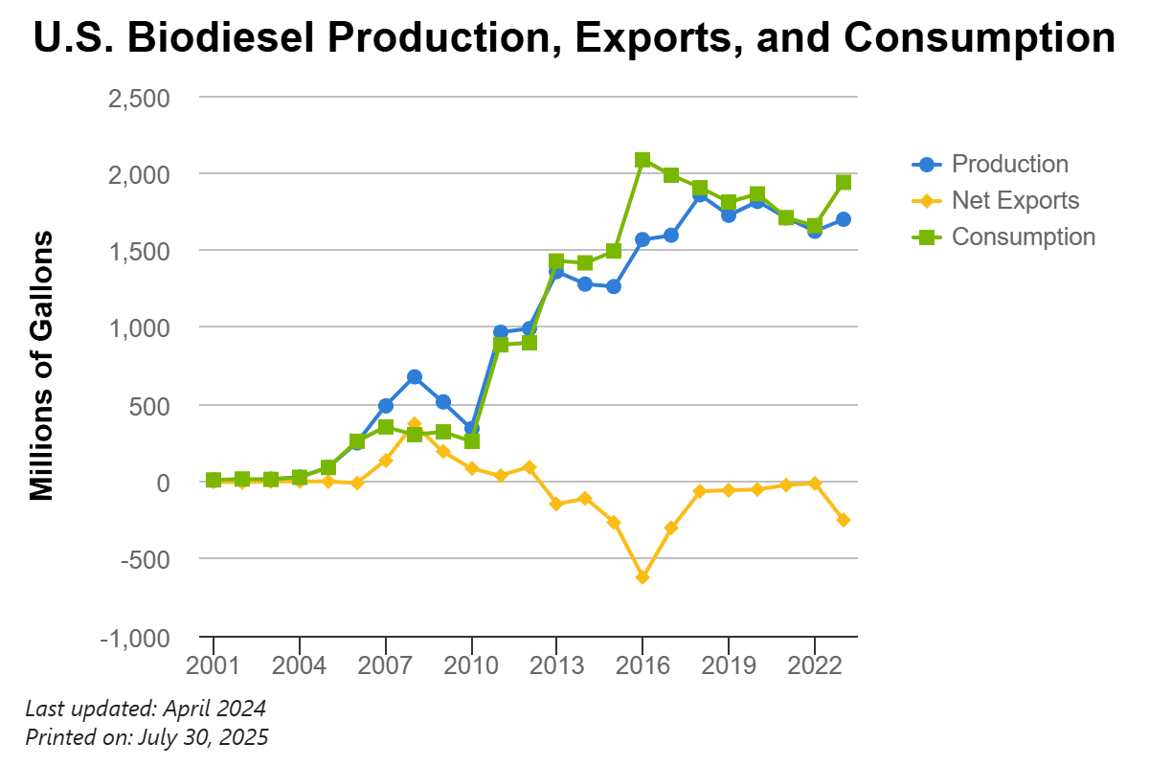
Pricing Analysis
05
Exports of biodiesel peaked in 2008 primarily because of an unintended effect of a biodiesel tax credit in the European Union. Exports then dropped after the effect was eliminated.
The increased production and consumption from 2011 onward was largely driven by the Renewable Fuel Standard.
In more recent years, production and consumption have declined, potentially impacted by the increase in renewable diesel in the market.
Source: AFDC’s Portal
Source: U.S. Energy Information Administration (EIA)

Slide 8
Pricing Analysis
Historical Pricing
B100 Wholesale Prices: Averaged USD 3.00 - 4.10/gal (USD 906 - 1,240/MT using 302 gal/MT conversion)
B20 Prices: Typically, USD 0.50 to 0.70/gal lower than B100 due to dilution with petro-diesel
Price Forecast (June–Aug 2025)
Assumptions
Feedstock Prices | Soybean oil, used cooking oil (UCO), and palm oil prices will remain within 5–7% of current levels.
Government Policy | Tax credits (e.g., U.S. BTC) and renewable fuel mandates will remain intact over the forecast period.
June 2025: USD 3.40 - 3.55/gal
July 2025: USD 3.50 - 3.65/gal (portrayed rise expecting higher demand in transport as Summer Travel Season in US & EU)
August 2025: USD 3.45 - 3.60/gal
Source: Iowa State’s CARD
Source: Volza

Slide 9
Regulatory Framework
06
U.S. Federal Policies Shaping the Market
Policy | Impact
Renewable Fuel Standard (RFS) | Mandates blending of biofuels like biodiesel into diesel; drives demand.
Blender’s Tax Credit (BTC) | USD 1/gallon credit to blenders using biodiesel; incentivizes production & usage.
Inflation Reduction Act (IRA, 2022) | Offers extended clean fuel production credits; long-term market stability.
Clean Fuels Program (California, Oregon) | Rewards low carbon fuels like biodiesel; raises competitiveness regionally.
Policy Impact on the U.S. Biodiesel Market
Policy | Key Features | Influence on Market
Renewable Fuel Standard (RFS1 & RFS2) | Mandated annual blending of renewable fuels (incl. biodiesel) with petroleum diesel | Created a stable demand baseline and long-term certainty
Blender’s Tax Credit (BTC) | USD 1/gallon tax credit to blenders using biodiesel | Directly reduced biodiesel cost, boosting blending and production
Anti-Dumping Duties on Argentina/Indonesia | Prevented cheap biodiesel imports flooding the U.S. market | Supported domestic producer pricing and competitiveness
California Low Carbon Fuel Standard (LCFS) | Incentivizes fuels with lower carbon intensity | Boosted biodiesel consumption due to carbon score benefits
Inflation Reduction Act (IRA) | Extended clean fuel incentives till 2027 and added new credits under Clean Fuel Production Credit (45Z) | Strong support for clean fuel investment and long-term pricing outlook

Slide 10
Impact of US Tariff
07
In early 2025, President Trump invoked the International Emergency Economic Powers Act (IEEPA) to declare national emergencies addressing fentanyl trafficking, immigration, and trade deficits, enabling rapid tariff imposition without lengthy Trump administration formally declared that “foreign trade and economic practices have created a national emergency,” invoking IEEPA to regulate imports and impose tariffs.
Four-Phase Tariff Rollout
February 1, 2025: Initial targeted tariffs: 25% on most imports from Mexico & Canada; 10% on imports from China.
March - April 2025: Expansion to 10% baseline on all imports (effective Apr 5) plus higher reciprocal rates (effective Apr 9) before a 90-day pause on escalations.
Mid-Year Adjustments: Country-specific escalations paused or renegotiated, leading to tailored threats and partial rollbacks through June-July.
Scheduled August 1, 2025: Reinstatement or implementation of final negotiated rates for China, EU, Canada, India, and Japan.

Slide 11
Impact of US Tariff
China
Initial Rate (Feb 1): 10% on all Chinese imports.
Mid-Year Change (May 12): U.S. and China agreed to a 30% “truce” rate; a planned escalation to 125% was paused on Apr 9 as part of that truce.
Latest Effective Rate: 30% remains in force on selected product categories until the truce expires on Aug 10.
Initial Rate (Apr 2): A 10% baseline emergency tariff applicable to all EU goods.
Mid-Year Evolution (Apr 9–May 25): The EU imposed 25% retaliatory duties. The U.S. proposal of 50% tariffs on EU cars and other goods was withdrawn on May 25 following negotiations.
Latest Effective Rate: A 15% tariff on certain EU products, agreed as part of the U.S.–EU tariff deal finalized on July 27.
EU Union
Canada
Initial Rate (Feb 1): 25% tariffs on non-USMCA-compliant imports.
Mid-Year Pause: Tariffs on USMCA-origin goods were suspended pending verification.
Latest Effective Rate: A 35% tariff on imports failing USMCA rules, set to take effect on Aug 1.
India
Initial Rate (Apr 2): 10% baseline emergency tariff.
Mid-Year Threat (July 7): Trump announced plans to raise rates to 20–25%, contingent on deal progress.
Latest Scheduled Rate: 20–25% tariff level scheduled to go into effect on Aug 1 if no agreement is reached.
Japan
Initial Rate (Apr 2): 10% baseline tariff.
Mid-Year Threat (July 12): A 25% tariff threat on Japanese autos and electronics.
Latest Scheduled Rate: A negotiated 15% tariff to take effect on Aug 1 under the U.S.–Japan deal reached July 22.

Slide 12
Sources:
Secondary Research Data
AI Tools Used for Analysis
Source Type | Platforms/Databases | Justification
Statistical Databases | EIA (U.S. Energy Information Administration), USDA, EPA, Iowa State’s CARD | Official U.S. government sources with validated and updated energy & policy data
Trade Platforms | Volza, World Bank | Provide reliable global trade volumes, pricing data, and forecasts
News Reports | Argus Media, Biofuels Digest, ICIS | Trusted for price benchmarks, policy updates, and expert market ideas.
Industry Reports | IEA, Clean Fuels Alliance, Reuters, AFDC’s Portal | In-depth reports help in understanding value chain dynamics and market drivers
Tool Name | Purpose
OpenAI GPT-4 / ChatGPT | Assisted in summarizing, structuring insights, drafting reports & presentation decks
Excel/Power BI | Data cleaning, unit conversion, visualizing 12-month price trends
Dealing with Conflicting or Incomplete Data
Cross-Validation: Data was compared across 2–3 trusted platforms.
Weight to Official Sources: Priority was given to government-backed databases (e.g., EIA, EPA).

