Slide 1
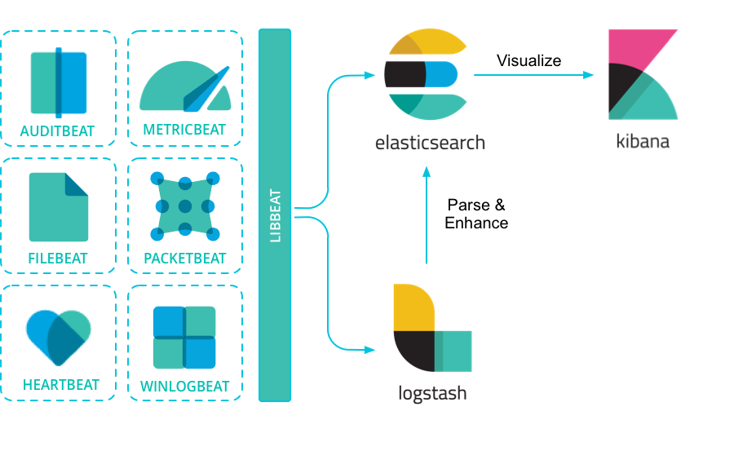
Elastic Stack

Slide 2
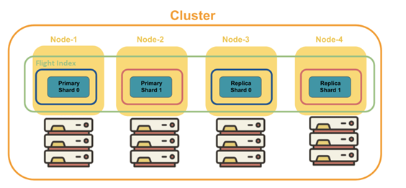
Elasticsearch
Elasticsearch is a distributed document store. Instead of storing information as rows of columnar data, Elasticsearch stores complex data structures that have been serialized as JSON document
Elasticsearch provides a simple, coherent REST API for managing your cluster and indexing and searching your data
Elasticsearch makes JSON documents searchable and aggregatable. The documents are stored in an index or data stream, which represent one type of data.
Elasticsearch automatically distributes your data and query load across all of the available nodes

Slide 3
Elasticsearch
Index, the largest unit of data in Elasticsearch, are logical partitions of documents and can be compared to a database
Document is JSON objects that are stored within an Elasticsearch index and are considered the base unit of storage.
Shards are a single Lucene index. They are the building blocks of Elasticsearch and what facilitate its scalability
Replicas are Elasticsearch fail-safe mechanisms and are basically copies of your index’s shards
Ingest pipelines let you perform common transformations on your data before indexing. For example, you can use pipelines to remove fields, extract values from text, and enrich your data
index template is a way to tell Elasticsearch how to configure an index when it is created. For data streams, the index template configures the stream’s backing indices as they are created
Mapping is the process of defining how a document, and the fields it contains, are stored and indexed.
Dynamic mapping -automaticall detection and adding new fields to the index
Data stream lets you store append-only time series data across multiple indices while giving you a single named resource for request

Slide 4
Kibana
Kibana lets you visualize your Elasticsearch data and navigate the Elastic Stack. With Kibana, you can
  Search, observe, and protect your data.
  Analyze your data. Search for hidden insights, visualize what you’ve found in charts, gauges, maps, graphs, and more, and combine them in a dashboard.
  Manage, monitor, and secure the Elastic Stack.

Slide 5
Logstash
Logstash is an open source data collection engine with real-time pipelining capabilities.
The Logstash event processing pipeline has three stages: inputs → filters → outputs. Inputs generate events, filters modify them, and outputs ship them elsewhere.
Inputs:
  File -reads from a file on the filesystem, much like the UNIX command tail -0F
  Syslog - stens on the well-known port 514 for syslog messages and parses according to the RFC3164 format
  Redis -reads from a redis server, using both redis channels and redis lists.
  Beats - Filebeat realtime inside into log data, Packetbeat – analize network paket data, Metricbeat – ship monitoring metrics, Heartbeat – ping infrustructure, Functionbeat – ship cloud data with serverless infra
Filters are intermediary processing devices in the Logstash pipeline. You can combine filters with conditionals to perform an action on an event if it meets certain criteria.
  grok: parse and structure arbitrary text. Grok is currently the best way in Logstash to parse unstructured log data into something structured and queryable. With 120 patterns built-in to Logstash, it’s more than likely you’ll find one that meets your needs!
  mutate: perform general transformations on event fields. You can rename, remove, replace, and modify fields in your events.
  drop: drop an event completely, for example, debug events.
  clone: make a copy of an event, possibly adding or removing fields.
  geoip: add information about geographical location of IP addresses (also displays amazing charts in Kibana!)
Outputs are the final phase of the Logstash pipeline. Some commonly used outputs include
  Elasticsearch: send event data to Elasticsearch. If you’re planning to save your data in an efficient, convenient, and easily queryable format…​ Elasticsearch is the way to go. Period. Yes, we’re biased :)
  File: write event data to a file on disk.
  Graphite: send event data to graphite, a popular open source tool for storing and graphing metrics. http://graphite.readthedocs.io/en/latest/

Slide 6
Filebeat
Filebeat is a lightweight shipper for forwarding and centralizing log data. Installed as an agent on your servers
Filebeat monitors the log files or locations that you specify, collects log events, and forwards them either to Elasticsearch or Logstash for indexing.
Filebeat consists of two main components: inputs and harvesters. These components work together to tail files and send event data to the output that you specify.
There are several ways to collect log data with Filebeat:
  Data collection modules — simplify the collection, parsing, and visualization of common log formats. They contain default configurations, Elasticsearch ingest pipeline definitions, and Kibana dashboards to help you implement and deploy a log monitoring solution.
  ECS loggers — structure and format application logs into ECS-compatible JSON
  Manual Filebeat configuration
When manually configuring You can configure Filebeat to use the following inputs:AWS CloudWatch AWS S3 Azure Event Hub Cloud Foundry CometD Container filestream GCP Pub/Sub HTTP Endpoint HTTP JSON journald Kafka Log (deprecated in 7.16.0, use filestream) MQTT NetFlow Office 365 Management Activity API Redis Stdin Syslog TCP UDPT
You configure Filebeat to write to a specific output by setting options in the Outputs section of the filebeat.yml config file. Only a single output may be defined: Elasticsearch Service Elasticsearch Logstash Kafka Redis File Console
If you want to use Logstash to perform additional processing on the data collected by Filebeat, you need to configure Filebeat to use Logstash.

Slide 7
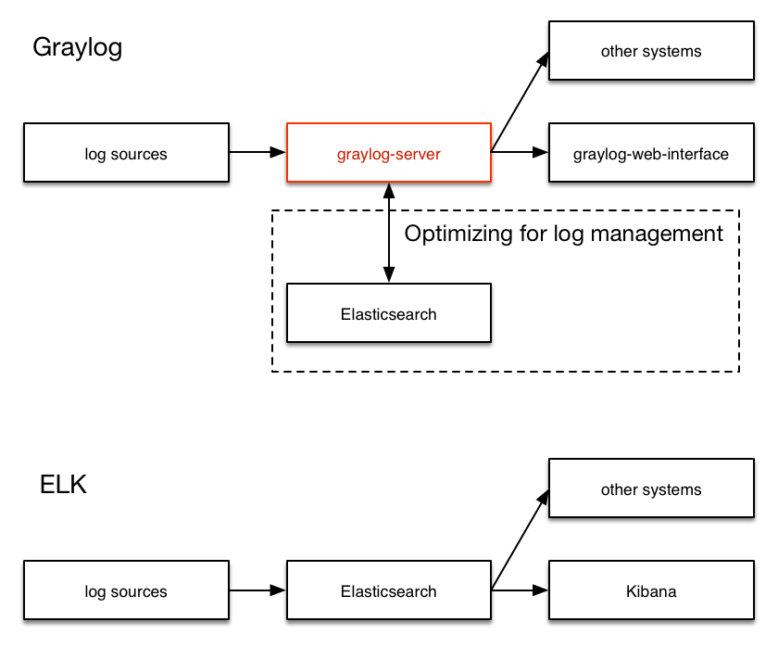
GrayLog
Graylog Cluster consists of several components:
Graylog server – Log processor.its in the middle and works around shortcomings of Elasticsearch (a full text search engine, not alog management system) for log management.It also builds an abstraction layer on top of it to make data access as easy as possible without having to select indices and write tedious time range selection filters, etc
Graylog web UI – Graylog web user interface
MongoDB – store configuration and the dead letter messages
ElasticSearch – store messages (if you lose your ElasticSearch data, the messages are gone)

Slide 8
Lab
ELK stack
install Elastic stack on local machine
Install Filebeat
Index Nginx access log from real web server (speasap.com) using filebeat without logstash
Visualize Nginx access log data using kibana
Index Fail2ban logs from real web server (speasap.com) using filebeat and logstash
Create custom mapping for storing geo_location data
Visualize Fail2ban logs data using Kibana
Graylog
Setup Graylog instance
Set up graylog input with custom grok extractor
Feed nginx access log data into graylog

Slide 9
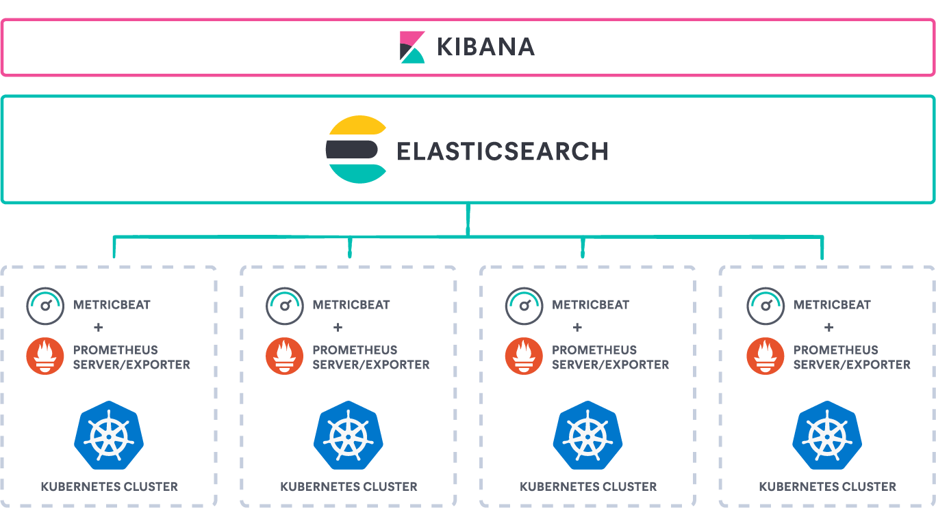
Terraform Puppet and Prometheus
Terraform – Infrastructure provisioner Can be used to deploy all cloud resources needed to run ELK
Puppet - Configuration management. Can be used to deploy ELK components into infrastructure provisioned by Terraform
Puppet and Terraform can be tied together using Puppet provisioner for Terraform
Prometheus - monitoring engine for Kubernetes workload. Can be used with ELK in two scenarios
  To monitor ELK if it is run in Kuberenetes.
  To collect metric data from Prometheus using metricbeat

