Slide 1
Computer Vision Project
Incisor Segmentation
Sumit Kumar Dey (R0607761)
Master of Artificial Intelligence

Slide 2
Road Map
From Training Data:
Develop Shape Models
Develop Gray Models
Create Template
On Test Data:
Match Template & place mean shape model
Find new points using gray model match
Fit Shape Model
Repeat

Slide 3
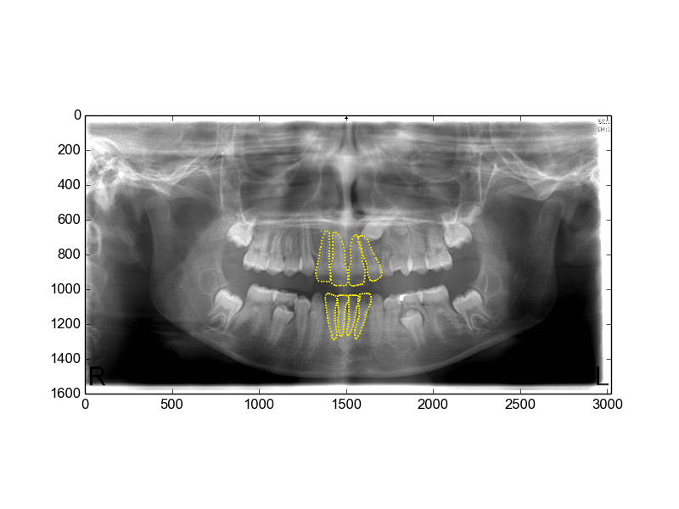
Landmarks

Slide 4
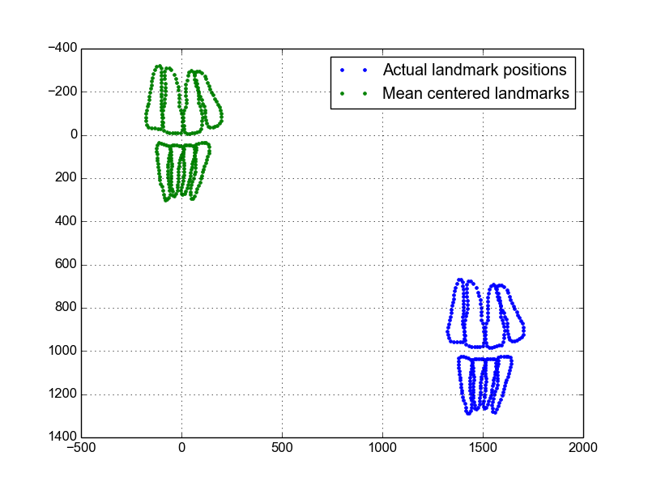
Procrustes Analysis
Center each shape to (0,0)

Slide 5
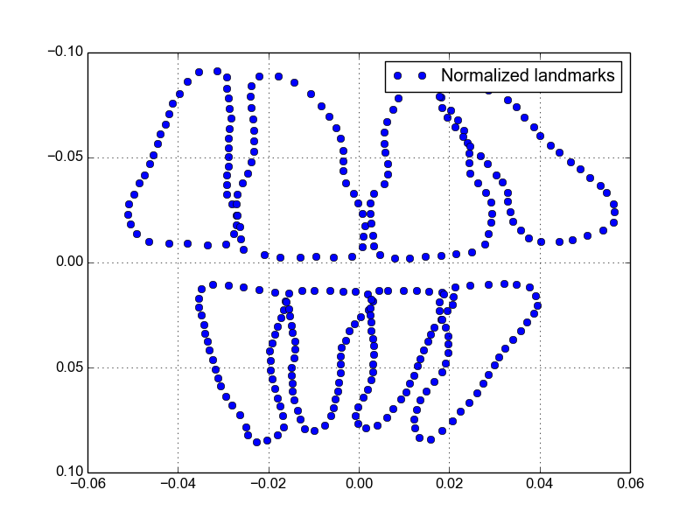
Procrustes Analysis
Normalized shape

Slide 6
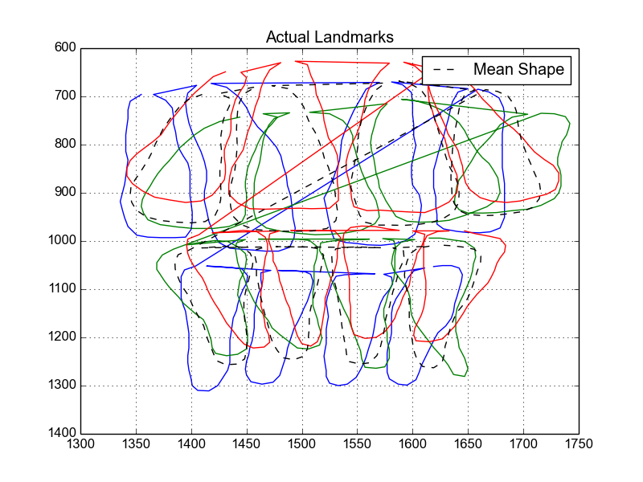
Procrustes Analysis
Before Aligning the shapes

Slide 7
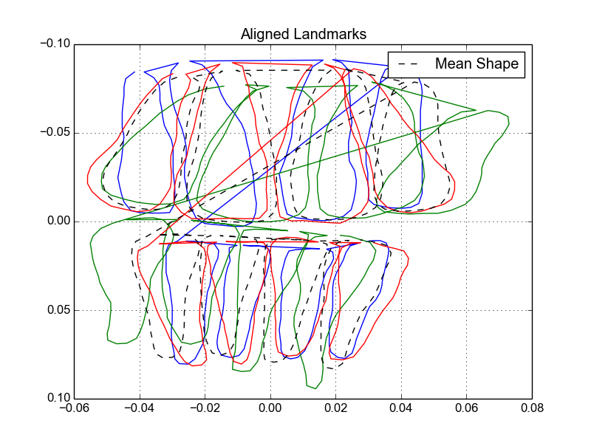
Procrustes Analysis
After Aligning the shapes

Slide 8
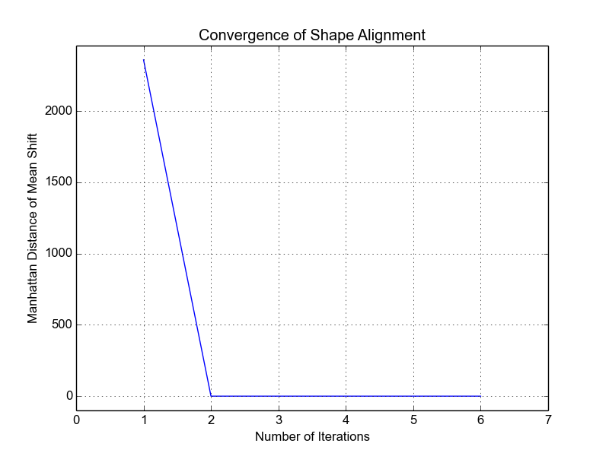
Procrustes Analysis
Convergence

Slide 9
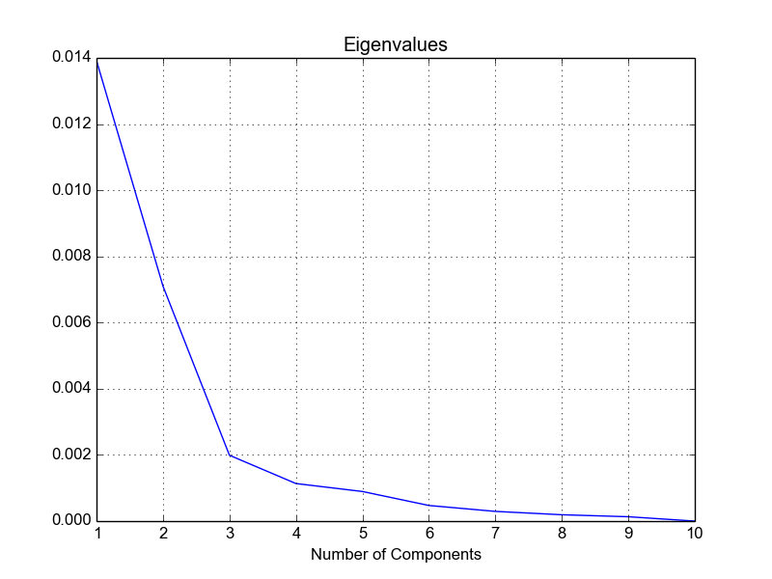
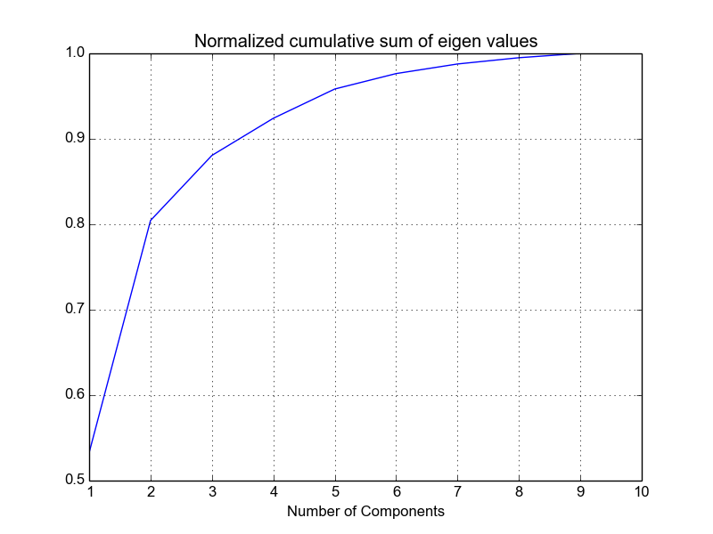
PCA
Eigen Values for 8 Teeth

Slide 10
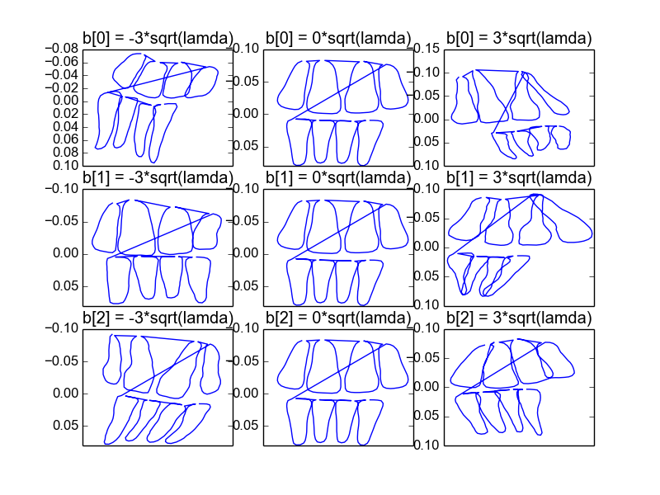
PCA

Slide 11
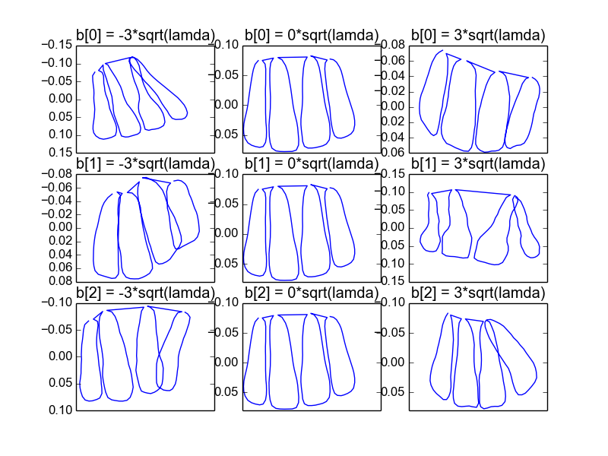
PCA

Slide 12
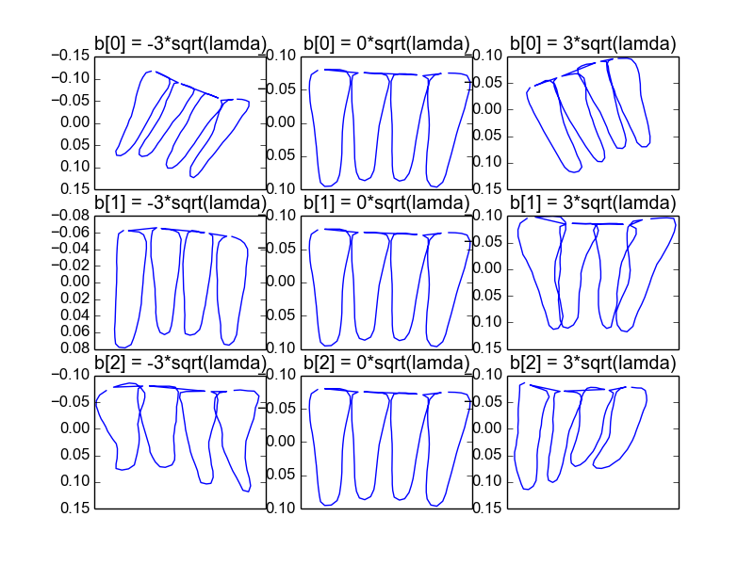
PCA

Slide 13
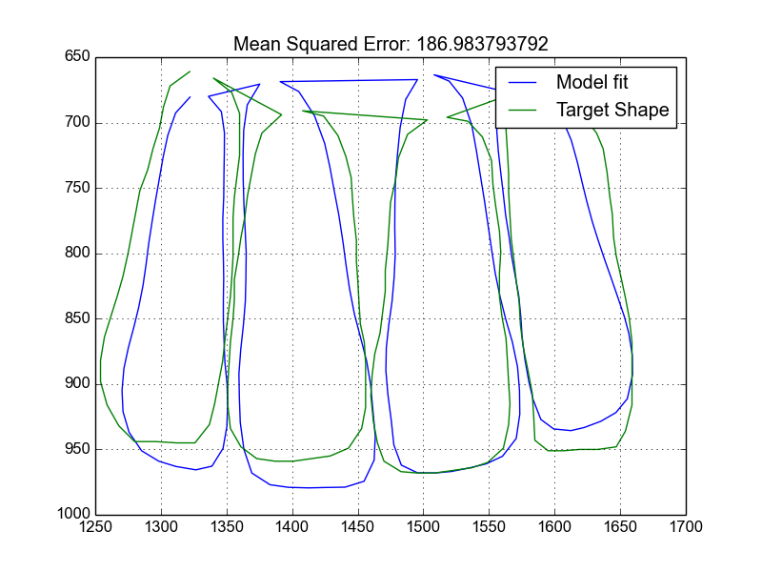
Model Fitting
Initial

Slide 14
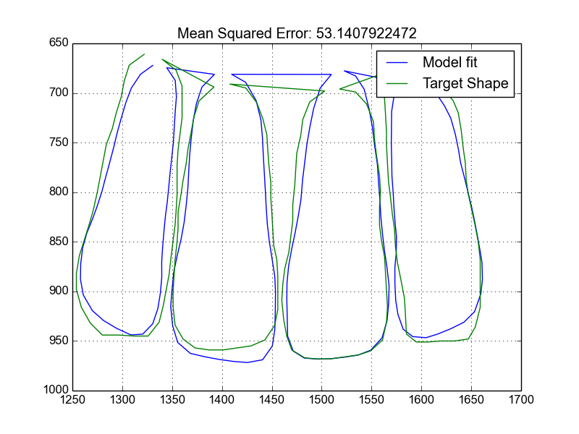
Model Fitting
Final

Slide 15
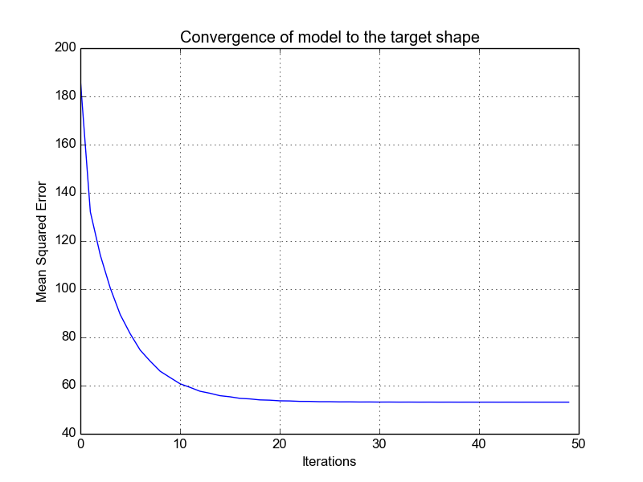
Model Fitting

Slide 16
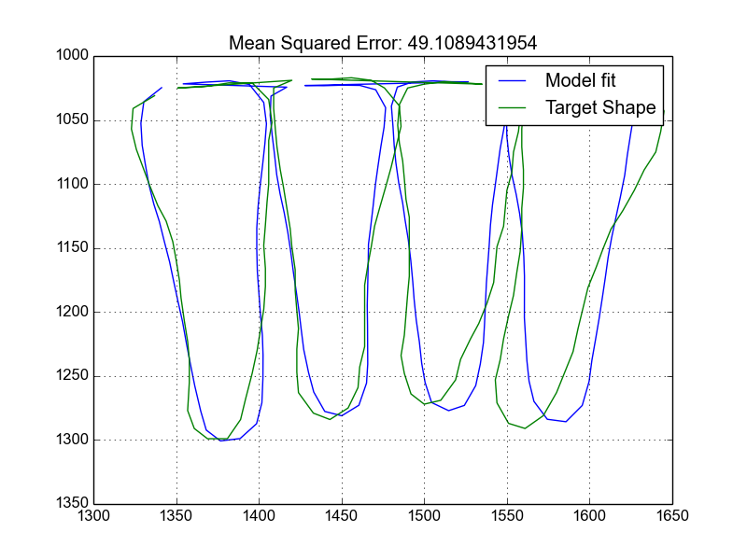
Model Fitting
Initial

Slide 17
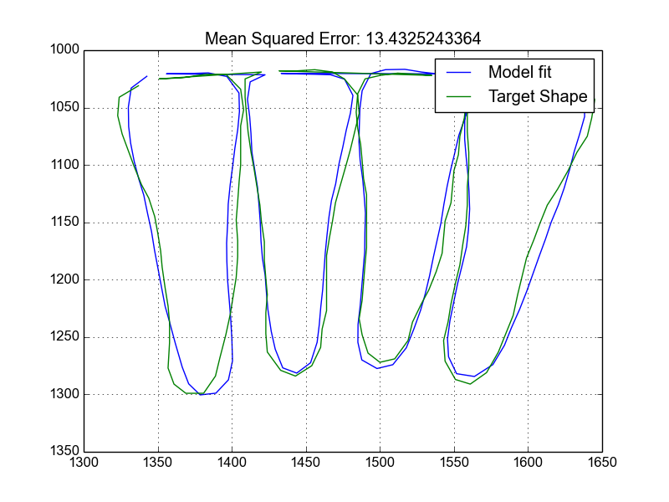
Model Fitting
Final

Slide 18
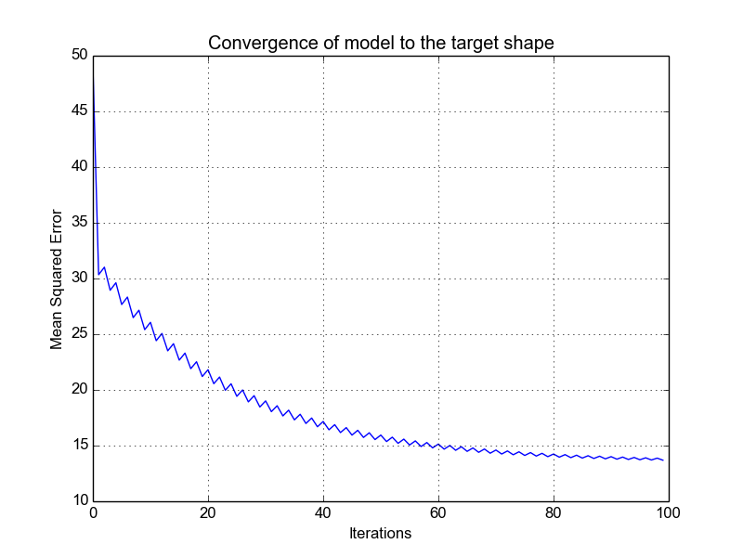
Model Fitting

Slide 19
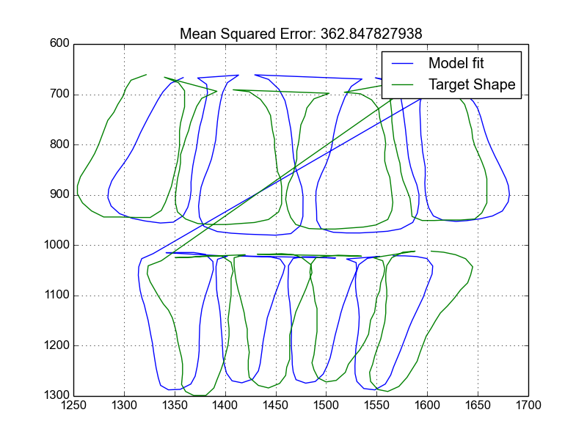
Model Fitting
Initial

Slide 20
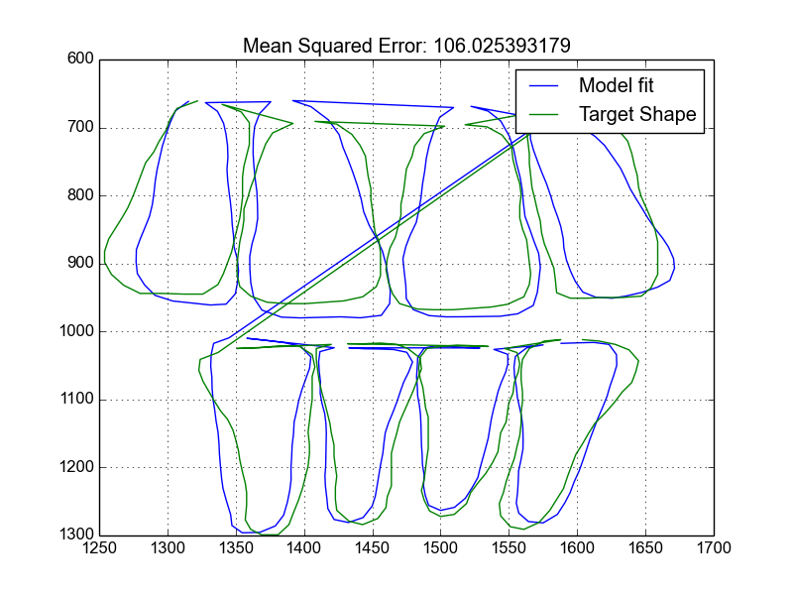
Model Fitting
Final

Slide 21
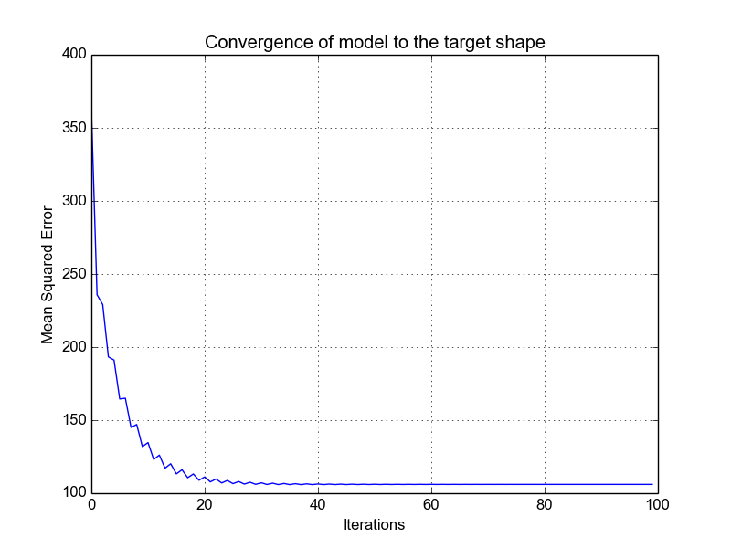
Model Fitting

Slide 22
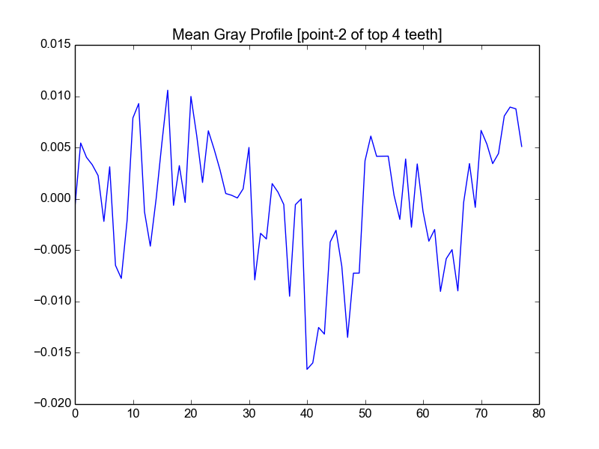
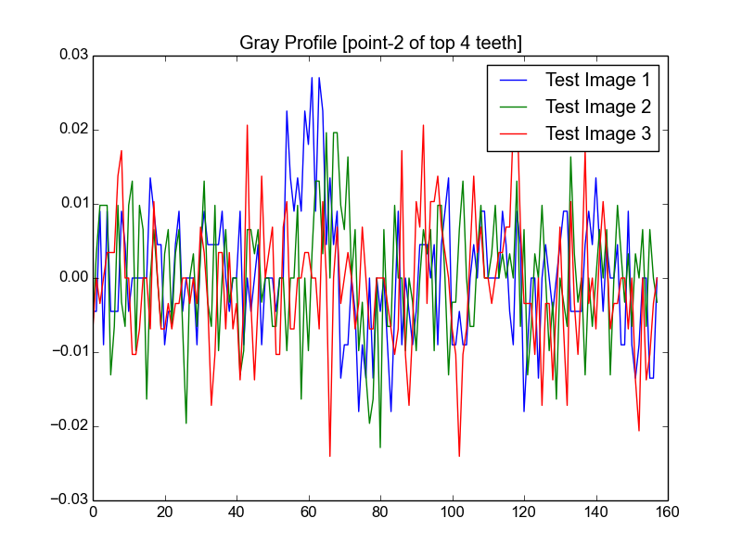
Gray Profiles

Slide 23
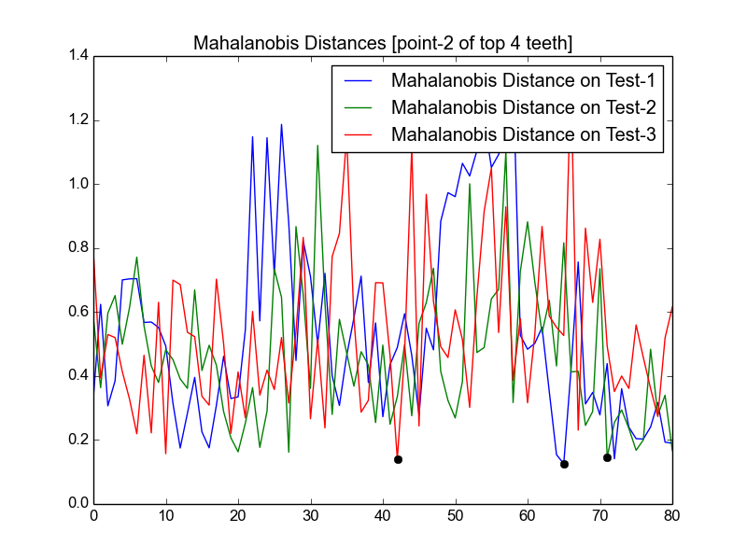
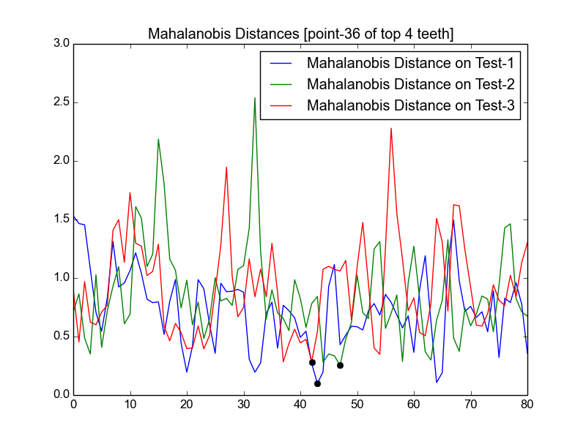
Gray Profiles

Slide 24
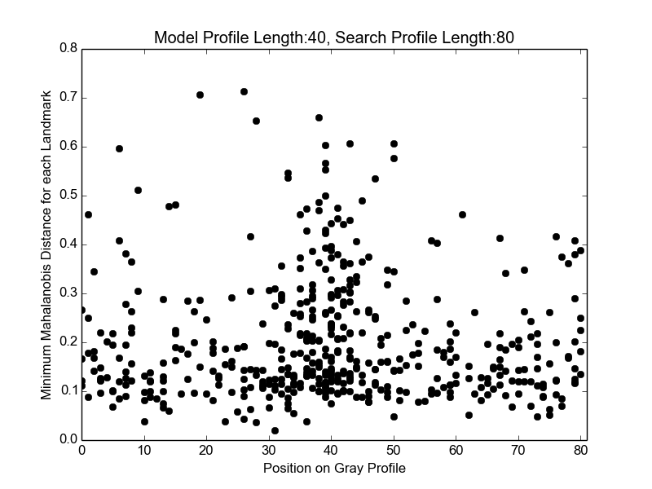
Distribution of min(MD)

Slide 25
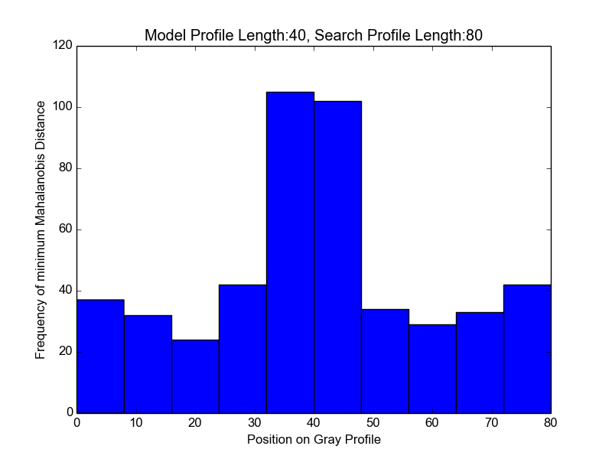
Distribution of min(MD)

Slide 26
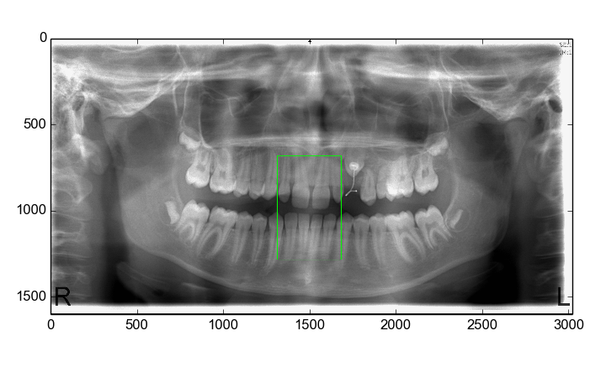
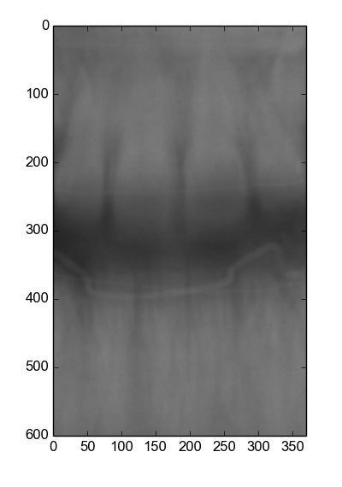
Template Match

Slide 27
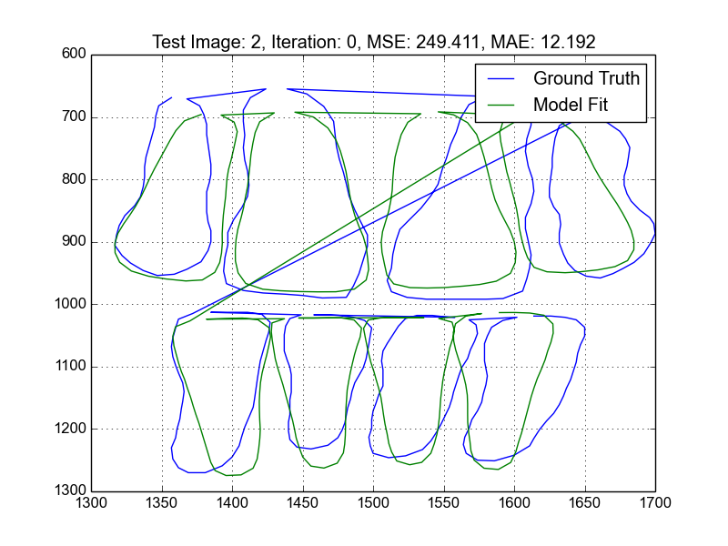
Gray + Shape Fit
Iteration: 0

Slide 28
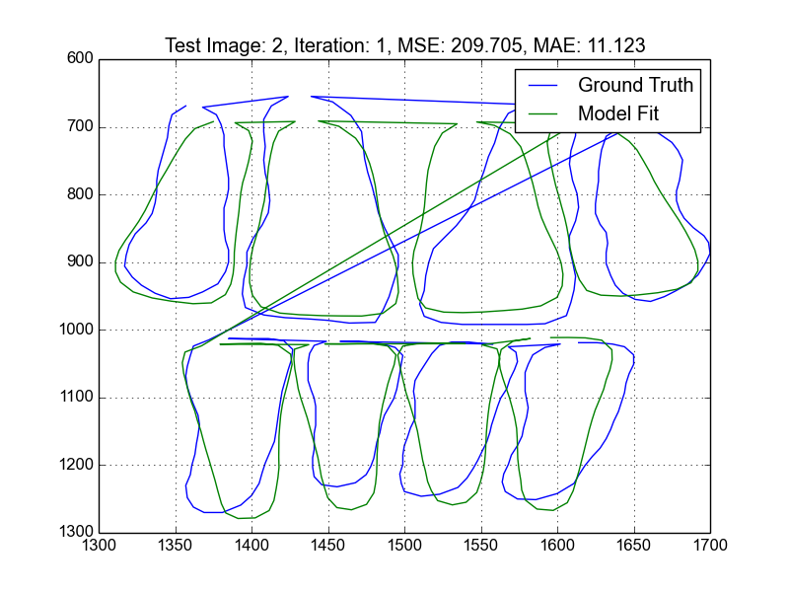
Gray + Shape Fit
Iteration: 1

Slide 29
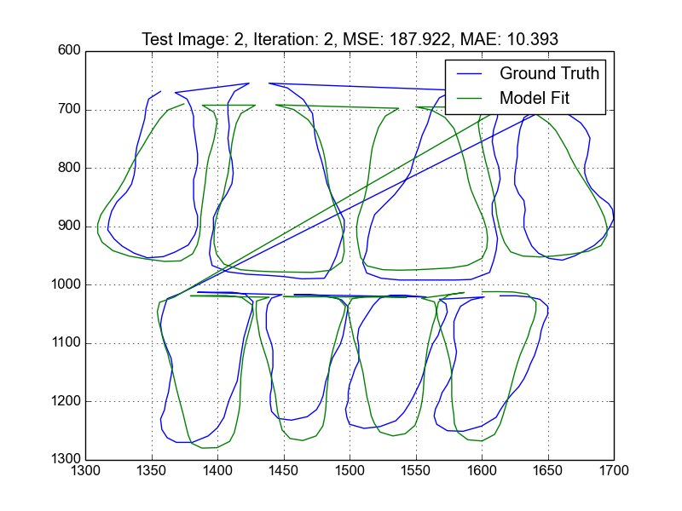
Gray + Shape Fit
Iteration: 2

Slide 30
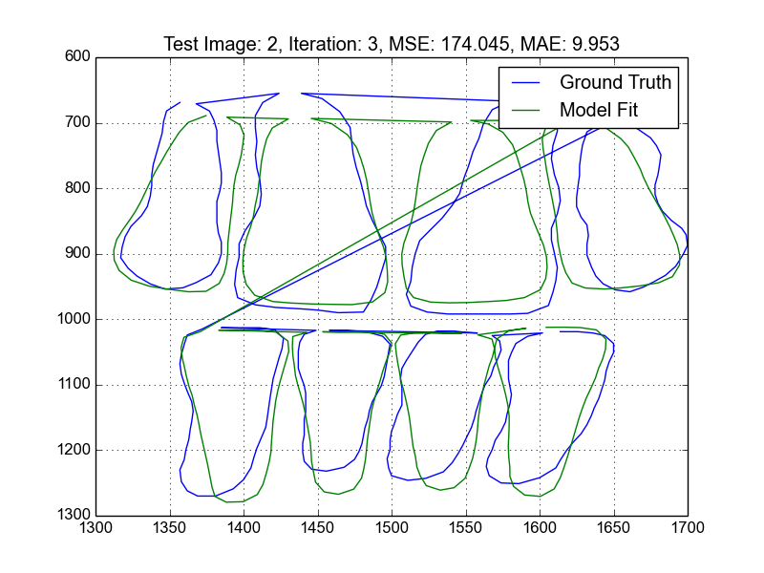
Gray + Shape Fit
Iteration: 3

Slide 31
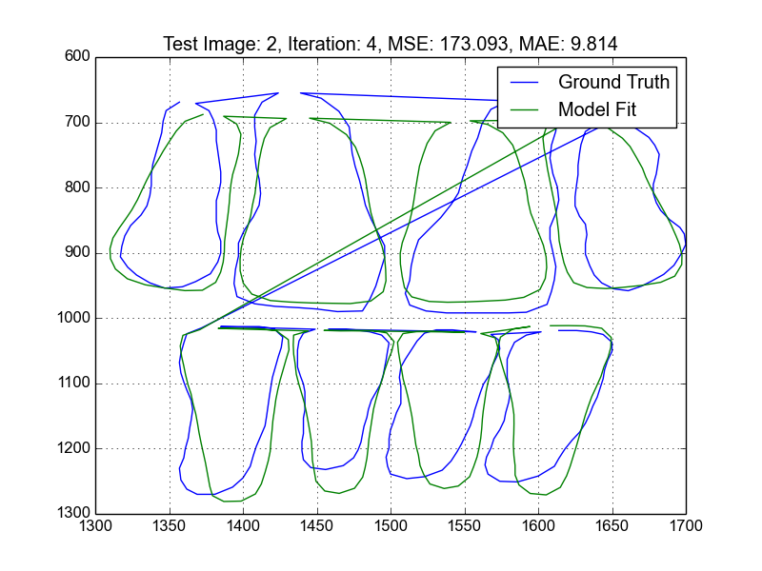
Gray + Shape Fit
Iteration: 4

Slide 32
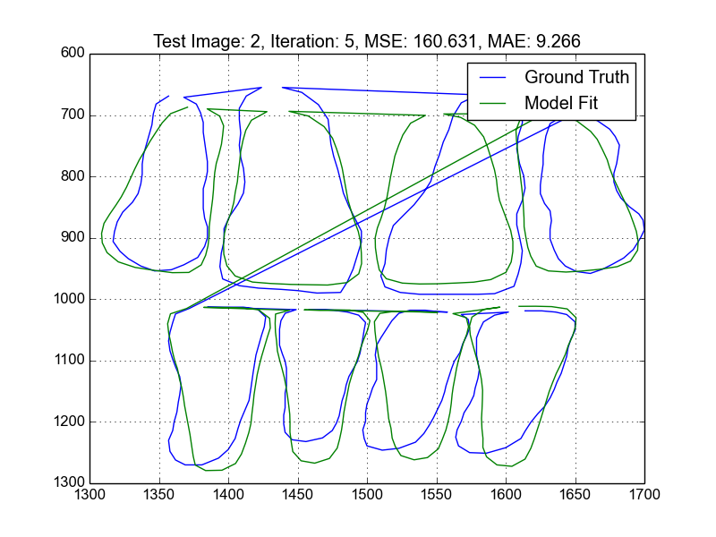
Gray + Shape Fit
Iteration: 5

Slide 33
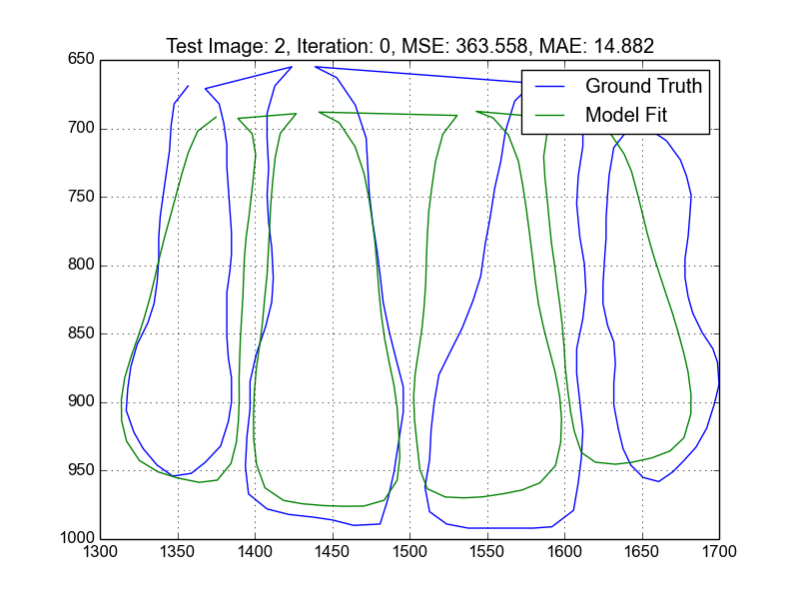
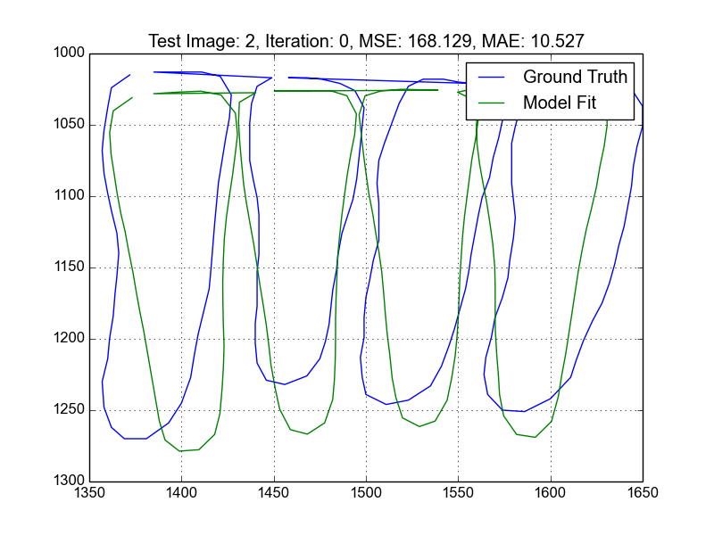
Gray + Shape Fit

Slide 34
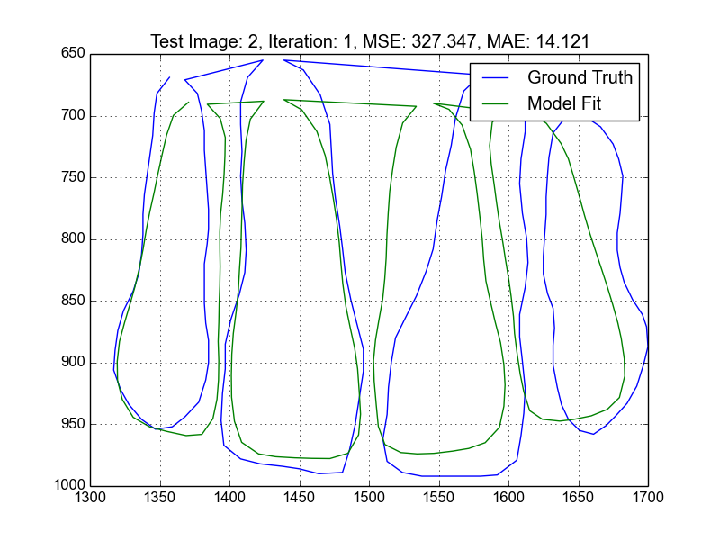
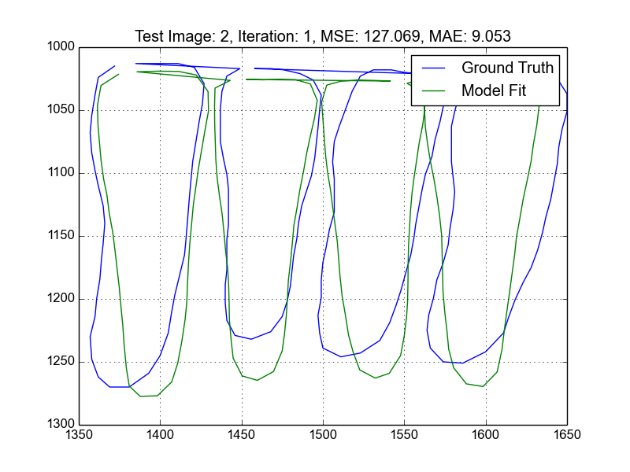
Gray + Shape Fit

Slide 35


Gray + Shape Fit

Slide 36
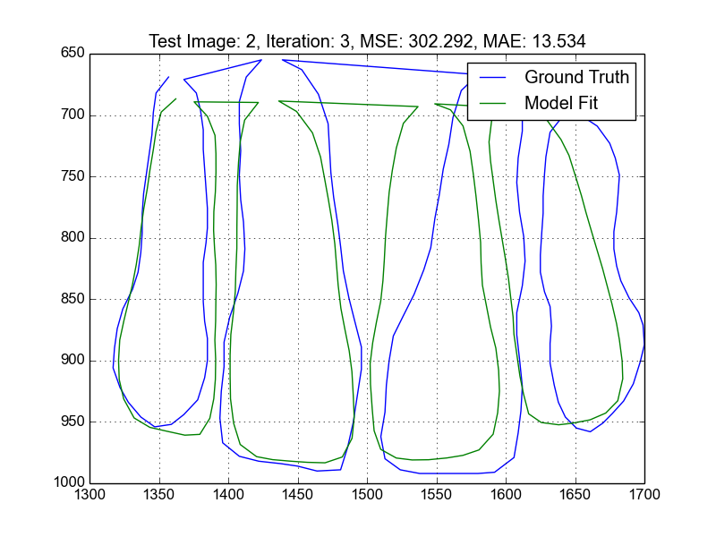
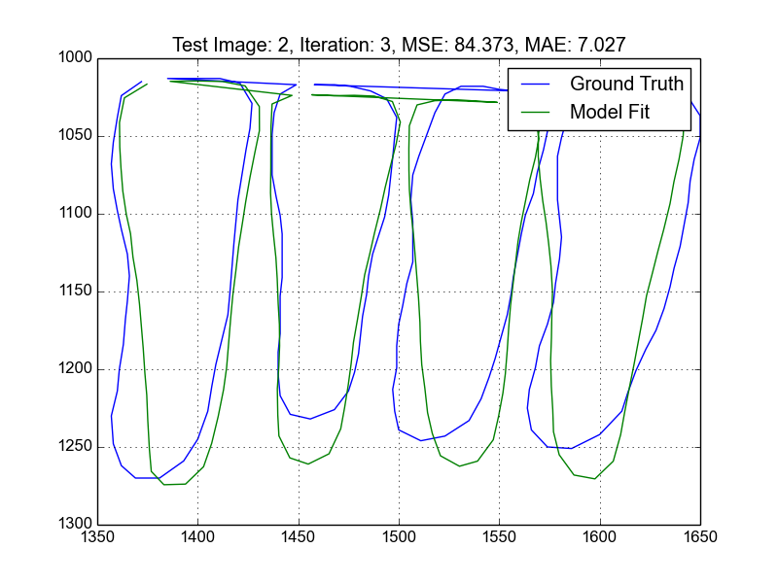
Gray + Shape Fit

Slide 37


Gray + Shape Fit

Slide 38
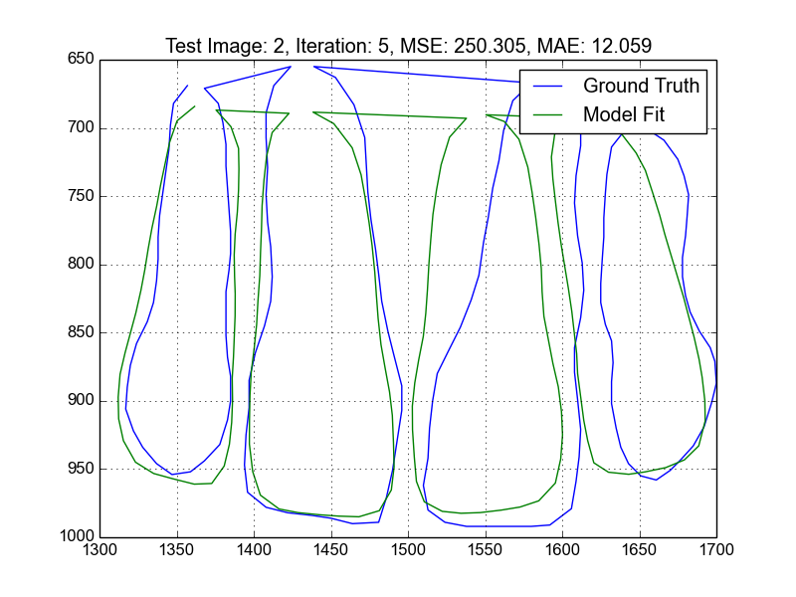
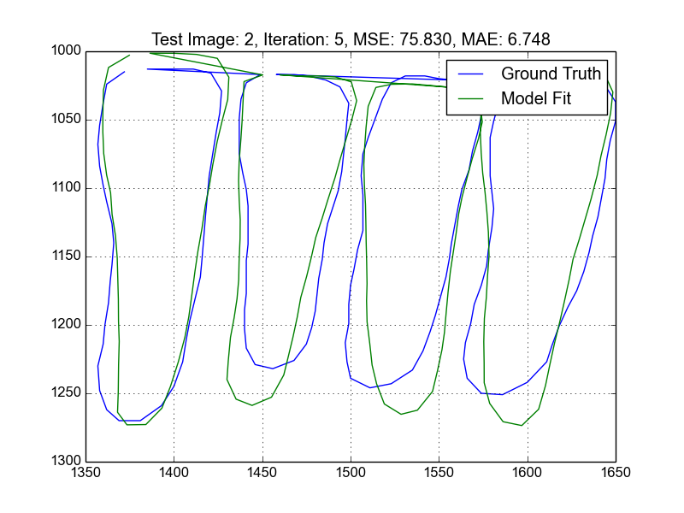
Gray + Shape Fit

Slide 39
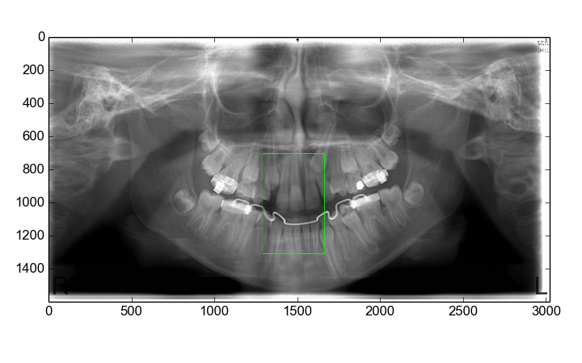
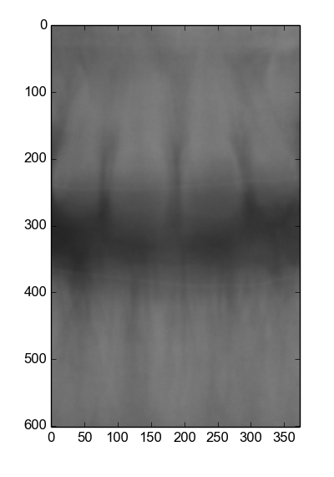
Template Match
If initialization is not good enough

Slide 40
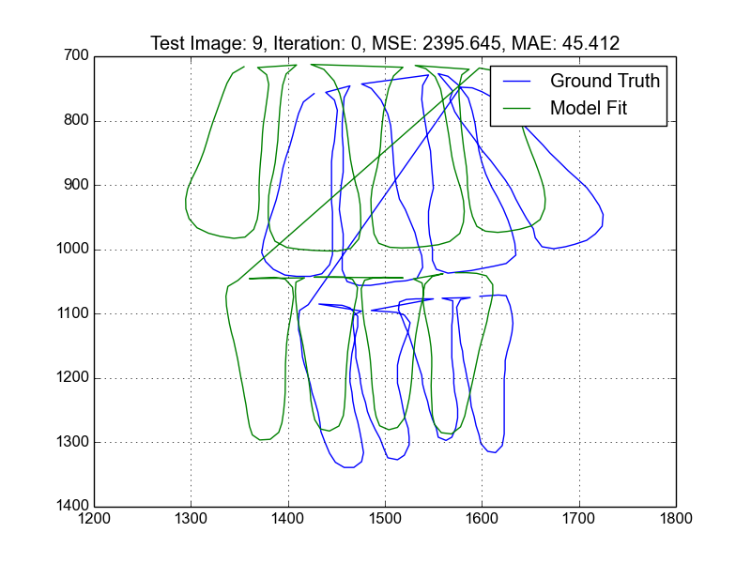
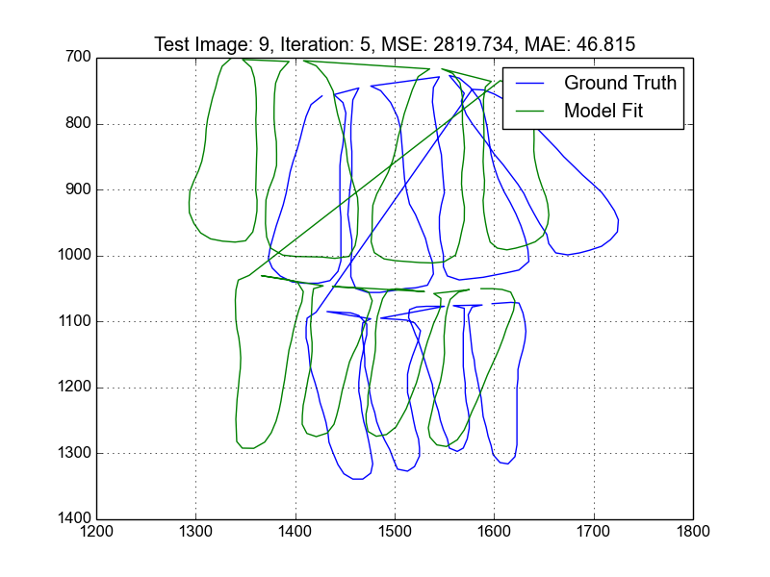
Gray + Shape Fit
If initialization is not good enough

Slide 41
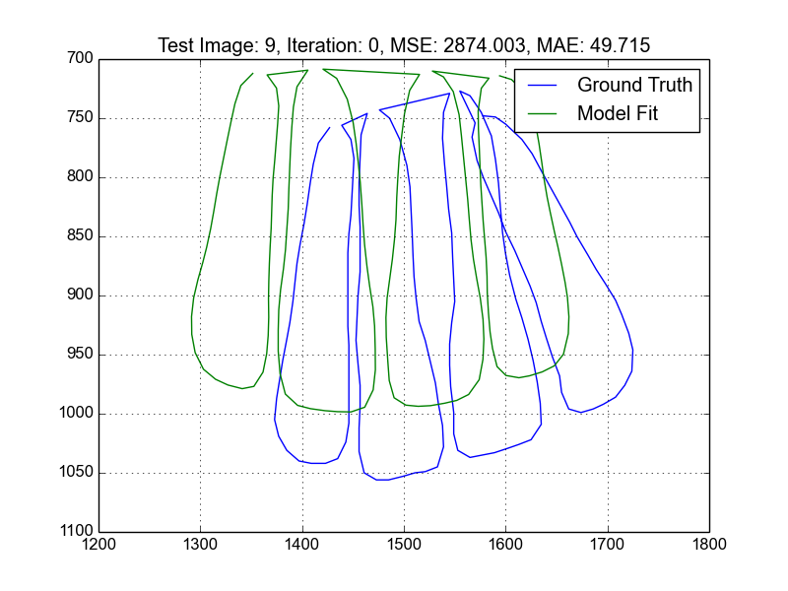
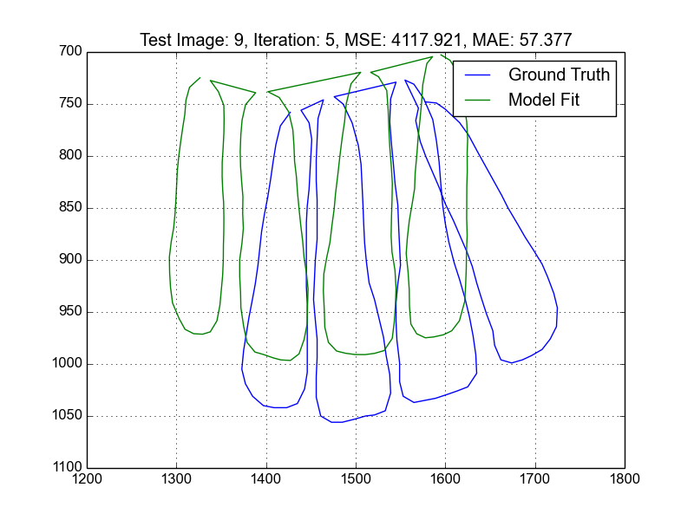
Gray + Shape Fit
If initialization is not good enough

Slide 42
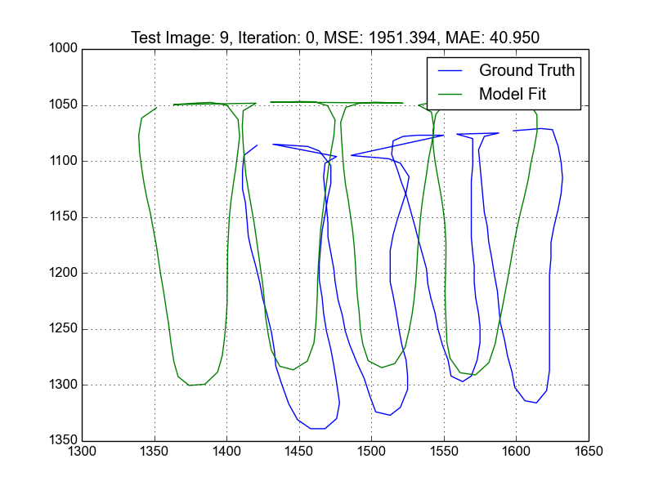
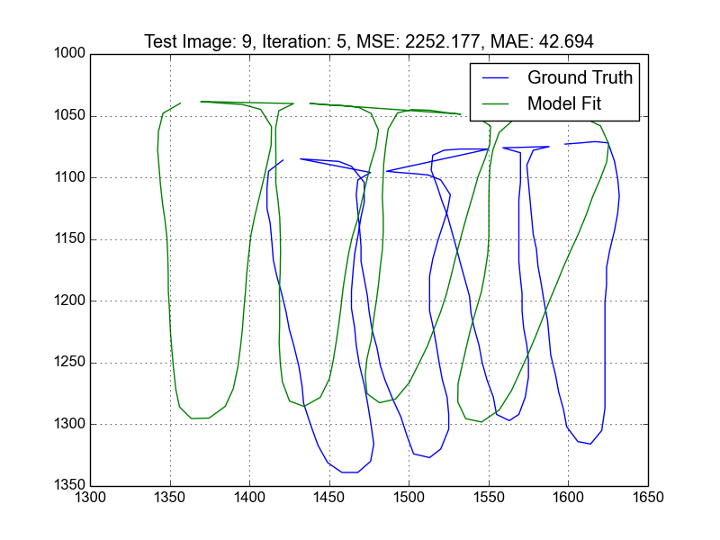
Gray + Shape Fit
If initialization is not good enough

Slide 43
Conclusion
Highly sensitive to initialization
Not all landmarks are equally good
Choice of length of search profile is a matter of trade-off. Longer search profiles better with initialization offset but more wrong results
Convergence is not guaranteed

