Slide 1



Global Super Store Sales Analysis (Power BI) Tonmoy Dey
View in Power BI
Last data refresh:
6/18/2023 4:46:18 PM UTC
Downloaded at:
6/18/2023 10:36:09 PM UTC

Slide 2
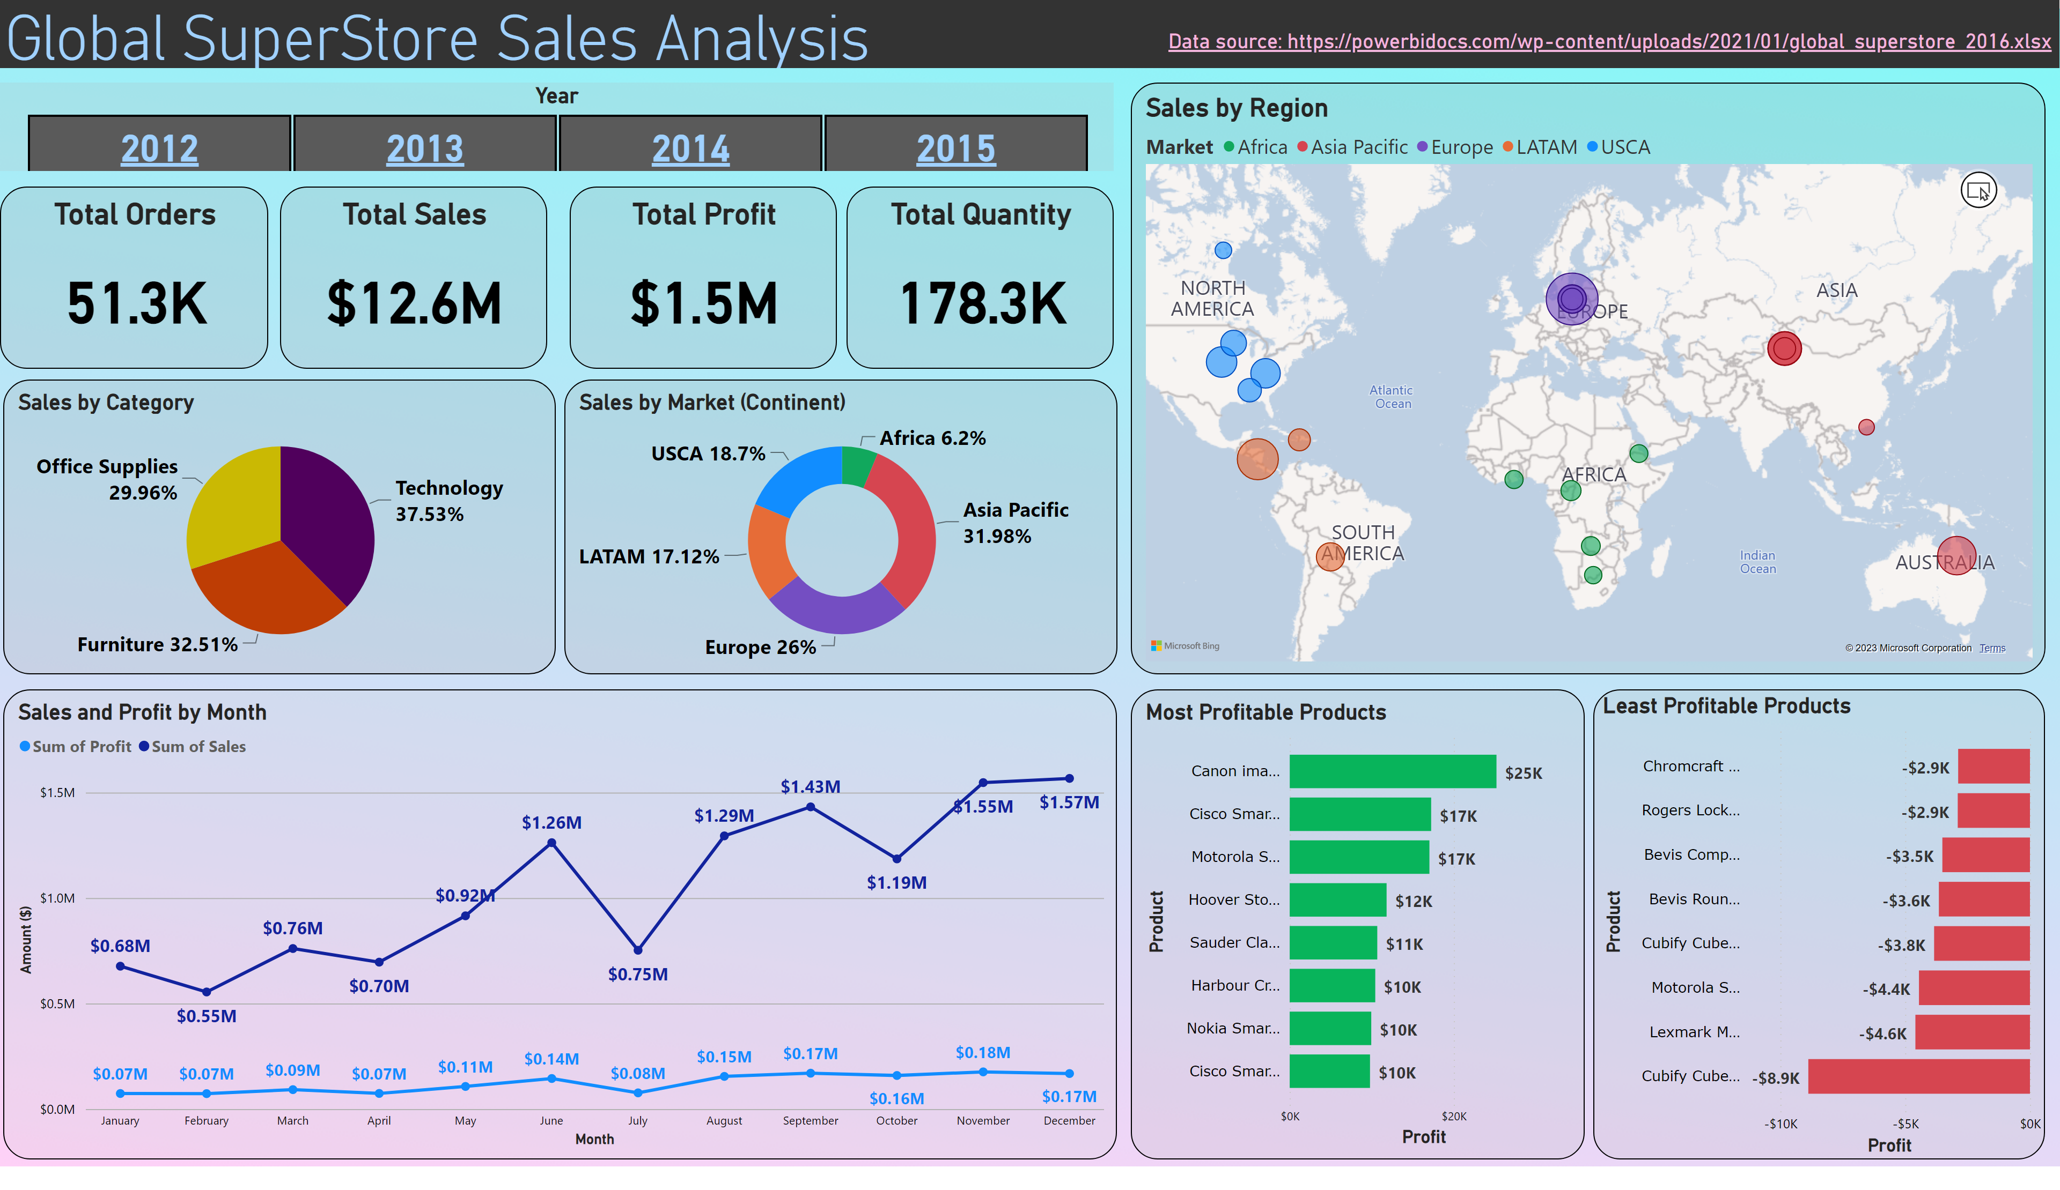
Page 1
Notes:
Total Sales
No alt text provided
Total Quantity
No alt text provided
Year
Use CMD/ CTRL for multi-select
Sales by Region
No alt text provided
Total Orders
No alt text provided
Most Profitable Products
No alt text provided
Total Profit
No alt text provided
Sales by Category
No alt text provided
Sales by Market (Continent)
No alt text provided
Least Profitable Products
No alt text provided
Sales and Profit by Month
No alt text provided
Data source: https://powerbidocs.com/wp-content/uploads/2021/01/global_superstore_2016.xlsx
No alt text provided
Global SuperStore Sales Analysis
No alt text provided

