Slide 1
Introduction to the Digital Lensmeter
Anurag Kanase & Ahmad Zunnu Rain

Slide 2
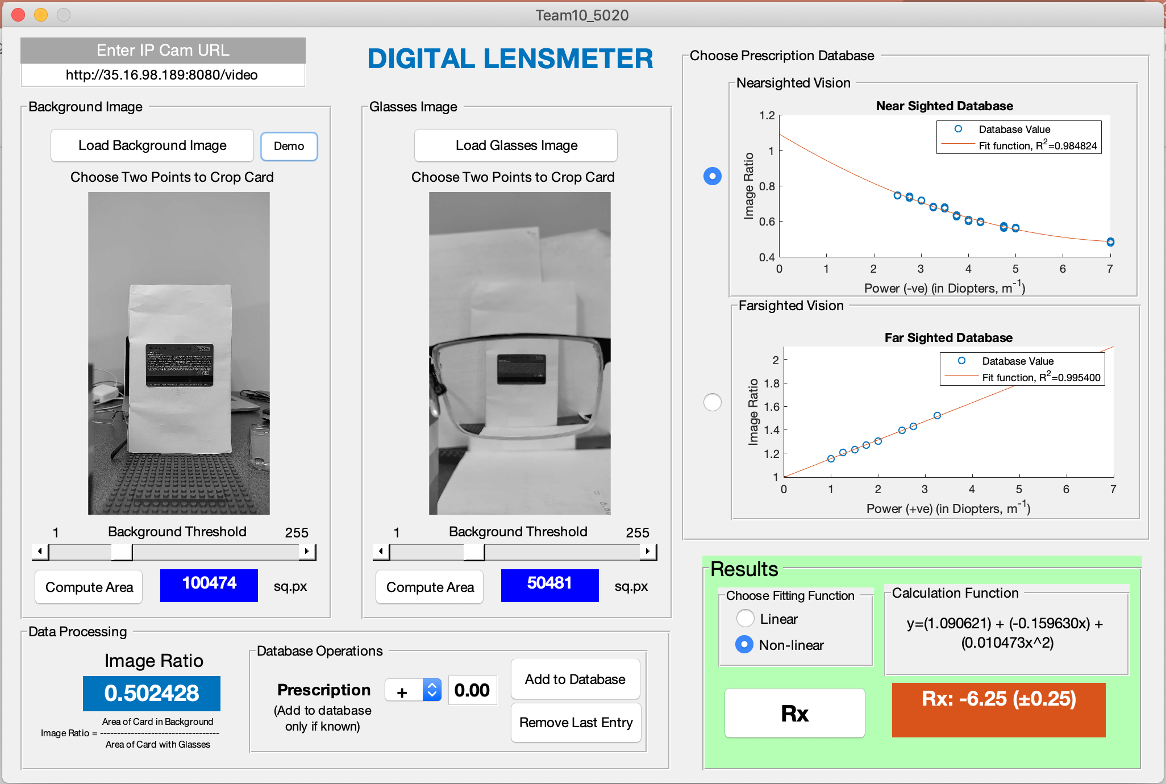
GUI Overview

Slide 3
Step 1: Demo User
Click Demo Button
2. Click A little above credit card
3. Click A little below credit card

Slide 4
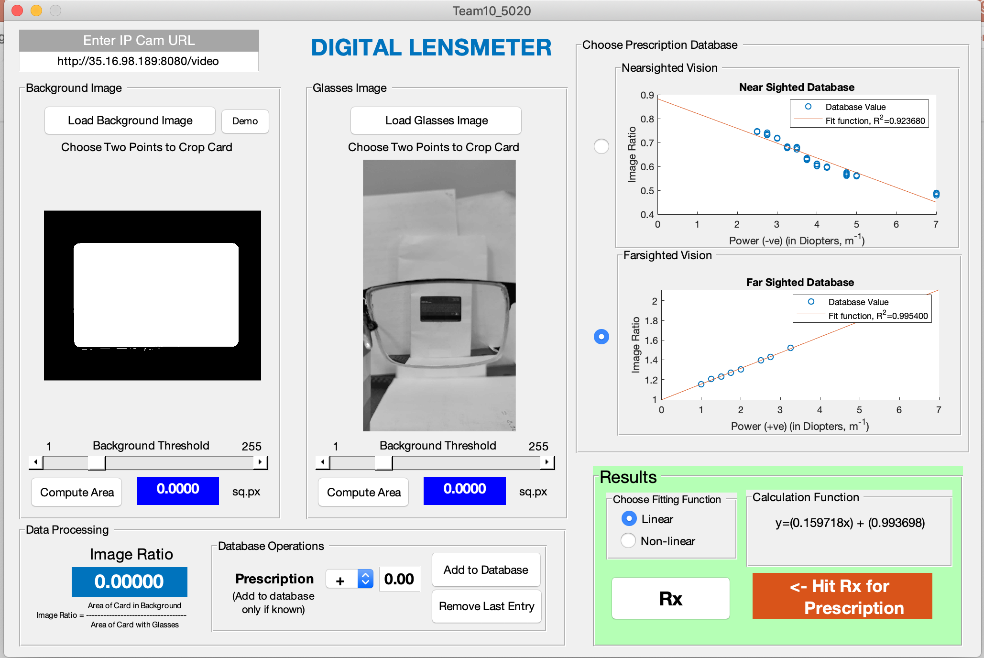
4. Click Threshold Slider and move
To see clear image

Slide 5
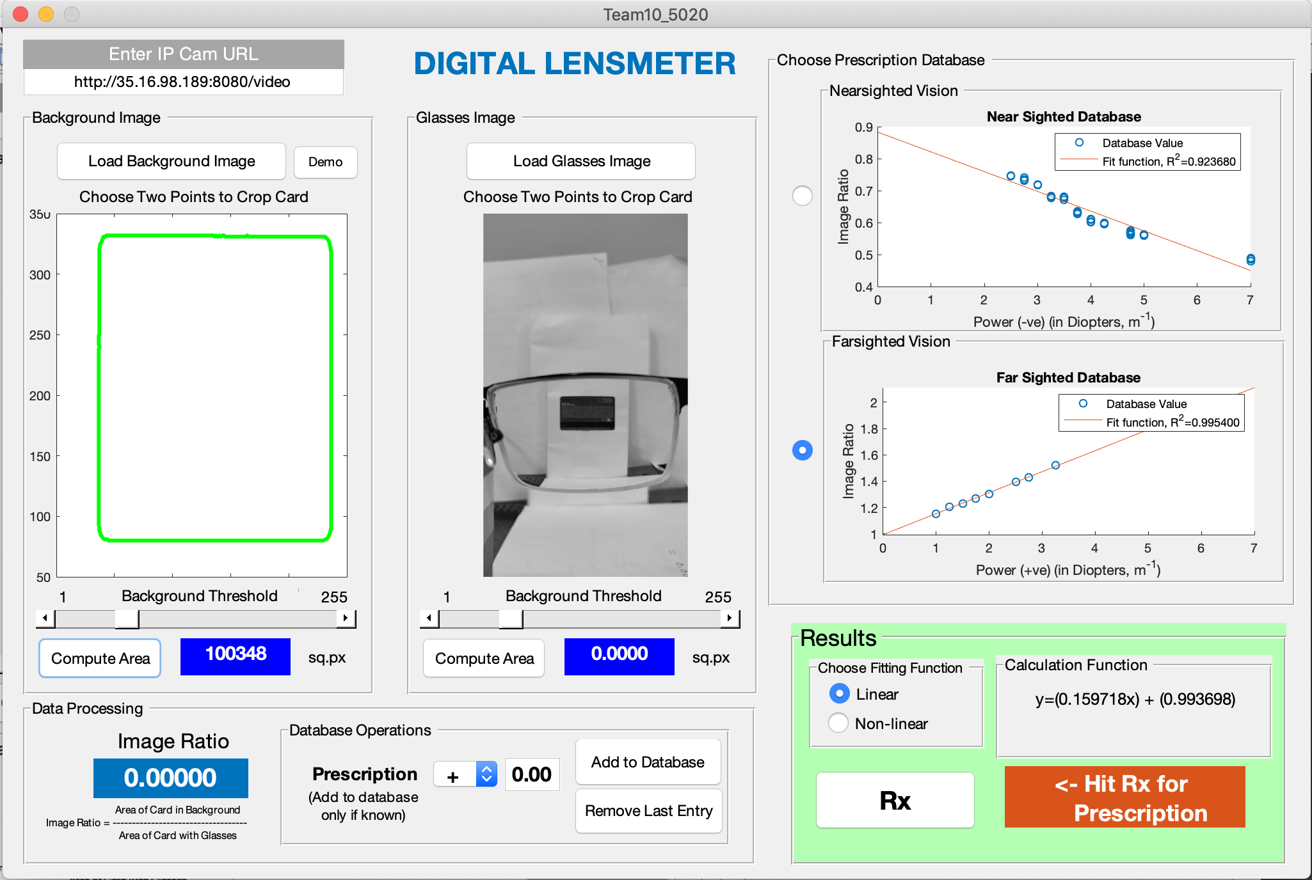
5. Click Compute
Area

Slide 6

6. Click A little above credit card
7. Click A little below credit card

Slide 7
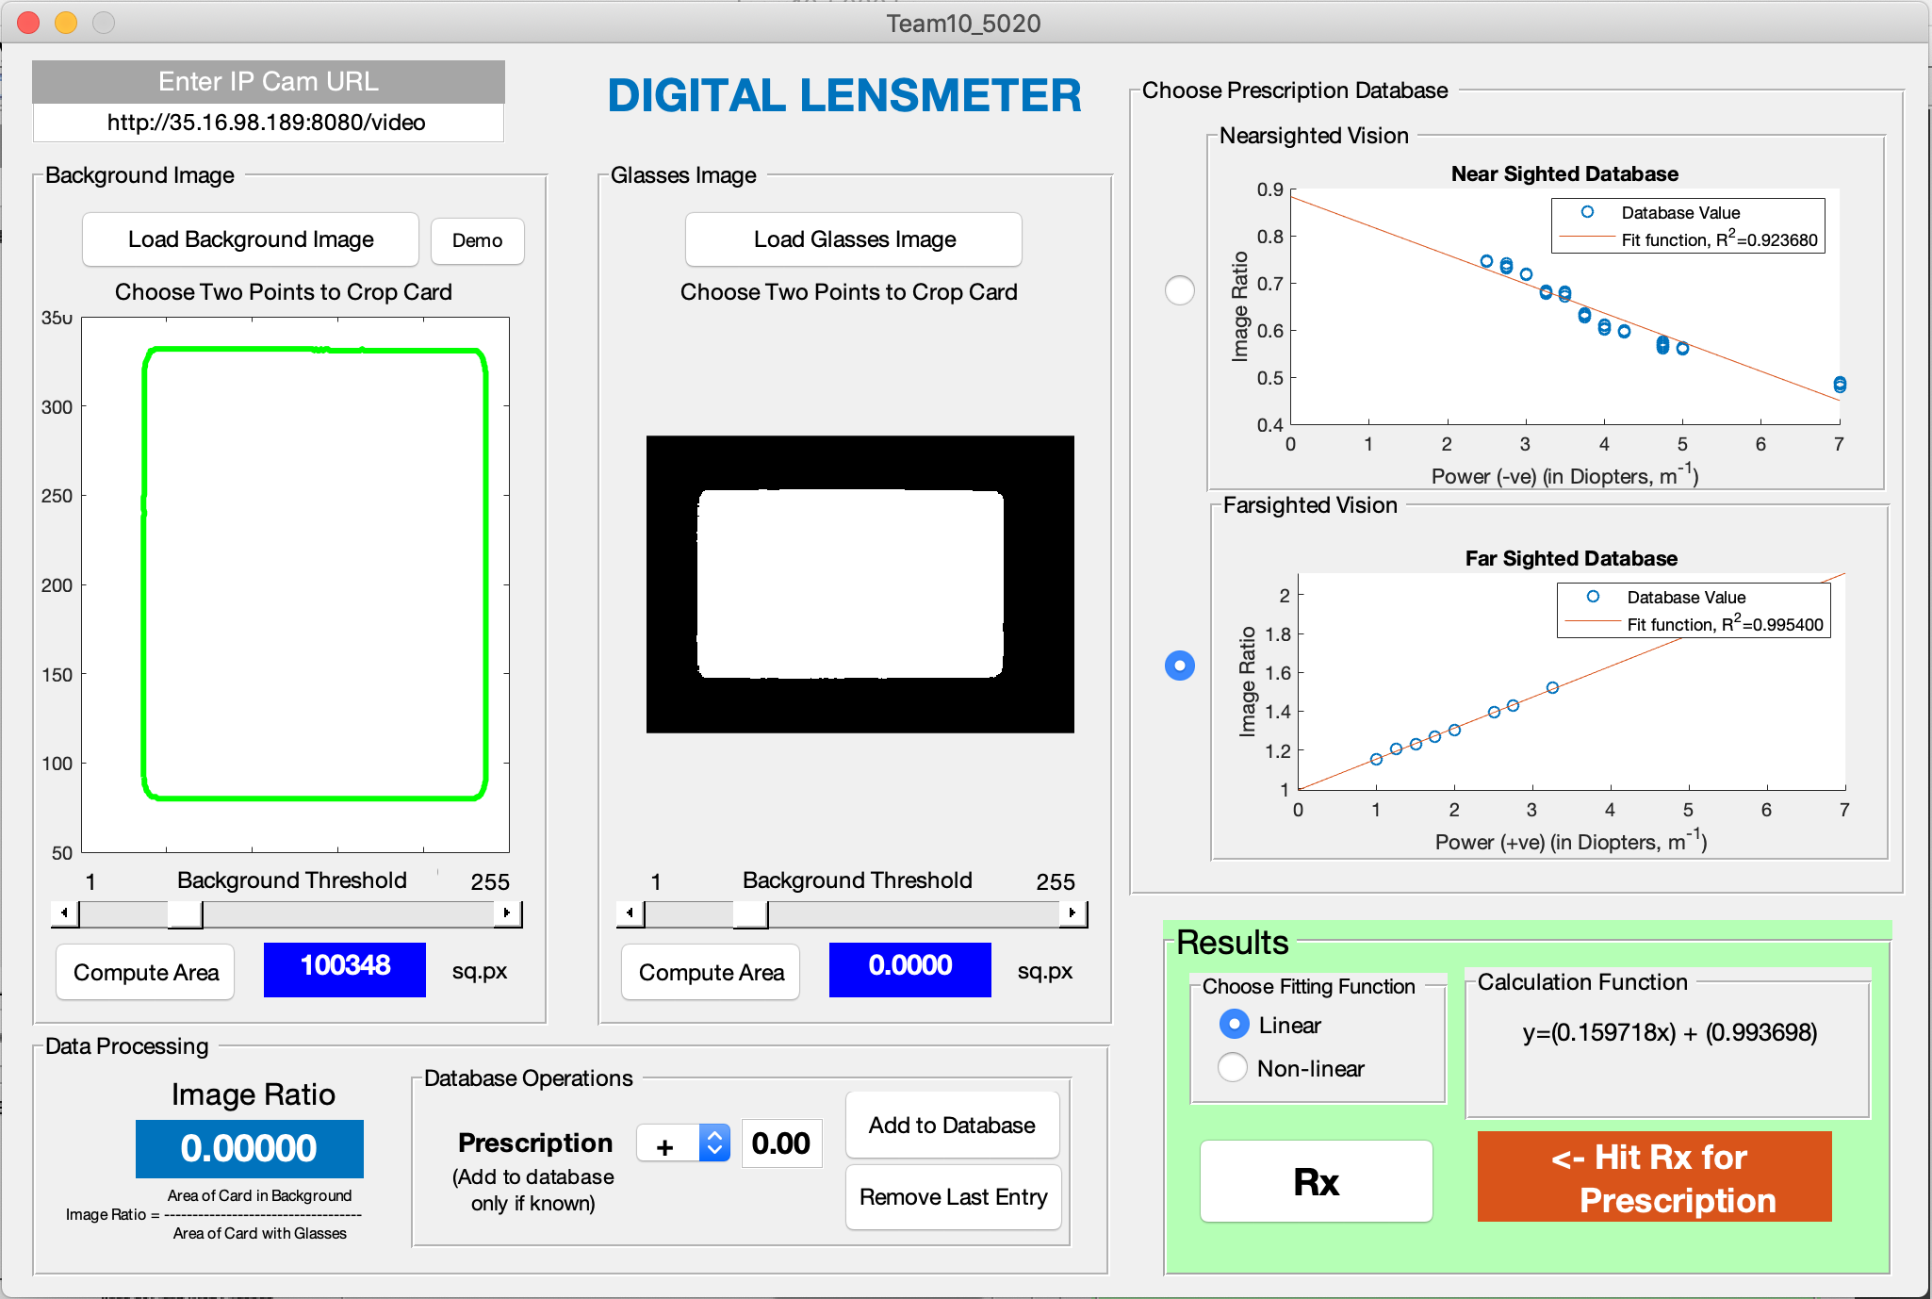
8. Click Threshold Slider and move
To see clear image

Slide 8
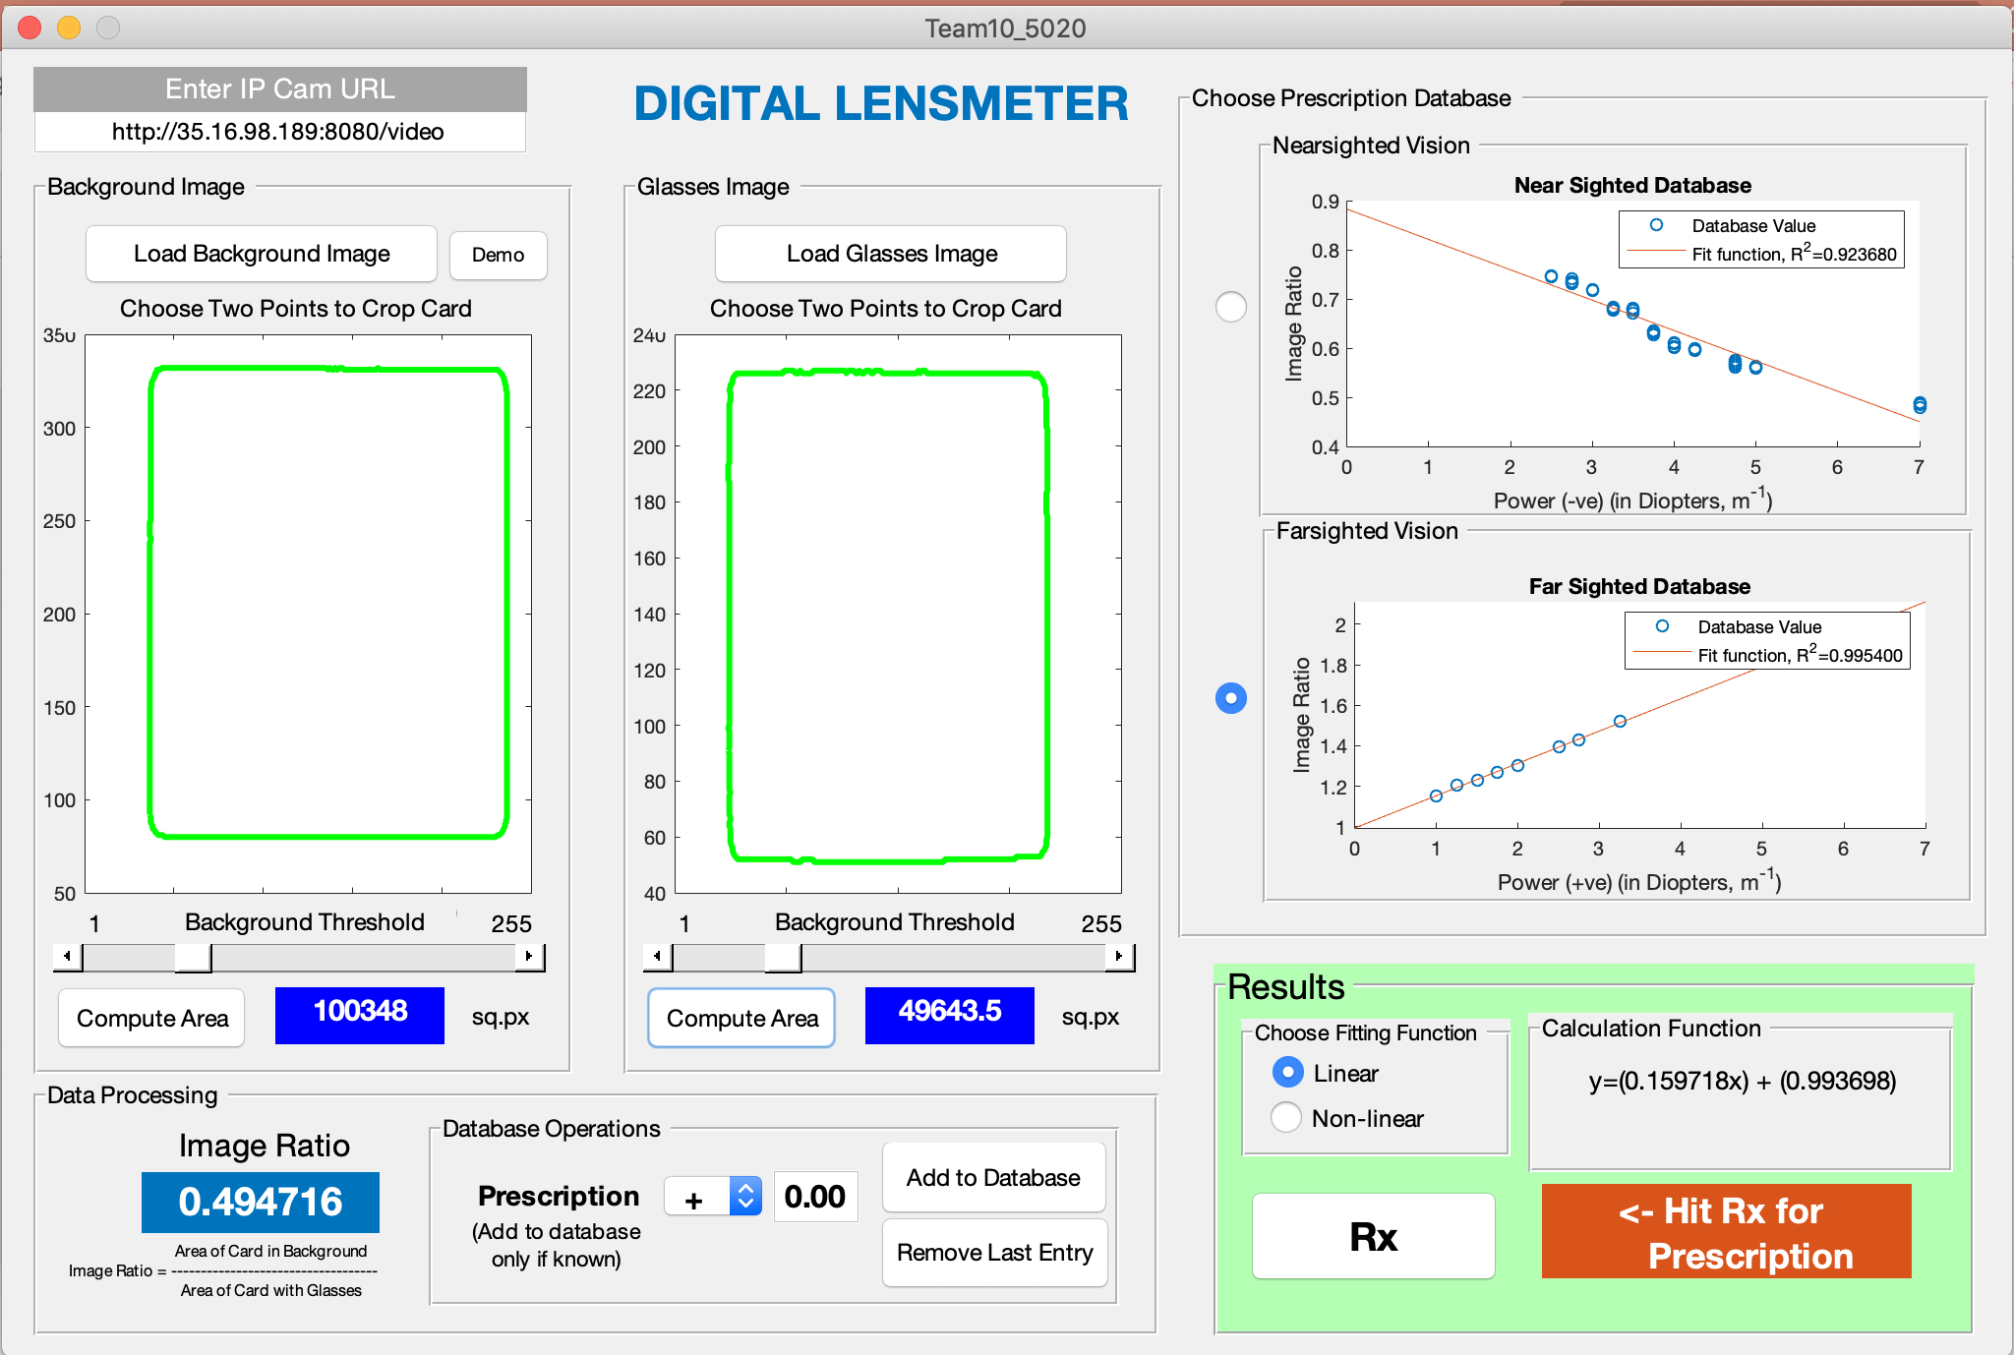
9. Click Compute
Area

Slide 9
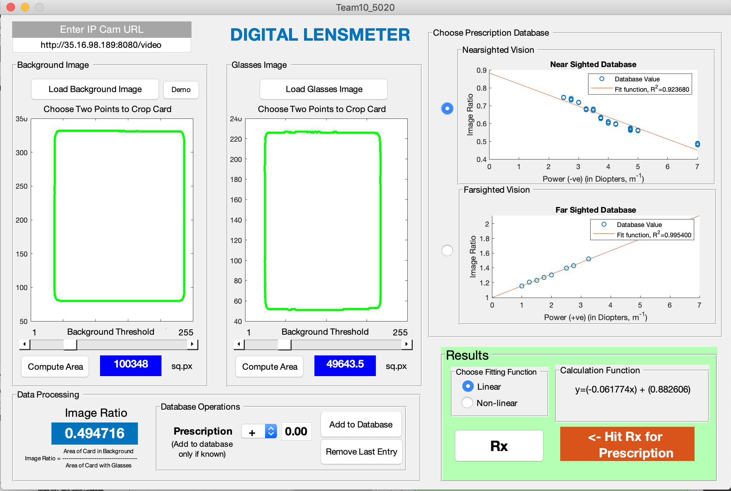
10. Since, the image ratio is lower than 1, it’s a Nearsighted. Choose, Nearsighted Radio Button
9. Click Compute
Area
11. Choose, between linear and non- linear method of .

Slide 10
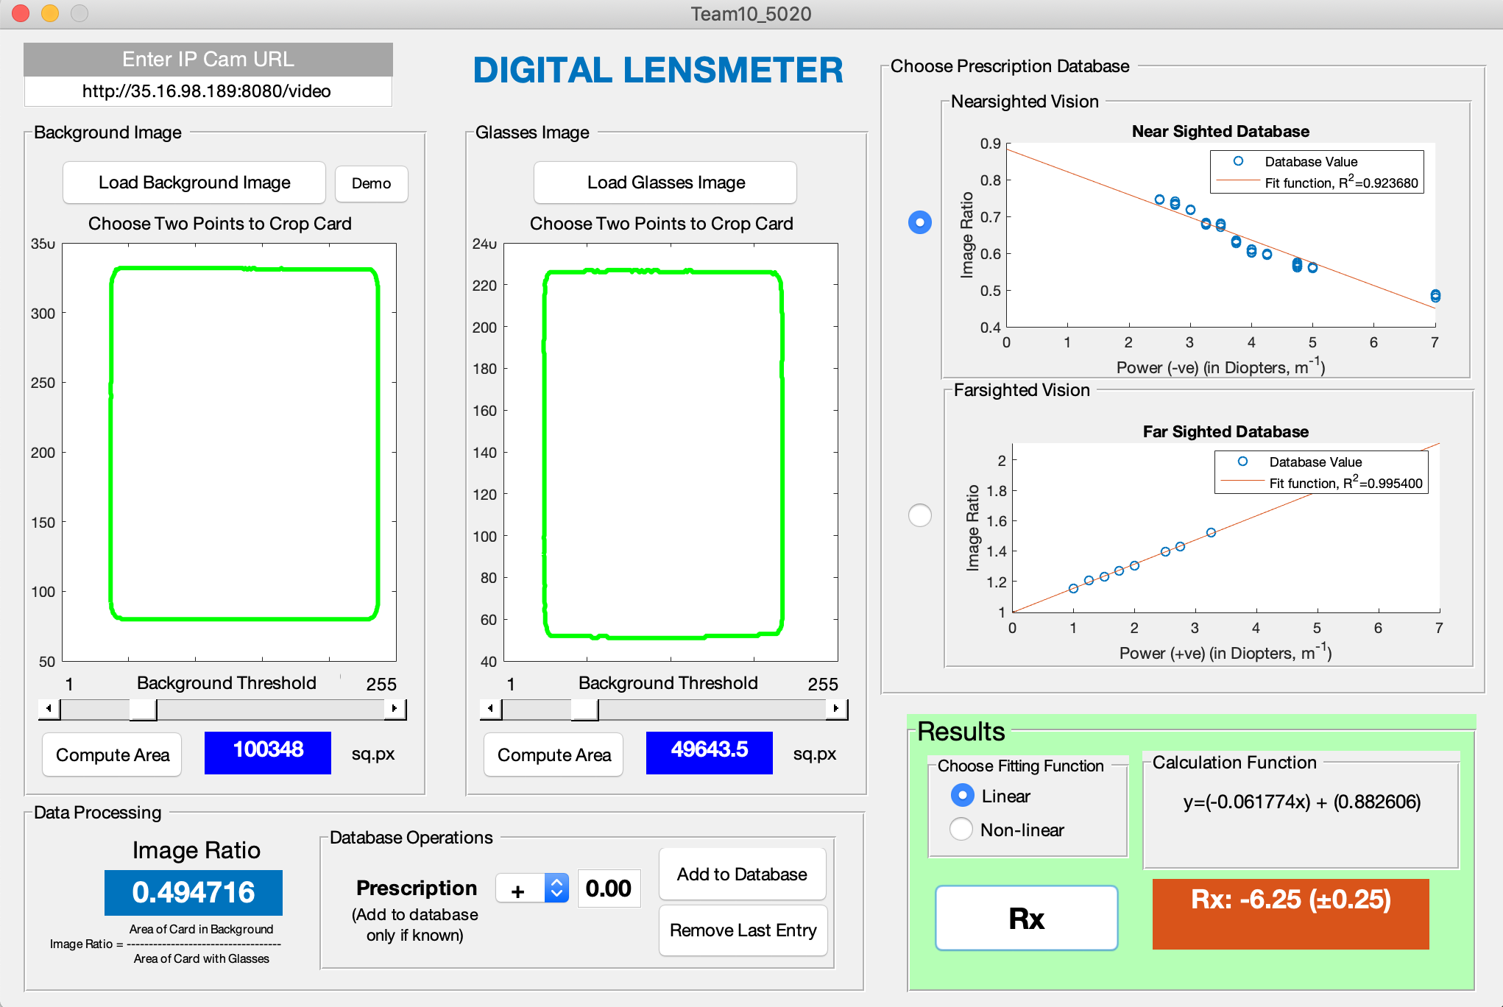
12. Hit key, Rx. And the prescription is available.

Slide 11
To load the program as Normal User
Install android app – IP Cam
Install the matlab driver, by entering
>> ipcam
in the command line of Matlab.
Enter the IP Address shown in the, Edit Text field ^^.
Click, load background
Click the top area of credit card, and bottom area of credit card.
Rest of the process is same as described earlier.

Slide 12
What else does the GUI perform?
You can add to correct value or remove incorrect value from the database for +ve and –ve prescriptions by hitting the respective button and choosing the popup sign.
The positive values are stored in “farsighted.txt” file
The negative values are stored in “nearsighted.txt” file.

Slide 13
What else does the GUI perform?
The program can display function by choosing the database and linear or non-linear equation.
The database is stored in:
NearSighted.dat & FarSighted.dat
File so that the data remains secured and
Unedited unless required.
It can be changed from the .m file.
Demo files are added, and can be used by making a background file called: bg.jpg and glasses file called: glass.jpg

