Slide 1
????
????
??????????????
??????
1. Merchant-style customer assistant
2. Review sentiment and defect analytics
??? AI ???? SaaS ??????????????????????????????
????
??? MVP?????? 50%??????? RAG ?????
?????
????
Streamlit?Pandas?asyncio/httpx?Gemini?DeepSeek?LangChain ? LlamaIndex?????????
?????????????????????
??? | ??? | ??? | ???
Notes:
??????????????????????????????

Slide 2
????
02 / 06
?????????????????????
????????????????????????????????????????
????
????
????
• ??????????????????
• ??????????????????
• ?????????????????????
• ??????????????????????
• ?????????????????????
• ??? SaaS ???????????????
????? + ???????????????
• faster customer response
• clearer defect discovery
• better product iteration
• lower after-sales loss
????????????????????????
Notes:
???????????????????

Slide 3
????
03 / 06
?????????????????????
?????????????????Prompt ????????????????
?? A?????
?? B?????
???
• ????????????????
• ?? Prompt ??? RAG ???????????
• ?????????????????
• ???????????????
• ??????????????????
• ???????????????
??
Python?Streamlit?Altair?Pandas
??
Python?asyncio?httpx?????? API ???
AI ???
Gemini?DeepSeek?Prompt Engineering?LangChain ? LlamaIndex?????????
Notes:
?????????????????

Slide 4
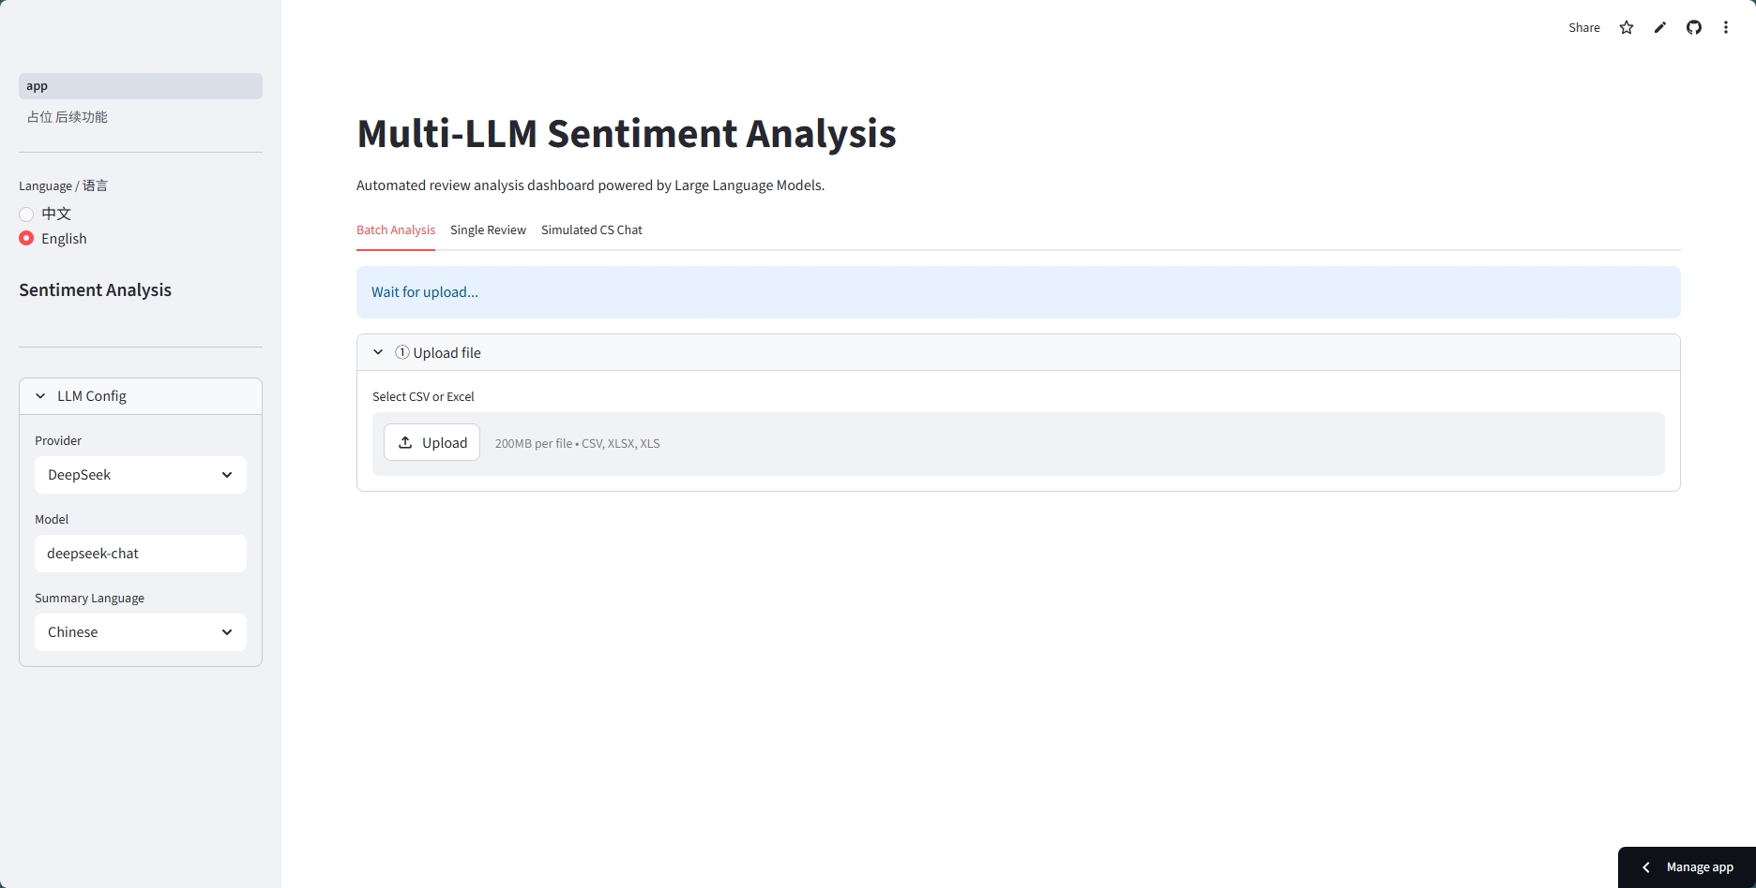
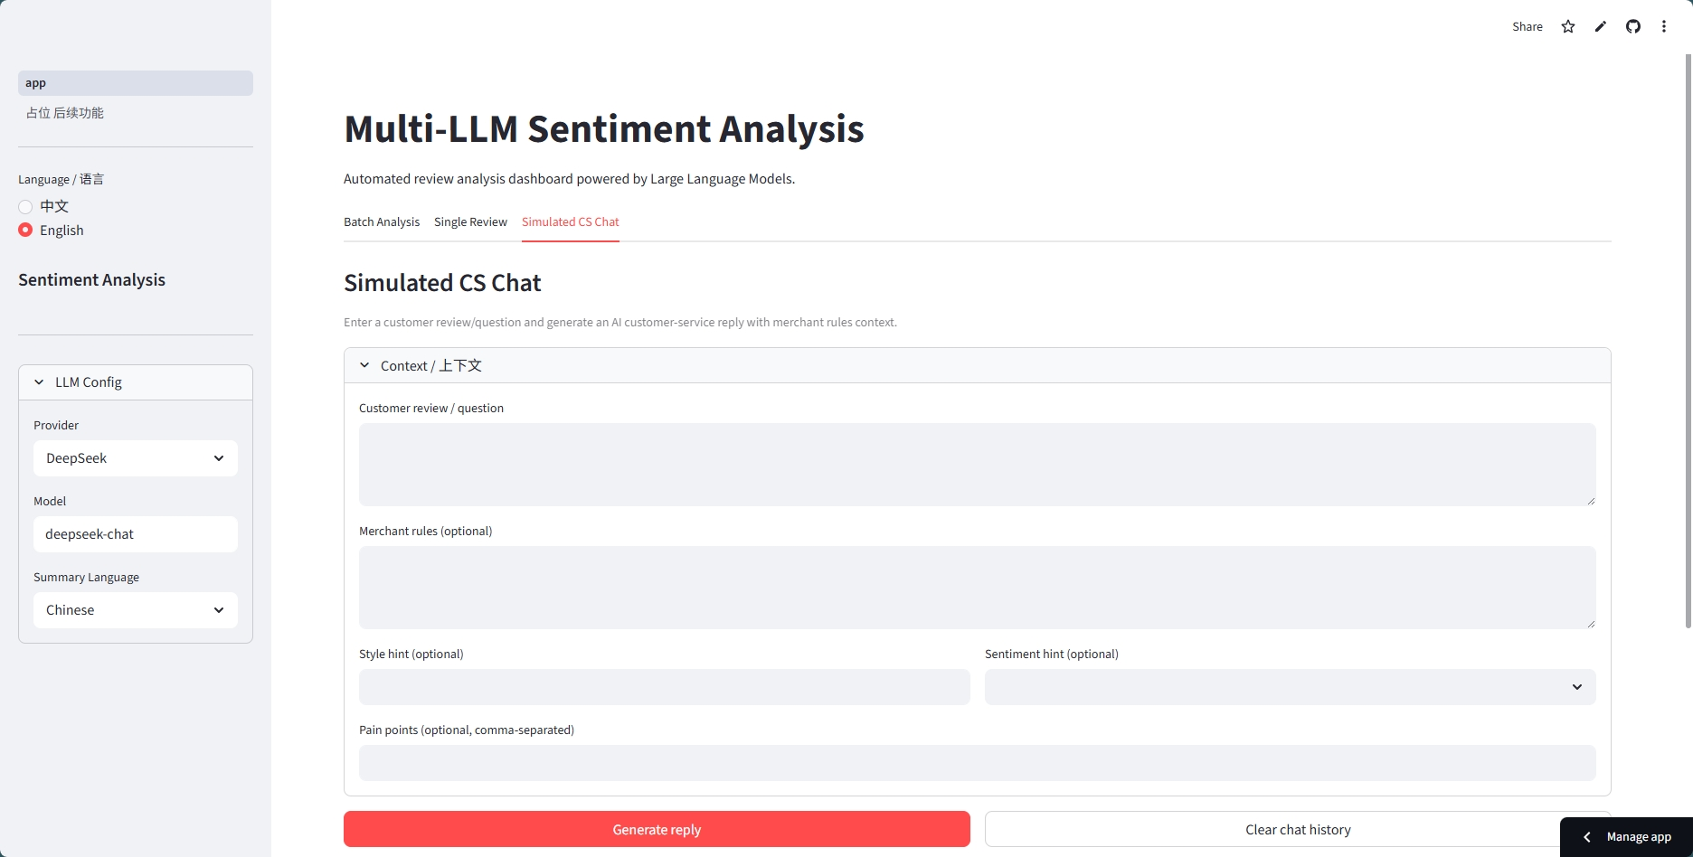
????
04 / 06
????????????????
?????????????????????????
???? A
???? B
???????????????
??????????????????????
Notes:
??????????????????????

Slide 5
????
05 / 06
????? MVP ????????????
??????? Prompt????????????????????????? RAG ?????
50%
200
80%+
?????
????
?????
???????
?????? API ?????????? UI ?????????????? RAG ???
???? 1?2 ??
????????
V2.0 Prompt ????
???
???
???
???
????
????
Prompt ?????
????
????????????? Gemini ?
DeepSeek
API???????????????????
?? Streamlit ?????Pandas
?????????????????
?? Few-shot?CoT ? Prompt
??????????????????????????
????????????????????????????
RAG ??????
Notes:
??????????????????????????

Slide 6
????
06 / 06
????????????????????
?????? RAG ??????????????????????
RAG ??
????
????
????
?????????????????????????
?????????????????????????
????????? UI ???????????????
?????????? PPT????????????????
?????
???????????????????????????????? AI ??????????
Notes:
????????????????

