Slide 1
MIDTERM REPORT
Project Snapshot
Automated Customer Service & Review Sentiment Analysis System
Two linked modules
1. Merchant-style assistant
2. Review sentiment analytics
An AI-driven SaaS concept that reduces support cost and turns raw reviews into actionable business insight.
Current status
MVP completed.
About 50% overall progress.
Now entering RAG integration.
Key stack
Core Value
Streamlit
Pandas
Gemini / DeepSeek
RAG / vector database
Lower support cost and surface product issues from reviews.
LIU DEZHENG | LIU JIACHENG | ZHENG WENBIN | JI TENGFEI
Notes:
Use this slide to open with the core value: one platform for customer-service automation and product-feedback mining.

Slide 2
WHY NOW
02 / 06
The pain point is operational overload for small sellers
Our project targets the gap between large volumes of inquiries and the limited ability to analyze product feedback.
Business Pain
Opportunity
Why this matters
• Too many repetitive customer
inquiries.
• Too little capacity to read
large review sets.
• Slow support and weak
visibility into product
issues.
• Automate routine support while
preserving merchant tone.
• Use sentiment analysis to
expose defect and return-risk
patterns.
• Offer a lightweight SaaS tool
for smaller seller teams.
Support automation + review mining creates a clear business loop:
• faster response
• clearer defect discovery
• better iteration
• lower after-sales loss
This project turns technical capability into visible commercial value.
Notes:
Stress the business need before going into implementation.

Slide 3
SYSTEM DESIGN
03 / 06
A dual-engine workflow connects service automation with insight generation
The solution combines a merchant-aligned customer assistant with an analytics pipeline built on LLMs, prompts, and retrieval.
Module A: Customer Service
Module B: Sentiment Analysis
Implementation Stack
• Matches merchant tone and
applies return rules.
• Uses prompts and later RAG
retrieval for more consistent
answers.
• Goal: faster service with
fewer handoffs.
• Classifies review sentiment
and summarizes pain points.
• Turns raw feedback into charts
and business insight.
• Goal: make iteration more
data-driven.
Frontend
Python, Streamlit,
Altair, Pandas
Backend
Python, asyncio, httpx
for high-concurrency requests
AI + Retrieval
Gemini, DeepSeek,
prompt engineering,
RAG / vector database
Notes:
Walk left to right from user inputs to outputs and then highlight the stack below.

Slide 4
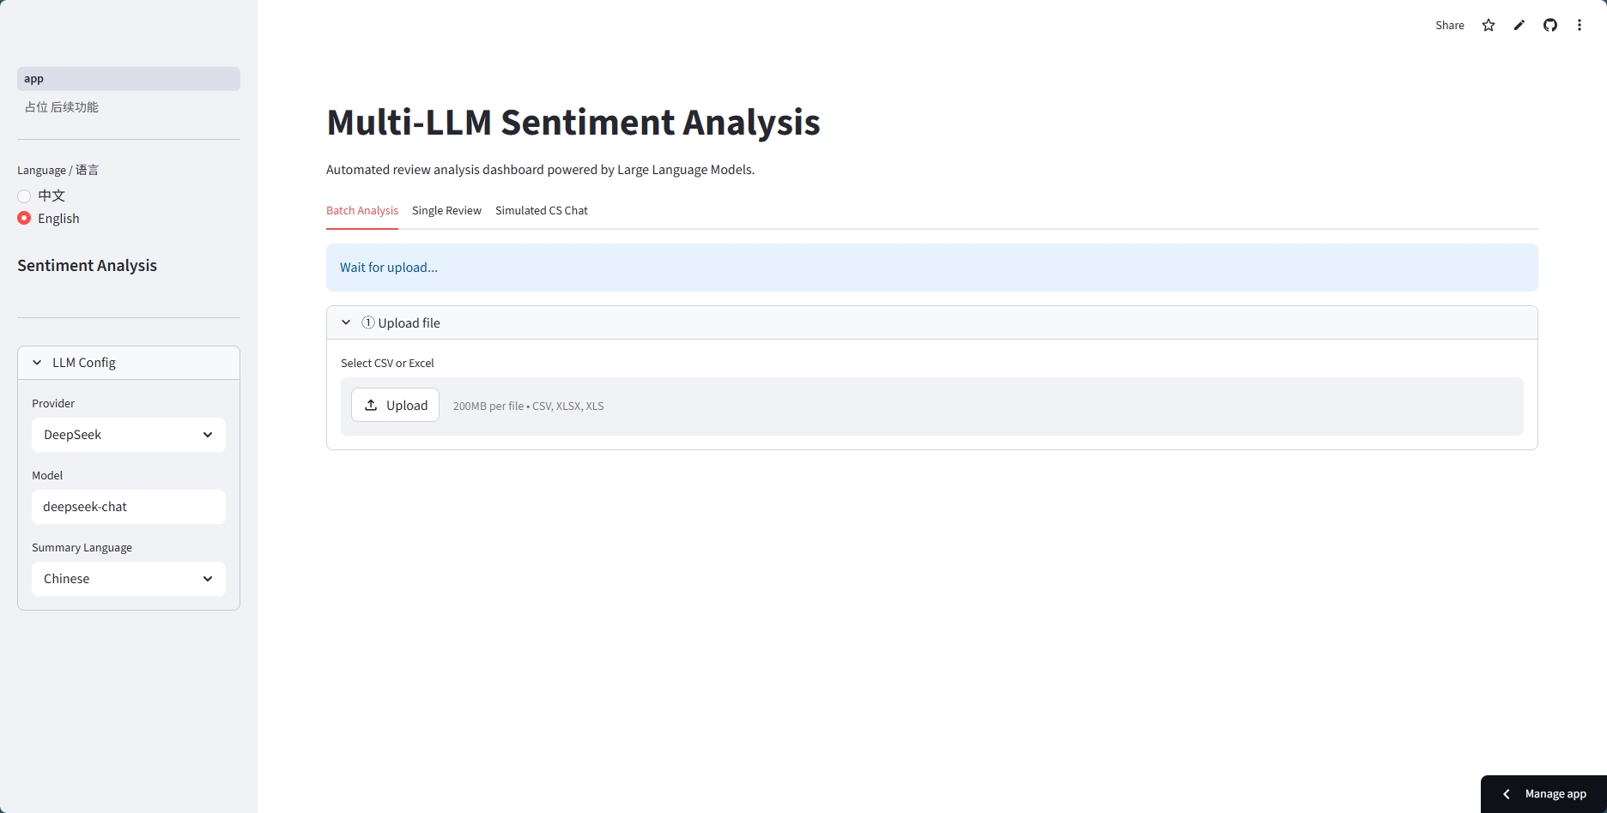
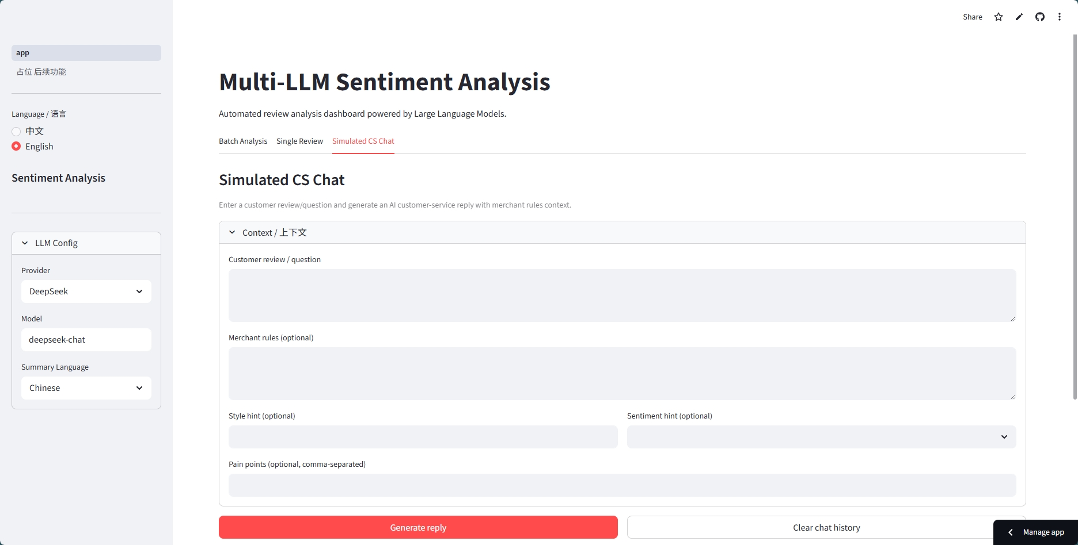
PROTOTYPE
04 / 06
The current prototype already covers the end-user workflow
Two interface views show the interaction flow and the analytics-oriented frontend experience.
Prototype View A
Prototype View B
Shows the main interaction flow.
Shows the analytics-oriented frontend.
Notes:
Use the screenshots to explain what users can actually do today in the prototype.

Slide 5
PROGRESS
05 / 06
The team has reached the MVP stage with measurable progress
We have working prompts, concurrency handling, a golden dataset, and a usable UI while preparing the formal RAG layer.
50%
200
80%+
Current milestone
Overall progress
Golden dataset
Sentiment accuracy
Rate-limit handling, merchant tone cloning, and the UI mockup are done.
The team is now moving into scalable RAG integration.
Stages 1-2 completed
Validation set ready
V2.0 prompt result
LIU DEZHENG
LIU JIACHENG
ZHENG WENBIN
JI TENGFEI
Backend Developer
Frontend Developer
Prompt Engineer & Tester
Data Collection
System architecture, Gemini
and DeepSeek integration,
and concurrency controls.
Streamlit interface, Pandas
cleaning, and
business-facing charts.
Prompt iteration, validation
datasets, and defensive
prompting.
Review collection, baseline
annotation, and merchant
knowledge prep.
Notes:
Mention both current outcomes and who owns each part of the system.

Slide 6
NEXT STEP
06 / 06
The next milestone is a reliable, presentation-ready final system
The roadmap focuses on RAG integration, stress testing, UI polish, and a strong final demonstration package.
RAG Integration
Stress Testing
Product Polish
Final Demo
Build the vector database and
validate retrieval quality.
Run end-to-end tests on
difficult edge cases.
Refactor bottlenecks and improve
usability.
Prepare materials and rehearse
Q&A.
Target outcome:
Deliver a reliable AI support and review-analysis platform that is technically solid, commercially meaningful, and ready for the final presentation.
Notes:
Close with confidence and emphasize execution discipline for the final phase.

