Slide 1
React Components
– Lesson 2
Understanding Components, JSX, and Rendering Lists
Presented by: [Your Name]
Course: 2510 React

Slide 2
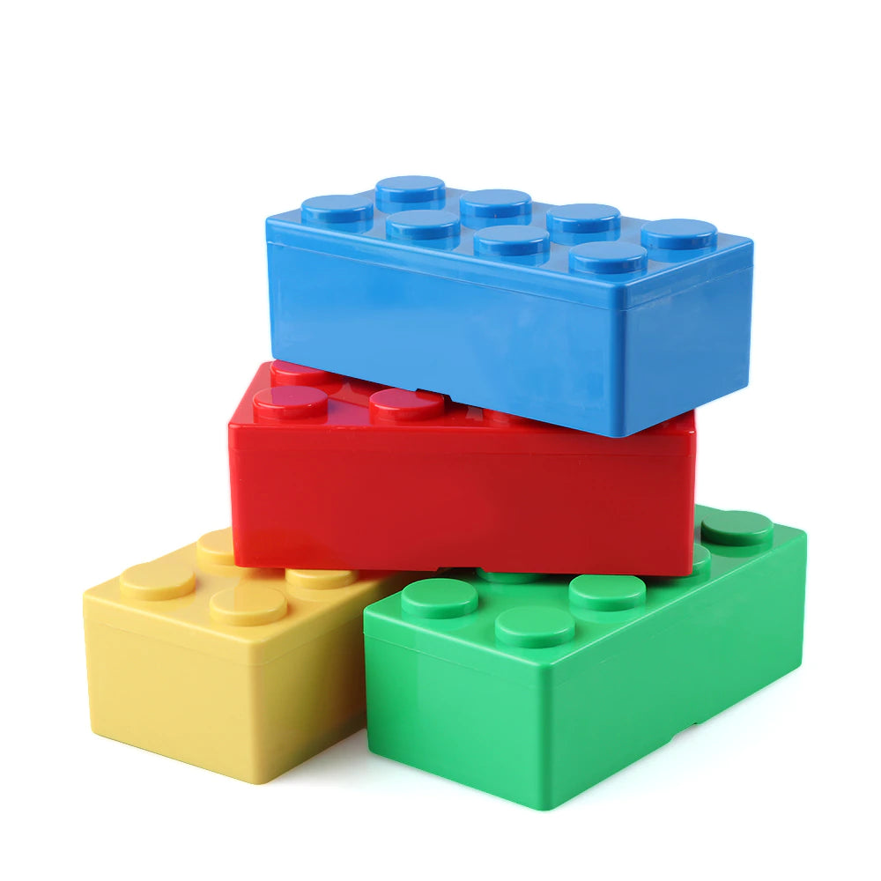
Introduction to React Components
React components are the building blocks of a React application.
Components can be functional or class-based.
Functional components are simpler and preferred for most use cases.
Class-based components offer more features but are less common in modern React.

Slide 3
JSX – JavaScript XML
JSX is a syntax extension for JavaScript that looks similar to HTML.
JSX allows you to write HTML-like code within JavaScript.
JSX is compiled to JavaScript by tools like Babel.
JSX makes it easier to create React components and manage UI.

Slide 4
Rendering Lists in React
React allows you to render lists of data using the map() function.
Use the map() function to iterate over an array and return a list of elements.
Each element in the list should have a unique key prop.
Example:
const items = ['Item 1', 'Item 2', 'Item 3'];
const listItems = items.map((item) => <li key={item}>{item}</li>);

Slide 5
Component Hierarchies
React applications are built using a hierarchy of components. Parent components can contain child components. Data can be passed from parent to child components via props.
Example:
function ParentComponent() {
return (
<div><ChildComponent propName='value' /></div>
);
}

Slide 6
Wrap-Up & Exercises
Explore:
[React Documentation](https://reactjs.org/docs/getting-started.html)
[JSX Documentation](https://reactjs.org/docs/introducing-jsx.html)
Practice:
Create a simple React component.
Render a list of items using the map() function.
Build a component hierarchy with parent and child components.

