Slide 1
4GB Canadian Learning Code Design Solution

Slide 2
Problem Statement
How do we manage a room of learners with different experience levels and learning speeds?
CLC would like to provide support for mentors and instructors to identify learners that are struggling with pace and are not comfortable publicly voicing it.
Please also consider ease of use for children or those that are newer to technology.

Slide 3
4GB Proposed Solution
How do we manage a room of learners with different experience levels and learning speeds?
Online Quizzes in the middle of session. Based on the quiz result
Teacher can identify students who needs help
Teacher can correct them self if they notice that whole class is lagging behind
Based on the interim marks, coupling of similar students based on their
Performance in the quizzes, Homework assignment, projects
Demographic and ethnic background
hgh

Slide 4
4GB Proposed Solution
CLC would like to provide support for mentors and instructors to identify learners that are struggling with pace and are not comfortable publicly voicing it.
Online Quizzes in the middle of session. Based on the quiz result
Teacher can identify students who needs help
Teacher can correct them self if they notice that whole class is lagging behind
Based on the interim marks, coupling of similar students based on their
Performance in the quizzes, Homework assignment, projects
Demographic ethnic background
Using slack, teacher can help urgent help, participate in group discussions, and help those who are too shy voice their opinion or ask questions
In order to understand which students are struggling, we propose to use python for the analysis of student marks
Additionally, we can use python for demographic classes so as to prepare classes accordingly.

Slide 5
4GB Proposed Solution
Please also consider ease of use for children, those that are newer to technology, and for people with disabilities
Problem sets of lower difficulty level
Assigned mentors based on their performance
Support tools such as text to speech, larger prints for the visually impaired, and etc.

Slide 6
Technology Used
Jupyter
Visual Studio .NET
Tableau
MS SQL Server
Power BI
Slack

Slide 7
Analysis
We prepared dummy data by mixing Student Performance Data Set (UCI) and the survey questions that were provided by CLC
We also created our own dummy features

Slide 8
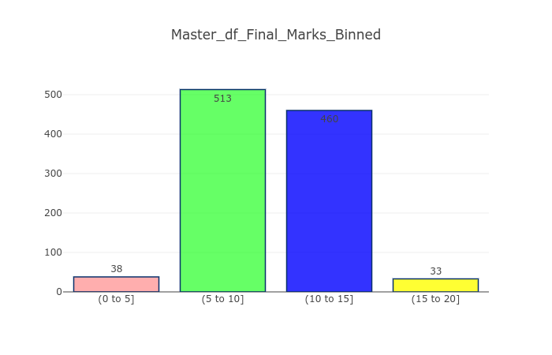
CLC Administrator Level View (Python Analysis)

Slide 9
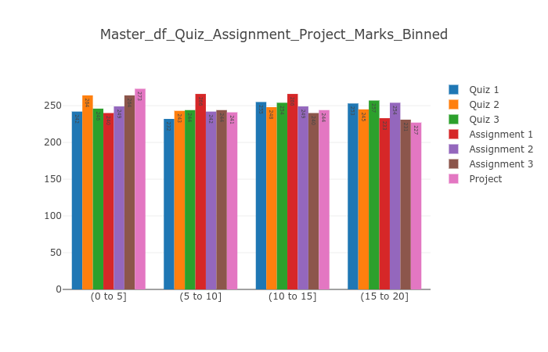
CLC Administrator Level View (Python Analysis) contd.

Slide 10
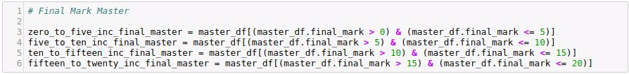
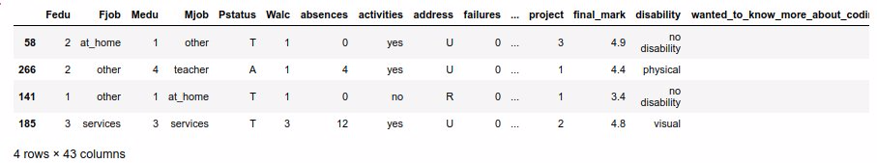
CLC Administrator Level View (Python Analysis) cont.
Next, we created 4 sub datasets in order to group students by their academic performance

Slide 11
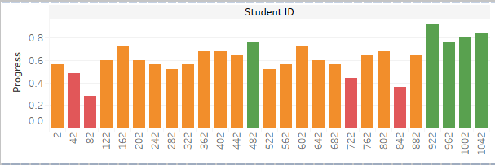
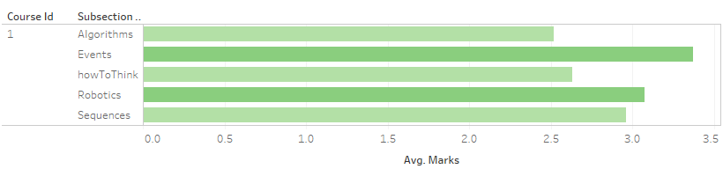
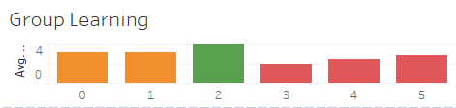
Teacher Level View (Tableau)
Product A
Product B
Feature 1
Feature 2
Feature 3
Feature 1
Feature 2
Feature 3

Slide 12
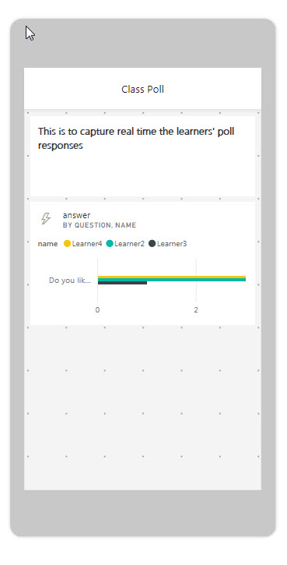
Classroom Data Collection
This is for classroom data collection through Poll/QA sessions. Multi Choices Poll/Questions are sent to students to do and the teacher can collect the data and also capture the response time.

Slide 13
Front End (Asp .Net)
Easy To Use
Teacher’s Interface
Can Initiate quizzes for the courses he is teaching
Can update marks of student’s. Homework, offline marking
Can provide direct feedback to students
Student’s Interface
Can Attempt quizzes for the course he is learning.
Can see the marks he got in the each course he enrolled.
Can receive direct feedback from his teacher.

Slide 14


Slide 15
Thank You

