Slide 1

Climate Change and Vegetation
David Failing – 11/12/2020

Slide 2
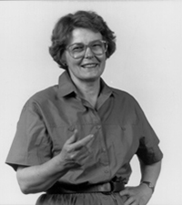
Margaret B. Davis (b. 1931, Bio)
Professor Emerita of Ecology University of Minnesota – Twin Cities (1976-2002) ESA President, 1987-1988
PhD in Biology, Harvard (1957) Positions at Caltech, Michigan, Washington, Yale
Paleoecologist – studied the response of ecosystems to (anthropogenic) environmental change.
Challenged ideas about plant community stability w/tree pollen
Studied past changes in geographic distribution of forests (Separate the role of natural processes from human causes.)
Fine-scale forest dynamics (Metadata needs in ITRDB)
Equal pay: "Men can move. Everybody believes women can’t.”
Notes:
Focused on fossil pollen distribution as a proxy for population of species that produced it, pioneered certain study techniques in 1963 “On The Theory of Pollen Analysis” paper. revolutionized how pollen records were interpreted. Her subsequent research considered how various tree species and forest communities migrated back and forth across eastern North America during the previous 14,000 years. This body of work helped to develop the modern theoretical basis for predicting changes in forest composition in response to global warming.

Slide 3
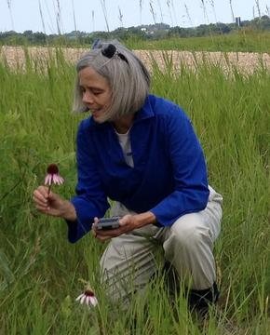
Ruth G. Shaw (b. 1953, Bio)
Professor of Ecology University of Minnesota – Twin Cities (1983 - )
PhD in Botany, Duke (1993 - ) Positions at Caltech, Michigan, Washington, Yale
Evolutionary biologist
Work with Davis – evolutionary adaptation occurs in plants subjected to rapid environmental change.
Gene flow from cultivated plants to wild relatives
Quantitative geneticist (new statistical techniques to estimate fitness and population growth rates – R Package)
Graduate advising – 15+ PhD students, ~ # postdocs.

Slide 4
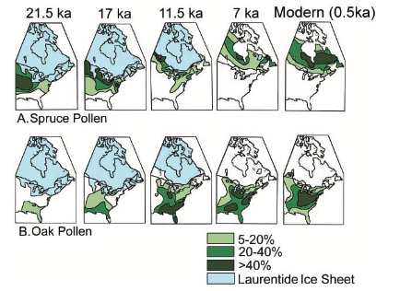
Range Shifts and Adaptive Responses to Quaternary Climate Change
Quaternary period: Last 2.5 million years, marked by several glaciations
Focus on late quaternary, last ~21,500 years, and esp. late Pleistocene / early Holocene
Variable climate change, as rapid as several ℃ in a decade, or slow as 1 ℃ per millennium. The authors review a variety of competing factors in response to change.
Responses to end of glacial interval varied by species.
Displacement (Spruce) vs. Expansion (Oak)
Population growth (Ponderosa) or decline (Bristlecone)
Elevation shift (Fig 2 – Nevada plants): Majority moved to higher elevations (in varying degrees)
Climate change is sufficient to explain these continental-scale patterns, and models can predict these movements.
Q: Can you think of other contrasting range shifts?

Slide 5
Range Shifts
Why might plants shift their range?
Warming or cooling trends, plus changes in seasonal variation
Precipitation patterns or amounts shift
Change in pressure from pests, disturbance, etc.
Ultimately, novel combinations of climate variables (think about fundamental niche)
Shifts are response to tolerance limits.
Do population-level adaptive differences matter in these shifts?
One opinion: No. Differences too small to affect model predictions.
Models referenced on last slide are coarse in spatial resolution (300-400km) and temporal resolution, and fossil pollen record is family/genus level, not species level.
In short: Genetics does matter, but climate reconstructions used in the studies reviewed do not display the effects.

Slide 6
Range Shifts and Genetics
There is an apparent contradiction within the classic paper - p675 says that differences at the population or stand level are considered too small to affect model predictions of biotic response to climate change. Later (p677) they bring in a study (Rehfeldt et al) that gives a "dramatic demonstration that intraspecific differentiation is large enough to affect predictions of biotic response to climate." How would you explain / account for this in the context of the studies they reviewed, and your own prior knowledge?
Notes:
I am a mathematician, not a biologist, so the genetics section was in large part indecipherable to me. Discuss for a few minutes.

Slide 7
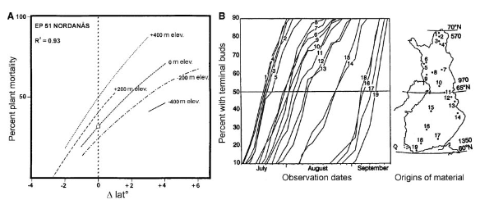
Transplant Trials - Scots pine in Nordnaas, Sweden
Modern populations that migrated previously are now adapted to local conditions. Unique pollen evidence – Rapid N. Eur. migration ~15,000y before present
Goal: Detect adaptation to local climate experimentally.
“The more northerly a population’s origin, and the higher the elevation, the earlier it initiated winter dormancy,” and the lower its mortality rate in the common garden.
These adaptations occurred despite gene flow.
Notes:
"Given the neutrality of molecular markers, assessment of genetic adaptation to climate has relied on an experimental approach in which plants, transplanted from regions of differing climate, are grown together in common conditions."

Slide 8
Breakout Rooms (~7 minutes)
The two papers present multiple approaches to "teasing out" the effects of climate on vegetation - the contemporary paper (next) focusing on observational data and its analysis, and the classic reviewing both experimental and observational data. What do you think the strengths and weaknesses are of each type of study in this context? Do you have any greater faith in the conclusions drawn from one type or another?
Notes:
Experimental approach (transplant trials) allow us to explore the fitness of present-day populations in future (rapidly shifted) climates. Those plants that perform well in the shift to lower latitudes / altitudes (lower mortality rate) may survive better as the Scots pine did, but examples of prairie annuals exist that produce fewer seeds when transplanted in the same climatological direction. We do not have much data from similar experiments performed to understand the rates of evolutionary response (adaptation) similar to the rates of migration. It is unclear from experimental evidence whether sufficiently rapid adaptation is possible.

Slide 9
Contemporary Paper - Coauthors
Rubén Delgado Manzanedo and Neil Pederson: University of Washington / Harvard Forest Conceived of the present study Previously updated ITRDB to render it more accessible. Corrected errors in data that left many chronologies unusable.
Tim Rademacher: Postdoc in Richardson Lab, SICCS; Harvard Forest Data analysis

Slide 10
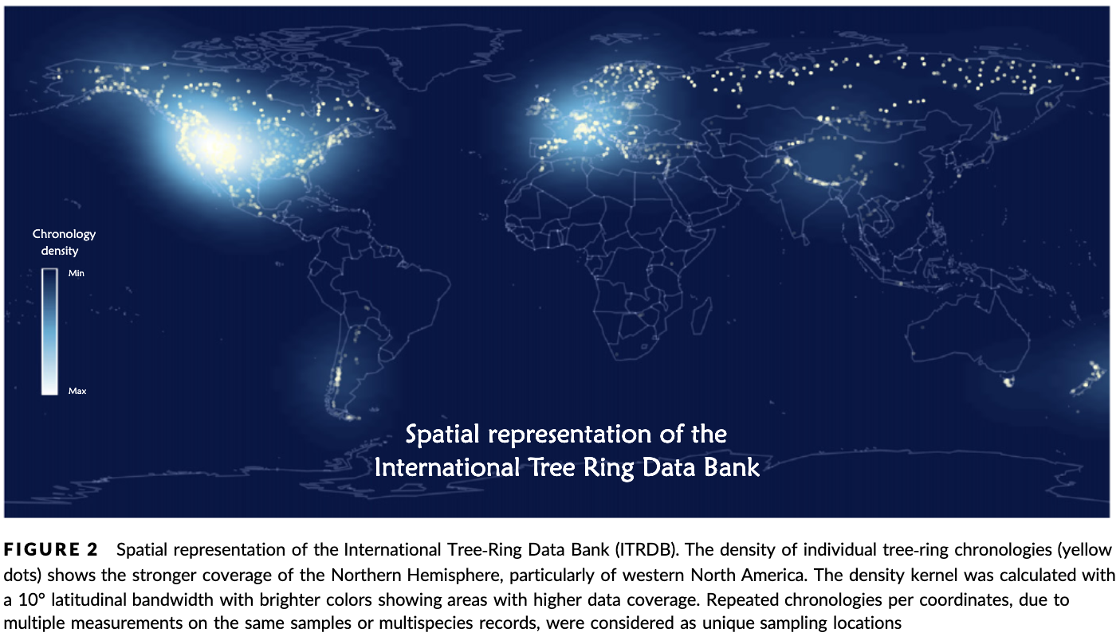

Slide 11

Spatial Synchrony
Concurrent changes in abundance or performance (e.g. growth) over time between distinct populations.
Intraspecific synchrony across space is an indicator of species stability and persistence.
Driving question: Is spatial synchrony in forest growth increasing at the global scale, and do the recent trends go beyond the long-term historical variability captured in these records?

Slide 12
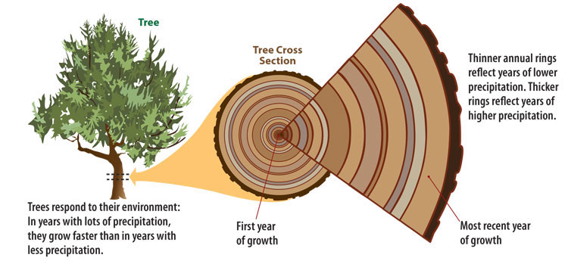
Data Processing
Sample cores from individual trees of same species at a single site.
Series – time series of ring widths (mm)
Detrending – use dplR, construct RWI series Ratio of raw width to expected width
Chronology – an average of RWI series across a site’s series WHY? Remove trends related to age, geometric constraints, and ecological disturbances
This paper: 4042 tree populations in 226 tree taxa NOTE: 5 species ~ 30% of records; conifers >80% of records

Slide 13
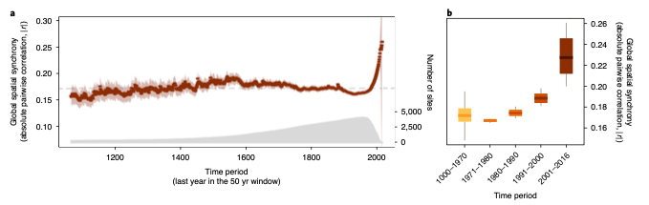
Comparing Chronologies
Compute mean (across all chronologies) absolute pairwise correlation |r| Value each year is for the (subchronology) 50 years ending that year.
Common practice: compare raw correlation (r), but mean may obscure trends (and lead to contradictory conclusions dependent on scale, region).
|r| range from 0.15-0.20 pre-1970, peak at |r|= 0.26 in 2016.
Two-Sample Kolmogorov-Smirnov test? Q: Do both samples (1000-1970 vs 1970-2016) come from the same distribution?
Notes:
"Given the neutrality of molecular markers, assessment of genetic adaptation to climate has relied on an experimental approach in which plants, transplanted from regions of differing climate, are grown together in common conditions."

Slide 14
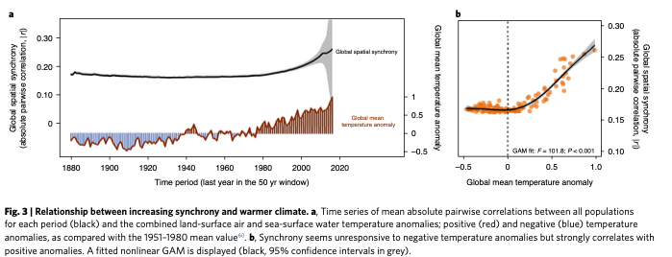
Increases in average temperature anomalies correspond
with higher global average correlation between forest populations
Notes:
The rise in |r| is explained (strongly) by the anomaly in global mean temperature.

Slide 15
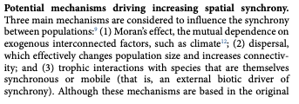
Breakout Rooms (~7 minutes)
The authors discuss potential mechanisms driving spatial synchrony (bottom of 3rd page). Summarize the evidence for (and/or against) the proposed mechanism that corresponds to your breakout room number. Do you agree with the authors’ conclusion about the primary driver?
Notes:
NOTE: GRAPH IN FIGURE 4 IS SUPPORT FOR MORAN’S EFFECT – TEMP BUT NOT PRECIP

Slide 16
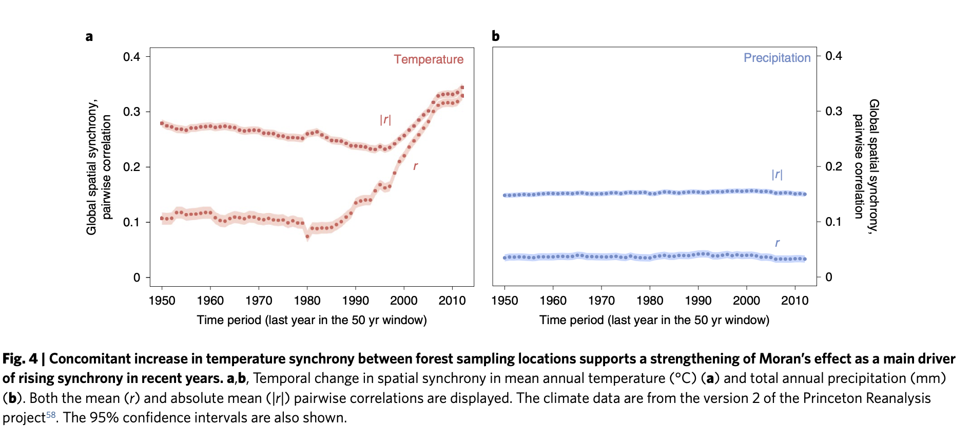

Slide 17
Breakout Rooms (~10 minutes)
The authors discuss other factors that may play important roles or interact with our current main driver candidate, temperature. (4th pg) (1) Rising atmospheric CO2 (2) Rising nitrogen deposition (3) Land use change (4) Shifting climate teleconnections and (5) Increasing frequency or intensity of extreme climate events. In your group, discuss these factors, how likely you think they are to influence the observed global synchrony patterns based on the presented evidence, and how you might test these links (either observationally or experimentally).
Notes:
Experimental approach (transplant trials) allow us to explore the fitness of present-day populations in future (rapidly shifted) climates. Those plants that perform well in the shift to lower latitudes / altitudes (lower mortality rate) may survive better as the Scots pine did, but examples of prairie annuals exist that produce fewer seeds when transplanted in the same climatological direction. We do not have much data from similar experiments performed to understand the rates of evolutionary response (adaptation) similar to the rates of migration. It is unclear from experimental evidence whether sufficiently rapid adaptation is possible.

Slide 18
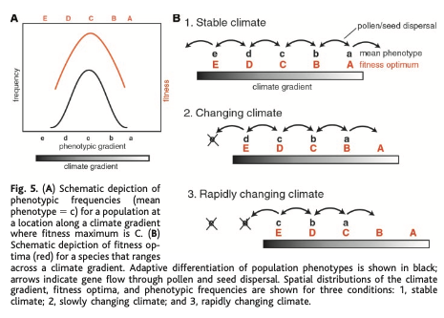
Discussion
What do you expect will be the effects of increasing growth synchrony? How will adaptation and migration rates be effected? Extinction rates? Is the “new, uncharted terrain” that higher synchrony pushes trees toward the same as the “novel climate” in the classic paper?
Notes:
Focused on fossil pollen distribution as a proxy for population of species that produced it, pioneered certain study techniques in 1963 “On The Theory of Pollen Analysis” paper. revolutionized how pollen records were interpreted. Her subsequent research considered how various tree species and forest communities migrated back and forth across eastern North America during the previous 14,000 years. This body of work helped to develop the modern theoretical basis for predicting changes in forest composition in response to global warming.

