Slide 1
uhcisask.com Technical Document/ How to run this application
Created by Damian Falcon

Slide 2
Resources needed
VS Code
Nodejs
MongoDB

Slide 3
Download the ZIP Folder
Open the ZIP folder
Move the project folder to the location you want it in
Open Visual Studio Code

Slide 4
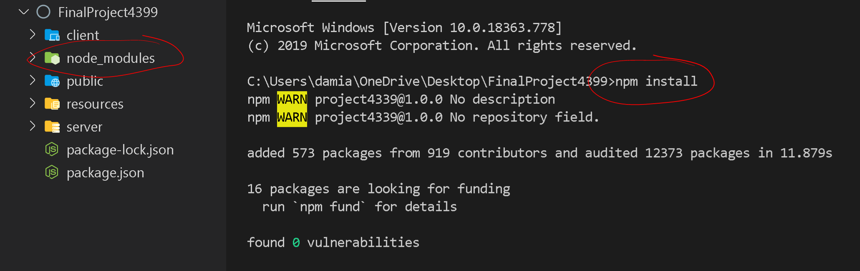
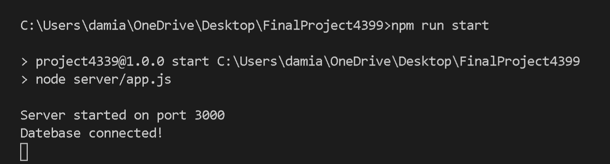
Server-Side: Installing Node Modules
Open the project folder in VS Code
Installing Node Modules for server-side:
Right click on the project folder
Click Open in Terminal
In the terminal run “npm install”
Wait for the installation
A folder named “node_modules” should now be in in your project folder
You can now run the server by typing “npm run start” in the terminal
If you see “Database connected!” you are done with the server-side!

Slide 5
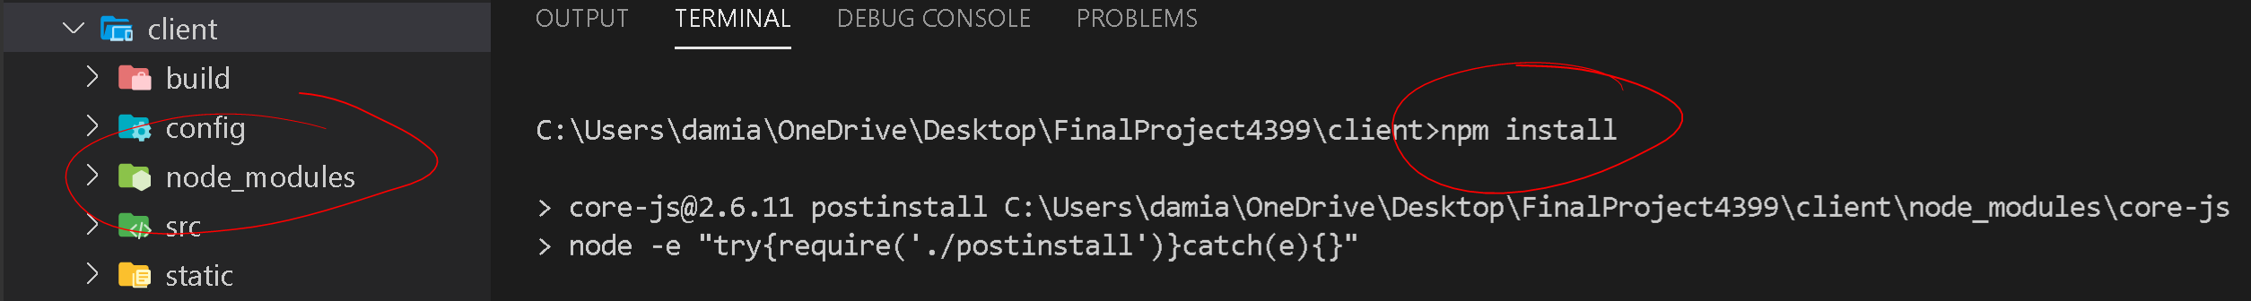
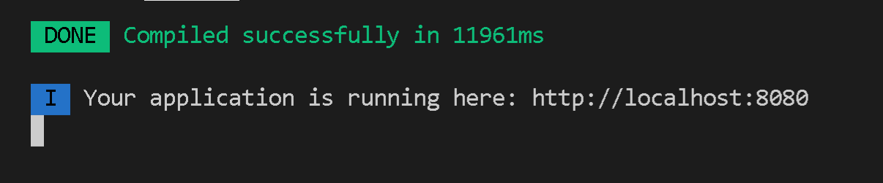
Client-Side: Installing Node Modules
Installing Node Modules for client-side:
Right click the “client” folder
Click Open in Terminal
In the terminal run “npm install”
Wait for the installation
A folder named “node_modules” should now be in in your client folder
You can now run the client by typing “npm run dev” in the terminal
If you see “Your application is running here: http://localhost:8080!” the application is running!

Slide 6
Access the application
Make sure both the server and client are both running
Go to your browser and type “localhost:8080”and your application should be running!

Slide 7
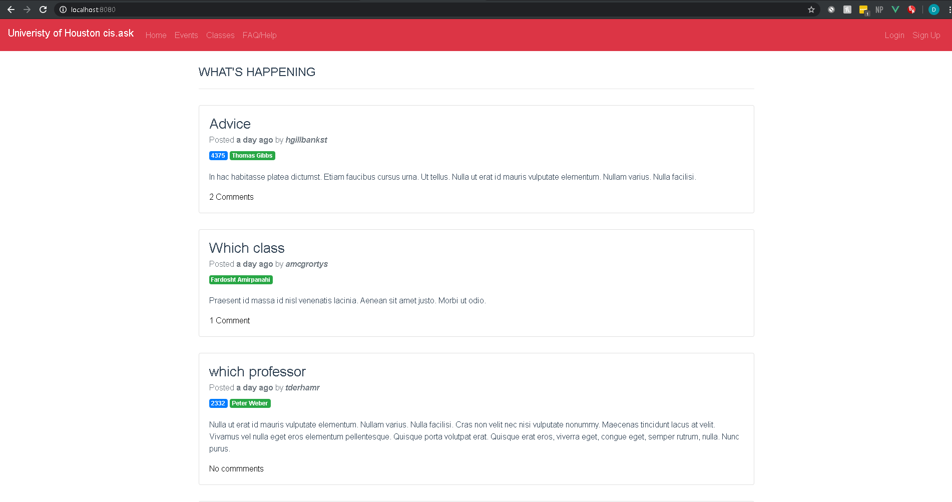
Application Running
Your application should be running in at the url “localhost:8080”
I hope you enjoy using the application!

