Slide 1
Uhcisask.com User Guide
Damian Falcon

Slide 2
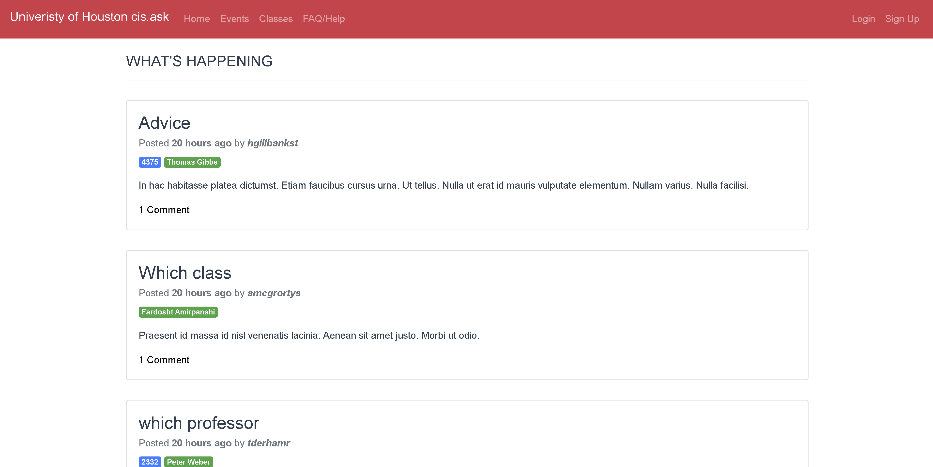
Home Page – not logged in
While not logged in users can read posts and visit the following pages:
Events
Classes
FAQ/Help

Slide 3
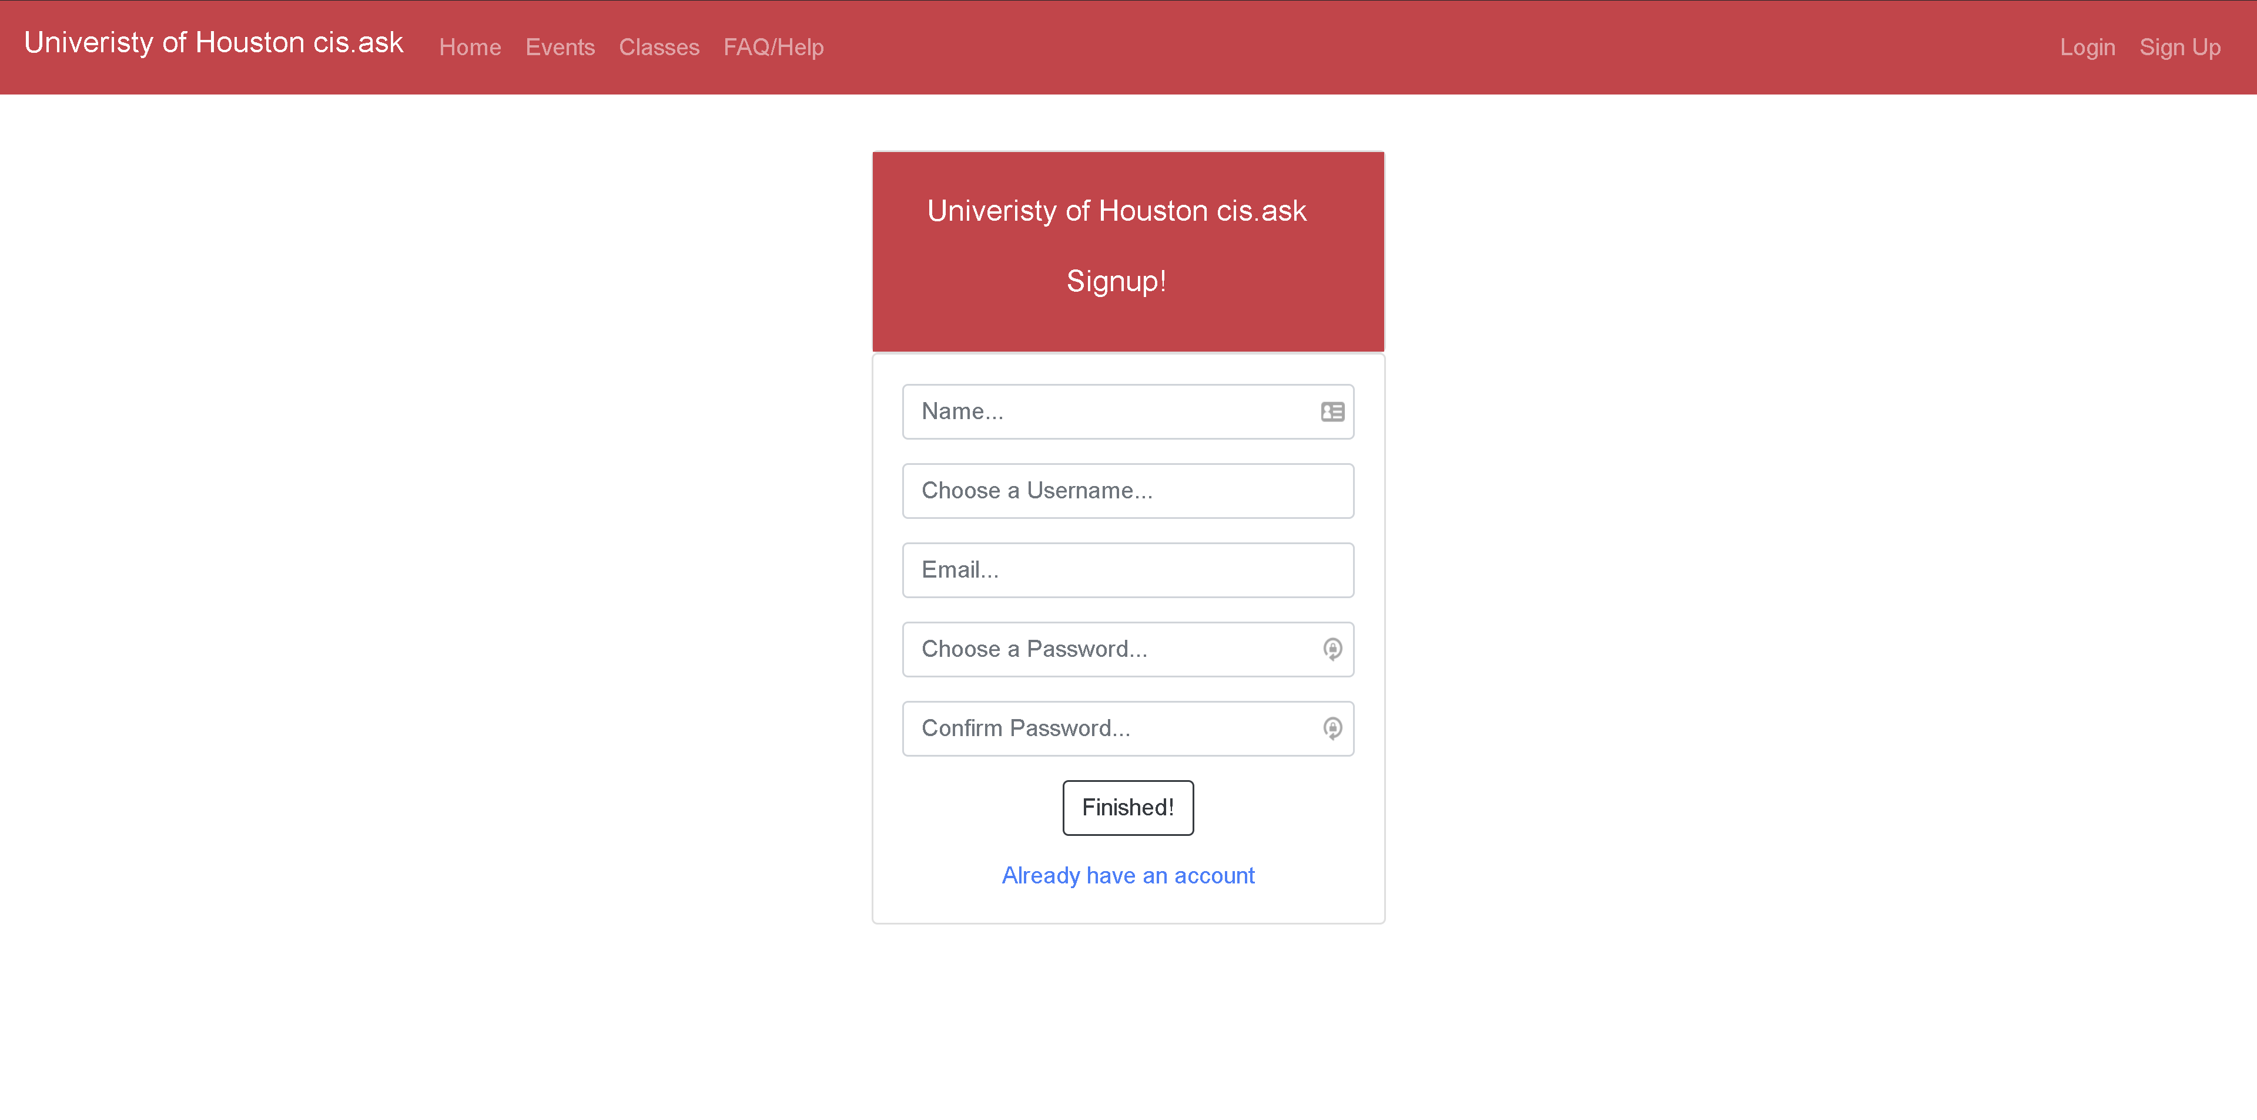
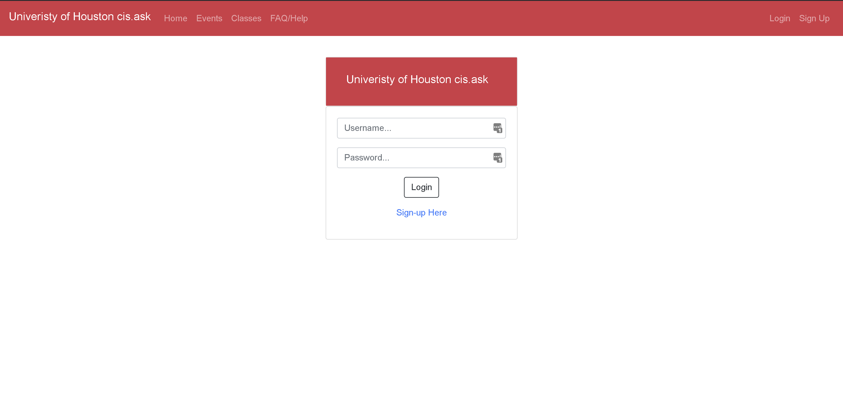
Sign Up & Login
Sign Up:
Click Sign Up
Fill out the form
Click Finished
Login:
Click Login or after Sign up you will be redirected to this page
Fill out username and password
Click Login

Slide 4
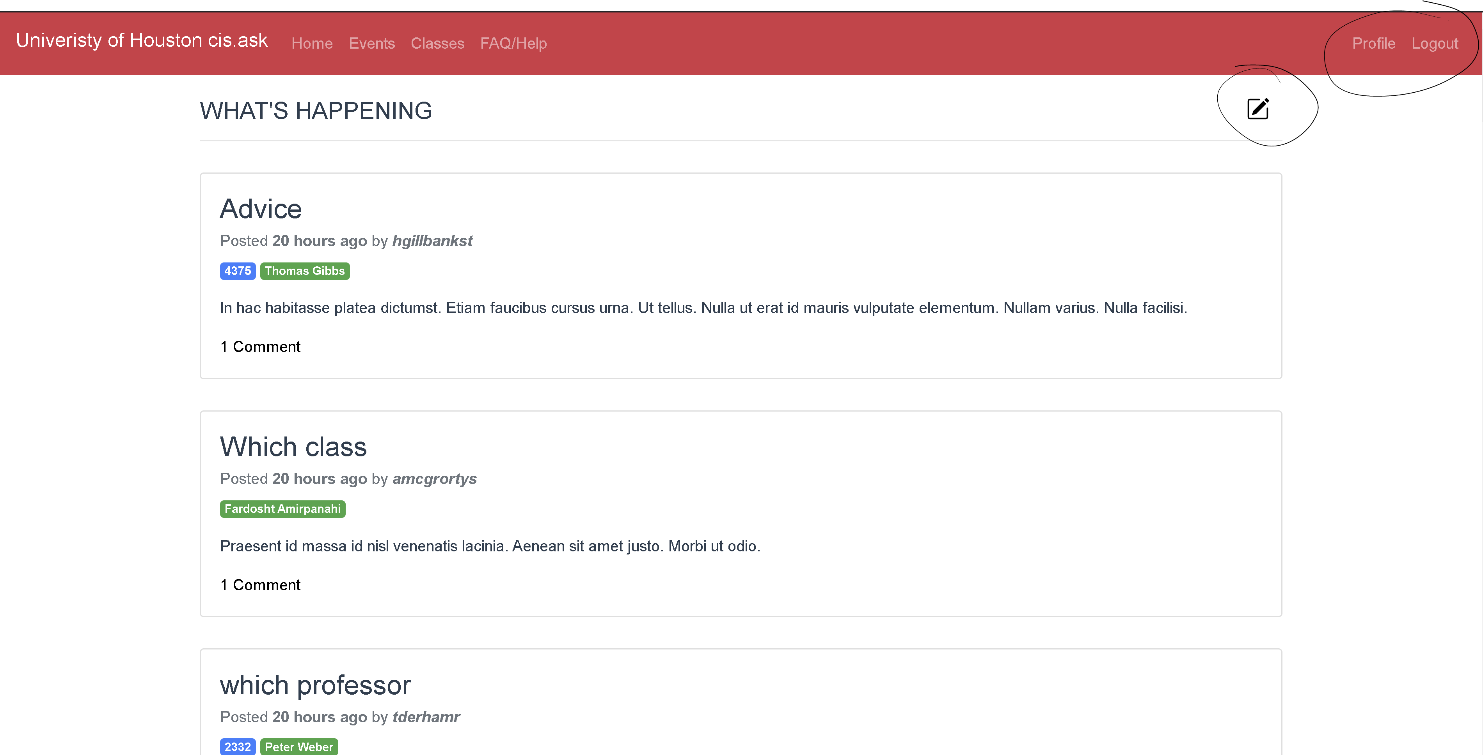
Home Page - logged in
New available features for logged in users:
Create a post
Write a comment on a post
Visit profile page
Delete a post
Logout
Lets see how to create a post!
Click the circled icon to the right of “WHAT’S HAPPENING”

Slide 5
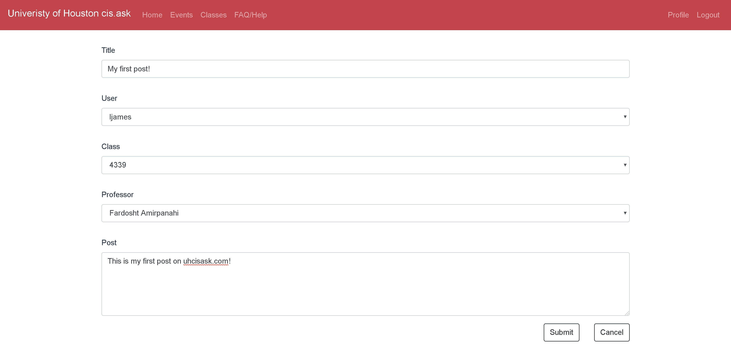
Creating a post
Fill out the form
Required fields will be shown if not filled out
Clicking anonymous user allows your username to be hidden on the post, but also wont show up on your profile page
Click Submit to publish your post
Click Cancel to discard your post and go to Home page

Slide 6
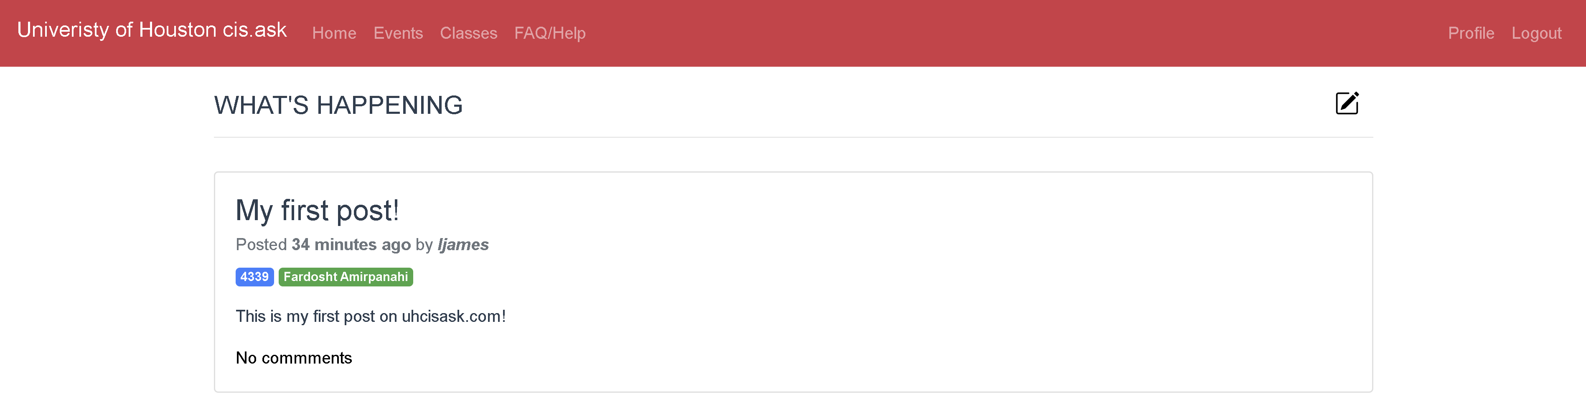
Your Post has been created!
Your post can now be seen by everyone on the home page!
Next, lets see how to write a comment on a post
Click anywhere inside the post you want to comment on

Slide 7
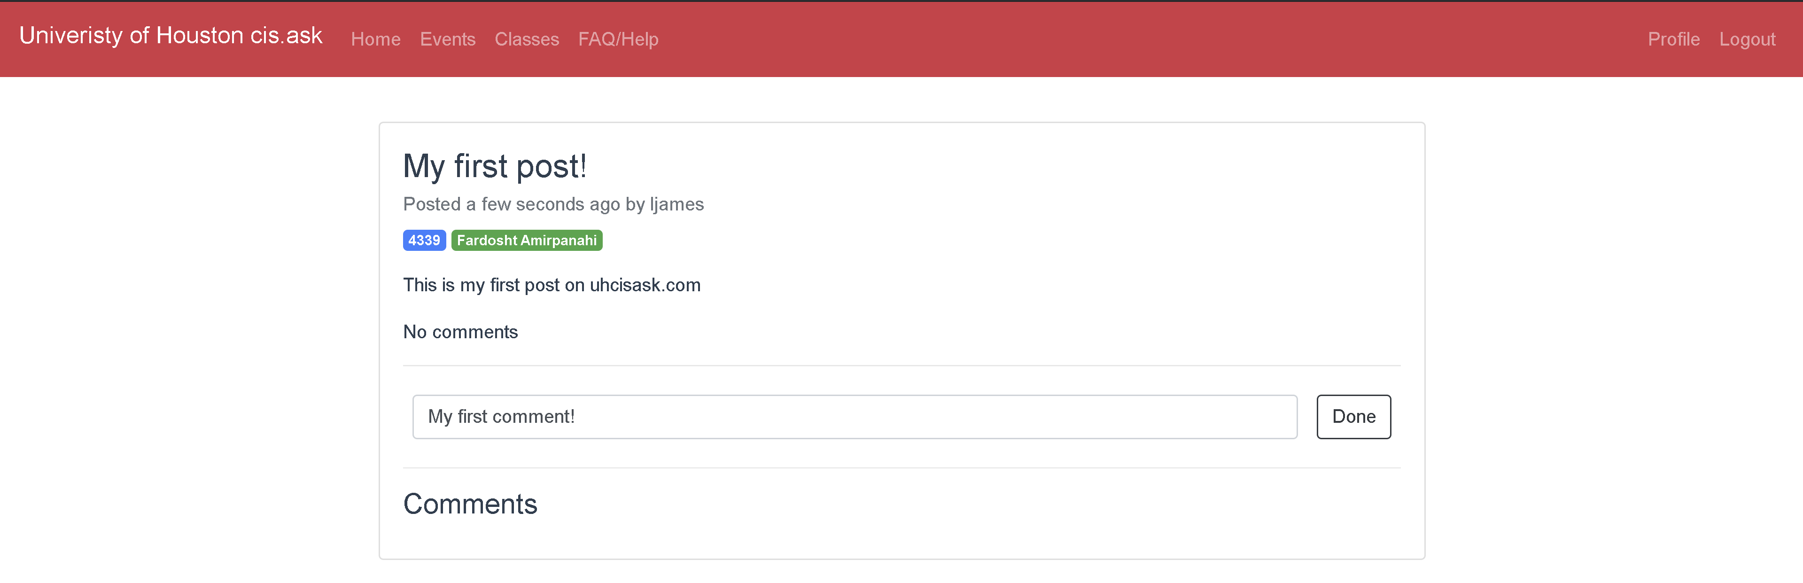
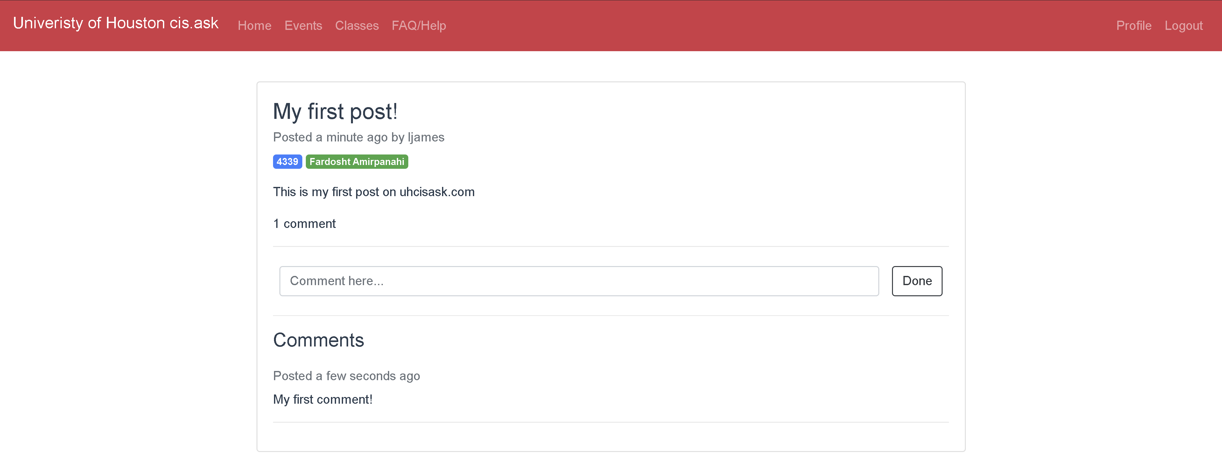
Comment on a post
Type your comment in the text box
Click done
Your new comment is now posted!
What if you decide you want to delete your post now?
Click on Profile

Slide 8
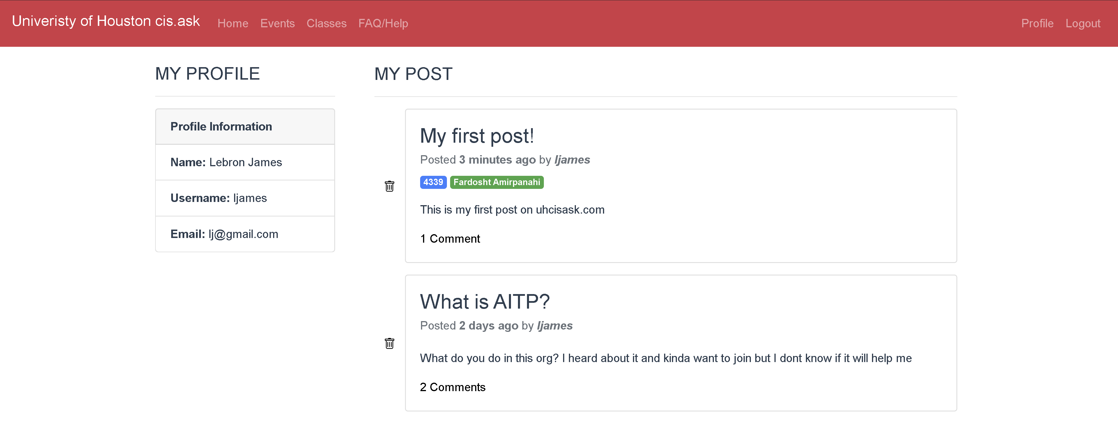
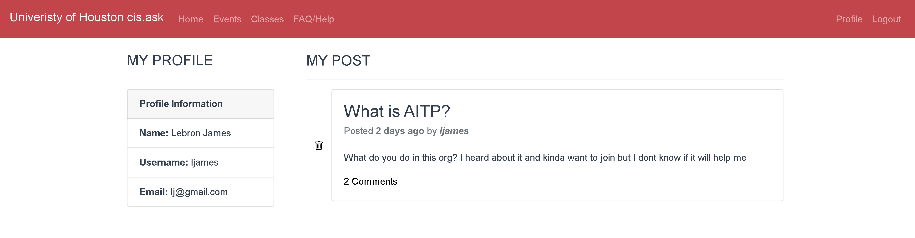
Delete a post
This page shows all of your post as well as your profile information
To delete a post Click the Trashcan Icon next to the post
This post will be gone forever, think before you click it!
Your post is not deleted!
Now lets take a look at the other pages on the site
Click Events

Slide 9
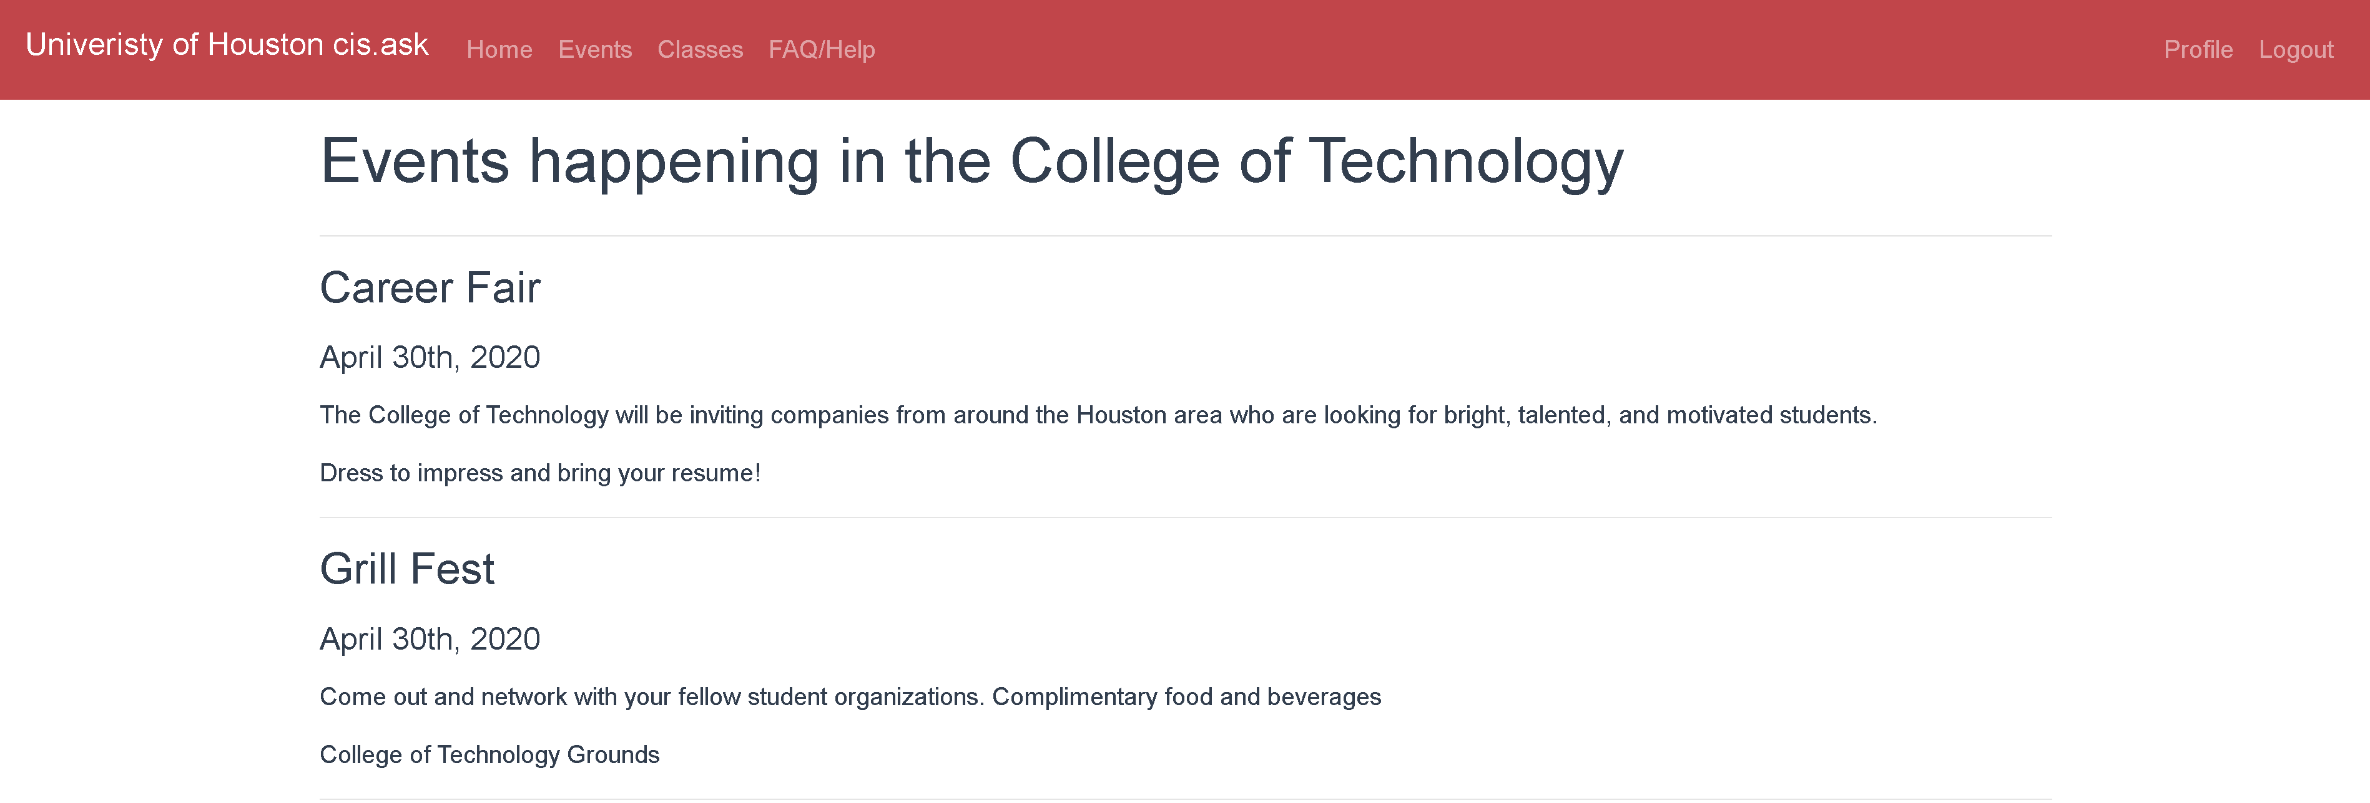
Events
Events Happening in the College of Technology
Next lets look at classes
Click Classes

Slide 10
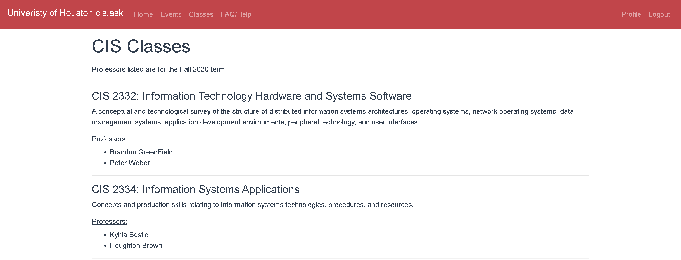
Classes
Core CIS classes
Professors for those class during Fall 2020
Next lets look at FAQ/Help
Click FAQ/Help

Slide 11
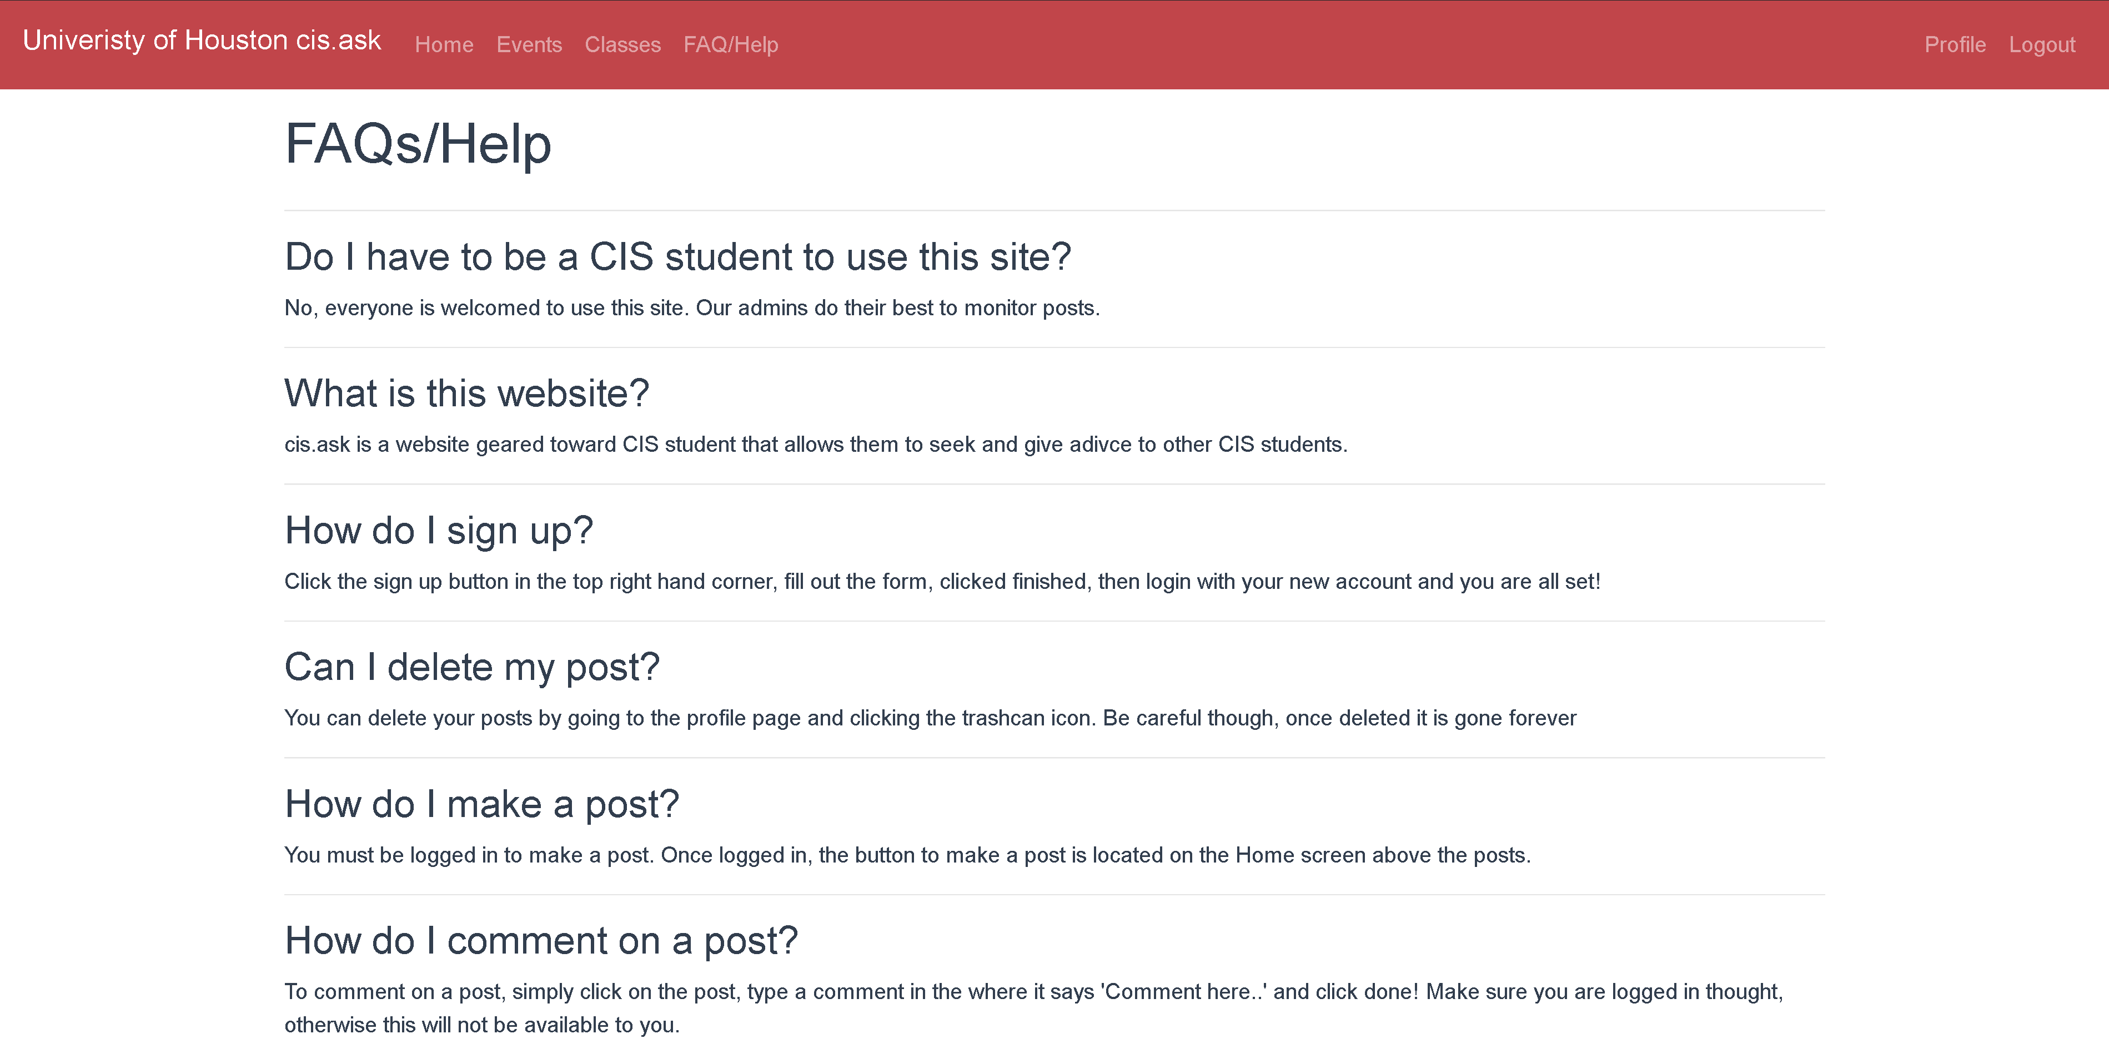
FAQ/Help
Frequently asked questions about the site
Link to the User Guide for extra help and guidance
Looks like we’ve gone through all the feature of the site, now we can logout
Click Logout

Slide 12

Hope you enjoy the site!

