Slide 1
Update 7/13/2016
JAMES DIAO

Slide 2
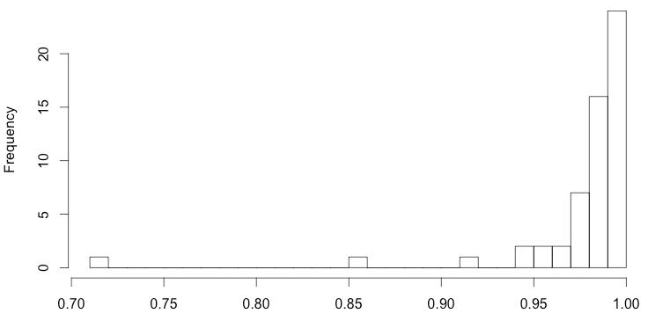
1000G-ExAC AF Correlations as Histogram

Slide 3
1000G: Selected Gene Region
Choosing tabix region:
Before: min(txstart) – max(txend)
Now: max(range
Note: different refGene IDs often have the exact same txstart/txend – I just pick the first one.
Question: which table do I add txstart/txend/refGene_ID columns to?

Slide 4
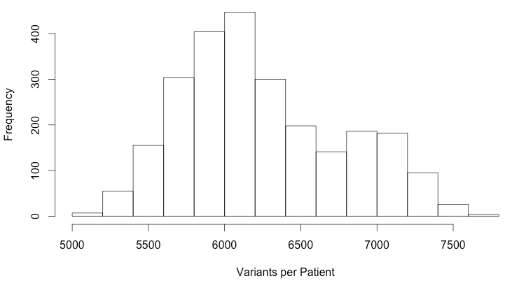
1000G ACMG Variants per Patient

Slide 5
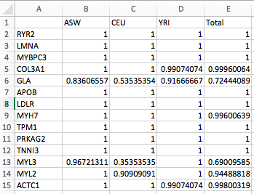
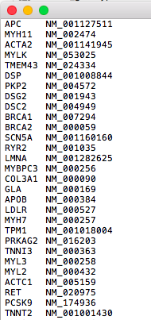
PopulationVariantStatus
RefGeneSources

Slide 6
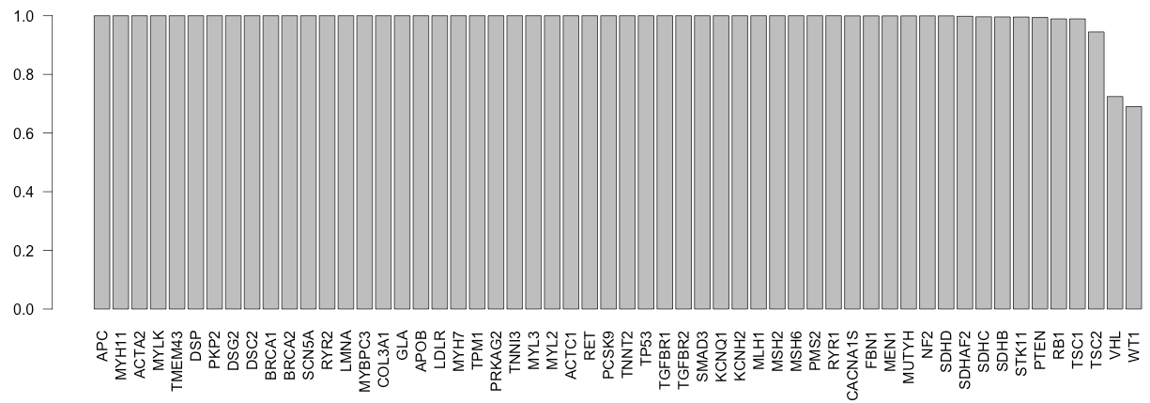
Fraction of individuals with a variant in each gene

Slide 7
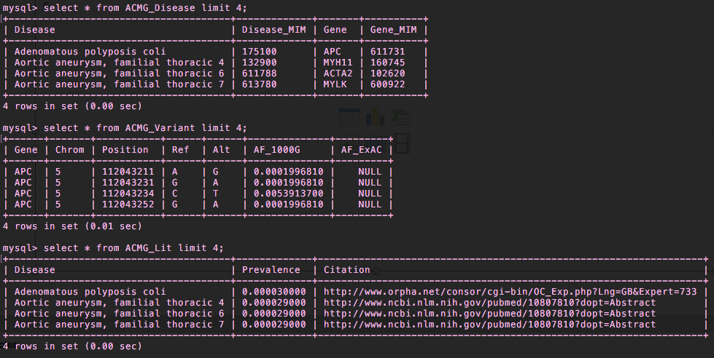
SQL Tables
ACMG_Disease
ACMG_Variant
ACMG_Lit

Slide 8
Collecting Prevalence Data
Disease | Inverse Prev 1 | Inverse Prev 2 | Inverse Prev Final | Citation
Dilated cardiomyopathy 1A | 14285 | \N | 14285 | www.ncbi.nlm.nih.gov/pubmed/9049523
Fabry's disease | 10000 | \N | 10000 | https://ojrd.biomedcentral.com/articles/10.1186/1750-1172-5-30
Li-Fraumeni syndrome 1 | 5000 | 20000 | 10000 | http://www.ncbi.nlm.nih.gov/books/NBK1311/

Slide 9
Questions about ACMG_Lit Prevalence
Point estimate of prevalence from multiple reports (e.g. 1:5,000 and 1:100,000)
Arithmetic mean seems like it would overestimate.
Geometric mean might work pretty well (~22,360) (bounded; effectively averaging some log function)
Alternatively, reported a range for now.
Citations
URL or MLA/APA…?
Original study, or overview sites?
Studies may be old, geographically limited
Potential additional mentions: country, date, population, birth/anesthesia, “likely underestimate”

