Slide 1
Update 7/12
James Diao

Slide 2
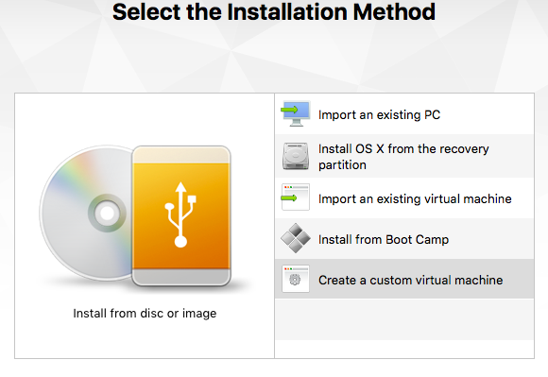
Create a custom virtual machine?

Slide 3
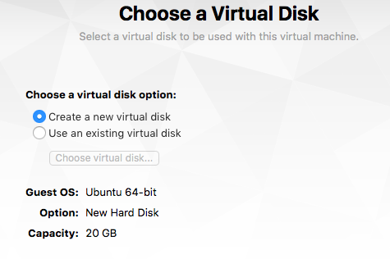
20 GB as default

Slide 4
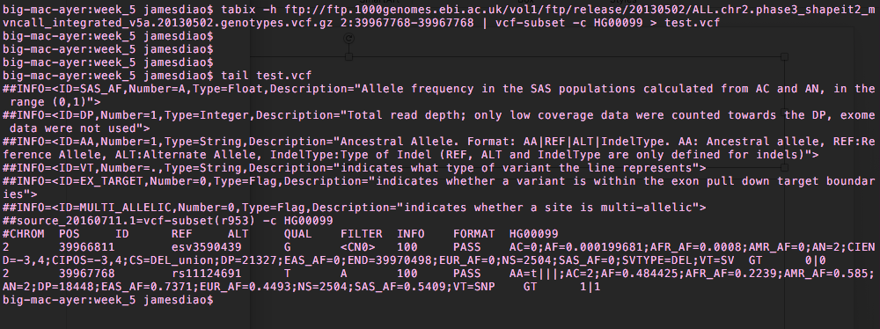
Tabix is working great

Slide 5
Download R

