Slide 1
HST Summer 2016
James Diao | Raj Manrai | 7/25/2016

Slide 2
ACMG Incidentalome App
User inputs list of genes:
Option 1: manual entry
Option 2: upload RData file from previous run
Option 3: scrape ACMG genes from ClinVar website or HCM panel from LMM
App downloads VCF files from 1000 genomes and generates plots:
Number of variants by population and by gene length.
Fraction of population with some variant.
Options for downloading plots and Rdata
Notifies user of failed downloads and omits these genes from analysis

Slide 3
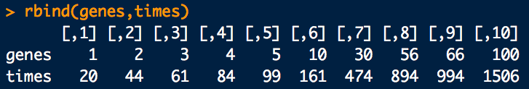
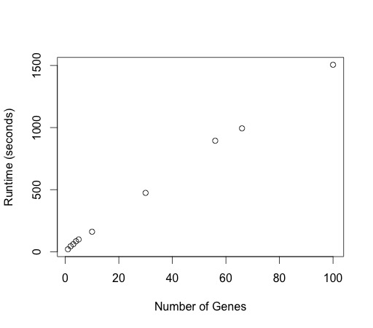
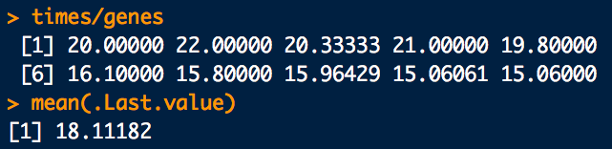
ACMG App Runtime
Runtime: 15-22 seconds per gene
1. Depends on gene length.
2. 100 random genes in 25 minutes.
3. Plot generation takes <1 sec / gene with Rdata upload.

Slide 4

ACMG Incidentalome
Raj and I are interested in the value of current pathogenicity ratings in ClinVar for the ACMG genes (actionable in genetic testing situations).
Penetrance = $P\left(D | V\right)=\frac{P\left(D\right)∗P(V|D)}{P\left(V\right)}$= $\frac{prevalence ∗ P(V|D)}{allele . frequency}$
We need: (1) prevalence, (2) allele frequency, and (3) allelic heterogeneity = P(V|D)

Slide 5
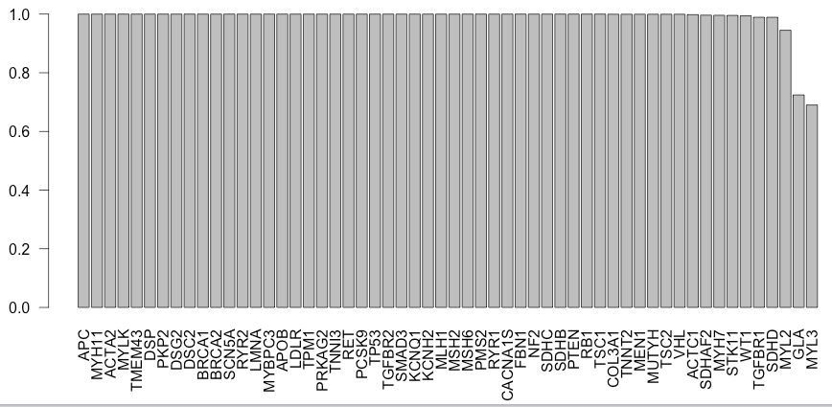
PopulationVariantStatus
Notes:
1000G

Slide 6
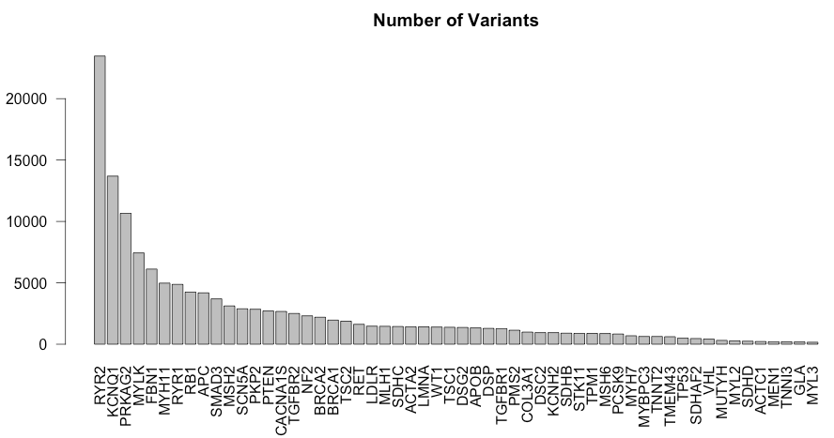
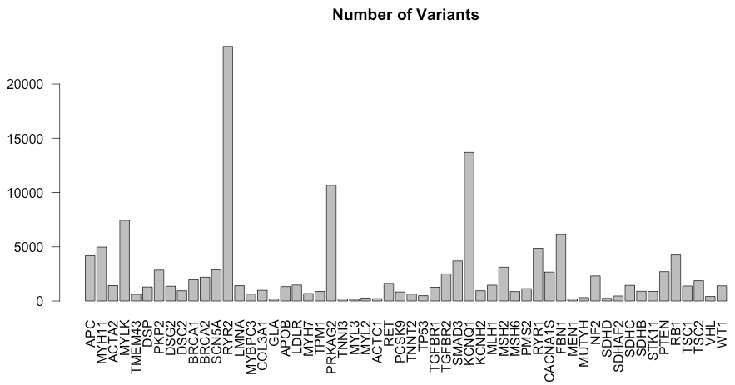
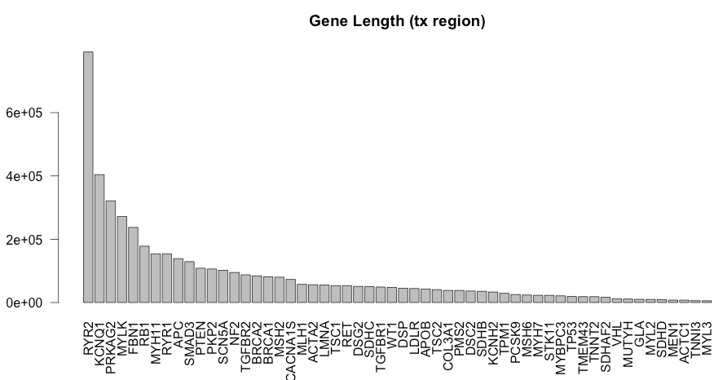
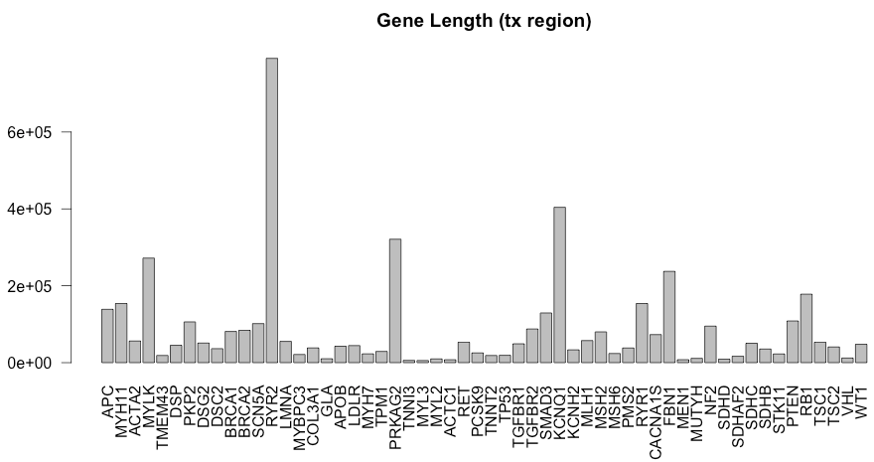


Slide 7
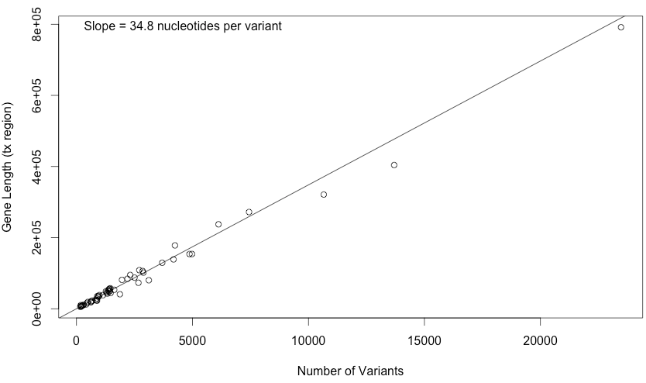
Around 35 nucleotides per variant

Slide 8
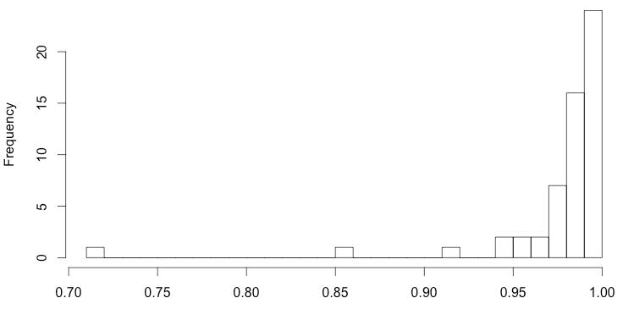
allele frequencies from 1000G and ExAC are highly correlated

Slide 9
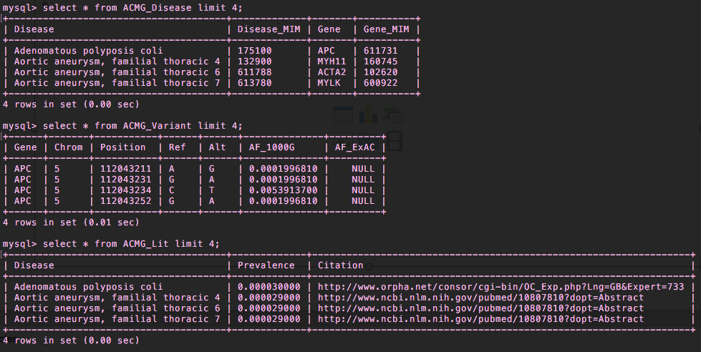
SQL Tables
ACMG_Disease
ACMG_Variant
ACMG_Lit

Slide 10
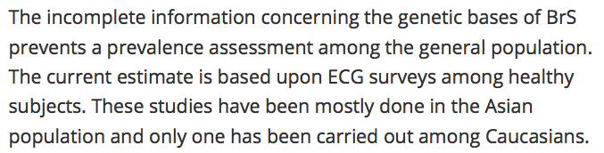
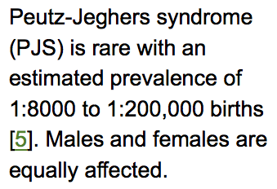
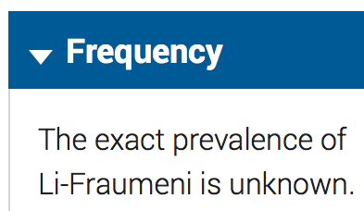
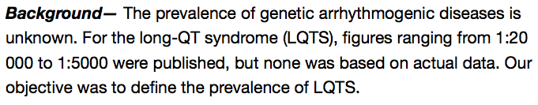

Estimates of Prevalence are Uncertain and Highly Variable

Slide 11
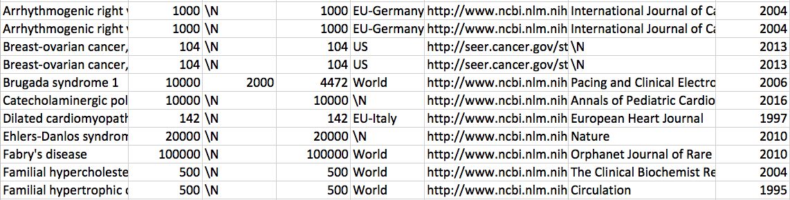
We try anyway

Slide 12
Combining 1000 genomes with Exac + esp + ClinVar

