Slide 1

Frequency of ACMG-56 Variants in Ancestrally Diverse Populations
James Diao | Raj Manrai | Kohane Lab | 7/29/2016

Slide 2
Background
ACMG: Issues policy statements laboratory/clinical guidelines for best practices in genomic medicine.
Incidental finding: Results of a search for pathogenic alternations in genes that are not apparently relevant to a diagnostic indication for which the sequencing test was ordered.
ACMG-56: According to ACMG recommendations, the set 56 genes in which pathogenic variants should be reported even when discovered incidentally.

Slide 3
Datasets
ClinVar: interpretations of clinically relevant variants (Benign, Likely Benign, VUS, Likely Pathogenic, Pathogenic)
1000 Genomes: genotype data (healthy cohort).
ExAC: population-level data (disease status contended).

Slide 4
Why is genomics concerned with ancestry?
Misclassification of variants occurs disproportionately in Black/African-American individuals.
Increasing recognition of ancestry effects on variants and associated disease states.
Newly available “control” data sets of from diverse populations allow for quantitative evaluation.

Slide 5
1000 Genomes Populations Analysis

Slide 6
1000 Genomes Populations Analysis
Our goal was to evaluate how variants are distributed in a healthy, diverse cohort.
We developed a workflow for visualizing how variants from specific sets of genes differ between populations.

Slide 7
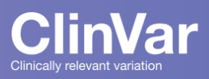



Workflow
Manual Input
Scrape ClinVar (ACMG-56)
File Upload (.txt, .Rdata)
Scrape LMM (Panel Test)
Gene Inputs
Download 1000 Genomes Phase 3 Populations Map
Retrieve Transcription Coordinates from UCSC Genome Browser
Download and Process VCF files from 1000 genomes
Plot 1: Mean number of non-reference sites by population
Plot 2: Number of reference sites per nucleotide by gene
Plot 3: Fraction with at least 1 non-reference site by population

Slide 8
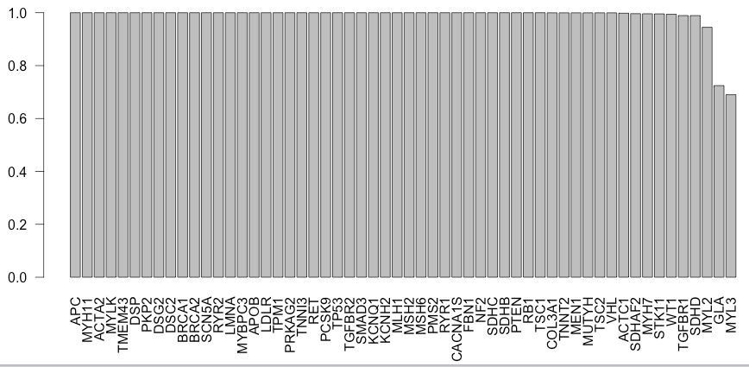
Pretty much all 1000G patients have some variants in each ACMG genes
Exceptions: the shortest genes
Doesn’t differentiate benign v. pathogenic

Slide 9
Joining individual-level data from diverse populations (1000 genomes) with pathogenicity data (ClinVar)

Slide 10
Joining Pathogenic Clinvar Variants with 1000G
140,000 variants in ACMG-56
Take only pathogenic variants in ClinVar
137 pathogenic variants in ACMG-56

Slide 11
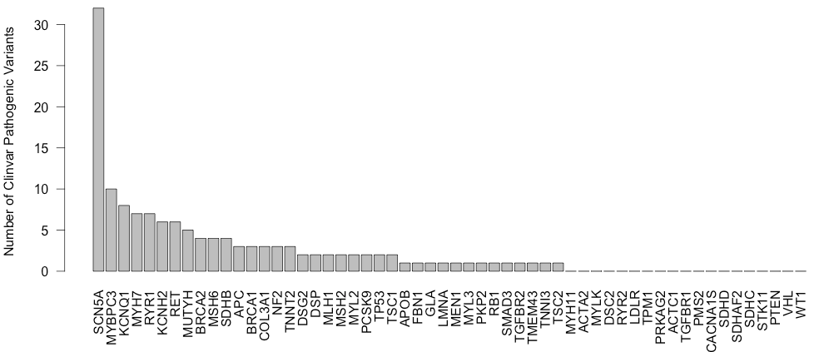

Pathogenic ACMG-56 Variants by Gene
137 Variants
19/56 ACMG genes are not associated with any pathogenic variants in 1000G.

Slide 12
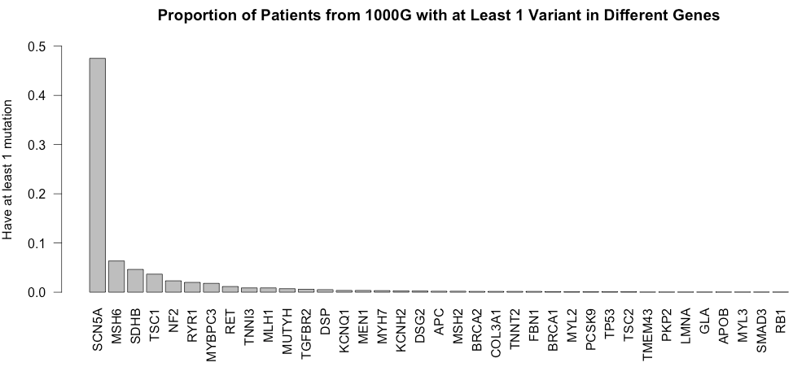
Proportion of individuals from 1000 genomes with at least 1 variant in each gene (an incidental finding!)
Closely follows previous plot: longer gene = more variants =
greater fraction of people with variants
Correlation = 0.908
SCN5A = 101,611 bp tx region
Notes:
For example: MYBPC3 is 1/50, but prevalence of HCM is 1/500. SCN5A mutations are in ½ of the population (?!?!)

Slide 13
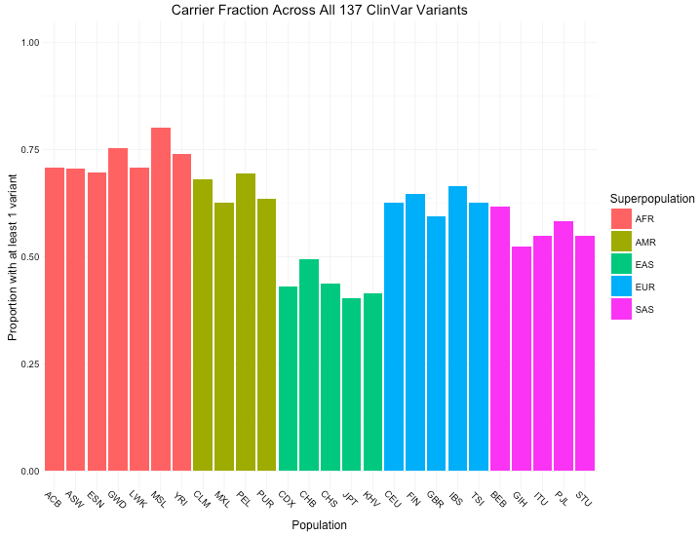
Proportion of individuals across 137 ClinVar-1000G variants with at least 1 pathogenic variant.
50-70% of people would be reported as having an incidental finding under ACMG guidelines.
AFR (African) groups seem to have the most pathogenic variants in ACMG-56, while
EAS (East Asian) groups have the least.
Notes:
Randomly select 56 genes 10 times
Carrier fraction in NOT SCN5A

Slide 14
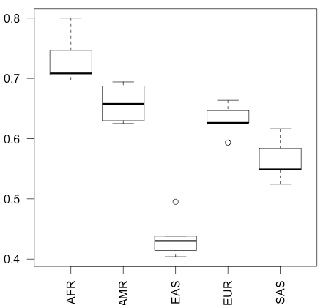
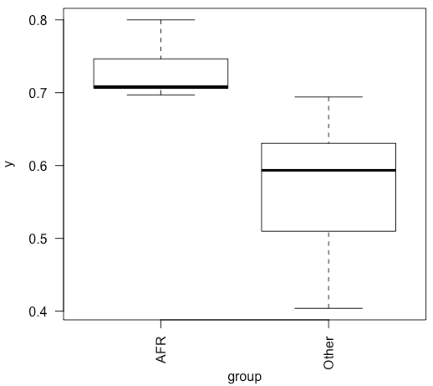
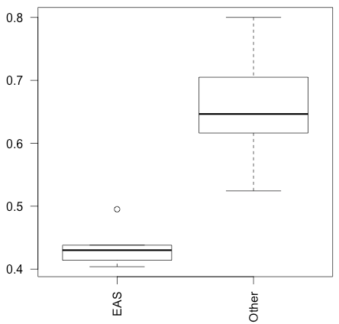
ANOVA for fraction of individuals with non-reference alleles
Between all groups: F-statistic = 58.4 P-value = 4.47 E-11
Between AFR and others: F-statistic = 19.6 P-value = 1.78 E-4
Between EAS and others: F-statistic = 42.4 P-value = 9.90 E-7
H₀ = All populations are drawn from the same distribution
For EUR/AMR/SAS:
0.30 < P-value < 0.60

Slide 15
Penetrance Sensitivity Analysis

Slide 16
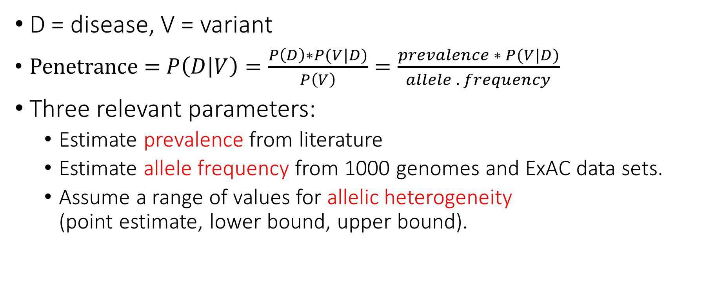
Penetrance Sensitivity Analysis
D = disease, V = variant
Penetrance = $P\left(D | V\right)=\frac{P\left(D\right)∗P(V|D)}{P\left(V\right)}=\frac{prevalence ∗ P(V|D)}{allele . frequency}$
Three relevant parameters:
Estimate prevalence from literature
Estimate allele frequency from 1000 genomes and ExAC data sets.
Assume a range of values for allelic heterogeneity (point estimate, lower bound, upper bound).

Slide 17
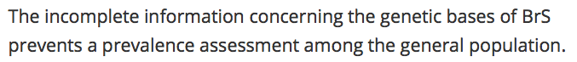
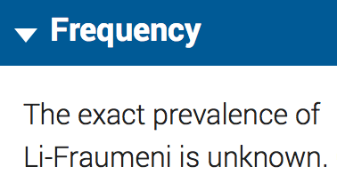
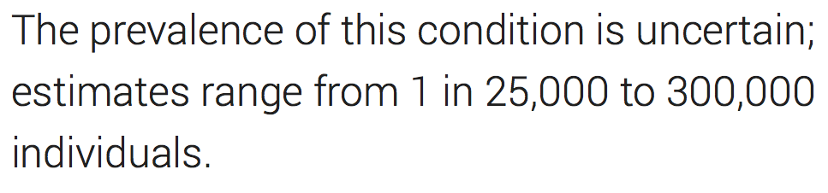
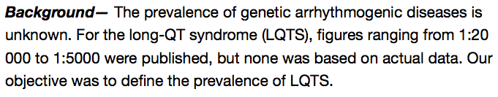
(1) Prevalence Estimates are Uncertain and Highly Variable
https://ojrd.biomedcentral.com/articles/10.1186/1750-1172-1-35
https://ghr.nlm.nih.gov/condition/peutz-jeghers-syndrome
https://ghr.nlm.nih.gov/condition/li-fraumeni-syndrome
http://www.ncbi.nlm.nih.gov/pubmed/19841298

Slide 18
Prevalence estimates found in the literature
Literature search heuristic:
Search “[Disease name] prevalence” on Google Scholar
Look through articles from most highly cited to less highly cited.
Recorded prevalence value (point or range), along with: region, URL, journal, year, sample size, author, population subset, date accessed, and potential issues.
Disease | Inverse Prevalence 1 | Inverse Prevalence 2 | Region | URL | Journal
Familial hypertrophic cardiomyopathy | 500 | \N | World | http://www.ncbi.nlm.nih.gov/pubmed/7641357 | Circulation
Familial medullary thyroid carcinoma | 14286 | \N | US | http://www.cancer.gov/types/thyroid/hp/thyroid-treatment-pdq | National Cancer Institute
Left ventricular noncompaction | 7143 | 385 | \N | http://www.omicsonline.org/open-access/left-ventricular-noncompaction-current-controversy-and-new-insights-2157-7412-6-255.php?aid=39346 | Journal of Genetic Syndromes & Gene Therapy
Li-Fraumeni syndrome | 5000 | 20000 | \N | http://www.ncbi.nlm.nih.gov/books/NBK1311/ | GeneReviews

Slide 19
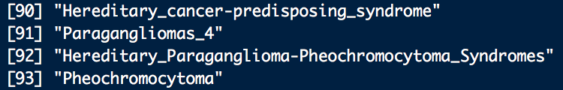
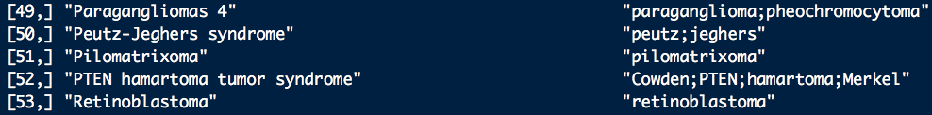
Allele Frequencies
Problem: Diverse set of names used to identify disease:
Solution: 1. Manually curate for unique disease tags (substrings + synonyms)
2. Use grep to match these patterns.
3. Pull out allele frequencies from all variants that match.

Slide 20
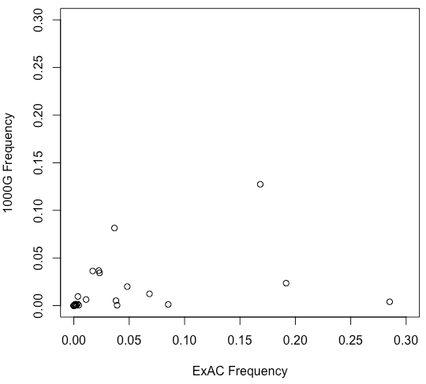
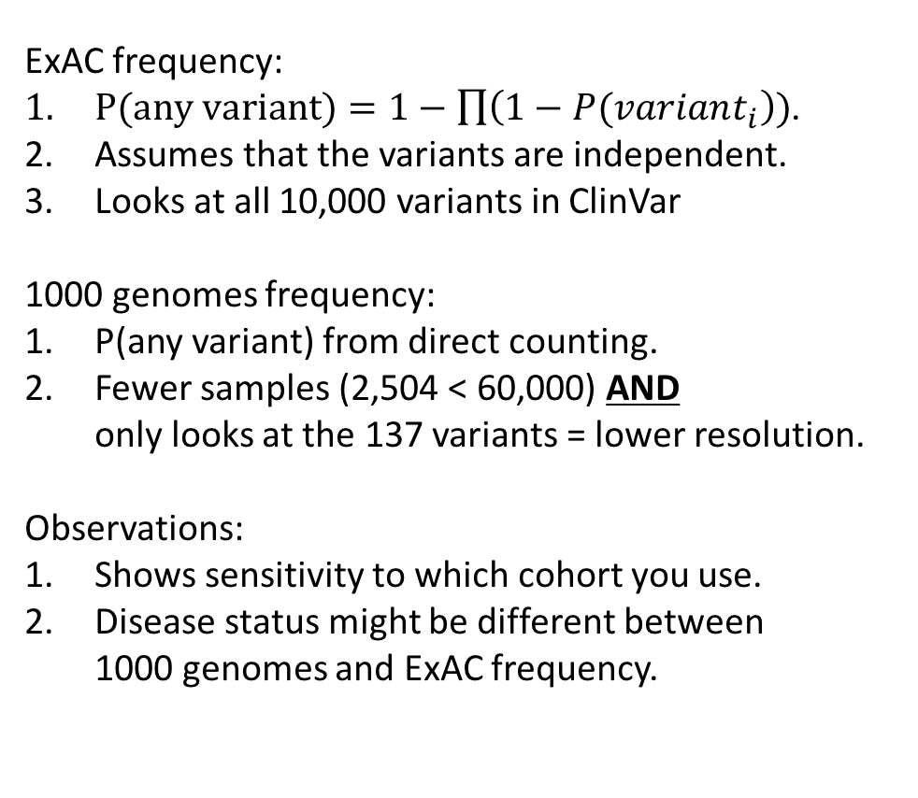
Allele Frequencies for each cohort by gene
ExAC frequency:
$P(any variant)=1−\prod{\left(1−P(variant_{i}\right))}$.
Assumes that the variants are independent.
Looks at all 10,000 variants in ClinVar
1000 genomes frequency:
P(any variant) from direct counting.
Fewer samples (2,504 < 60,000) AND only looks at the 137 variants = lower resolution.
Observations:
Shows sensitivity to which cohort you use.
Disease status might be different between 1000 genomes and ExAC frequency.
Notes:
Filter for 137 in ExAC

Slide 21
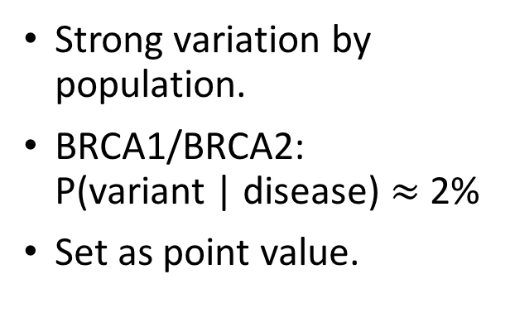
Allelic Heterogeneity
Strong variation by population.
BRCA1/BRCA2: P(variant | disease) $≈$ 2%
Set as point value.
 | BRCA1 | BRCA2
African-American | 1% | 3%
Ashkenazi Jewish | 9% | 1%
Asian-American | 1% | NA
Caucasian | 3% | 2%
Hispanic | 4% | NA
https://www.knowbrca.org/Provider/FNA/about-brca1-brca2-and-hereditary-breast-and-ovarian-cancers

Slide 22
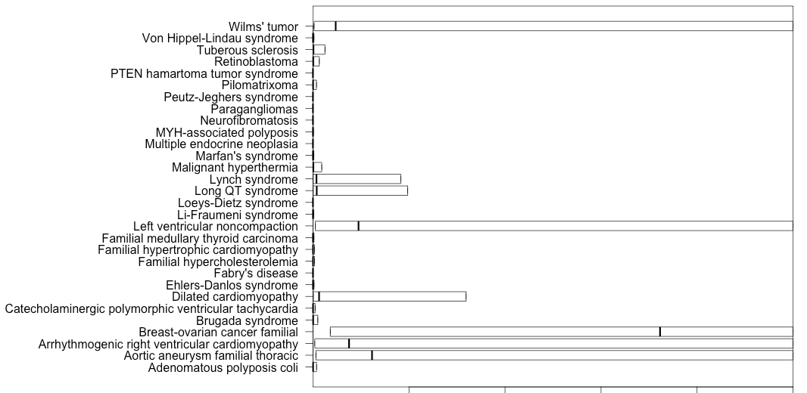
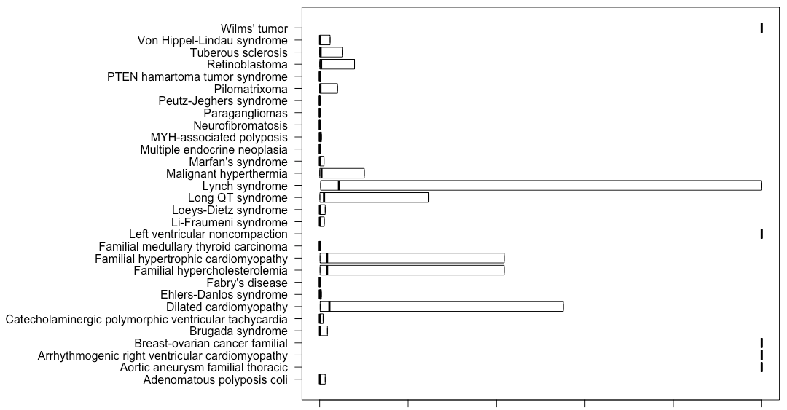
Penetrance as a function of allelic heterogeneity
ExAC
1000 genomes
0.0 0.2 0.4 0.6 0.8 1.0
0.0 0.2 0.4 0.6 0.8 1.0
Penetrance
Penetrance
Only 5/30 diseases have maximum theoretical penetrance > 50%
22/30 diseases have near 0 penetrance
Only 2/25 diseases have maximum theoretical penetrance > 50%
19/25 diseases have near 0 penetrance
Star: no variants observed = Inf penetrance
Notes:
Close to 0!!!
ONLY 2 where allele frequency was observed.
5 were not observed.
Penetrance as a function of allelic heterogeneity

Slide 23
Next steps
Demonstrating variation by prevalence ranges.
Establishing genome-wide background for penetrance-based test-statistics
Scaling up calculations in the cluster.

Slide 25
Extra Slides

Slide 26
Acknowledgements
Raj, for his mentorship and support throughout this project.
Susanne, Barbara, and Dominique, for making this whole summer experience possible.
DBMI: for taking us in, and for all the hot beverages.

Slide 27
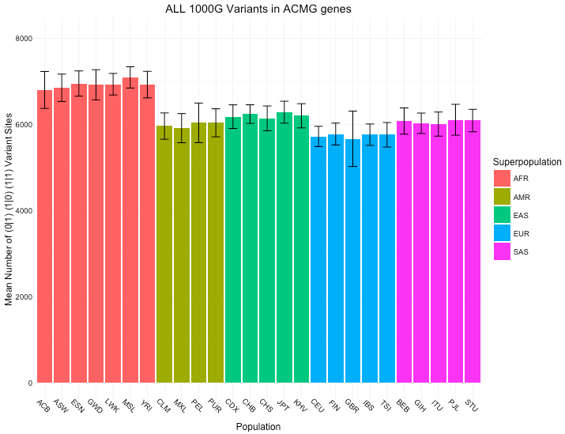
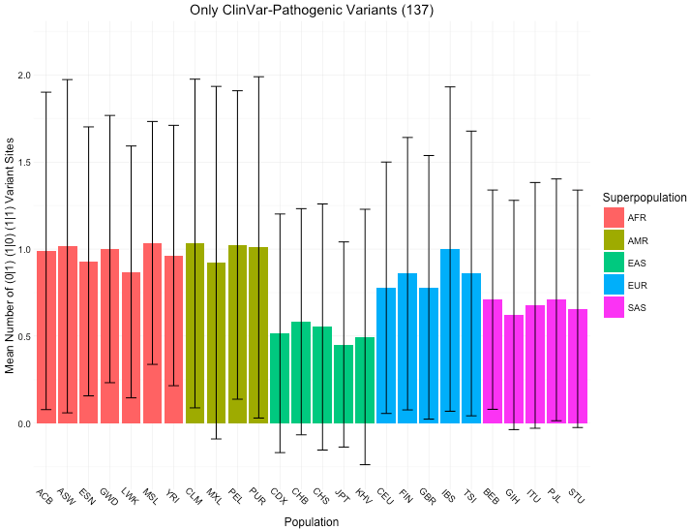
Mean variants across all 1000G variants vs. Mean variants across 137 ClinVar-1000G variants

