Slide 1
Frequency of ACMG 56 Variants in Ancestrally Diverse Populations
James Diao | Raj Manrai | 7/29/2016

Slide 2
Population Analysis Shiny App

Slide 3
1000 Genomes Population Analysis Shiny App
User inputs list of genes:
Option 1: manual entry
Option 2: upload RData file
Option 3: scrape genes listed in the ACMG recommendations for incidental findings from ClinVar website
Option 4: scrape HCM panel test genes from LMM website
App downloads VCF files from 1000 genomes and generates plots:
Number of variants by population and by gene length
Fraction of population with some variant
Notes:
Basically an overview of the app. I was planning to show it to him after this slide.

Slide 4
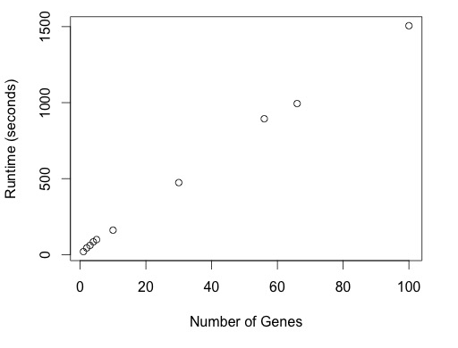
ACMG App Runtime
15-22 seconds per gene:
1. Depends on gene length.
2. Under 1 sec / gene with file upload.
Notes:
Briefly cover runtime.

Slide 5
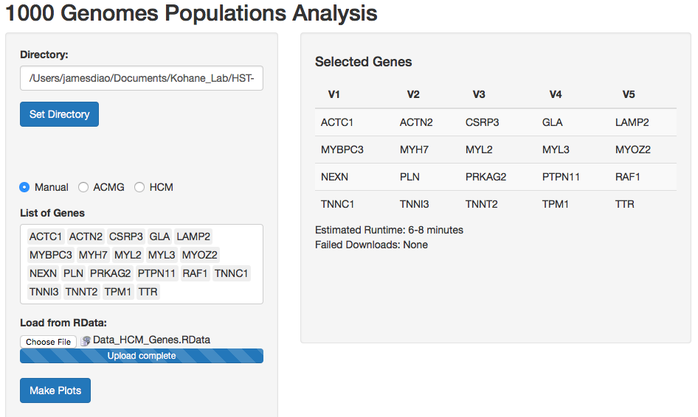
User Interface

Slide 6
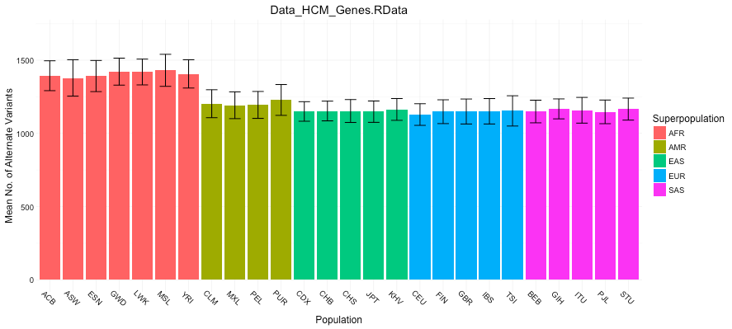
Output Plot 1:

Slide 7
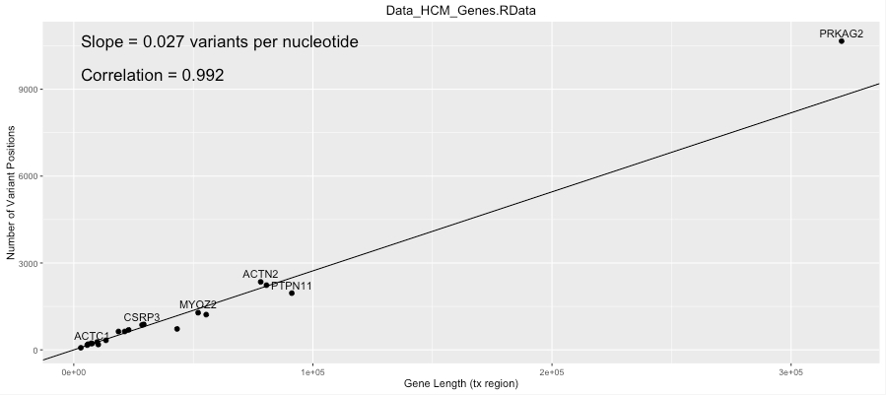
Output Plot 2:

Slide 8
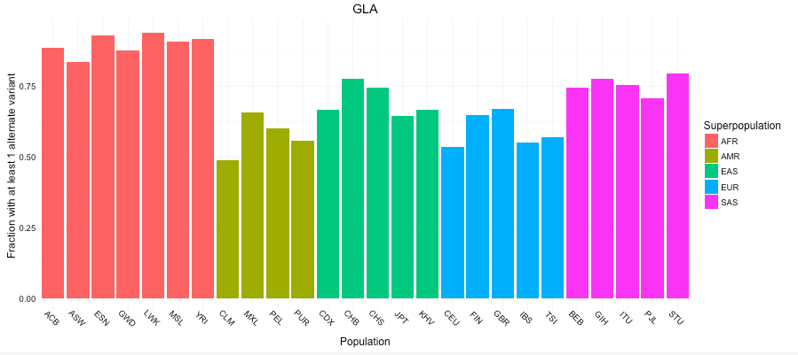
Output Plot 3:

Slide 9
Exploring the ACMG-recommended incidental report genes in 1000 genomes data

Slide 10
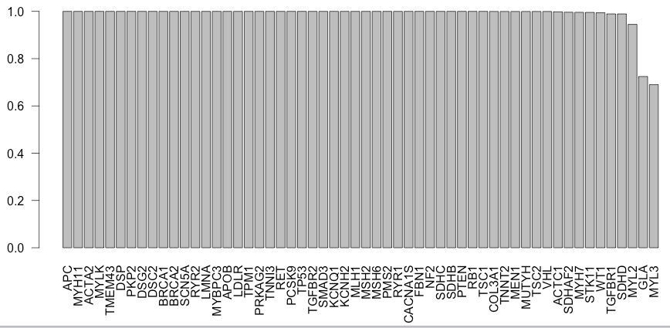
Pretty much all 1000G patients have some variants in each ACMG genes
Exceptions: the 2 shortest genes
Doesn’t differentiate benign v. pathogenic

Slide 11
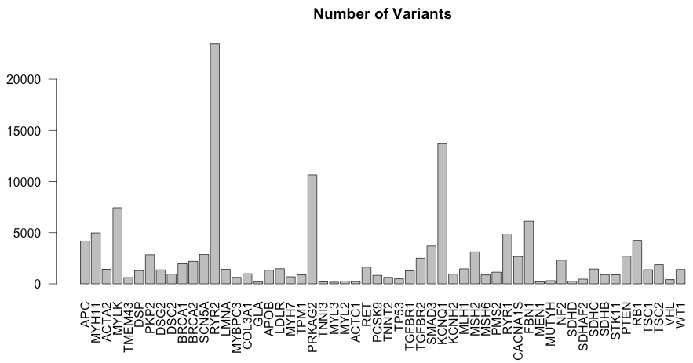
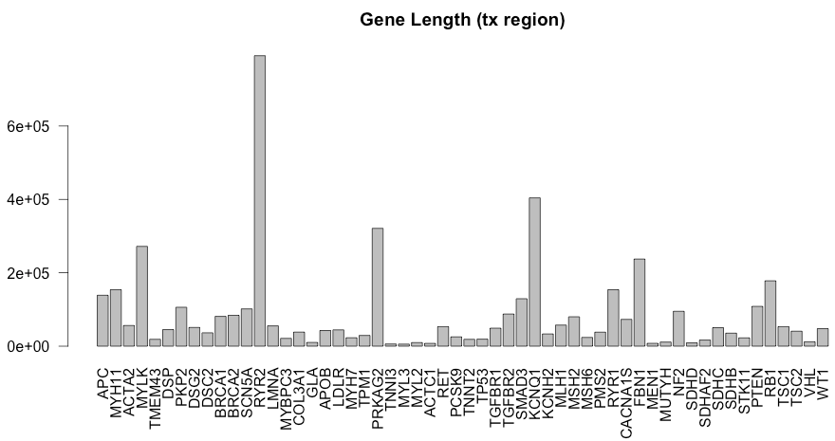

Gene Lengths $≈$ Number of variants
Correlation = 0.994

Slide 12
Combining individual-level data from 1000 genomes with pathogenicity data from ClinVar

Slide 13
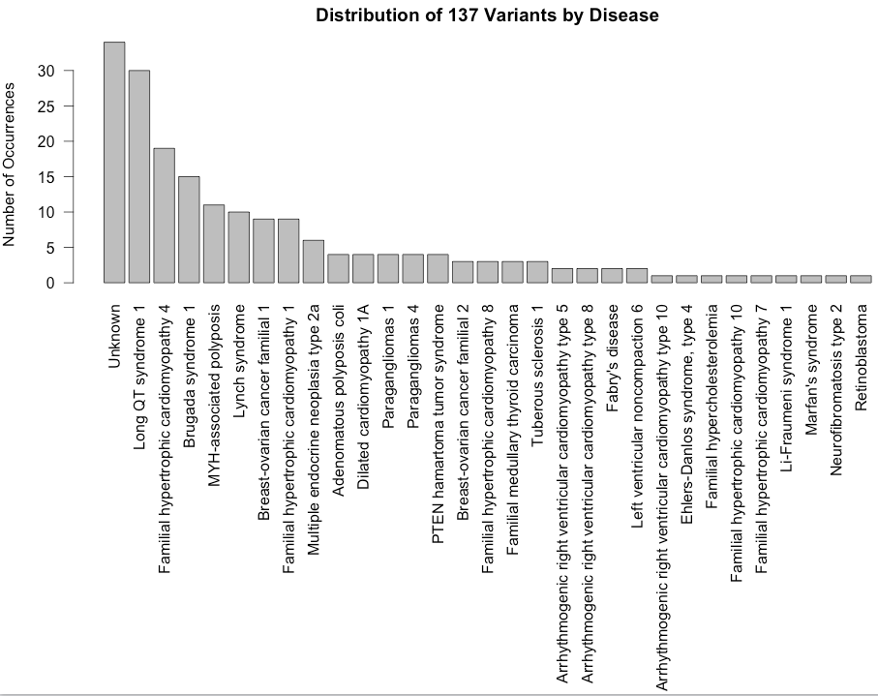
137 Pathogenic Clinvar Variants Distributed by Disease
All clinvar variants were associated with either one of the 56 ACMG-relevant genes, or labeled “Unknown.”
>80% of the variants were explicitly ACMG-relevant.

Slide 14
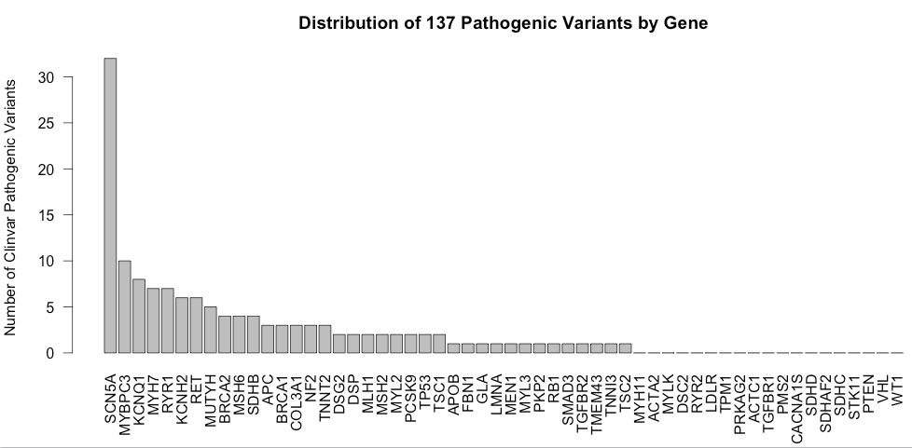
Joining Pathogenic Clinvar Variants with 1000G
1000 genomes: 139,388 unique variants
ClinVar: 10,286 NON-unique pathogenic variants (8,441 unique)
Intersection: 137 unique variants in both datasets, associated with 192 diseases
37/56 have at least 1 variant 19/56 are not associated with any pathogenic variants in 1000G.

Slide 15
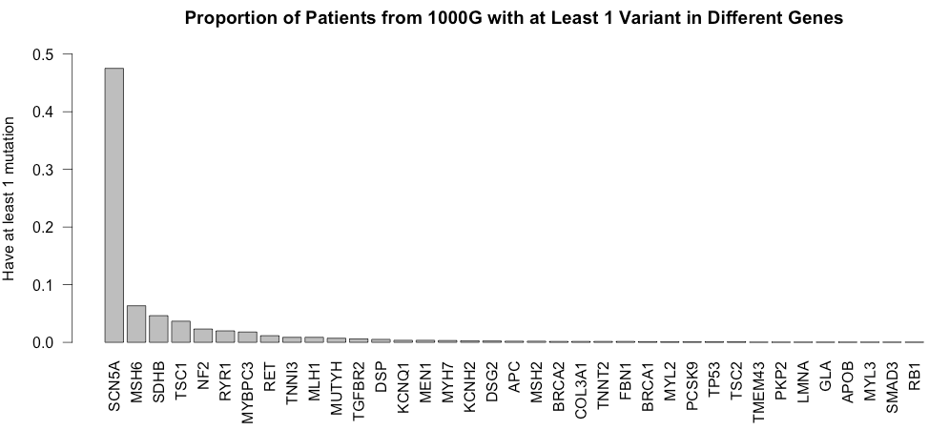
1000G individuals with mutations
Closely follows previous plot: longer gene = more variants =
greater fraction of people with variants
Correlation = 0.908
SCN5A = 101,611 bp tx region 12/56 in length.
SCN5A is a sodium voltage-gated channel- associated with long QT syndrome and Brugada syndrome.
Notes:
For example: MYBPC3 is 1/50, but prevalence of HCM is 1/500. SCN5A mutations are in ½ of the population (?!?!)

Slide 16
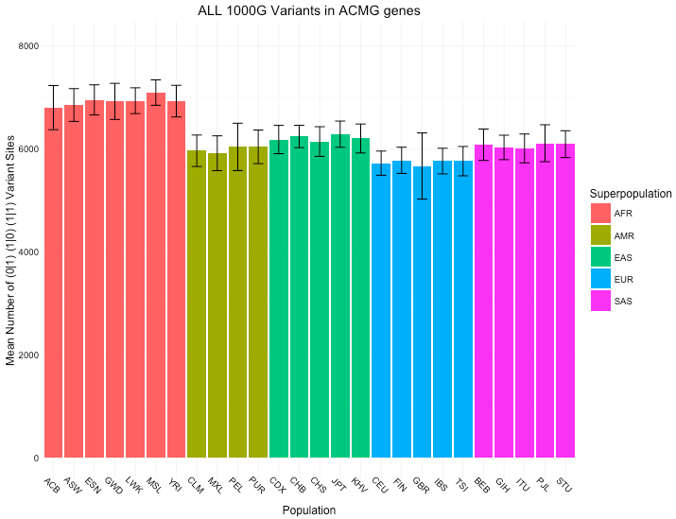
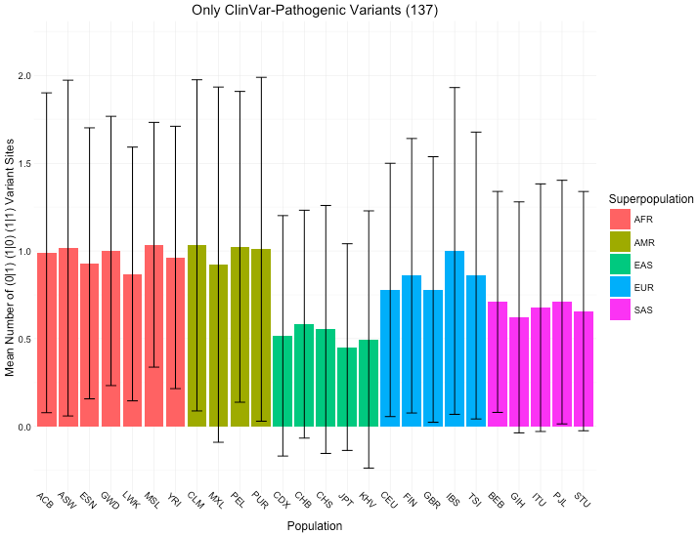
Mean variants across all 1000G variants vs. Mean variants across 137 ClinVar-1000G variants

Slide 17
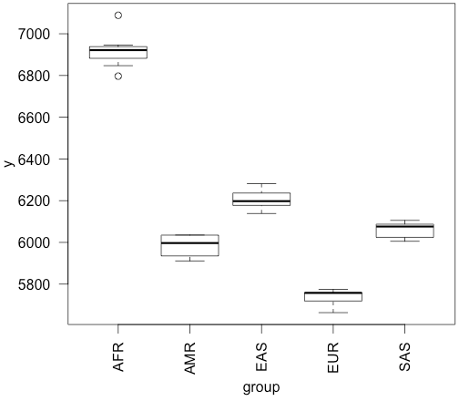
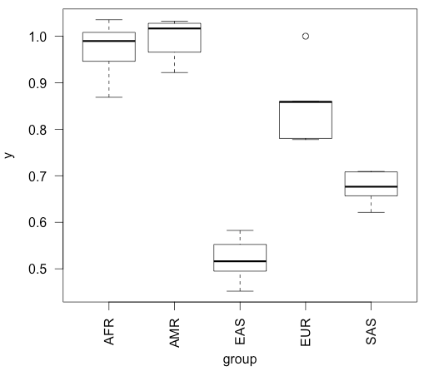
ANOVA Table: F-statistic comparing ALL groups to each other
All 1000G 138,000 variants results:
F-value = 294.88 P(>F) = 2.2 E-16
ClinVar-1000G 137 variant results:
F-value = 58.685 P(>F) = 4.25 E-11
F-statistic + p-values: H0 = all groups drawn from same distribution

Slide 18
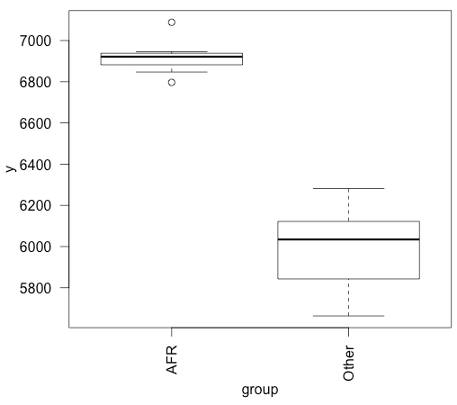
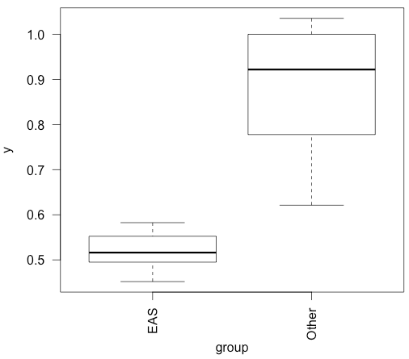
ANOVA Table: F-statistic comparing 1 group to all other groups
All 1000G 138,000 variants results:
Diff group = “AFR”
F-value = 156.22 P(>F) = 5.35 E-12
ClinVar-1000G 137 variant results:
Diff group = “EAS”
F-value = 30.869 P(>F) = 1.025 E-5

Slide 19
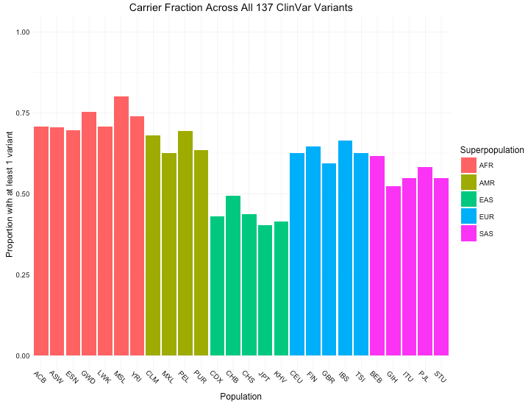
Carrier fraction across 137 ClinVar-1000G variants
50-70% of people would be reported as having some disorder under ACMG guidelines.
These are also potential additions to the app.
Notes:
Randomly select 56 genes 10 times

Slide 20
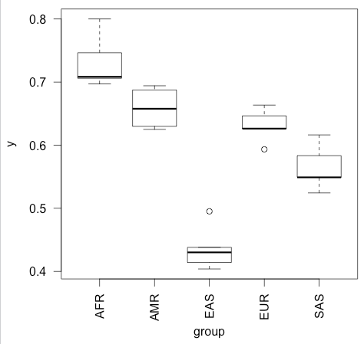
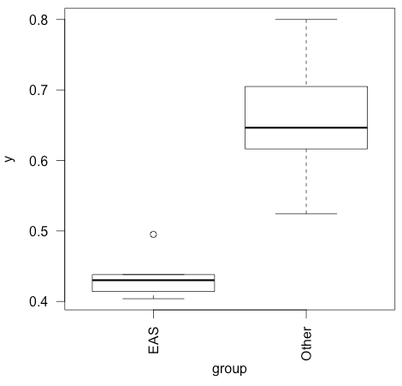
ClinVar-1000G Fraction Carriers: between each group
F-value = 58.377 P(>F) = 4.47 E-11
ClinVar-1000G Fraction Carriers: between “EAS” and other groups
Diff group = “EAS”
F-value = 42.359 P(>F) = 9.90 E-7

Slide 21
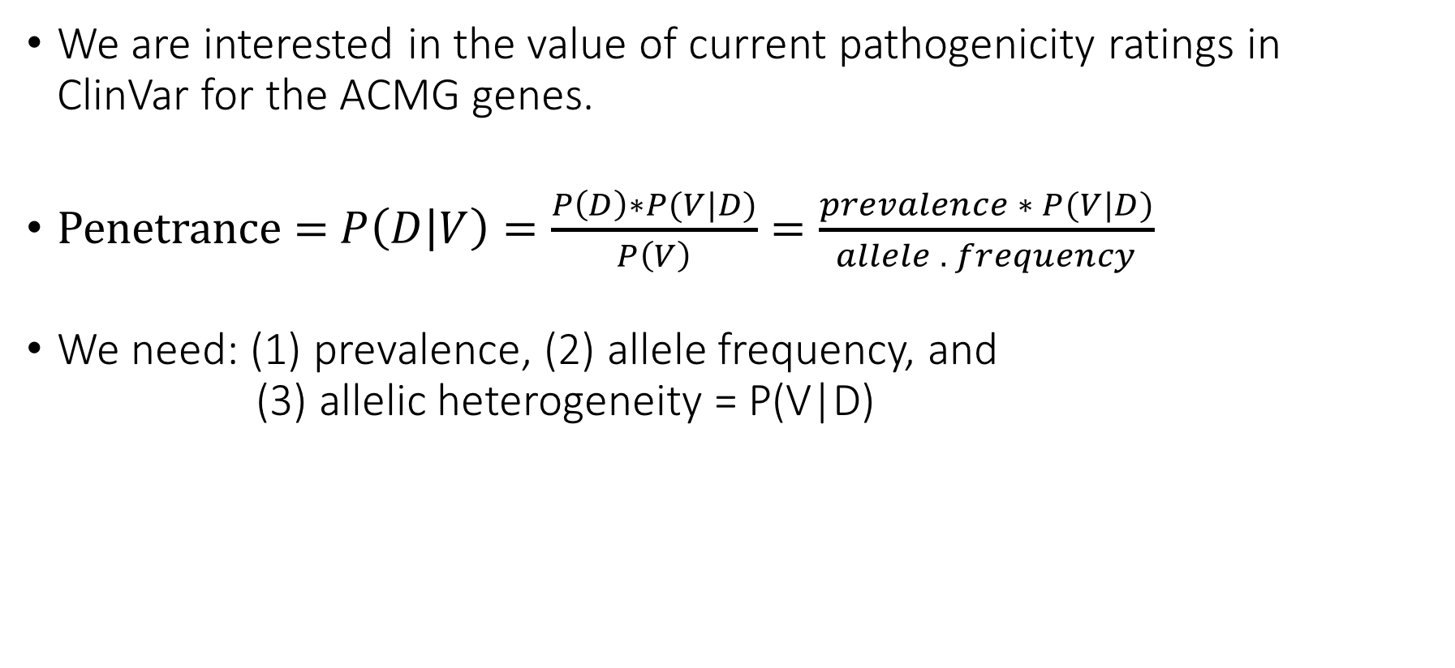
ACMG Incidentalome
We are interested in the value of current pathogenicity ratings in ClinVar for the ACMG genes.
Penetrance = $P\left(D | V\right)=\frac{P\left(D\right)∗P(V|D)}{P\left(V\right)}=\frac{prevalence ∗ P(V|D)}{allele . frequency}$
We need: (1) prevalence, (2) allele frequency, and (3) allelic heterogeneity = P(V|D)

Slide 22
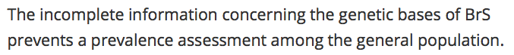
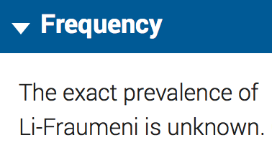
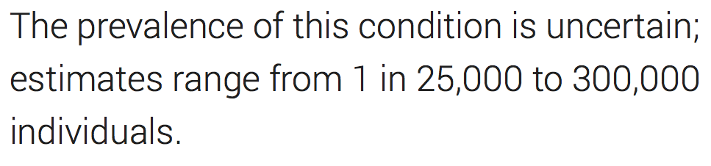
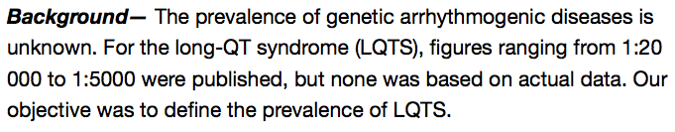
(1) Prevalence Estimates are Uncertain and Highly Variable
https://ojrd.biomedcentral.com/articles/10.1186/1750-1172-1-35
https://ghr.nlm.nih.gov/condition/peutz-jeghers-syndrome
https://ghr.nlm.nih.gov/condition/li-fraumeni-syndrome
http://www.ncbi.nlm.nih.gov/pubmed/19841298
Notes:
Use URLS

Slide 23
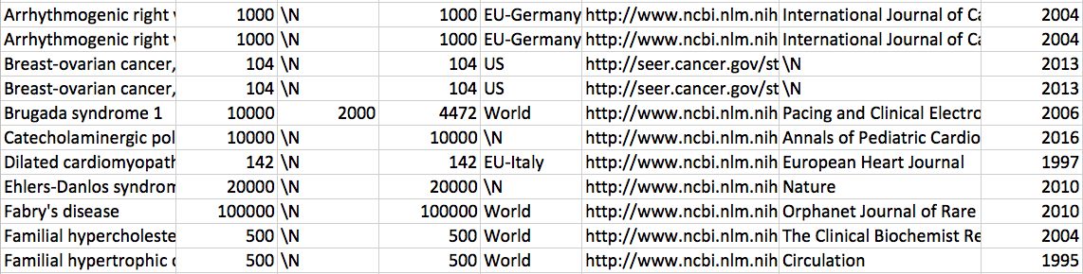
Prevalence estimates found on Pubmed/Google Scholar
Notes:
Describe search heuristic

Slide 24
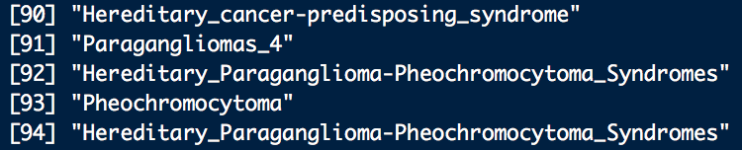
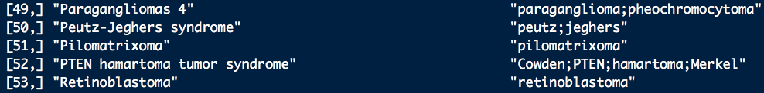
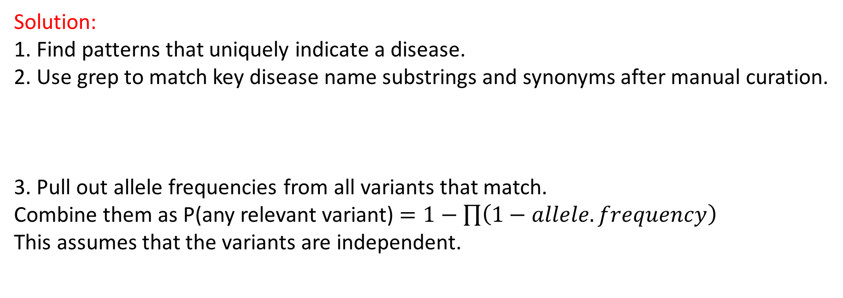
(2) Allele Frequencies
Problem: Diverse set of names used to identify disease:
Solution: 1. Find patterns that uniquely indicate a disease.
2. Use grep to match key disease name substrings and synonyms after manual curation.
3. Pull out allele frequencies from all variants that match. Combine them as P(any relevant variant) $=1−\prod{\left(1−allele.frequency\right)}$ This assumes that the variants are independent.

Slide 25
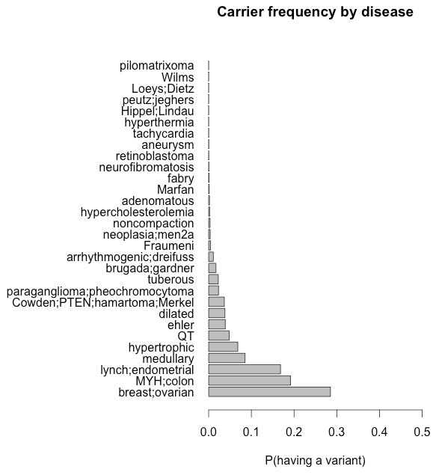
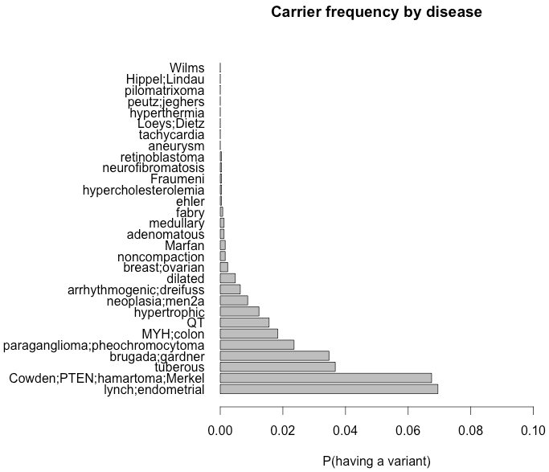
(2) Allele Frequencies: ExAC (left), 1000G (right)
Correlation: 0.316
Breast/ovarian cancer: 30%
MYH-polyposis: 20%
Lynch syndrome: 17%
Medullary thyroid cancer: 9%
Hypertrophic cardiomyopathy: 7%
Every other: <5%
Lynch syndrome: 7%
PTEN hamartomas: 6.7%
Tuberous sclerosis: 3.5%
Brugada syndrome: 3.5%
Paragangliomas: 2.4%
Every other: <2%

Slide 26
(2) 1000G Allele Frequencies
Lynch syndrome: 7%
PTEN hamartomas: 6.7%
Tuberous sclerosis: 3.5%
Brugada syndrome: 3.5%
Paragangliomas: 2.4%
Every other: <2%

Slide 27
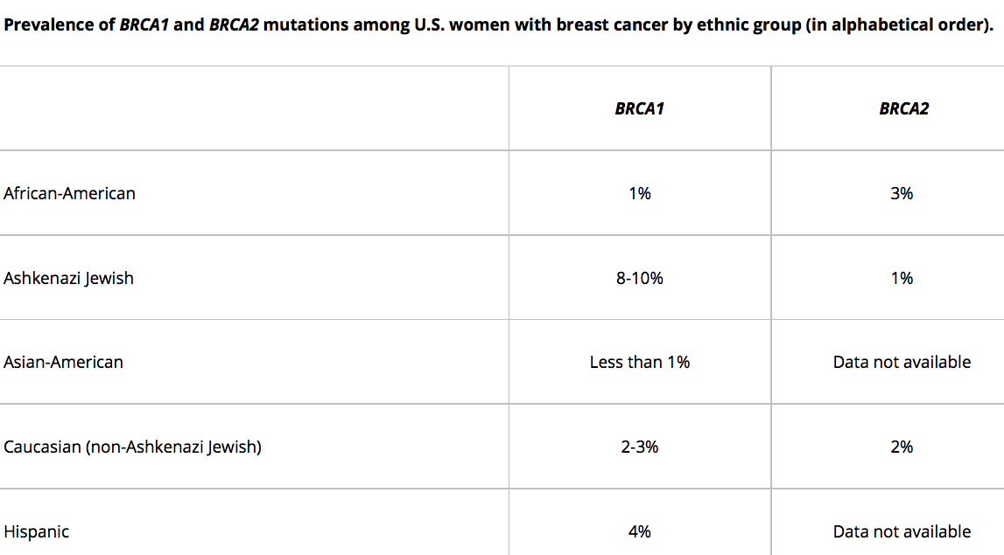
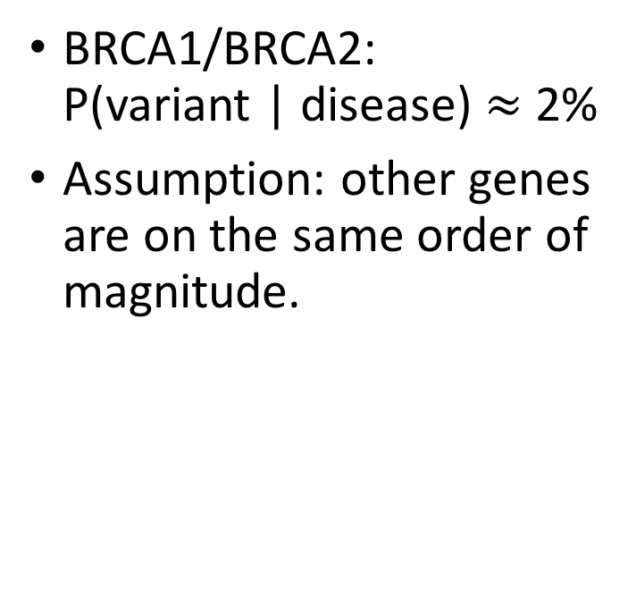
(3) Allelic Heterogeneity
BRCA1/BRCA2: P(variant | disease) $≈$ 2%
Assumption: other genes are on the same order of magnitude.

Slide 28
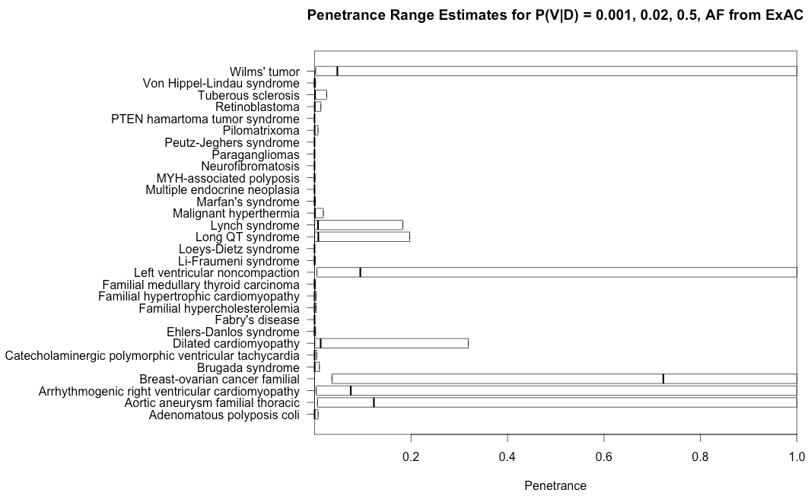
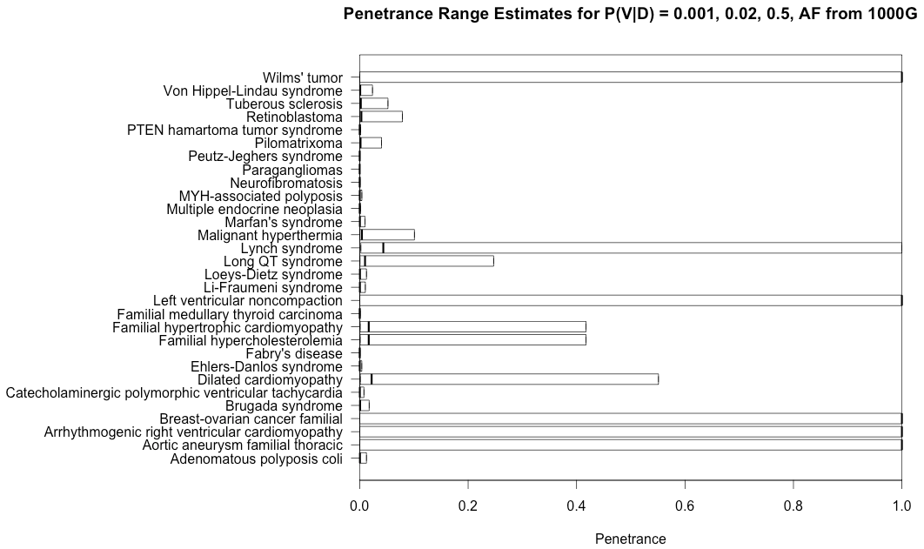
Rough Penetrance Estimates: ExAC
Penetrance estimates have a similar shape, but are increased because 1000G has fewer individuals.
Some values are Inf because no individuals in 1000G were found with those alleles.

