Slide 1
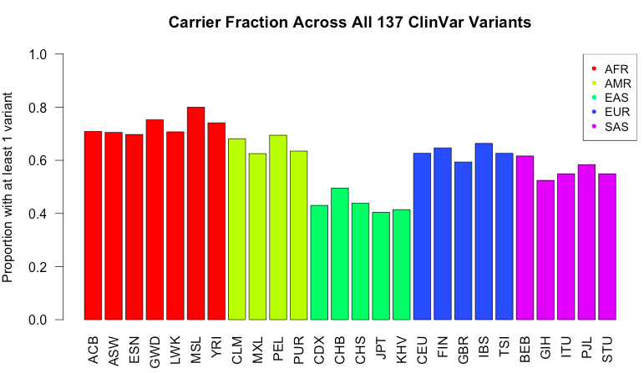
ORIGINAL SLIDE
50-70% of people would be reported as having some disorder under ACMG guidelines.
These are also potential additions to the app.
Notes:
Left: fraction of people in each population that carry at least 1 variant for all pathogenic ACMG genes.
Right: mean number of variants total.

Slide 2
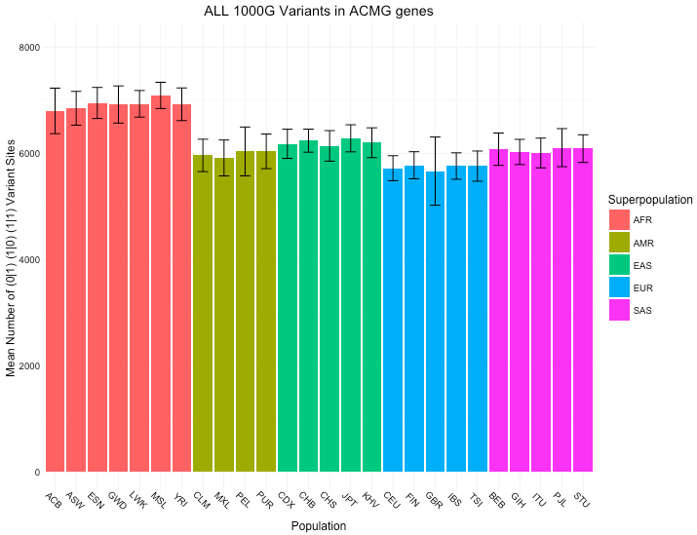
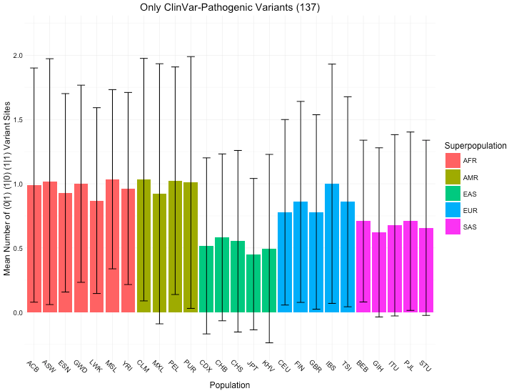
Mean variants across all 1000G variants vs. Mean variants across 137 ClinVar-1000G variants

Slide 3
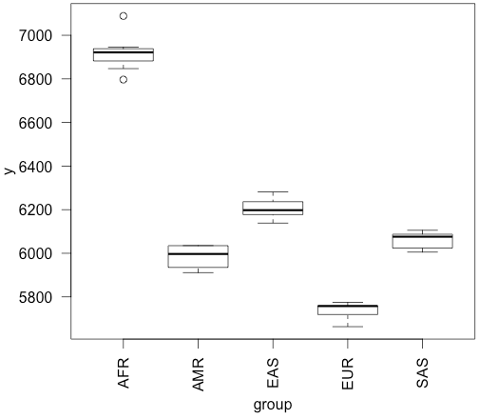
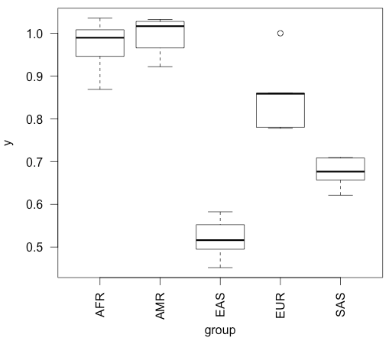
ANOVA Table: F-statistic comparing ALL groups to each other
All 1000G 138,000 variants results:
F-value = 294.88 P(>F) = 2.2 E-16
ClinVar-1000G 137 variant results:
F-value = 58.685 P(>F) = 4.25 E-11
F-statistic + p-values: H0 = all groups drawn from same distribution

Slide 4
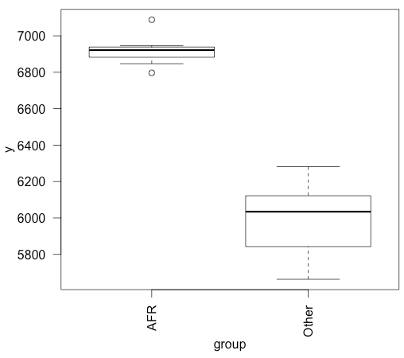
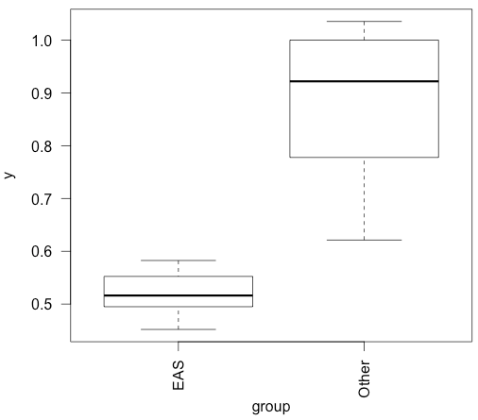
ANOVA Table: F-statistic comparing 1 group to all other groups
All 1000G 138,000 variants results:
Diff group = “AFR”
F-value = 156.22 P(>F) = 5.35 E-12
ClinVar-1000G 137 variant results:
Diff group = “EAS”
F-value = 30.869 P(>F) = 1.025 E-5

Slide 5
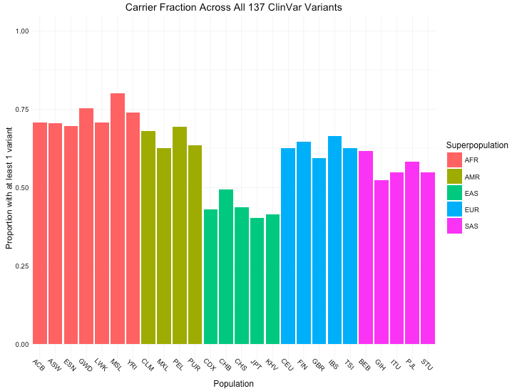
Mean variants across all 1000G variants vs. Carrier fraction across 137 ClinVar-1000G variants

Slide 6
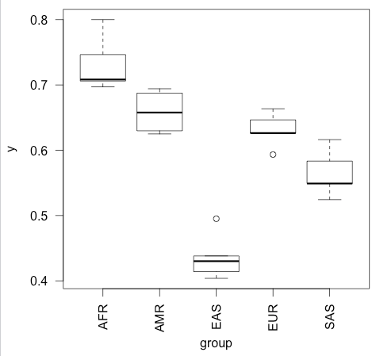
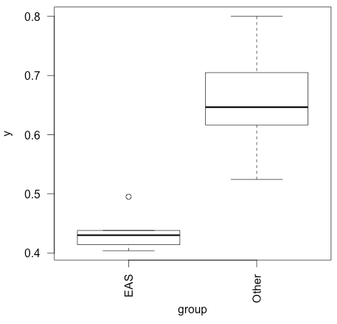
ClinVar-1000G Fraction Carriers: between each group
F-value = 58.377 P(>F) = 4.47 E-11
ClinVar-1000G Fraction Carriers: between “EAS” and other groups
Diff group = “EAS”
F-value = 42.359 P(>F) = 9.90 E-7

