Slide 1
Ubuntu: Downloaded R and tabix
Takes up 7GB, around 7 GB remaining
Confirmed: R opens properly
Confirmed: tabix works properly with vcf-subset and bgzip.
Unsure about anaconda: seems like a much larger file.
Notes:
Plot number of variants across 20 genes per individual (Hist)
Plot barplot of individuals who have a variant in each gene, rv desc frac of genes by gene
Table (gene specific) for ASW, CEU, YRI columns and genes

Slide 2
Downloading VCF
ExAC: by hand
1000 genomes:
Scrape ACMG website for gene names and associated diseases.
Connecting USCS Genome Browser to get gene info: chrom, start, stop.
Use Tabix

Slide 3
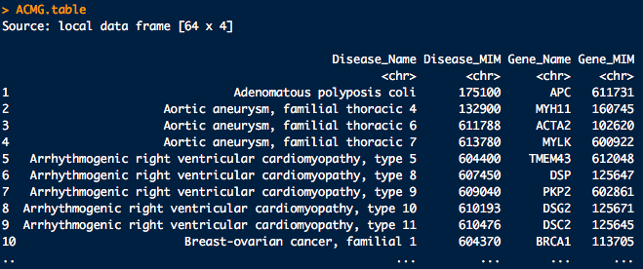
Scrape for ACMG
ACMG.page <- scrape(url ="http://www.ncbi.nlm.nih.gov/clinvar/docs/acmg/")

Slide 4
Connect to UCSC Genome Browser
Step 1: Connect to UCSC Genome Browser: chrom/start/stop
Step 2: Query from a table: RefGene or GeneReviews
GeneReviews generally has 1 entry per gene; missing PRKAG2
RefGene has multiple entries per gene; full coverage, tx vs. coding
I chose RefGene, min tx-start, max tx-end.
Step 3: Collect/process other inputs: chrom, version, chrom.num, start, end, gene.
Notes:
Select a real refgene entry (largest)

Slide 5
Call Tabix from System
Step 4: Call tabix:
"tabix -h ftp://ftp.1000genomes.ebi.ac.uk/vol1/ftp/release/ 20130502/ALL.%s.phase3_%s.20130502.genotypes.vcf.gz %s:%s-%s > %s_genotypes.vcf” %>%
sprintf(UCSC$chrom, version, chrom.num, UCSC$start, UCSC$end, gene) %>% system
Step 5: Output progress (e.g. MYBPC3 17/56) and check whether the file exists and has size > 0.
Step 6: Compare with the dozen or so downloaded by hand earlier.

Slide 6
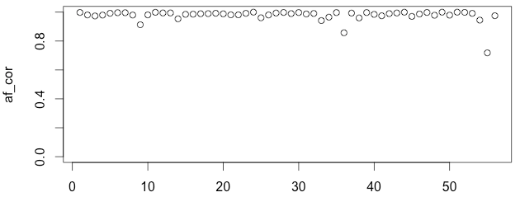
Join 1000G data to ExAC: Correlations
Take intersecting variants only (due to liberal estimate on tx regions)
VHL: 72%
MLH1: 86%
DSC2: 91%
All others above 94%
Notes:
Plot as a histogram
Look at crappy ones; look at size distribution
Gene level: number of variants (histogram across genes)

Slide 7
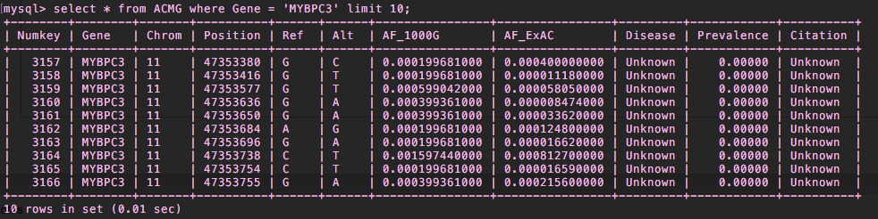
Load ACMG data into MySQL table
mysql> create table ACMG (Numkey int … Citation varchar(200));
mysql> load data local infile '/Users/jamesdiao/Documents/Kohane_Lab/ HST-2016/week_5/ACMG_output.txt' into table ACMG lines terminated by '\n';
Records: 9199 Deleted: 0 Skipped: 0 Warnings: 0
Notes:
Create 3 tables:
ACMG_Disease: Disease/Gene/Chrom/Start/End/Refgene entry
ACMG_Lit: Disease/Prev/Cit

Slide 8
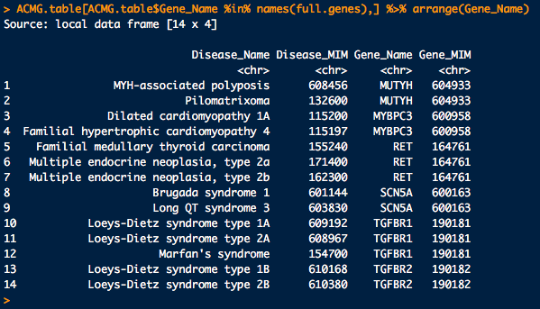
ACMG Disease Status
Multiple diseases implicated for some genes
Do I just handcode the rest?

Slide 9
Update 7/13/2016
JAMES DIAO

Slide 10
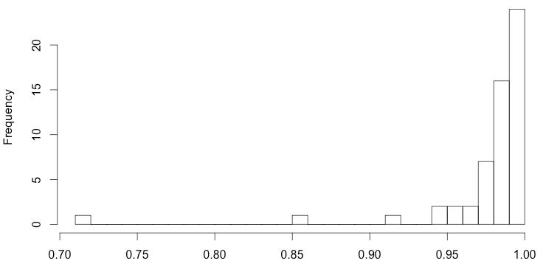
Correlations as histogram

Slide 11
Questions about Collecting Prevalence
Point estimate of prevalence from multiple reports (e.g. 1:5,000 and 1:100,000)
Arithmetic mean seems like it would overestimate.
Geometric mean might work pretty well (~22,360) (bounded; effectively averaging some log function)
Alternatively, report a range for now.
Going to original study, or general site?
Studies may be old, geographically limited.
Include relevant place and date?

Slide 12
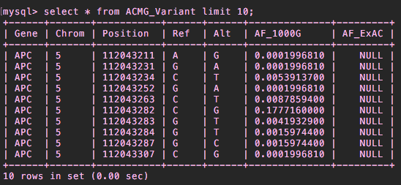
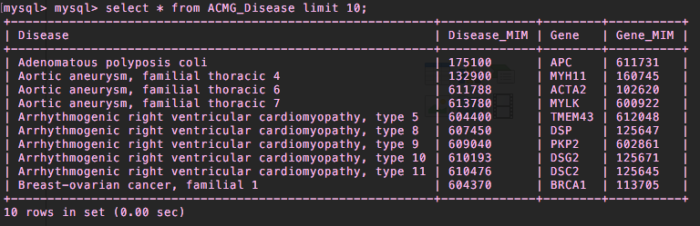
SQL Tables
ACMG_Variant
ACMG_Disease

Slide 13
Population_Variant_Status.txt
What about how many people have … ?

Slide 14
RefGene Sources

Slide 15
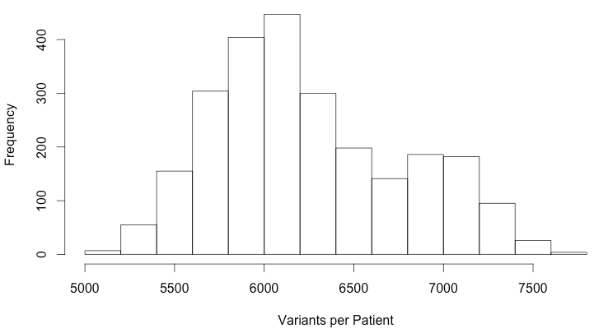

Slide 16
Barplot of individuals who have a variant in each gene, reverse descending (fraction of genes = y, gene = x)

Slide 17
Anaconda sh

