Slide 1
Update 7/15/2016
JAMES DIAO

Slide 2
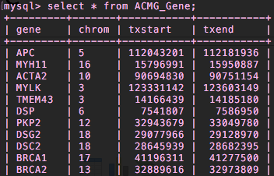
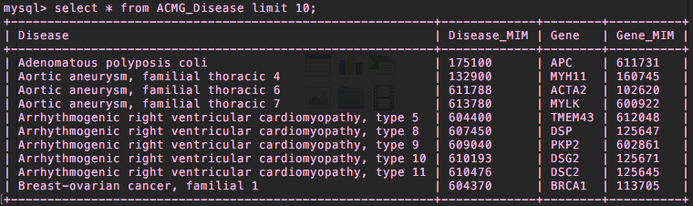
Add txstart/txend/refGene NEW ACMG_Gene table vs. redundancy in ACMG_Disease

Slide 3
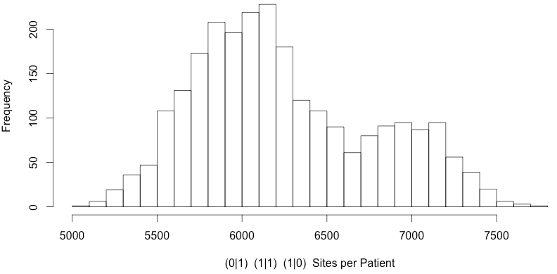
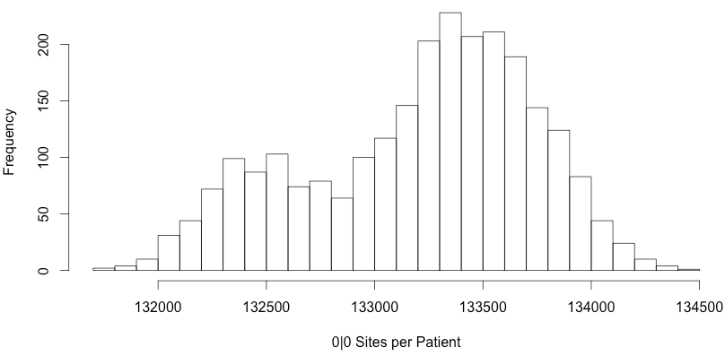
Variants across 56 ACMG genes in 1000 G patients
Notes:
Histogram of homozygous reference sites

Slide 4
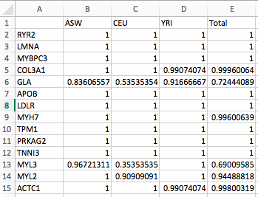
PopulationVariantStatus
Notes:
For correlations plots: add a column for direct length of gene + number of variant positions / gene.
See if exceptions have anything to do with them.

Slide 5
Questions about ACMG_Lit Prevalence
Point estimate of prevalence from multiple reports (e.g. 1:5,000 and 1:100,000)
Arithmetic mean seems like it would overestimate.
Geometric mean might work pretty well (~22,360) (bounded; effectively averaging some log function)
Alternatively, reported a range for now.
Citations
URL + PubMed ID + Author et al., Journal, Year.
Original study
Additional fields: country, ^categorical: newborns/children/adult

