Slide 1
Frequency of ACMG 56 Variants in Ancestrally Diverse Populations
James Diao | Raj Manrai | 7/29/2016

Slide 2
Background
ACMG: American College of Medical Genetics & Genomics
Incidental finding: Results of a search for pathogenic alternations in genes that are not apparently relevant to a diagnostic indication for which the sequencing test was ordered.
ACMG-56: Set of 56 genes in which pathogenic variants should be reported even when discovered incidentally, as per ACMG recommendations.
ClinVar: crowd-sourced public archive of reports of human variations and related phenotypes (disease states).

Slide 3
1000 Genomes Population Analysis Shiny App

Slide 4
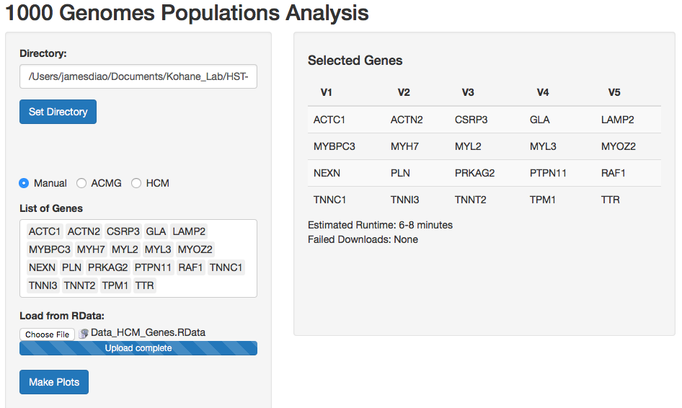
User Interface
Input list of genes: Option 1: manual entry Option 2: upload .RData Option 3: scrape ACMG-56 from ClinVar website. Option 4: scrape HCM panel test genes from LMM website.
App downloads VCF files from 1000 genomes and generates plots

Slide 5
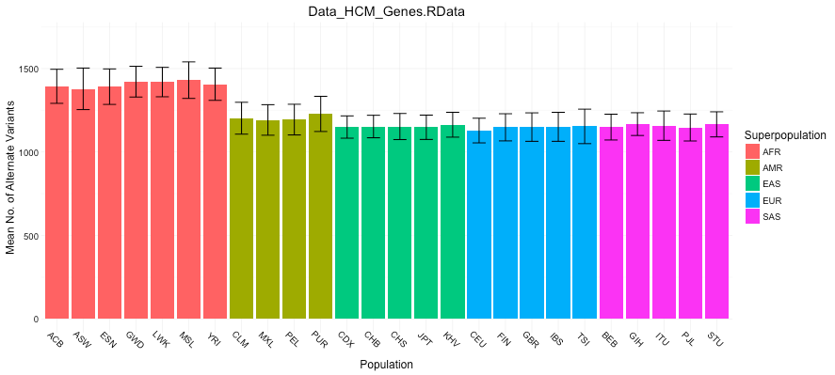
Output Plot 1: Mean number of non-reference sites by population

Slide 6
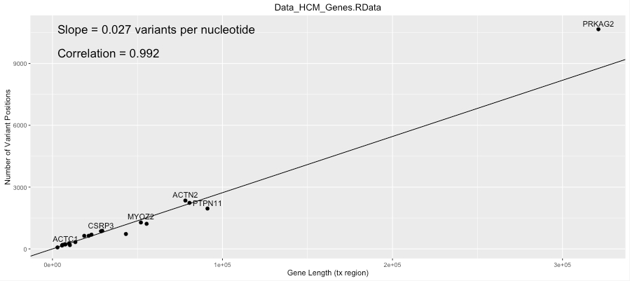
Output Plot 2: Number of reference sites per nt for each gene

Slide 7
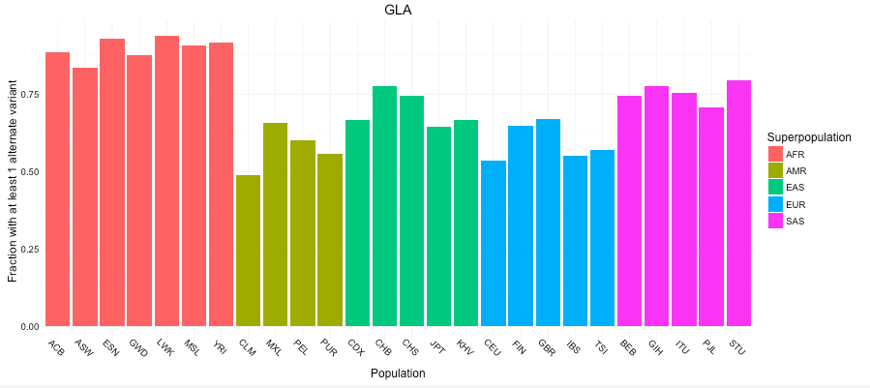
Output Plot 3: Fraction with at least 1 non-reference site for a specified gene, by population

Slide 8
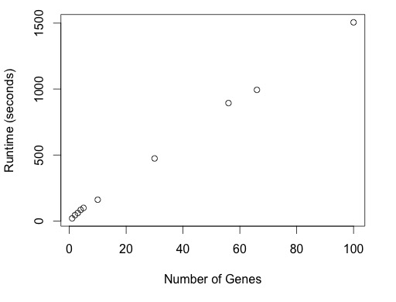
Runtime
15-22 seconds per gene:
1. Depends on gene length.
2. Under 1 sec / gene with file upload.
3. 20,000 genes in 3-4 days
Notes:
Briefly cover runtime.

Slide 9
Exploring the ACMG-recommended incidental report genes in 1000 genomes data

Slide 10
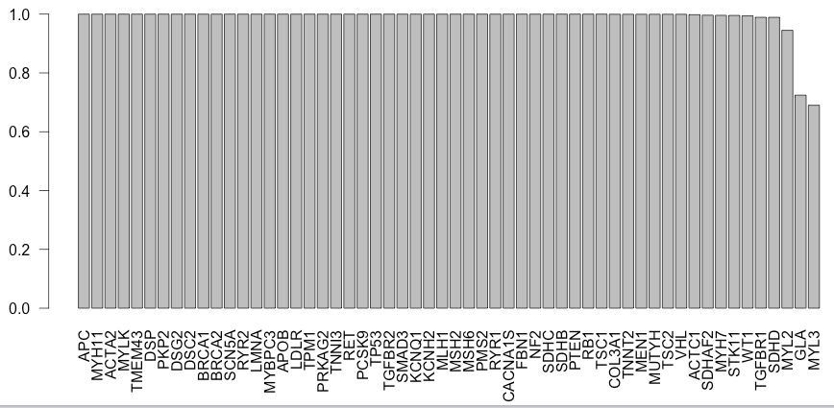
Pretty much all 1000G patients have some variants in each ACMG genes
Exceptions: the 2 shortest genes
Doesn’t differentiate benign v. pathogenic

Slide 11
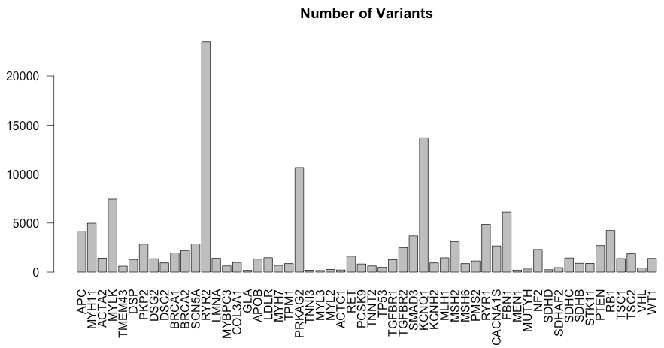
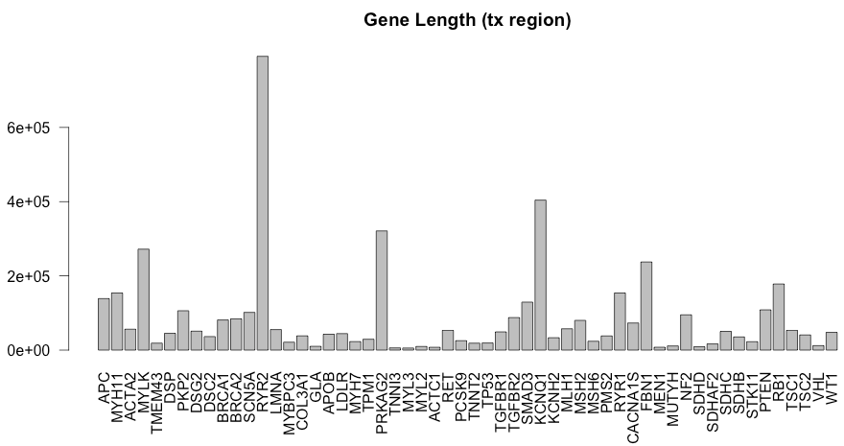

Gene Lengths $≈$ Number of variants
Correlation = 0.994
Notes:
As we’ll later show, the frequency of certain variants is inversely proportional to penetrance.

Slide 12
Combining individual-level data from 1000 genomes with pathogenicity data from ClinVar Part 1: Overview

Slide 13
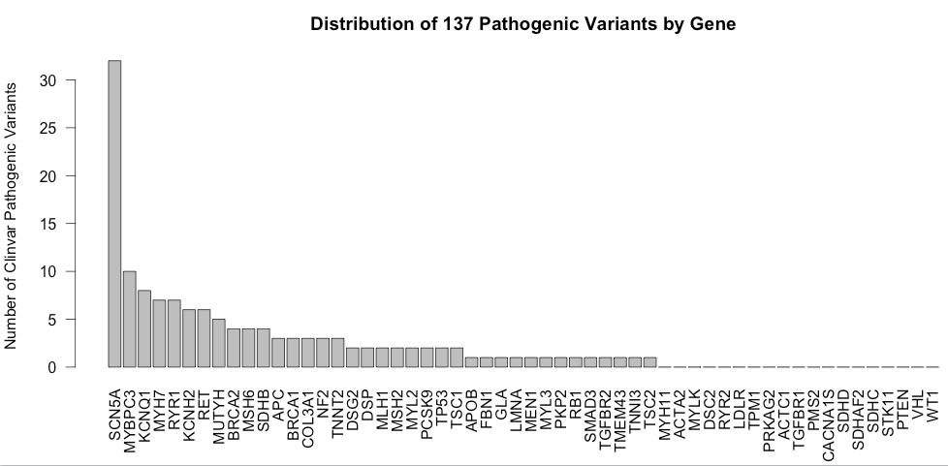
Joining Pathogenic Clinvar Variants with 1000G
1000 genomes: 139,388 unique variants in ACMG-56.
ClinVar: 10,286 NON-unique pathogenic variants (8,441 unique) across ~27,000 genes
Intersection: 137 unique variants in both datasets, associated with 192 diseases
37/56 have at least 1 variant 19/56 are not associated with any pathogenic variants in 1000G.

Slide 14
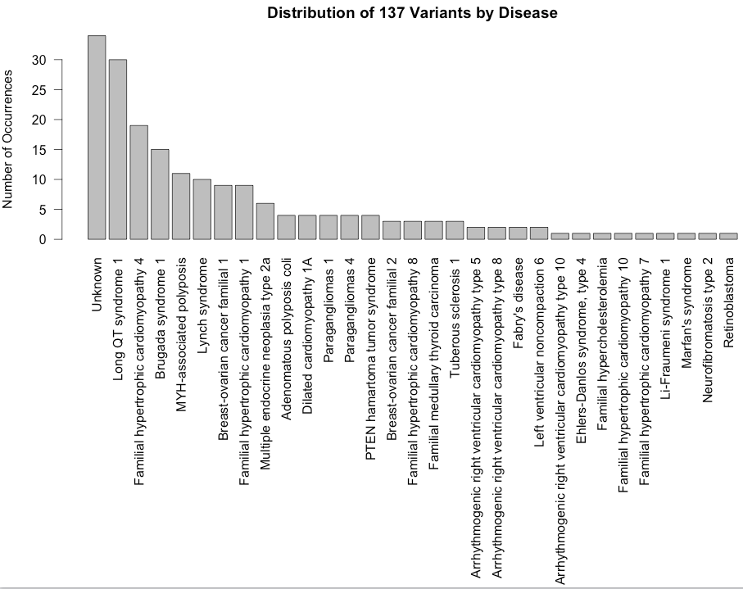
137 Pathogenic Clinvar Variants Distributed by Disease

Slide 15
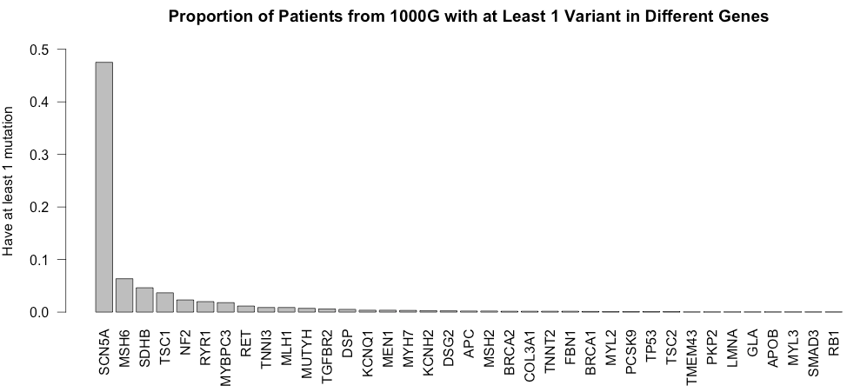
1000G individuals with pathogenic mutations
Closely follows previous plot: longer gene = more variants =
greater fraction of people with variants
Correlation = 0.908
SCN5A = 101,611 bp tx region
SCN5A is a sodium voltage-gated channel- associated with long QT syndrome and Brugada syndrome.
Notes:
For example: MYBPC3 is 1/50, but prevalence of HCM is 1/500. SCN5A mutations are in ½ of the population (?!?!)

Slide 16
Combining individual-level data from 1000 genomes with pathogenicity data from ClinVar Part 2: Populations Analysis

Slide 17
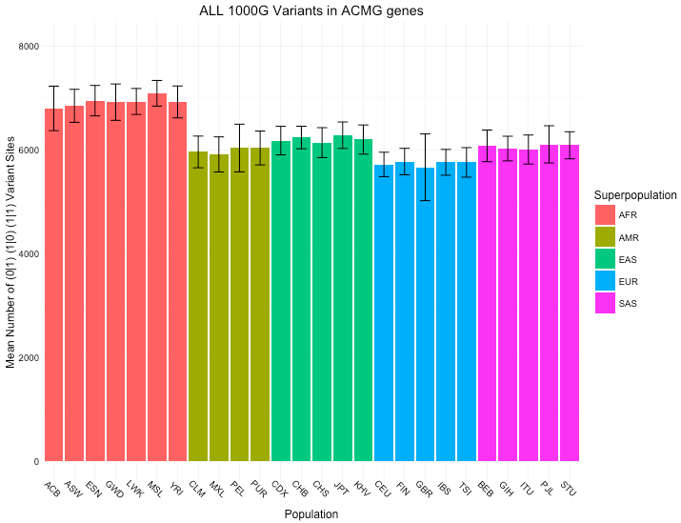
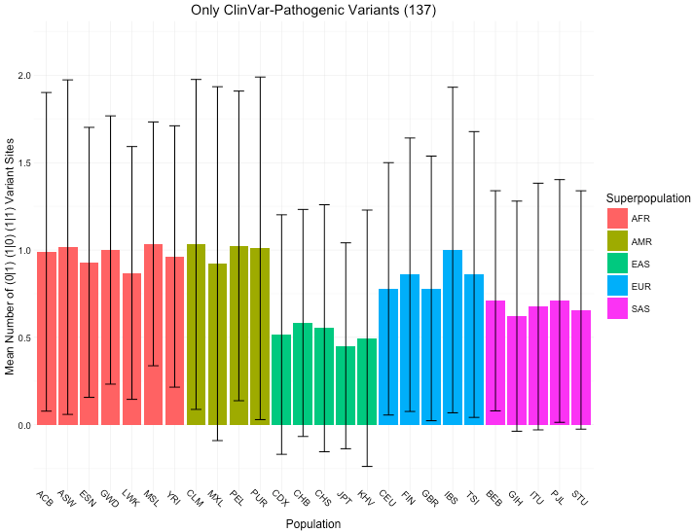
Mean variants across all 1000G variants vs. Mean variants across 137 ClinVar-1000G variants

Slide 18
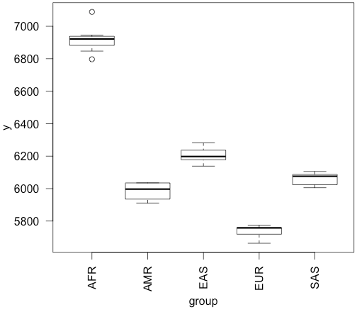
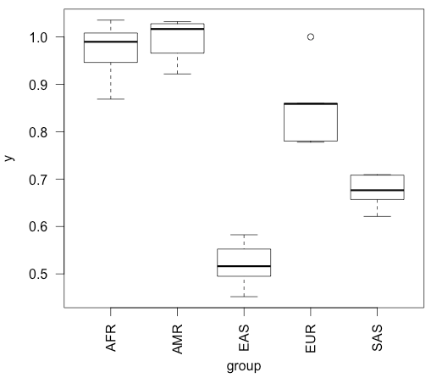
ANOVA Table: F-statistic comparing ALL groups to each other
All 1000G 138,000 variants results:
F-value = 294.88 P(>F) = 2.2 E-16
ClinVar-1000G 137 variant results:
F-value = 58.685 P(>F) = 4.25 E-11
F-statistic + p-values: H0 = all groups drawn from same distribution

Slide 19
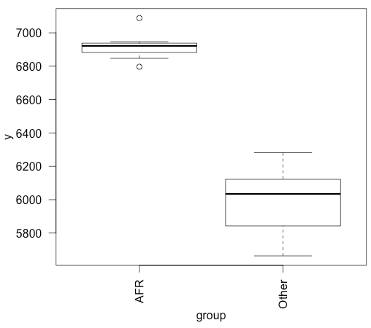
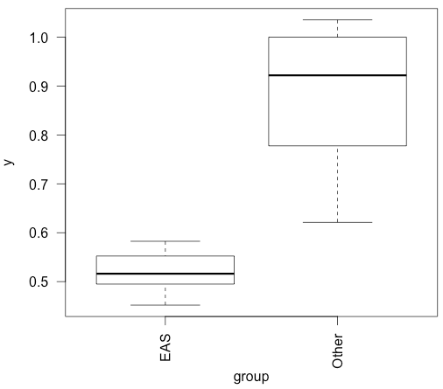
ANOVA Table: F-statistic comparing 1 group to all other groups
All 1000G 138,000 variants results:
Diff group = “AFR”
F-value = 156.22 P(>F) = 5.35 E-12
ClinVar-1000G 137 variant results:
Diff group = “EAS”
F-value = 30.869 P(>F) = 1.025 E-5

Slide 20
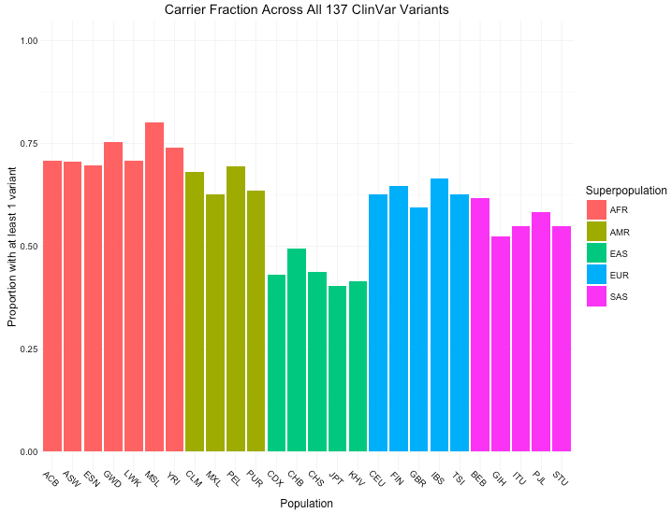
Carrier fraction across 137 ClinVar-1000G variants
50-70% of people would be reported as having some disorder under ACMG guidelines.
EAS (East Asian) groups seem to have the least pathogenic variants in ACMG-56
Notes:
Randomly select 56 genes 10 times

Slide 21
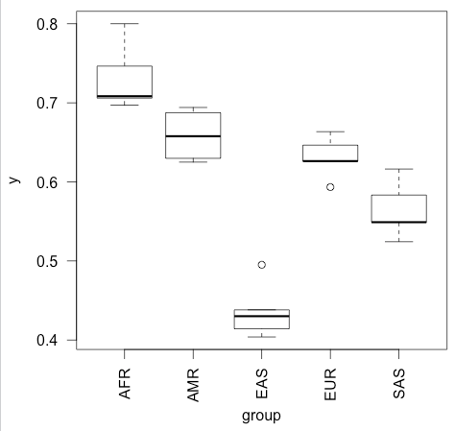
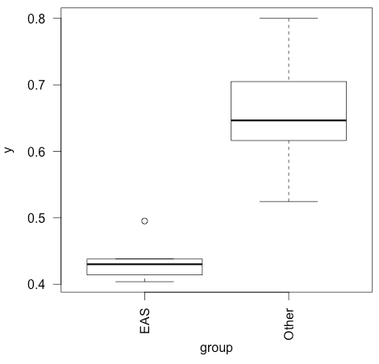
ClinVar-1000G Fraction Carriers: between each group
F-value = 58.377 P(>F) = 4.47 E-11
ClinVar-1000G Fraction Carriers: between “EAS” and other groups
Diff group = “EAS”
F-value = 42.359 P(>F) = 9.90 E-7

Slide 22
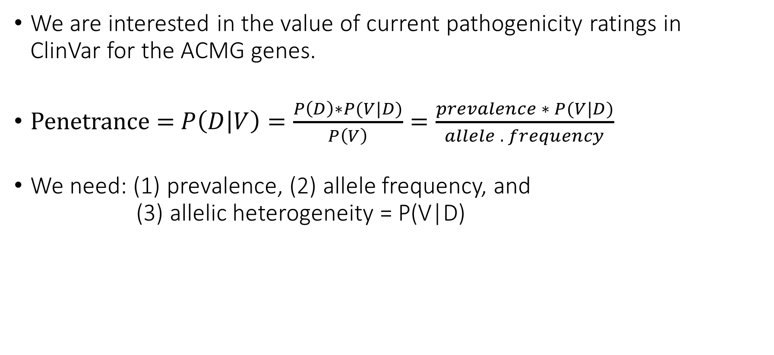
ACMG Incidentalome
We are interested in the value of current pathogenicity ratings in ClinVar for the ACMG genes.
Penetrance = $P\left(D | V\right)=\frac{P\left(D\right)∗P(V|D)}{P\left(V\right)}=\frac{prevalence ∗ P(V|D)}{allele . frequency}$
We need: (1) prevalence, (2) allele frequency, and (3) allelic heterogeneity = P(V|D)

Slide 23
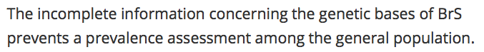
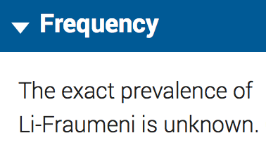
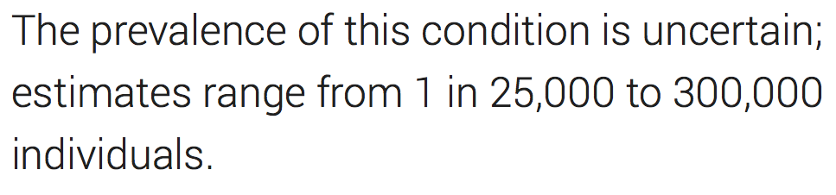
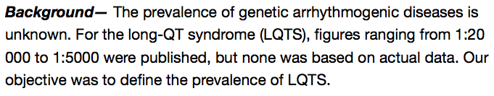
(1) Prevalence Estimates are Uncertain and Highly Variable
https://ojrd.biomedcentral.com/articles/10.1186/1750-1172-1-35
https://ghr.nlm.nih.gov/condition/peutz-jeghers-syndrome
https://ghr.nlm.nih.gov/condition/li-fraumeni-syndrome
http://www.ncbi.nlm.nih.gov/pubmed/19841298

Slide 24
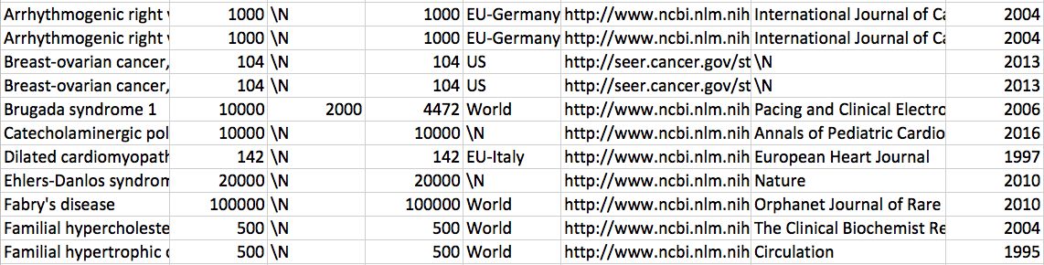
Prevalence estimates found on Pubmed/Google Scholar
Notes:
Describe search heuristic

Slide 25
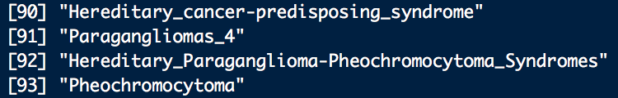
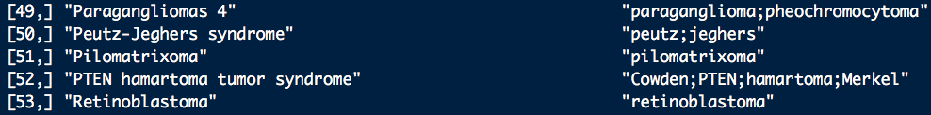
(2) Allele Frequencies
Problem: Diverse set of names used to identify disease:
Solution: 1. Find patterns that uniquely indicate a disease.
2. Use grep to match key disease tags (substrings and synonyms) after manual curation.
3. Pull out allele frequencies from all variants that match.

Slide 26
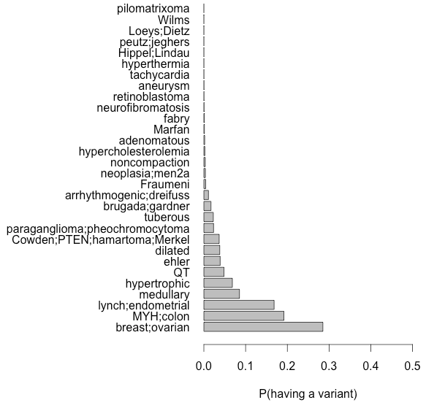
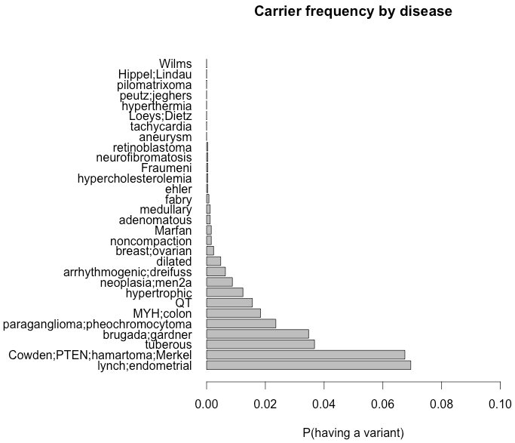
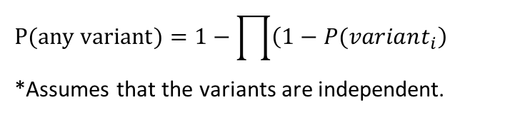
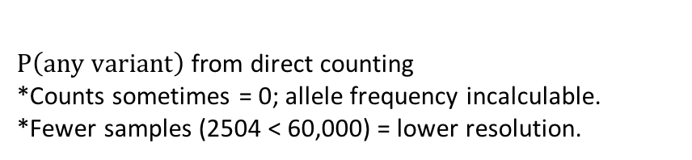
(2) Allele Frequencies: ExAC (left), 1000G (right)
Correlation: 0.316
Breast/ovarian cancer: 30%
MYH-polyposis: 20%
Lynch syndrome: 17%
Medullary thyroid cancer: 9%
Hypertrophic cardiomyopathy: 7%
Every other: <5%
Lynch syndrome: 7%
PTEN hamartomas: 6.7%
Tuberous sclerosis: 3.5%
Brugada syndrome: 3.5%
Paragangliomas: 2.4%
Every other: <2%
$$P(any variant)=1−\prod{\left(1−P(variant_{i}\right)}$$ *Assumes that the variants are independent.
$P\left(any variant\right)$from direct counting *Counts sometimes = 0; allele frequency incalculable. *Fewer samples (2504 < 60,000) = lower resolution.

Slide 27
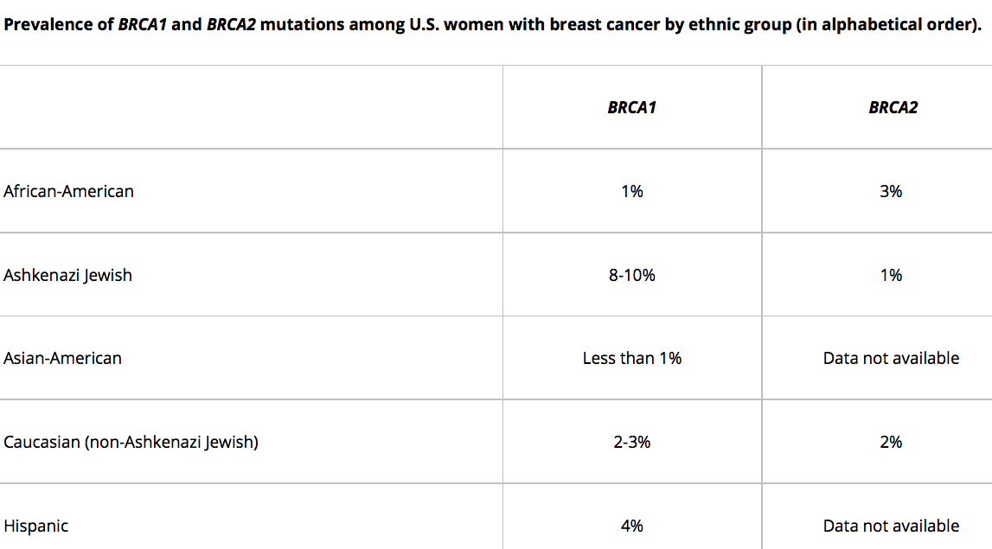
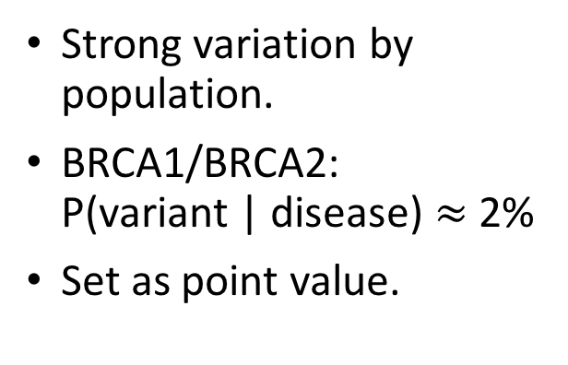
(3) Allelic Heterogeneity
Strong variation by population.
BRCA1/BRCA2: P(variant | disease) $≈$ 2%
Set as point value.

Slide 28
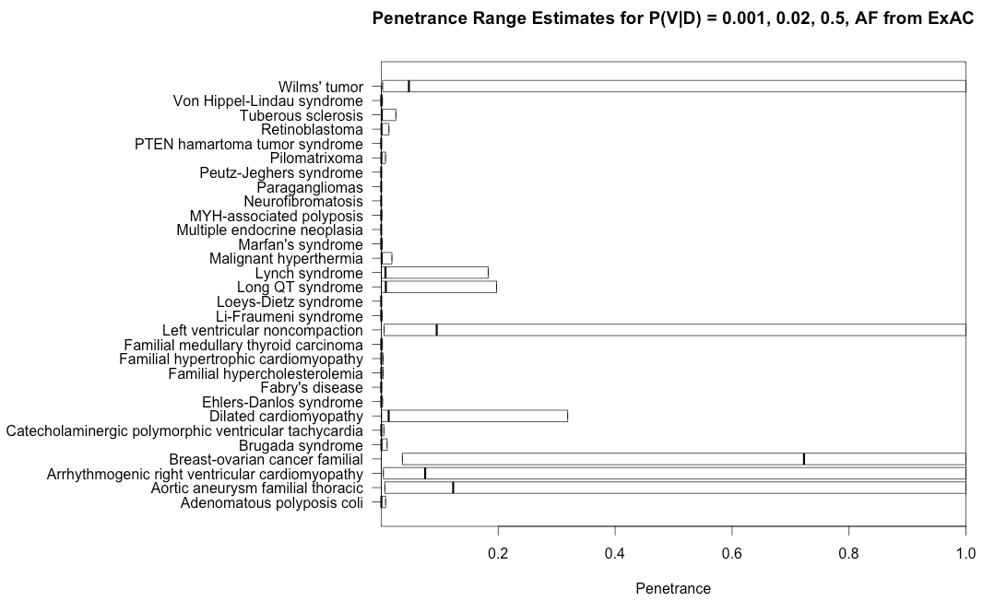
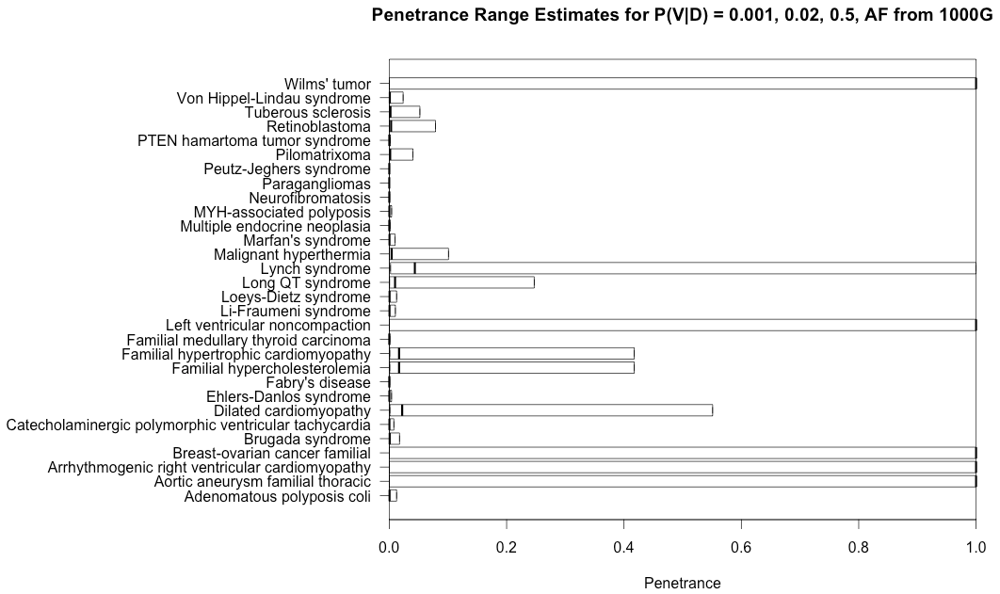
Rough Penetrance Estimates: ExAC
*Penetrance estimates have a similar shape, but are increased because 1000G has fewer individuals.
*Some values are Inf because no individuals in 1000G were found with those alleles.

