Slide 1
ROC Incidentalome App
James Diao | Raj Manrai | Kohane Lab | 7/6/2016

Slide 2
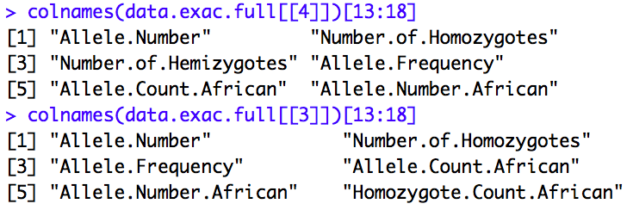
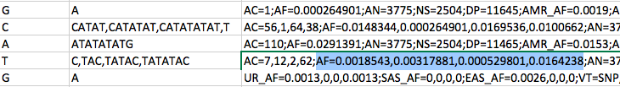
1. Reconcile variant-level allele frequency data from ExAC and 1000G: Difficulties
Naming Inconsistencies
Organizational difficulties

Slide 3
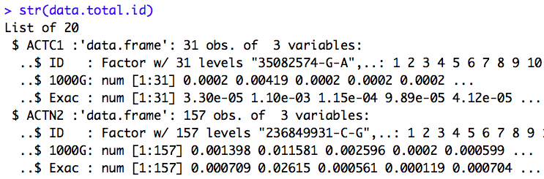
1. Reconcile variant-level allele frequency data from ExAC and 1000G: Final Data List

Slide 4
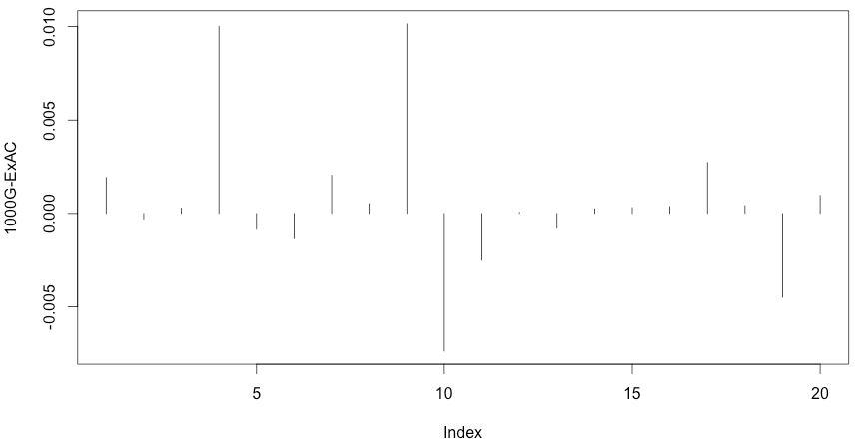
1. Reconcile variant-level allele frequency data from ExAC and 1000G: Between Datasets

Slide 5
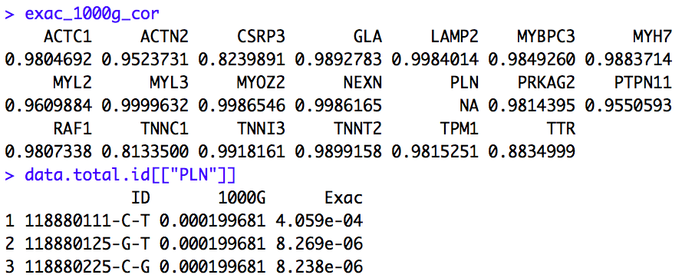
1. Reconcile variant-level allele frequency data from ExAC and 1000G: Correlation

Slide 6
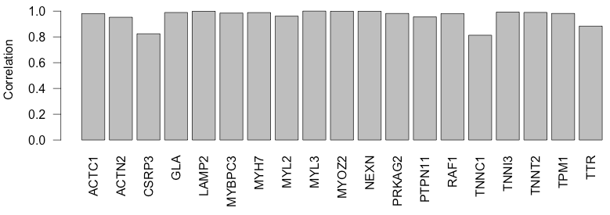
1. Reconcile variant-level allele frequency data from ExAC and 1000G: Correlation

Slide 7
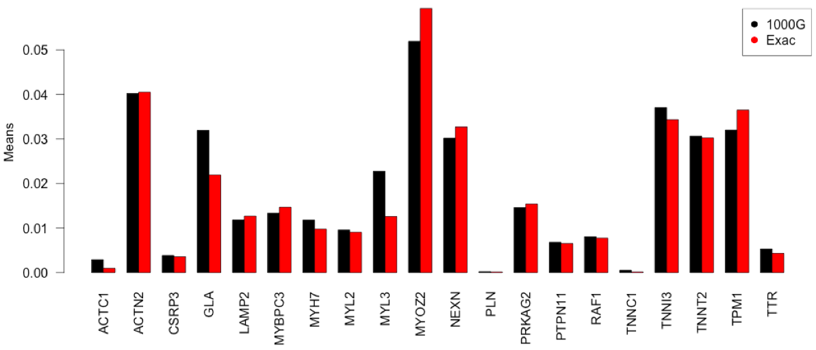
1. Reconcile variant-level allele frequency data from ExAC and 1000G: Mean

Slide 8
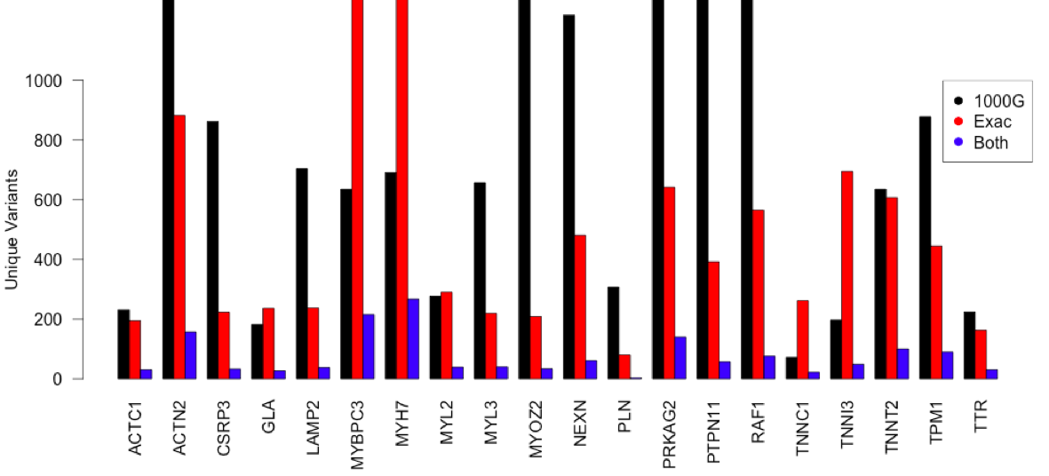
1. Reconcile variant-level allele frequency data from ExAC and 1000G: Counts
Notes:
Look at which cohorts you're downloading from.
Which population are contained.

Slide 9
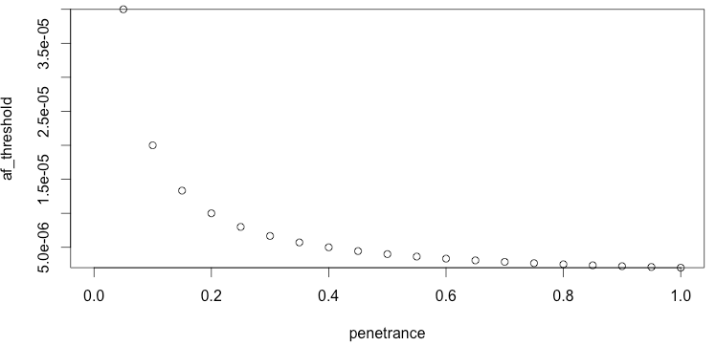

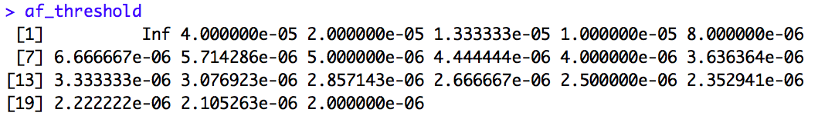
2. Compute HCM allele frequency threshold
Notes:
Set 1 of the parameters as a range, the others as fixed values

Slide 10
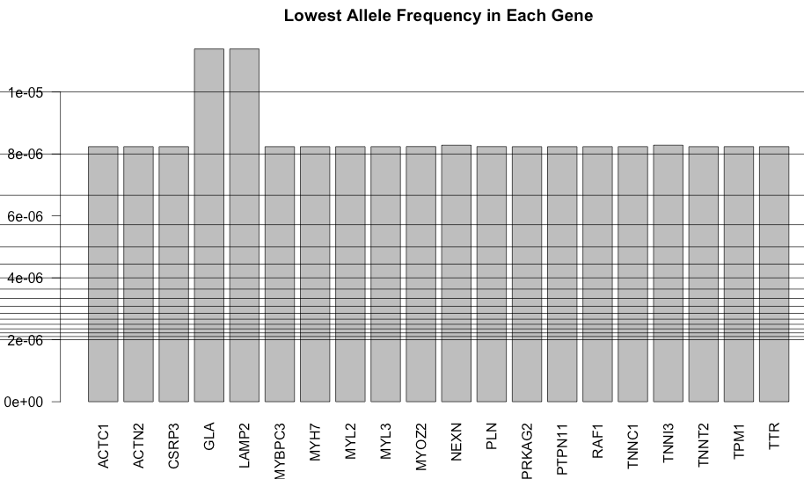
Note: most allele frequency thresholds miss everything (shown most stringent 16/20)
Notes:
Space them out, label with penetrance values

Slide 11
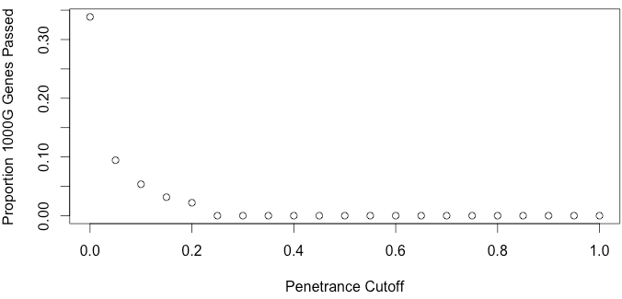
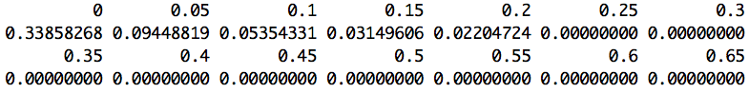
Proportion Genes Passed (MYBPC3, Var1)
Most penetrance cutoffs ( > 0.2) make no pathogenic classifications.
Notes:
Redo plot

Slide 12
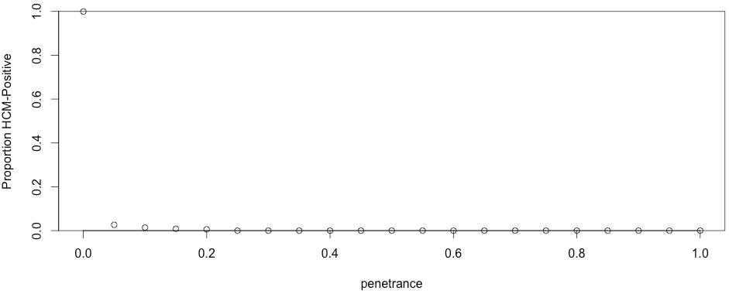
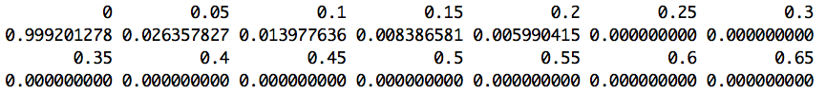
Proportion Patients Sick (MYBPC3, Var1)
Most penetrance cutoffs (>0.2) make no pathogenic classifications
= no sick cohort.

Slide 13
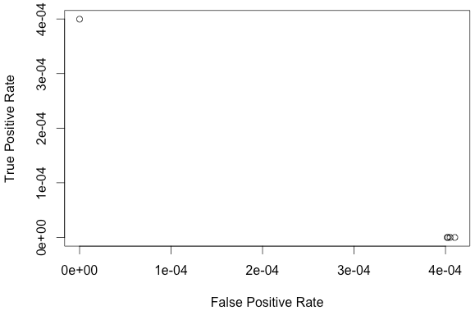
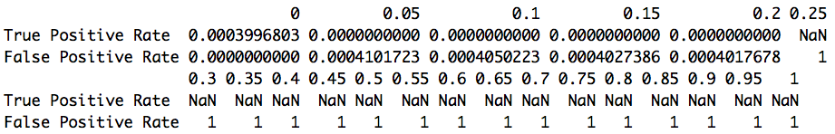
ROC “Curve”
Problem: Most penetrance cutoffs make no pathogenic classifications = no sick cohort = poor ROC.
Since no one is actually positive for penetrance > 0.2:
True positive rate = 0/0 = NaN (no one is actually positive)
False positive rate = 100% (every variant claim will be false)

Slide 14
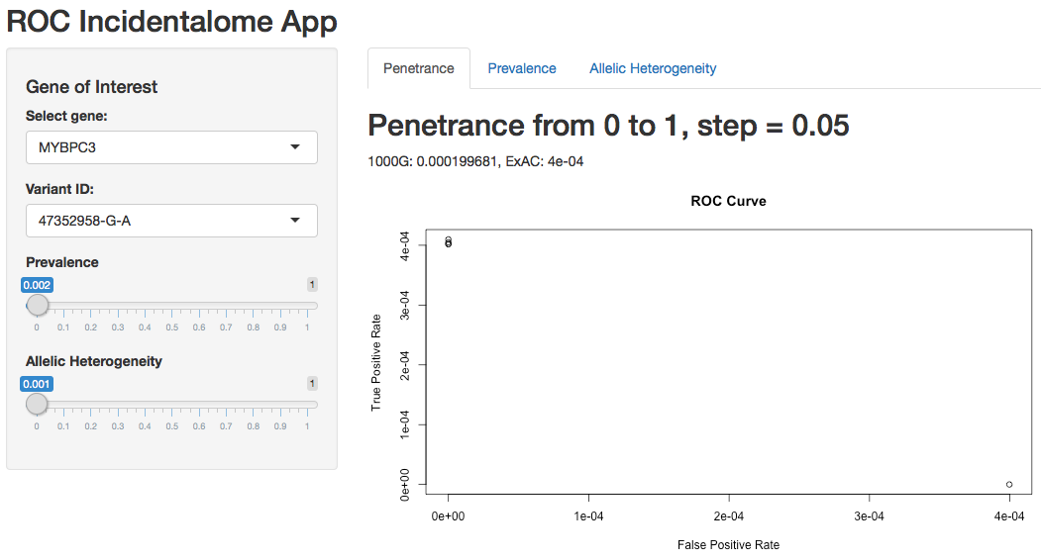

Slide 15
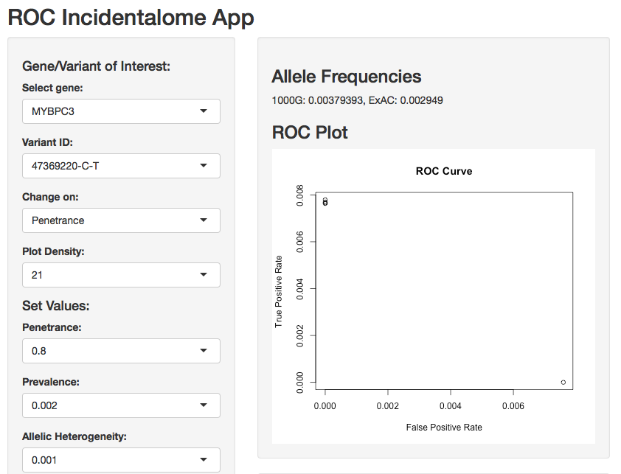
Question:
Varying the threshold seems to move TPR/FPR along a very non-ROC-like path. Why’s that?
Notes:
If any subpopulation has a high frequency, then this variant is not pathogenic;
More sensitive way of finding variants – ancestrally informative

Slide 16
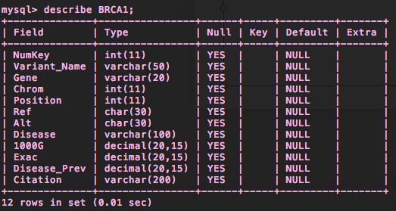
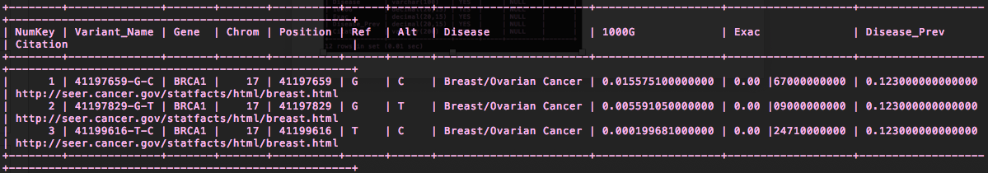
ACMG 46 Task

Slide 17
Other things I’ve been working on:
Reading articles, starting to write methods section (help!)
Learning to use dpylr and tidyr (%>% is amazing!)
I was able to hear a talk by Heidi Rehm (on the ACMG working group) – got some interesting insight on how they categorized variants and how LMM works with ClinVar.

Slide 18
That is all ☺

