Slide 1
Update: Week 4
James Diao | Raj Manrai | Kohane Lab | HST

Slide 2
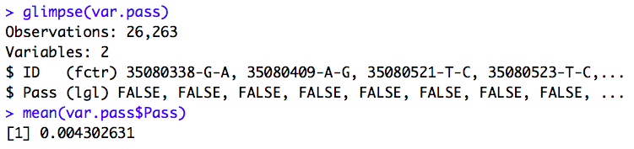
Gold Standard Population
Gold Standard Settings: I aimed to get final prevalence as close to 0.002 as possible.
Proportion of 1000G variants that pass the “Gold Standard” threshold

Slide 3
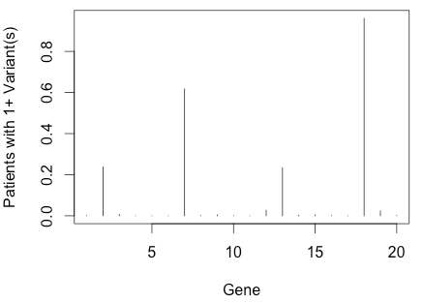
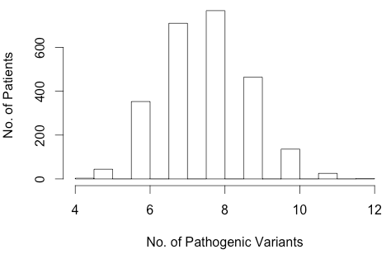
Everyone (>99%) is HCM-positive, even under the most stringent conditions that allow any variants to pass:
We didn’t see this before because we were only looking at 1 gene. Now that we’re looking at all 20 genes, we have 20x more chances, and it only takes 1 hit to make them HCM-positive.
A few of the genes (4/20) seem to account for the majority of these.

Slide 4
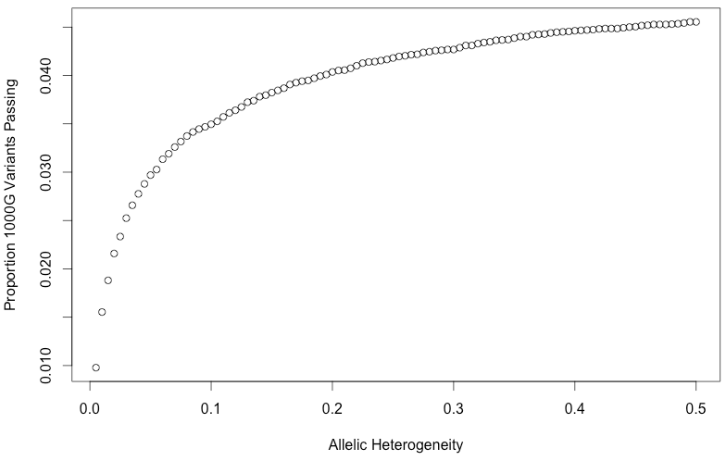
Effect of Allelic Heterogeneity Assumptions for the Gold Standard Variant Classification

Slide 5
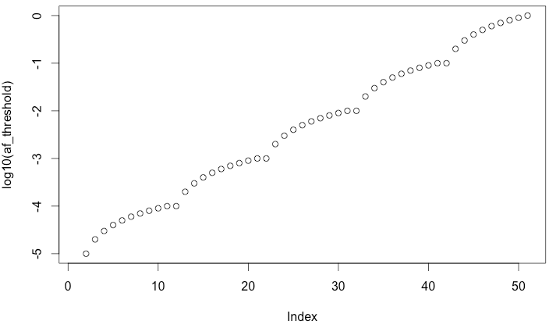
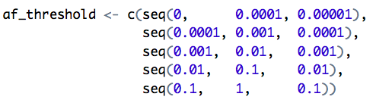
Static ROC Curve: Change on Allele Frequencies
Log-scale resolution:

Slide 6
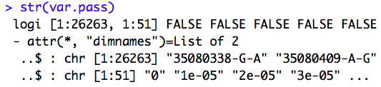
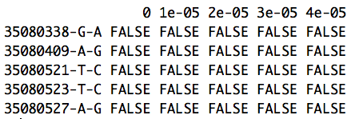
Var.pass: matrix of pathogenicity status of variants across 51 allele frequency values

Slide 7
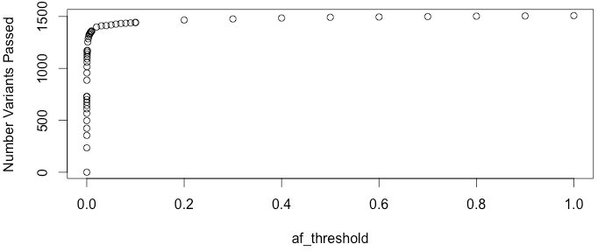
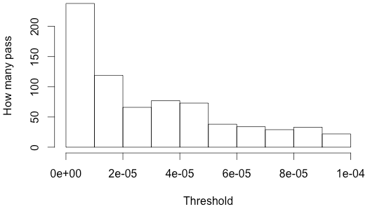
Number of variants that pass allele thresholds (out of 26263), <6%

Slide 8
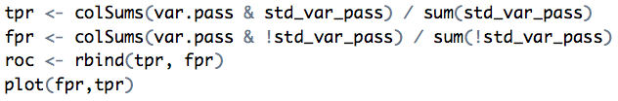
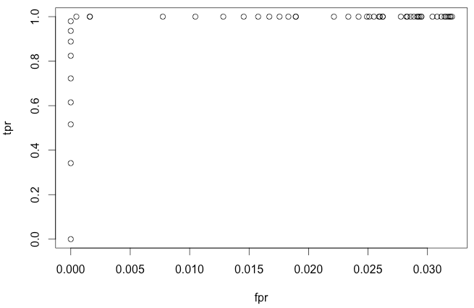
Static ROC Curve for AF from 0-1:

Slide 9
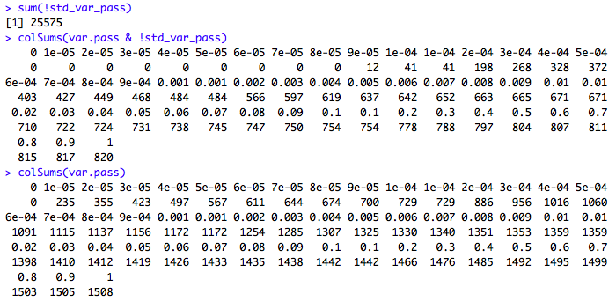
Why is false positive rate so low?
Most gold standard variants are false (not pathogenic): 25,575/26,263, >97%
No. of false pathogenic
for each threshold:
No. of assigned true pathogenic:
NOTE: This peaks with intersecting overlap (max < 6%)

Slide 10
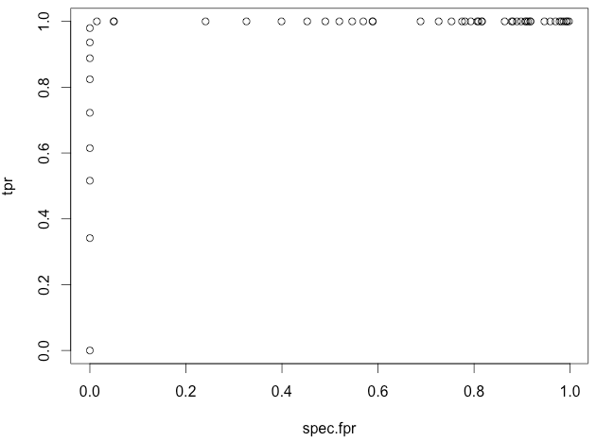
Scaled ROC Curve

Slide 11
Why is the ROC Curve so perfect?
The classifier can be perfect because we can perfectly recreate the gold-standard allele frequency threshold.
Up until the magic number (0.0033), increasing the threshold will ONLY allow values that were also accepted by the gold-standard threshold.
After the magic number (0.0033), increasing the threshold will ONLY allow values that were NOT accepted by the gold-standard threshold.

Slide 12
How can I scrape for downloads?

