Slide 1
Week 2 - Part 2
James Diao | Kohane Lab | 06/23/2016

Slide 2
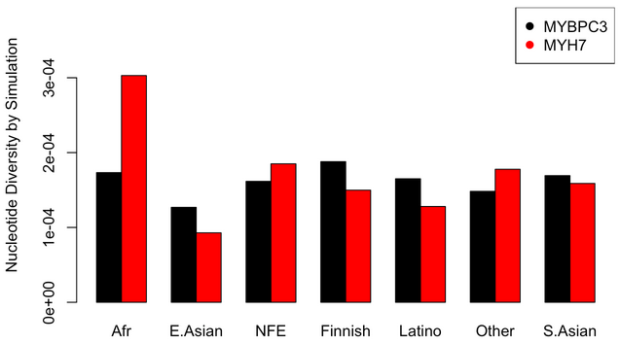



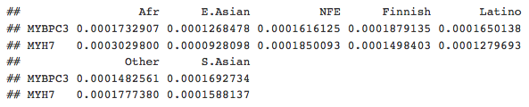
1. Bootstrap Simulation of Nucleotide Diversity

Slide 3
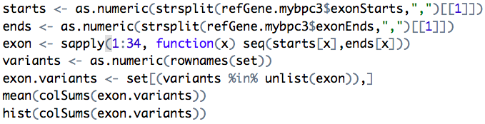
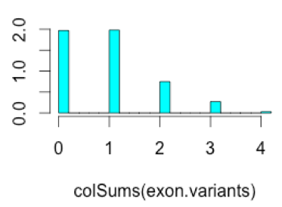

Variants/Chromosome for MYBPC3
ExAC:
85 downstream
45 upstream
14 UTRs
469 introns
73 splice region
5 splice acceptor
691/1433 ~ 48%
Hypothesis: Lower because not including 3’/5’ UTRs.
Can be tested- will get to that next week!

Slide 4
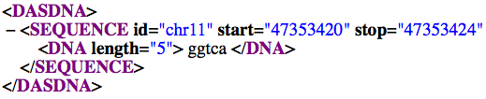
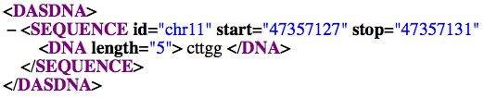
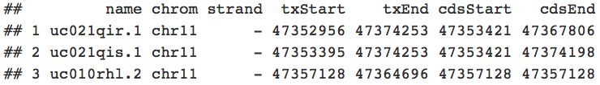
ExAC data using hg19: no start codon?

Slide 5
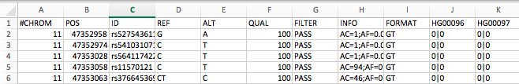
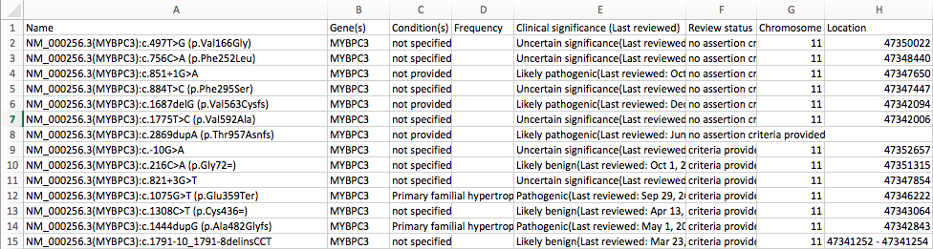
Allele Frequencies using 1000G/ Clinvar

