Slide 1
HST Summer 2016
James Diao | Raj Manrai | 7/25/2016

Slide 2
1000 genomes populations analysis shiny app
User inputs list of genes:
Option 1: manual entry
Option 2: upload RData file from previous run
Option 3: scrape genes listed in the ACMG recommendations for incidental findings (56 unique) from ClinVar website
Option 4: scrape HCM panel test genes (20) from LMM website.
App downloads VCF files from 1000 genomes and generates plots:
Number of variants by population and by gene length.
Fraction of population with some variant.
Options for downloading plots and Rdata
Notifies user of failed downloads and omits failed genes from analysis
Notes:
Basically an overview of the app. I was planning to show it to him after this slide.

Slide 3
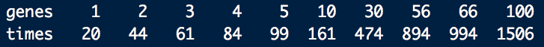
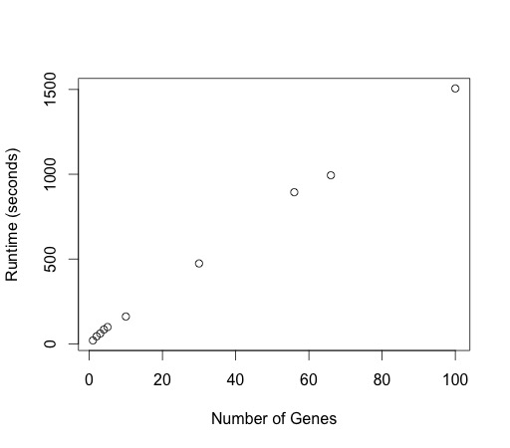
ACMG App Runtime
Runtime: 15-22 seconds per gene
1. Depends on gene length.
2. 100 random genes in 25 minutes.
3. Plot generation takes <1 sec / gene with Rdata upload.
Notes:
Briefly cover runtime.

Slide 4
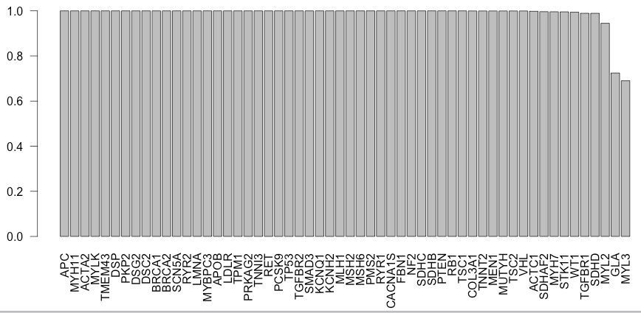
Pretty much All 1000G patients have some variants in each ACMG genes
Doesn’t differentiate benign v. pathogenic
Exceptions: the 2 shortest genes

Slide 5
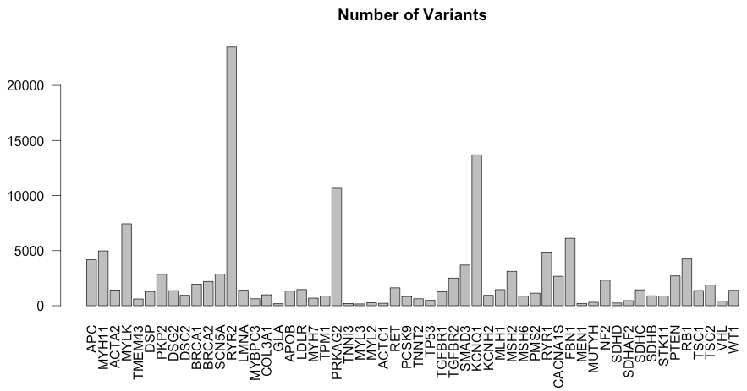
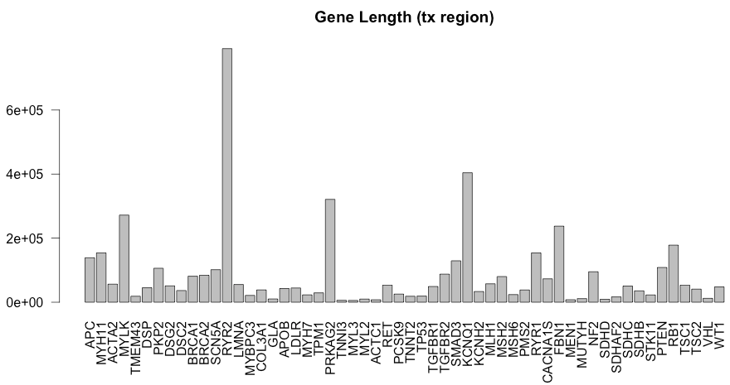

Gene Lengths ~ Number of variants

Slide 6
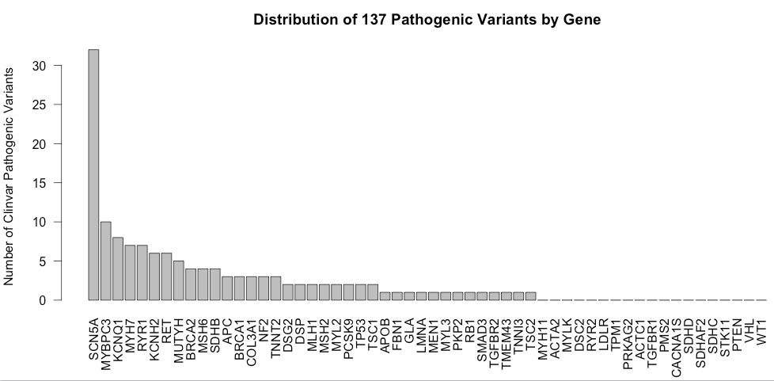
Joining the pathogenic Clinvar Variants with 1000G
1000 genomes: 139,388 unique variants
ClinVar: 10,286 NON-unique pathogenic variants (8,441 unique)
Intersection: 137 unique variants in both datasets, associated with 192 diseases
37/56 have at least 1 variant 19/56 are not associated with any pathogenic variants in 1000G.

Slide 7
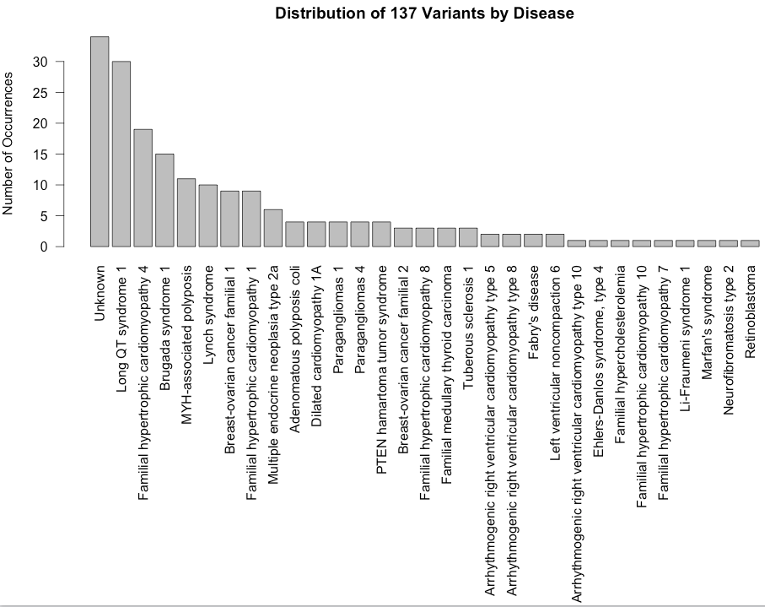
137 Pathogenic clinvar Variants distributed by disease
All clinvar variants were associated with either one of the 56 ACMG-relevant genes, or labeled “Unknown.”
>80% of the variants were explicitly ACMG-relevant.

Slide 8
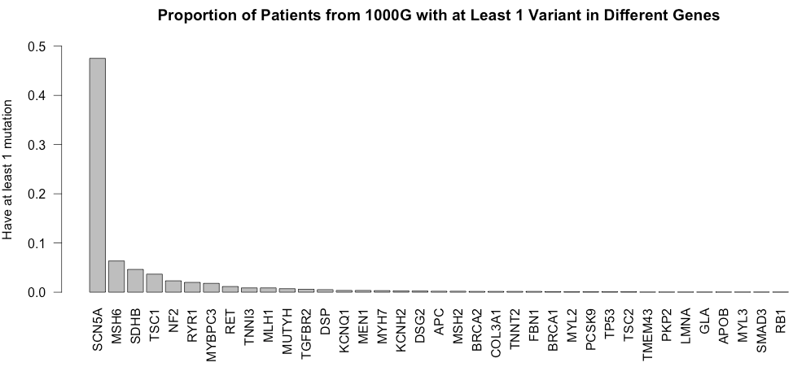

1000G patients with mutations
Closely follows previous plot: longer gene = more variants =
greater fraction of people with variants
SCN5A is a sodium voltage-gated channel- associated with long QT syndrome and Brugada syndrome.
Notes:
For example: MYBPC3 is 1/50, but prevalence of HCM is 1/500. SCN5A mutations are in ½ of the population (?!?!)

Slide 9
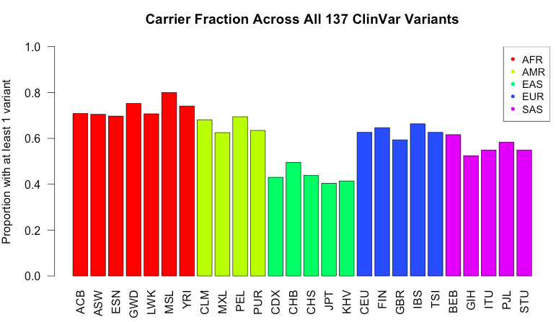
1000G/Clinvar join: Population Analysis
50-70% of people would be reported as having some disorder under ACMG guidelines.
These are also potential additions to the app.
Notes:
Left: fraction of people in each population that carry at least 1 variant for all pathogenic ACMG genes.
Right: mean number of variants total.

Slide 10
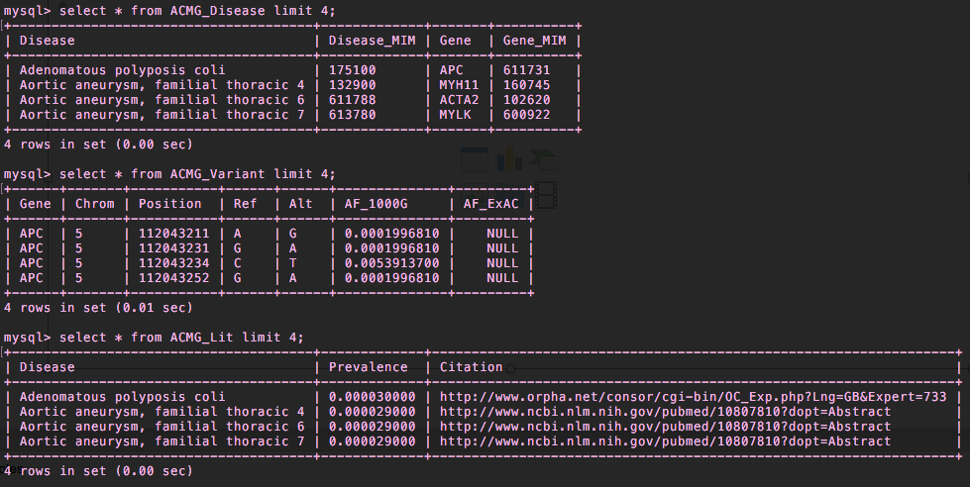
ACMG_Disease
ACMG_Variant
ACMG_Lit

Slide 11

ACMG Incidentalome
Raj and I are interested in the value of current pathogenicity ratings in ClinVar for the ACMG genes (actionable in genetic testing situations).
Penetrance = $P\left(D | V\right)=\frac{P\left(D\right)∗P(V|D)}{P\left(V\right)}=\frac{prevalence ∗ P(V|D)}{allele . frequency}$
We need: (1) prevalence, (2) allele frequency, and (3) allelic heterogeneity = P(V|D)
Notes:
Haven’t actually put these together yet!!!!!

Slide 12
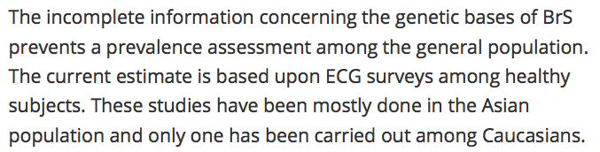
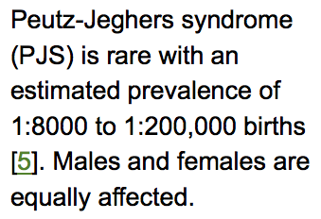
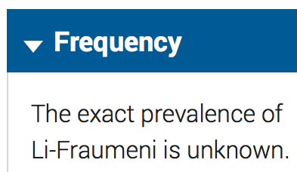
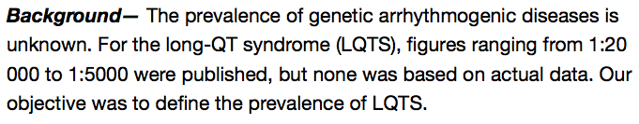

(1) Prevalence: Estimates are Uncertain and Highly Variable

Slide 13
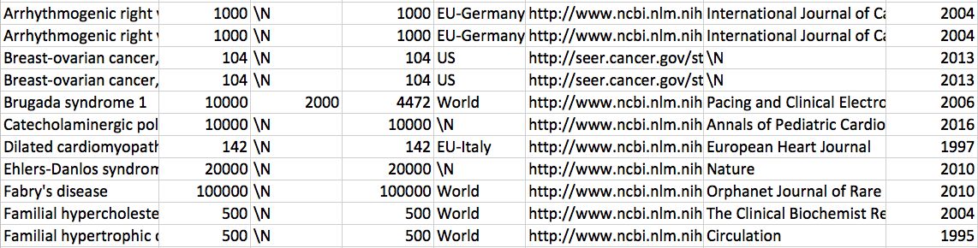
We try anyway (Prevalence Estimates)

Slide 14
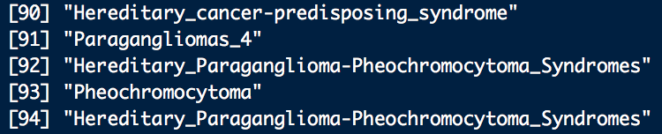
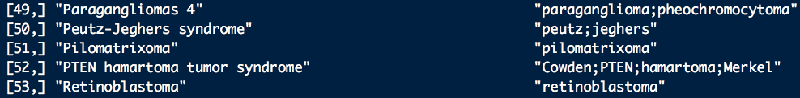

(2) Allele Frequencies
Problem: Diverse set of names used to identify disease:
Solution: 1. Find patterns that uniquely indicate a disease.
2. Use grep to match pattern in the list of disease names.
3. Pull out allele frequencies from all variants that match. Combine them as P(variant) $=1−\prod{(1−allele.frequency)}$

Slide 15
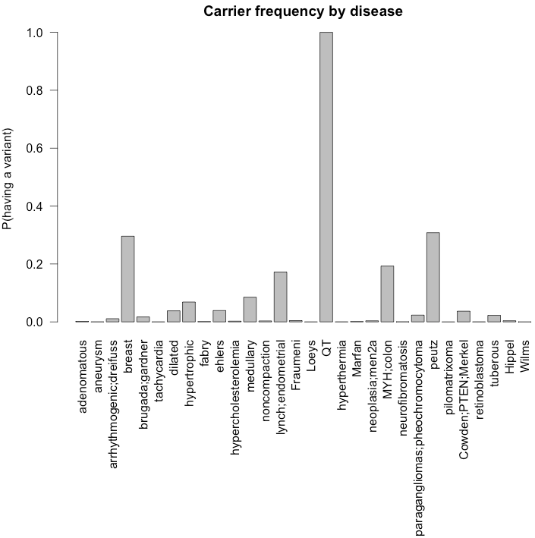
Results

Slide 16
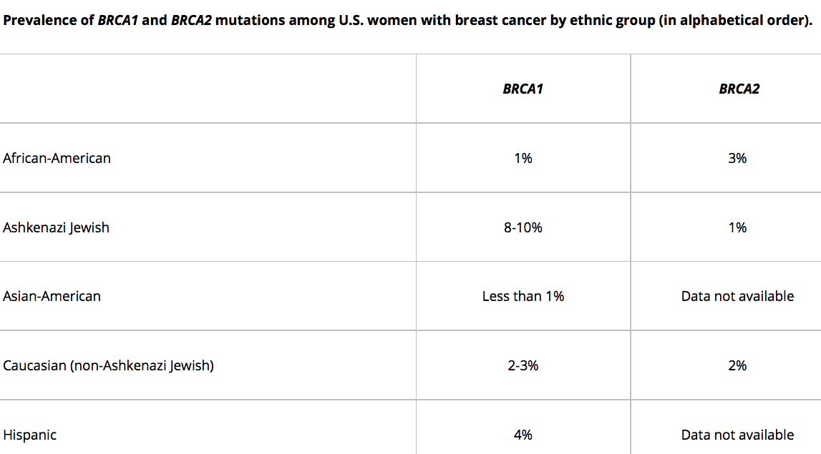
Allelic heterogeneity
BRCA1/BRCA2: P(variant | disease) = ~2%
I’m assuming most of them are on the same order of magnitude.

Slide 17
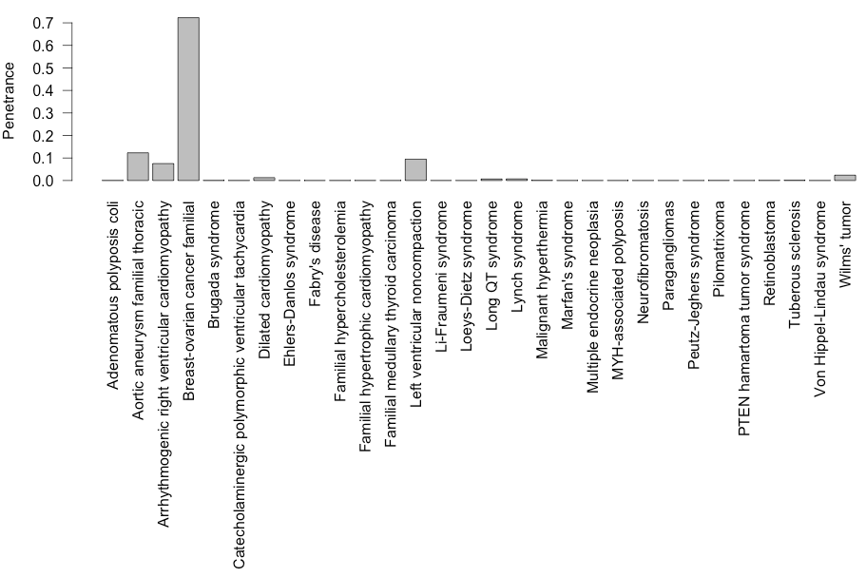
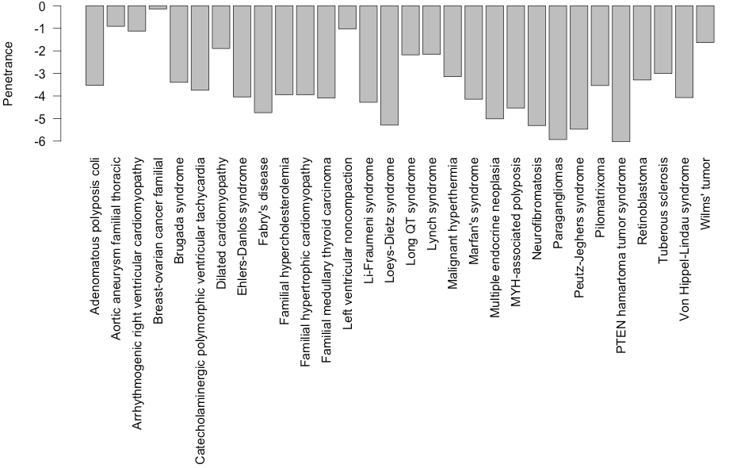
Assuming Allelic heterogeneity of ~2% for all genes:

