Slide 1
Frequency of ACMG 56 Variants in Ancestrally Diverse Populations
James Diao | Raj Manrai | Kohane Lab | 7/29/2016

Slide 2
Background
ACMG: American College of Medical Genetics & Genomics
Incidental finding: Results of a search for pathogenic alternations in genes that are not apparently relevant to a diagnostic indication for which the sequencing test was ordered.
ACMG-56: According to ACMG recommendations, the set 56 genes in which pathogenic variants should be reported even when discovered incidentally.
ClinVar: central repository for interpretations of clinically relevant variants.
1000 genomes: contains genotype data for 2,504 healthy individuals.

Slide 3
NEJM figure about importance of ancestry
Found in Zak lab previously
Looking in diverse populations and in clinically relevant variants

Slide 4
1000 Genomes Population Analysis

Slide 5
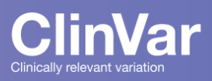



Workflow
Manual Input
Scrape ClinVar (ACMG-56)
File Upload (.txt, .Rdata)
Scrape LMM (Panel Test)
Gene Inputs
Download 1000 Genomes Phase 3 Populations Map
Retrieve Transcription Coordinates from UCSC Genome Browser
Download and Process VCF files from 1000 genomes
Plot 1: Mean number of non-reference sites by population
Plot 2: Number of reference sites per nucleotide by gene
Plot 3: Fraction with at least 1 non-reference site by population

Slide 6
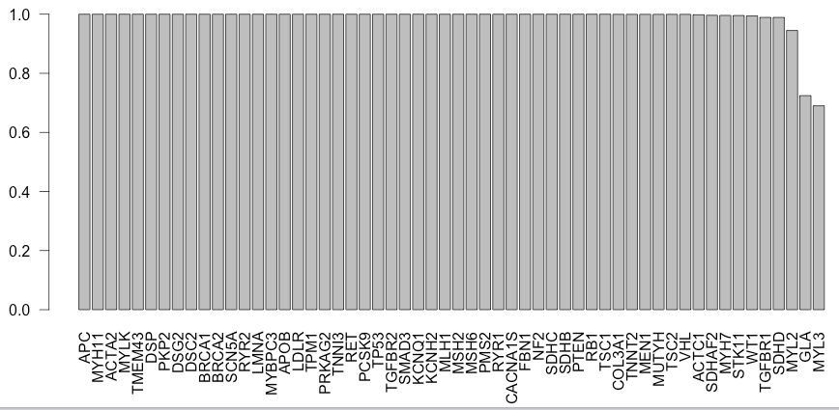
Pretty much all 1000G patients have some variants in each ACMG genes
Exceptions: the 2 shortest genes
Doesn’t differentiate benign v. pathogenic

Slide 7
Joining individual-level data from diverse populations (1000 genomes) with pathogenicity data (ClinVar)

Slide 8
Joining Pathogenic Clinvar Variants with 1000G
1000 genomes: 139,388 unique variants in ACMG-56.
ClinVar: 8,441 unique pathogenic variants across 27,000 genes
Intersection: 137 unique variants in both datasets
140,000 variants in 1000 genomes
Take only pathogenic variants in ClinVar
137 pathogenic ACMG-56 variants

Slide 9
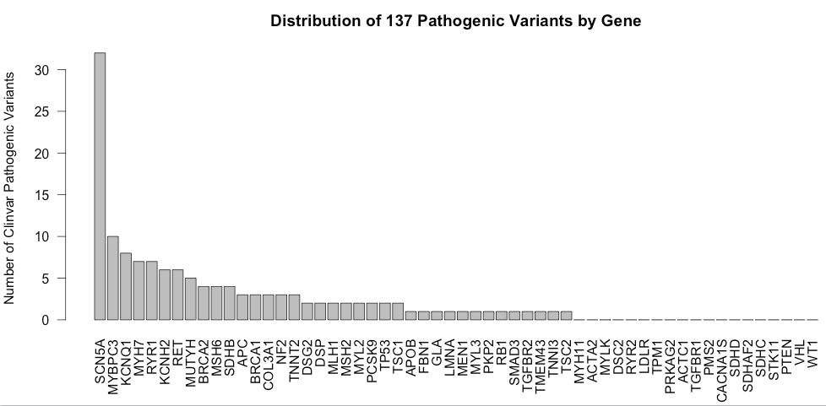
Pathogenic ACMG-56 Variants by Gene and Disease
37/56 have at least 1 variant 19/56 are not associated with any pathogenic variants in 1000G.

Slide 10
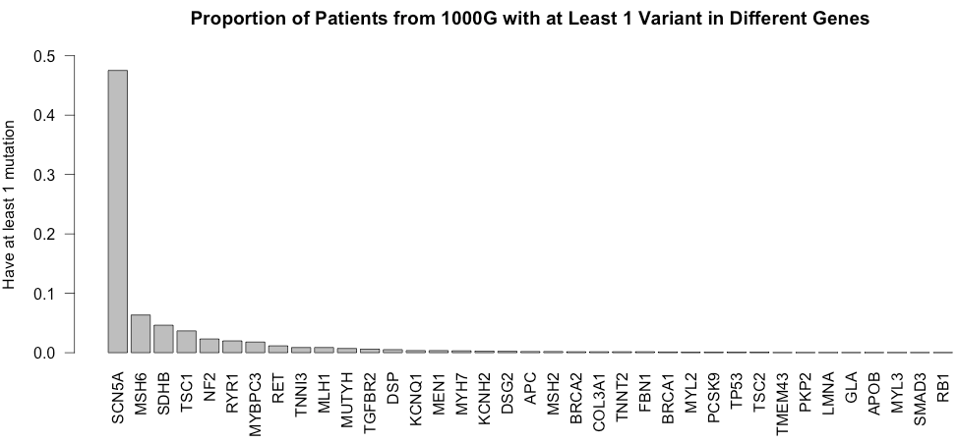
1000G individuals with pathogenic mutations
Closely follows previous plot: longer gene = more variants =
greater fraction of people with variants
Correlation = 0.908
SCN5A = 101,611 bp tx region
SCN5A is a sodium voltage-gated channel- associated with long QT syndrome and Brugada syndrome.
Notes:
For example: MYBPC3 is 1/50, but prevalence of HCM is 1/500. SCN5A mutations are in ½ of the population (?!?!)

Slide 11
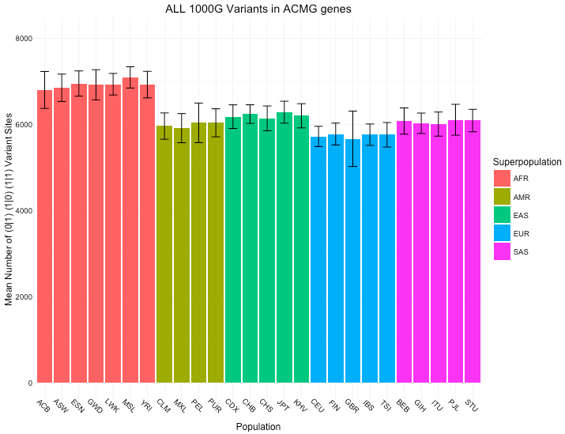
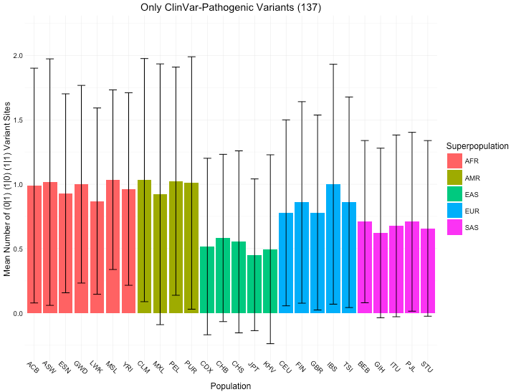
Mean variants across all 1000G variants vs. Mean variants across 137 ClinVar-1000G variants

Slide 12
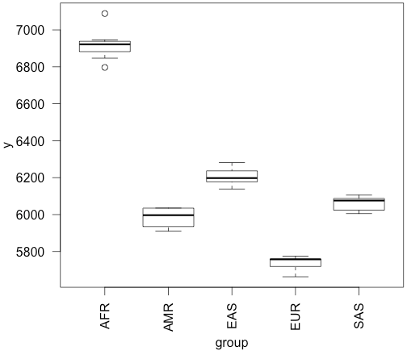
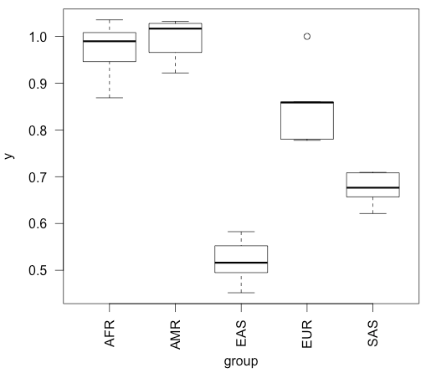
ANOVA Table: F-statistic comparing ALL groups to each other
All 1000G 138,000 variants results:
F-value = 294.88 P(>F) = 2.2 E-16
ClinVar-1000G 137 variant results:
F-value = 58.685 P(>F) = 4.25 E-11
F-statistic + p-values: H0 = all groups drawn from same distribution

Slide 13
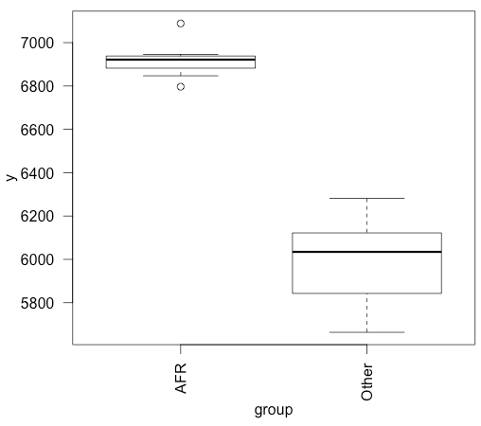
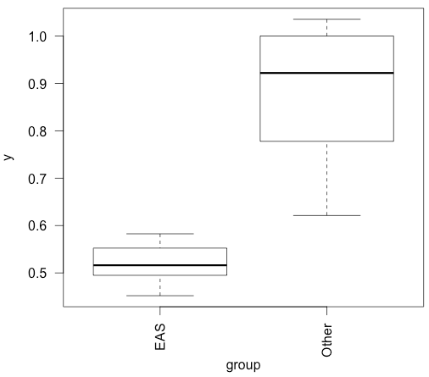
ANOVA Table: F-statistic comparing 1 group to all other groups
All 1000G 138,000 variants results:
Diff group = “AFR”
F-value = 156.22 P(>F) = 5.35 E-12
ClinVar-1000G 137 variant results:
Diff group = “EAS”
F-value = 30.869 P(>F) = 1.025 E-5

Slide 14
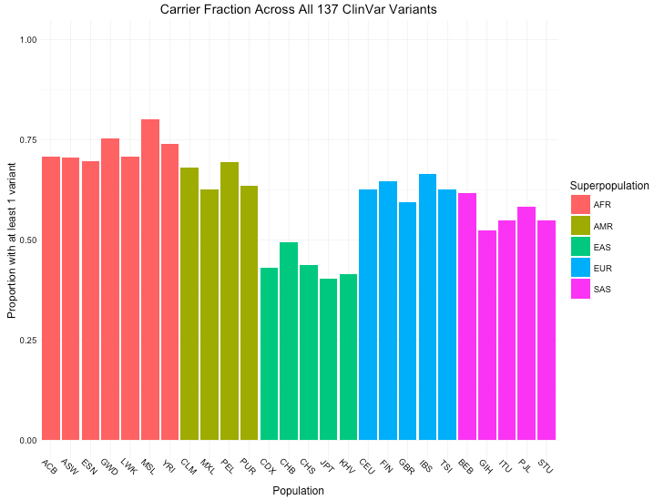
Carrier fraction across 137 ClinVar-1000G variants
50-70% of people would be reported as having an incidental finding under ACMG guidelines.
EAS (East Asian) groups seem to have the least pathogenic variants in ACMG-56
Notes:
Randomly select 56 genes 10 times

Slide 15
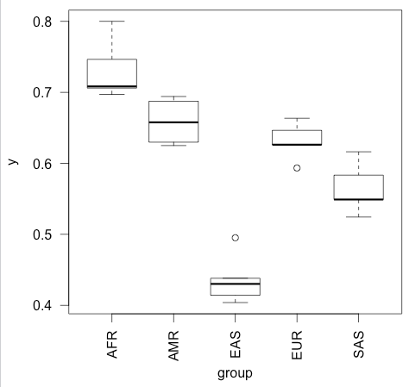
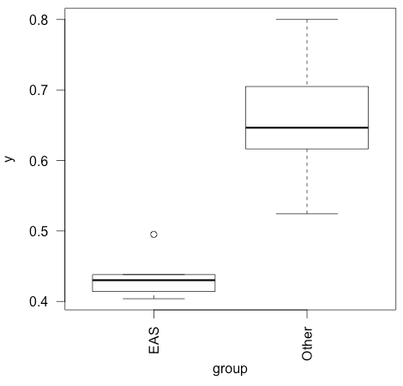
ClinVar-1000G Fraction Carriers: between each group
F-value = 58.377 P(>F) = 4.47 E-11
ClinVar-1000G Fraction Carriers: between “EAS” and other groups
Diff group = “EAS”
F-value = 42.359 P(>F) = 9.90 E-7
Notes:
AFR as well

Slide 16
Penetrance Sensitivity Analysis
Notes:
When introducing penetrance (have background)

Slide 17
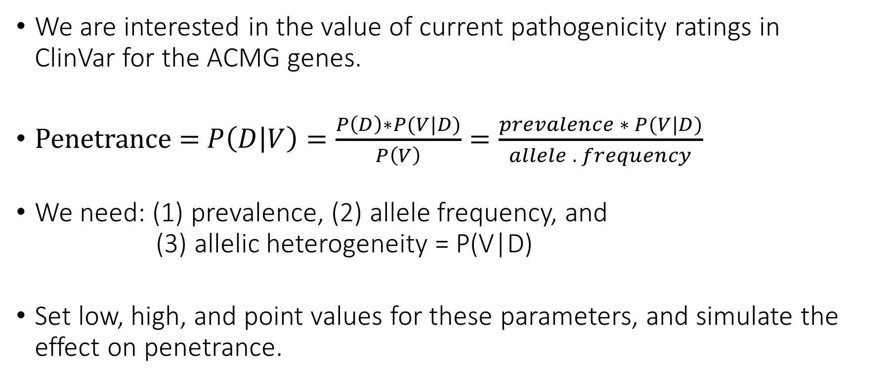
ACMG Incidentalome
We are interested in the value of current pathogenicity ratings in ClinVar for the ACMG genes.
Penetrance = $P\left(D | V\right)=\frac{P\left(D\right)∗P(V|D)}{P\left(V\right)}=\frac{prevalence ∗ P(V|D)}{allele . frequency}$
We need: (1) prevalence, (2) allele frequency, and (3) allelic heterogeneity = P(V|D)
Set low, high, and point values for these parameters, and simulate the effect on penetrance.
Notes:
Title?

Slide 18
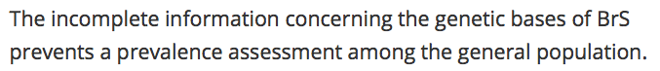
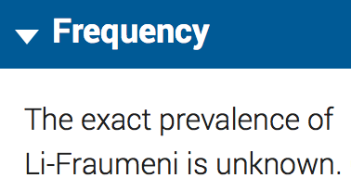
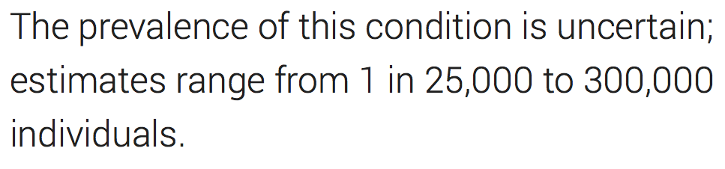
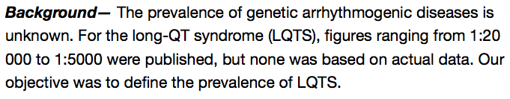
(1) Prevalence Estimates are Uncertain and Highly Variable
https://ojrd.biomedcentral.com/articles/10.1186/1750-1172-1-35
https://ghr.nlm.nih.gov/condition/peutz-jeghers-syndrome
https://ghr.nlm.nih.gov/condition/li-fraumeni-syndrome
http://www.ncbi.nlm.nih.gov/pubmed/19841298

Slide 19
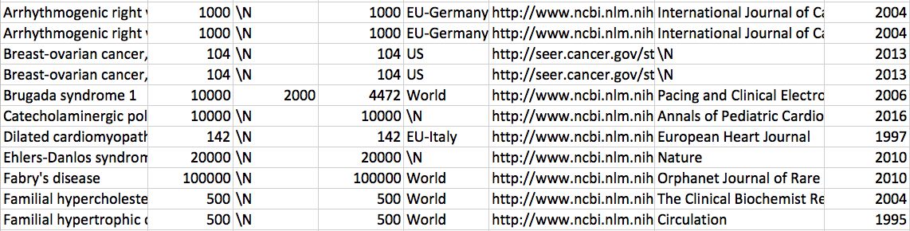
Prevalence estimates found on Pubmed/Google Scholar
Notes:
Describe search heuristic
Reverse citation order when available
Include other cols too

Slide 20
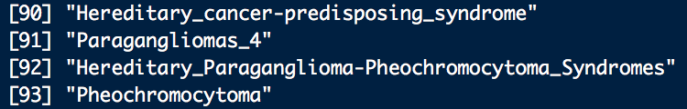
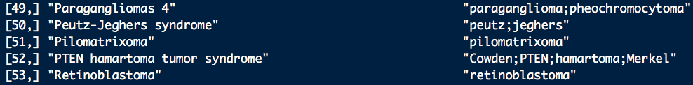
(2) Allele Frequencies
Problem: Diverse set of names used to identify disease:
Solution: 1. Find patterns that uniquely indicate a disease.
2. Use grep to match key disease tags (substrings and synonyms) after manual curation.
3. Pull out allele frequencies from all variants that match.

Slide 21
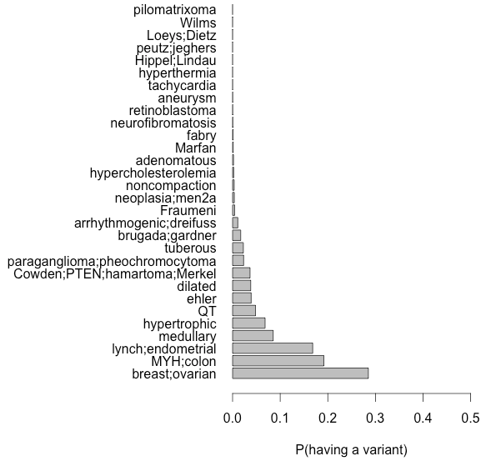
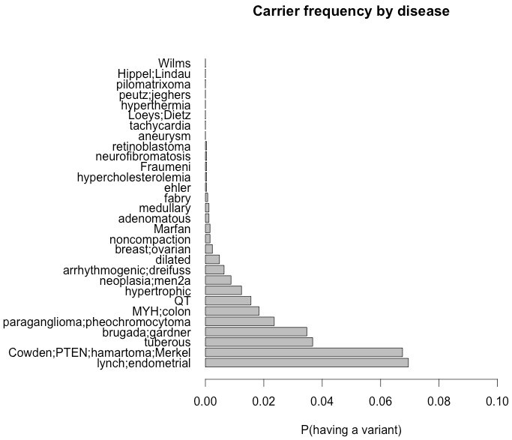
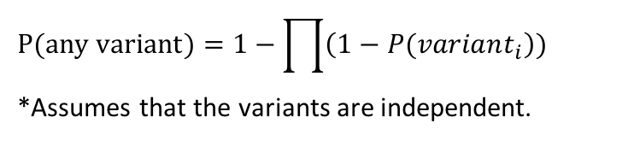
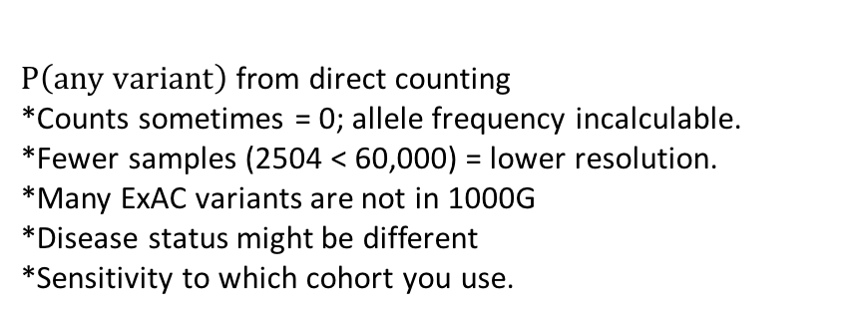
(2) Allele Frequencies: ExAC (left), 1000G (right)
Correlation: 0.316
Breast/ovarian cancer: 30%
MYH-polyposis: 20%
Lynch syndrome: 17%
Medullary thyroid cancer: 9%
Hypertrophic cardiomyopathy: 7%
Every other: <5%
Lynch syndrome: 7%
PTEN hamartomas: 6.7%
Tuberous sclerosis: 3.5%
Brugada syndrome: 3.5%
Paragangliomas: 2.4%
Every other: <2%
$$P(any variant)=1−\prod{\left(1−P(variant_{i}\right))}$$ *Assumes that the variants are independent.
$P\left(any variant\right)$from direct counting *Counts sometimes = 0; allele frequency incalculable. *Fewer samples (2504 < 60,000) = lower resolution.
*Many ExAC variants are not in 1000G
*Disease status might be different
*Sensitivity to which cohort you use.
Notes:
Make scatterplot of ExAC vs. 1000G
Take only the 137 that match (ExAC: used to separate out effects).

Slide 22
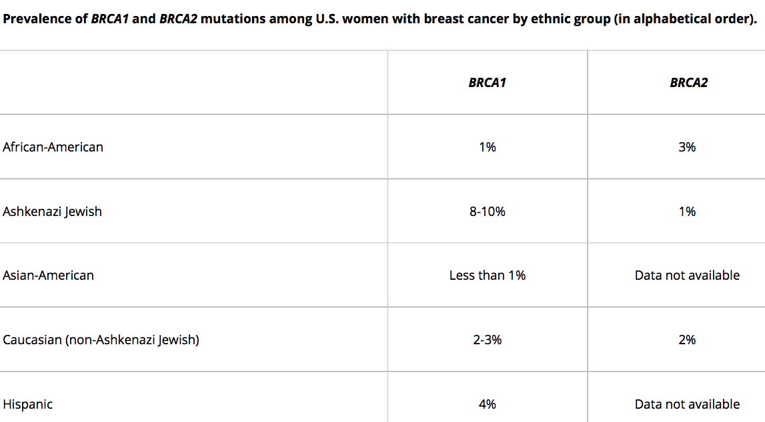
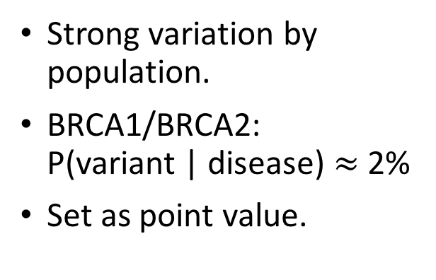
(3) Allelic Heterogeneity
Strong variation by population.
BRCA1/BRCA2: P(variant | disease) $≈$ 2%
Set as point value.
Notes:
Make own table

Slide 23
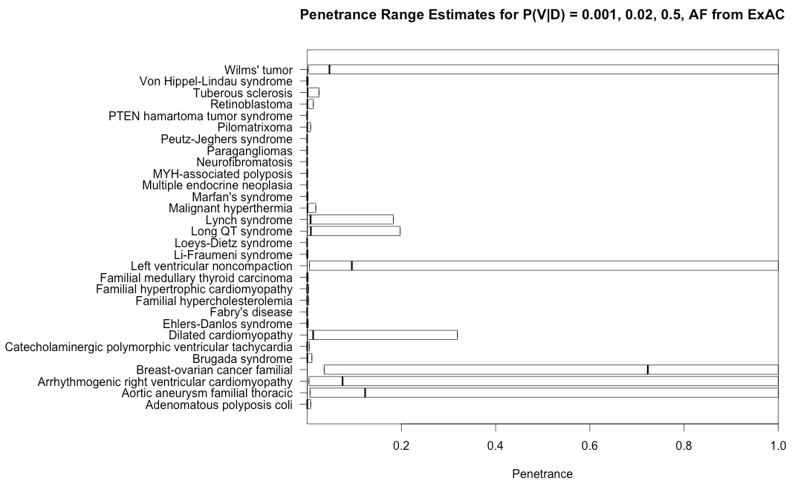
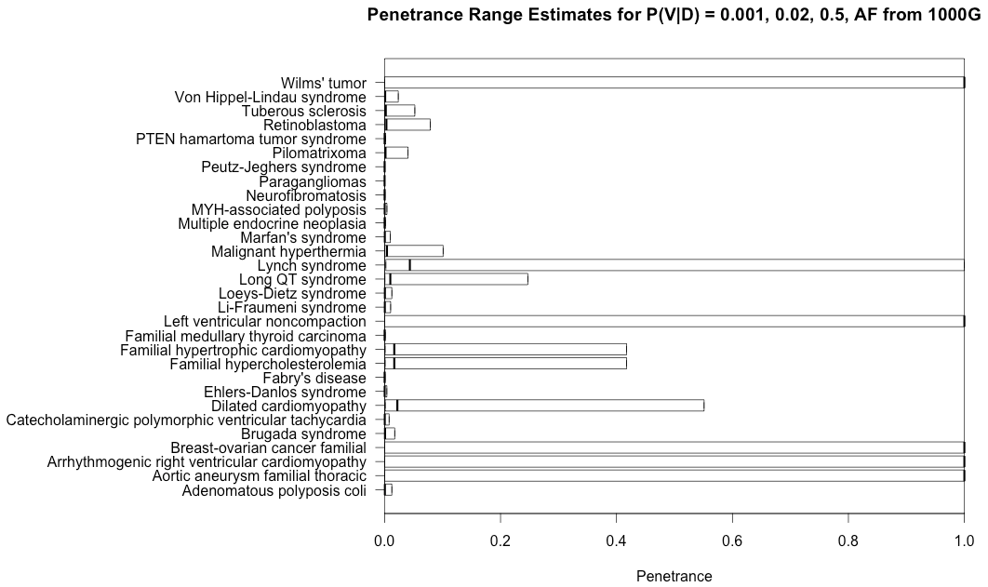
Rough Penetrance Estimates: ExAC (left) and 1000G (right)
*Penetrance estimates have a similar shape, but are increased because 1000G has fewer individuals.
*Some values are Inf because no individuals in 1000G were found with those alleles.
_ out of _ diseases have maximum penetrance < 50%
Asterisk those (coverage, representation in datasets), no estimate, assumed 0.
Notes:
All variants with no observations
ONLY BY VARYING ALLELIC HETEROGENEITY
Change the way Inf penetrance
Treating as parameter instead of estimate

