Slide 1
Update 7/15/2016
JAMES DIAO

Slide 2
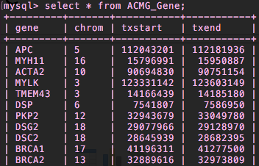
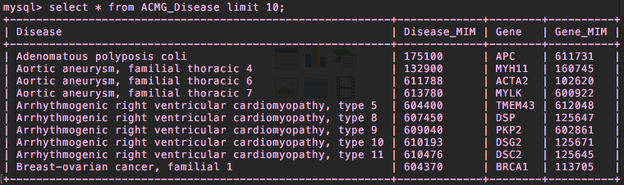
Add txstart/txend/refGene NEW ACMG_Gene table vs. redundancy in ACMG_Disease

Slide 3
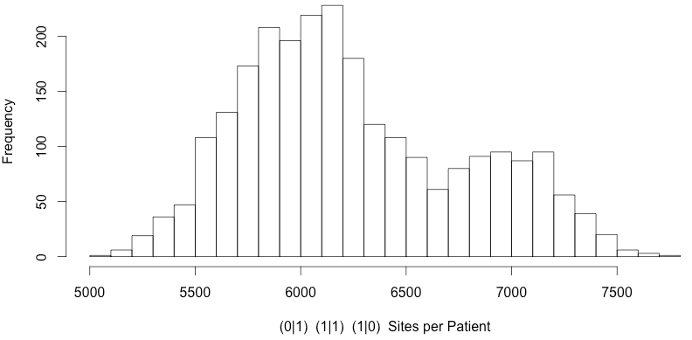
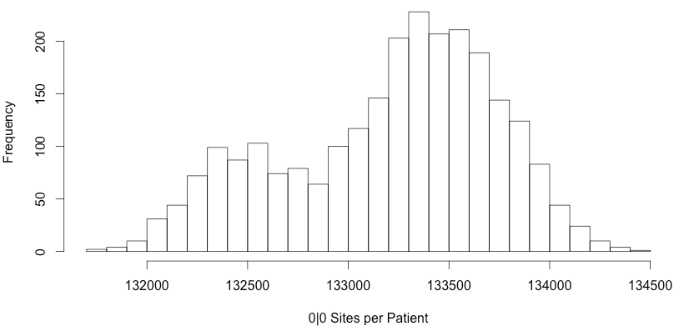
Variants across 56 ACMG genes in 1000 G patients

Slide 4
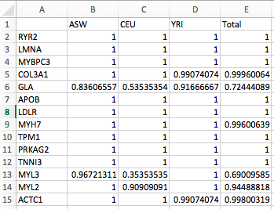
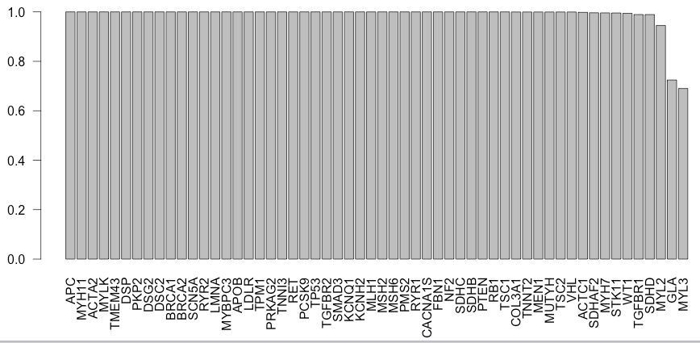
PopulationVariantStatus
Notes:
1000G

Slide 5

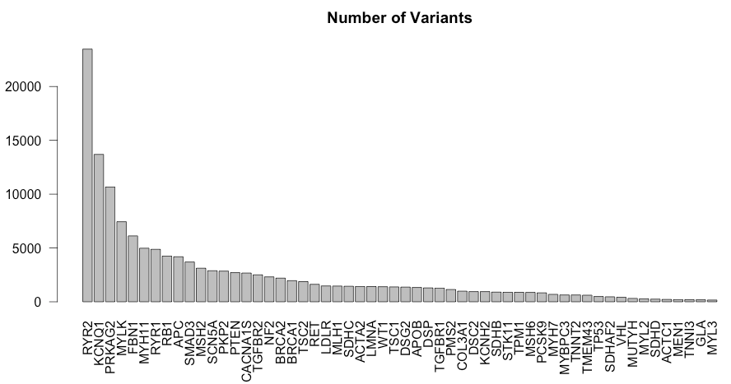
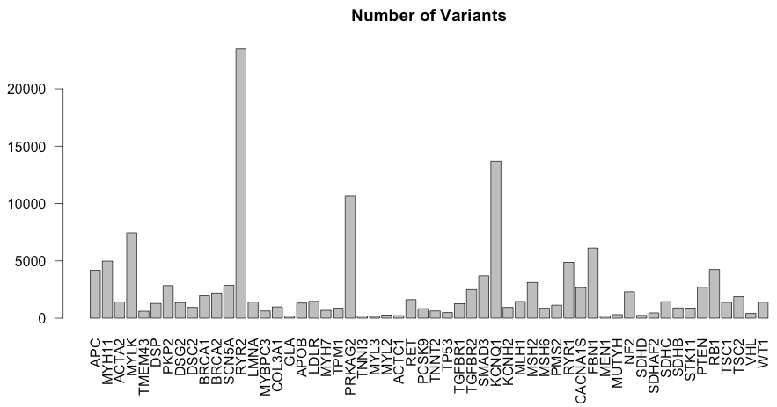
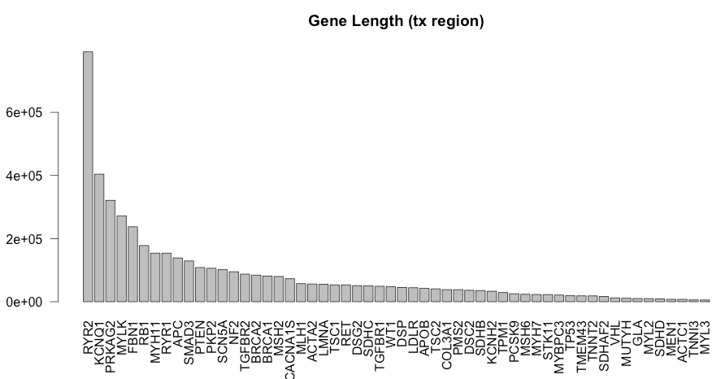
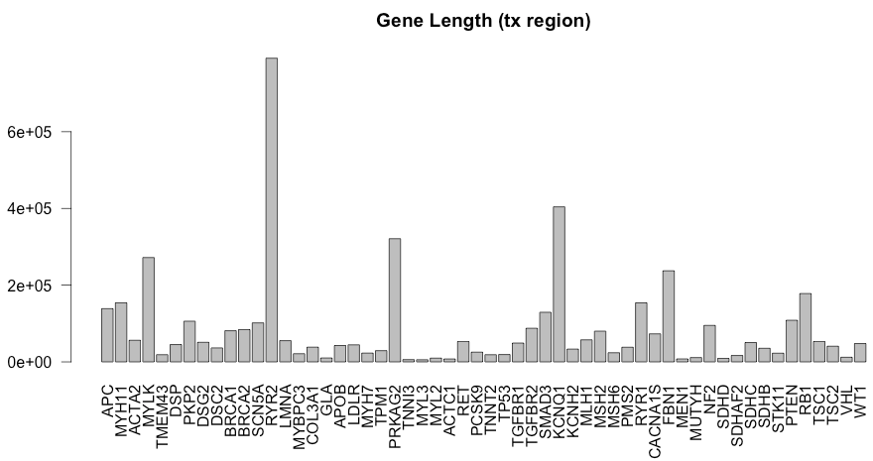

Slide 6
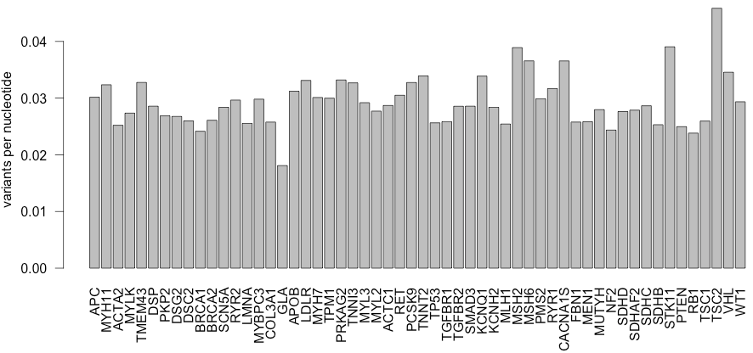
Around 0.03 variants per nucleotide

Slide 7
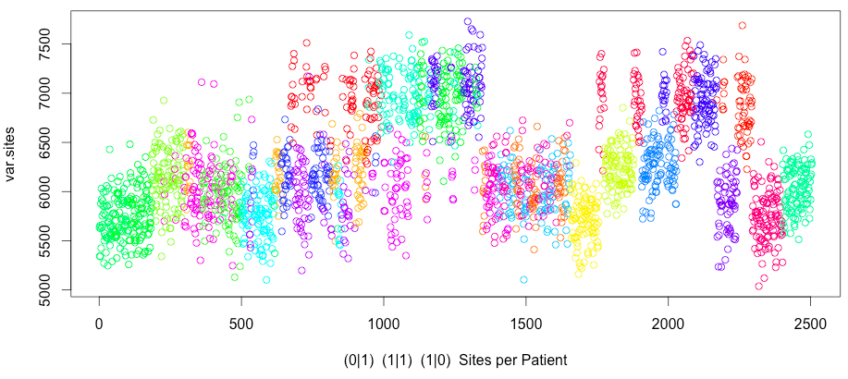
Side note: some clustering by population
Notes:
Download EIGENSTRAT
Skim documentation
Run PCA plot using EIGENSTRAT on just the ACMG and just the HCM.
Label the individuals by population.
1000G supplementary materials.

Slide 8
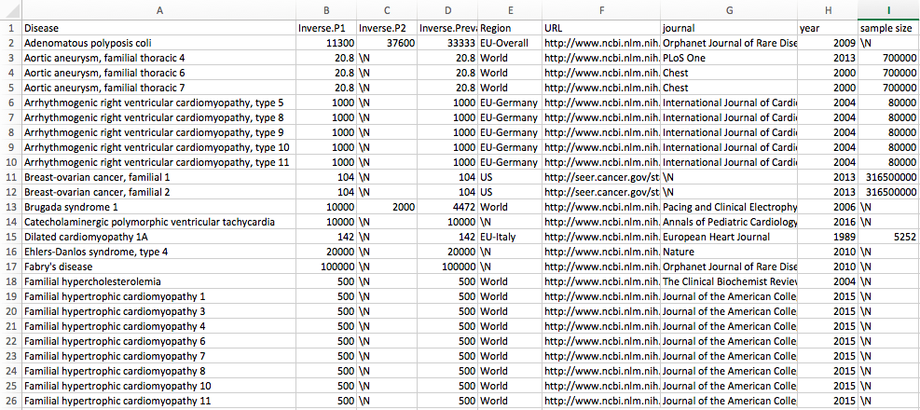
Working on ACMG_Lit
Notes:
Not population; probably projected out.
Author name
Google scholar: disease name, prevalence, most cited
Retrieval date and citation

Slide 9
Questions about ACMG_Lit Prevalence
Point estimate of prevalence from multiple reports (e.g. 1:5,000 and 1:100,000)
Arithmetic mean seems like it would overestimate.
Geometric mean might work pretty well (~22,360) (bounded; effectively averaging some log function)
Alternatively, reported a range for now.
Citations
URL + PubMed ID + Author et al., Journal, Year.
Original study
Additional fields: country, ^categorical: newborns/children/adult

