Slide 1
Update 7/18/2016
JAMES DIAO

Slide 2

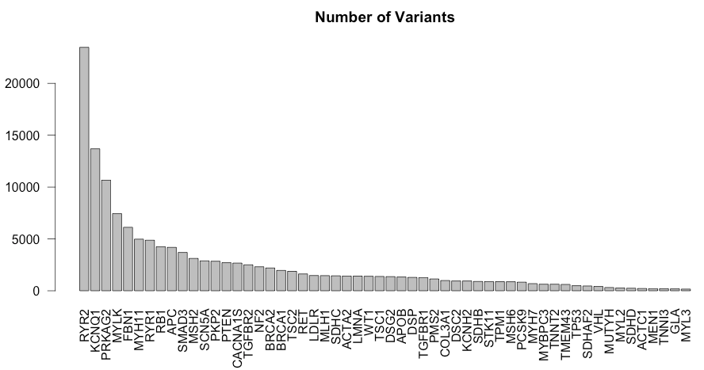
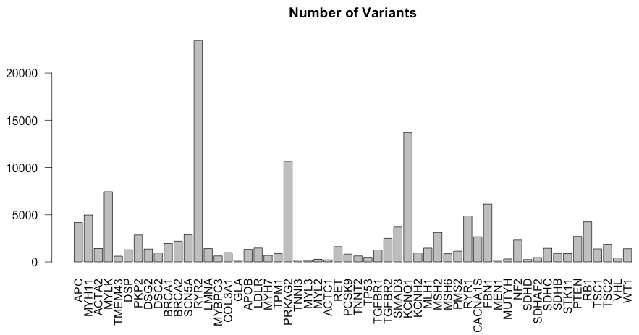
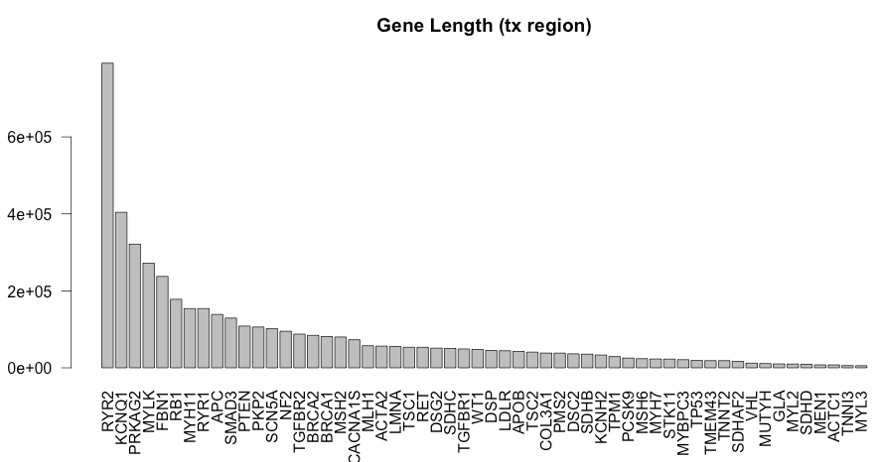
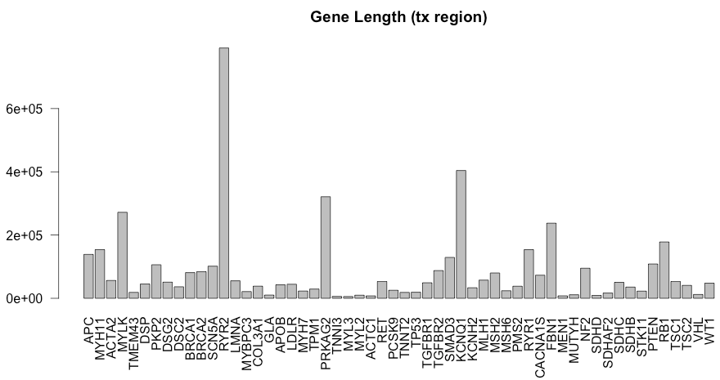

Slide 3
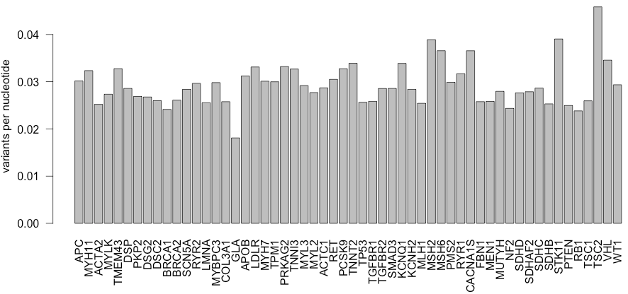
Around 0.03 variants per nucleotide
Notes:
Make plot

Slide 4
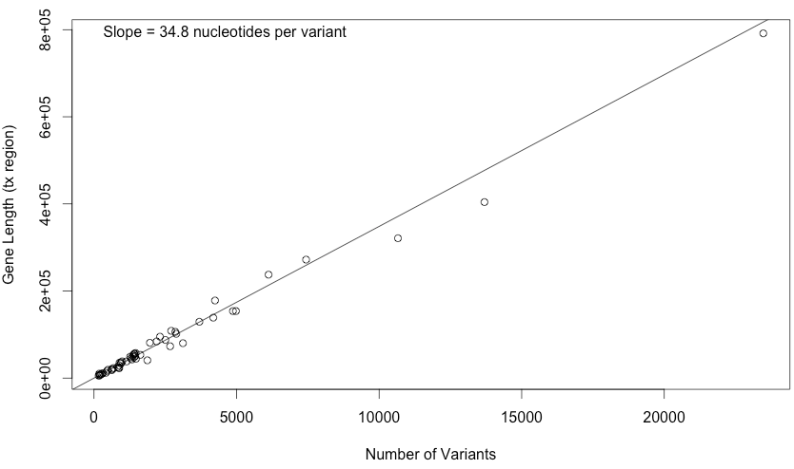
Around 35 nucleotides per variant

Slide 5
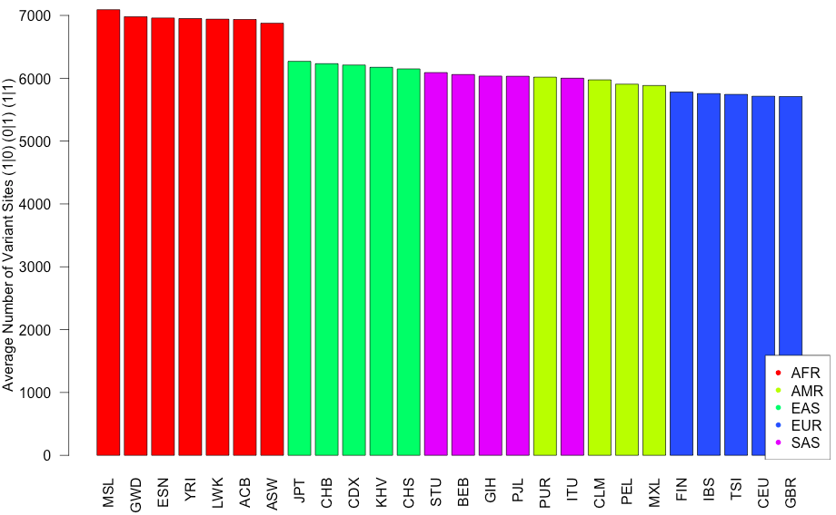
Average Number of Variant Positions: AFR > EAS > SAS > AMR > EUR
Notes:
Error bars
Double check labeling
Eigenstrat labeling on 1000G data.
Label plots with 1000G
ACMG literature search

Slide 6
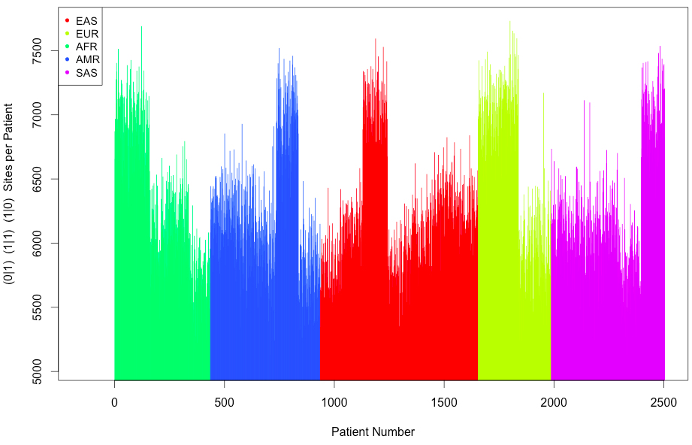
Clustering by Superpopulation (Diff colors)

Slide 7
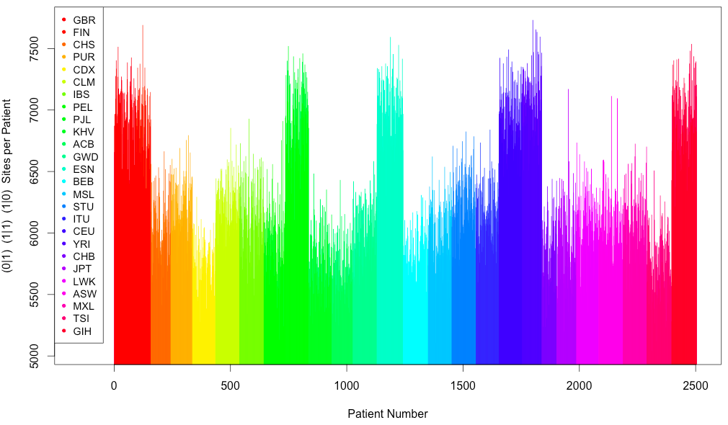
Clustering by Population
Notes:
Download EIGENSTRAT
Skim documentation
Run PCA plot using EIGENSTRAT on just the ACMG and just the HCM.
Label the individuals by population.
1000G supplementary materials.

Slide 8
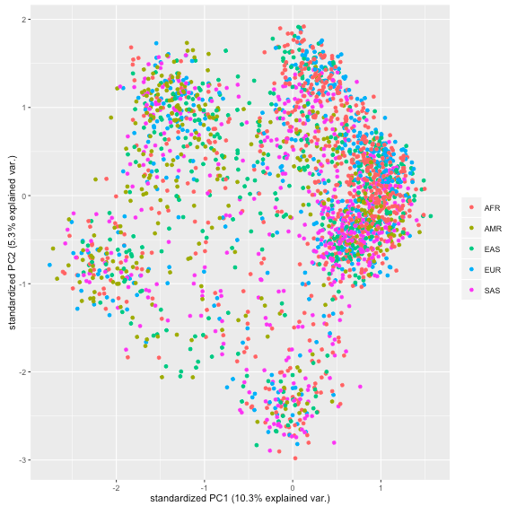
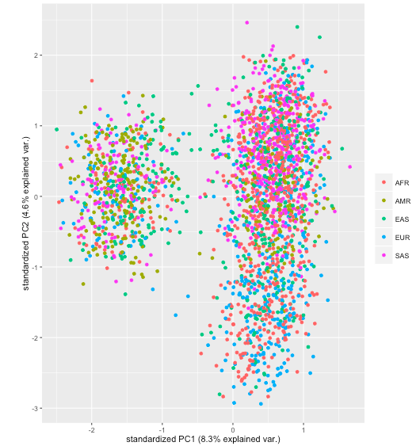
HCM ACMG
PCA with ggbiplot
Rows = variants (subset of 1000)
Columns = patients

Slide 9
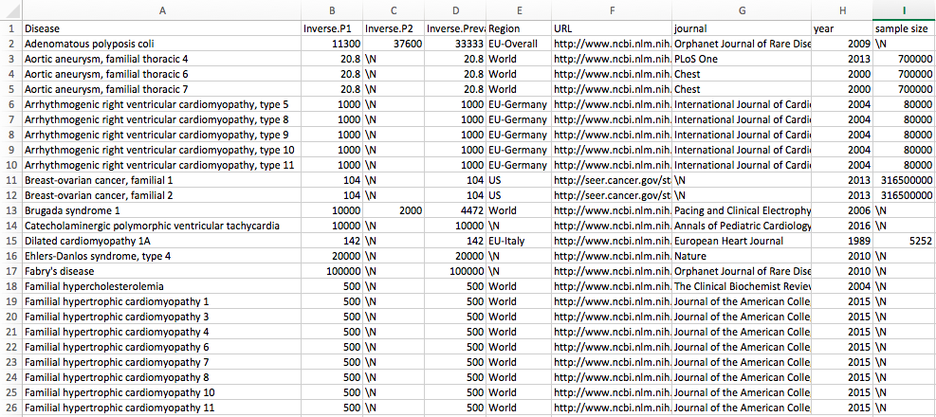
Working on ACMG_Lit
Notes:
Not population; probably projected out.
Author name
Google scholar: disease name, prevalence, most cited
Retrieval date and citation

Slide 10
Questions about ACMG_Lit Prevalence
Point estimate of prevalence from multiple reports (e.g. 1:5,000 and 1:100,000)
Arithmetic mean seems like it would overestimate.
Geometric mean might work pretty well (~22,360) (bounded; effectively averaging some log function)
Alternatively, reported a range for now.
Citations
URL + PubMed ID + Author et al., Journal, Year.
Original study
Additional fields: country, ^categorical: newborns/children/adult

