Slide 1
Unit and Acceptance Testing
Alex Ward
ONESite inc.
<award@onesite.com> or <daginus@gmail.com>

Slide 2
Unit Tests, what's the point?
Keeps you from repeating past mistakes
Ensures deployments will go smoothly by detecting problems before they occur
Changing one part of the code can have unexpected effects on other parts of the code.
Keeps you high and DRY (Don't repeat yourself) by reducing bugs.

Slide 3
Is it really necessary?
You can make perfectly deployable code without ever having run a unit test against it.
Manual testing can also help detect bugs.
Manual testing will never catch every situation.
Neither will unit testing.
A combination of testing strategies is needed to ensure bug minimization.

Slide 4
Great, how do I do this?
The hardest part of writing unit tests is figuring out how it could break.
  The developer who wrote the system is likely to not to know all the places in which their application can break (due to familiarity with the code)
  Pair programming for the test writing phase can help mitigate this problem
Writing the tests is the easier part

Slide 5
Unit Testing Tools
For PHP, phpunit is the standard testing framework
  It is a pain to install, instead, Jake Farrell (@eatfresh) has forked phpunit and made all its dependencies git submodules. (It's awesome).
  https://github.com/jfarrell/phpunit
  git clone git://github.com/jfarrell/phpunit.git
Documentation for phpunit is available online
  http://www.phpunit.de/manual/3.5/en/writing-tests-for-phpunit.html

Slide 6
Test Writing Process
Determine how your application is supposed to operate, and where it might fall apart
Write tests to ensure that it does what it is supposed to do, and then write tests to ensure it doesn't break under various circumstances.
Also remember to write tests to ensure it fails when it is supposed to.

Slide 7
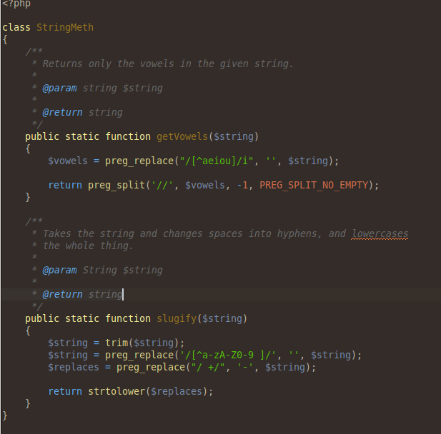
Testing Examples (Demo site)

Slide 8
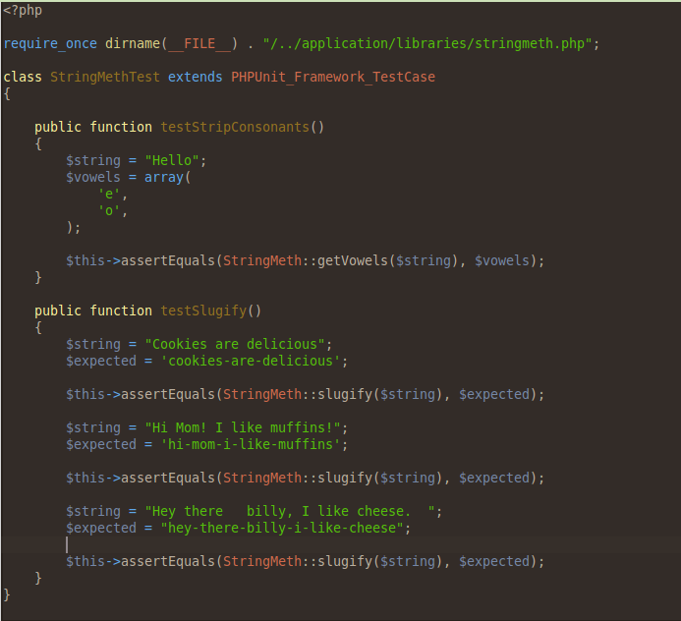
Testing Examples (Demo Site)

Slide 9
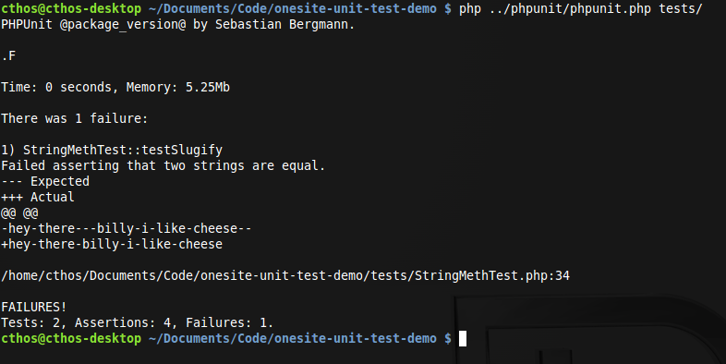
Testing Examples (Demo Site)

Slide 10
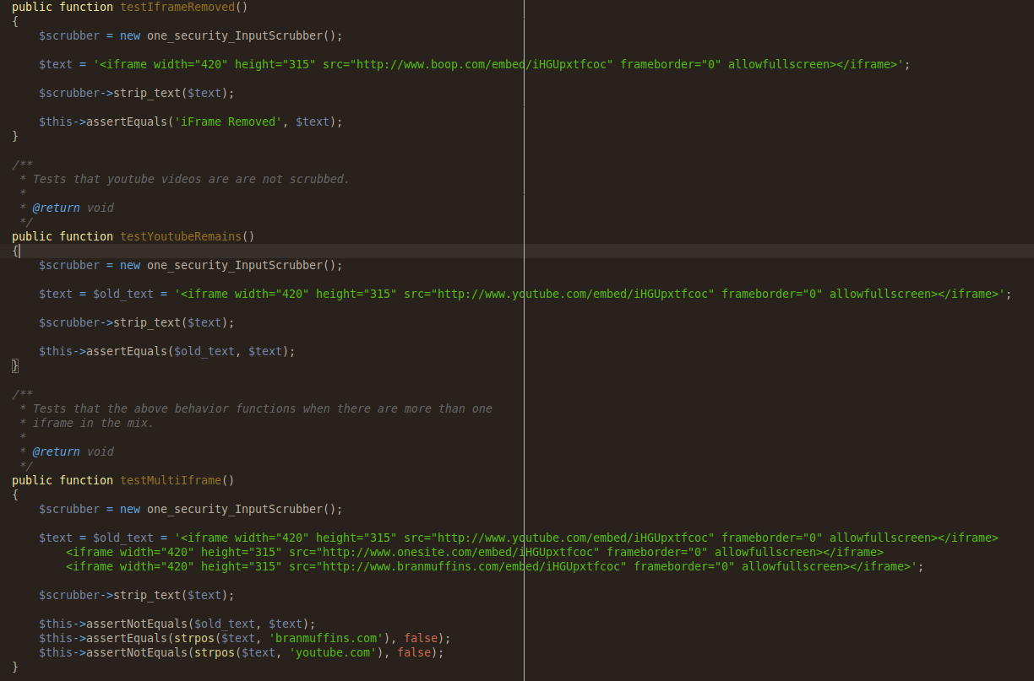
Testing Examples (ONESite)
IFrame Scrubber

Slide 11
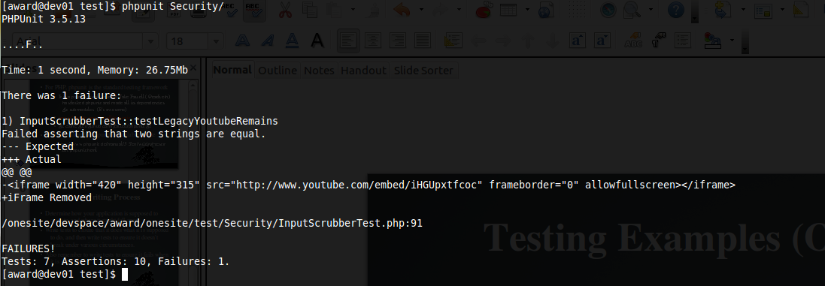
Testing Examples (ONEsite)
Test Results
I failed at this test, because the current branch I am on does not have all the appropriate patching done from the main branch. Which makes for a good example of seeing a unit test fail.

Slide 12
Selenium IDE Testing
A weakness of phpunit is that it is unable to test how a user would interact with a live site.
Selenium IDE is a Firefox plugin which allows you to write tests which will simulate user interaction and allow you to test javascript flows.
http://seleniumhq.org/projects/ide/
It also comes with a way to interface with a language directly, to test php server responses.

Slide 13
What is Selenium Good at?
Testing any flow that relies on javascript
  Ensuring popups display
  Social Login flows
Complex, multi-page flows which relies heavily on ux
  Making sure elements on the page display and are visible

Slide 14
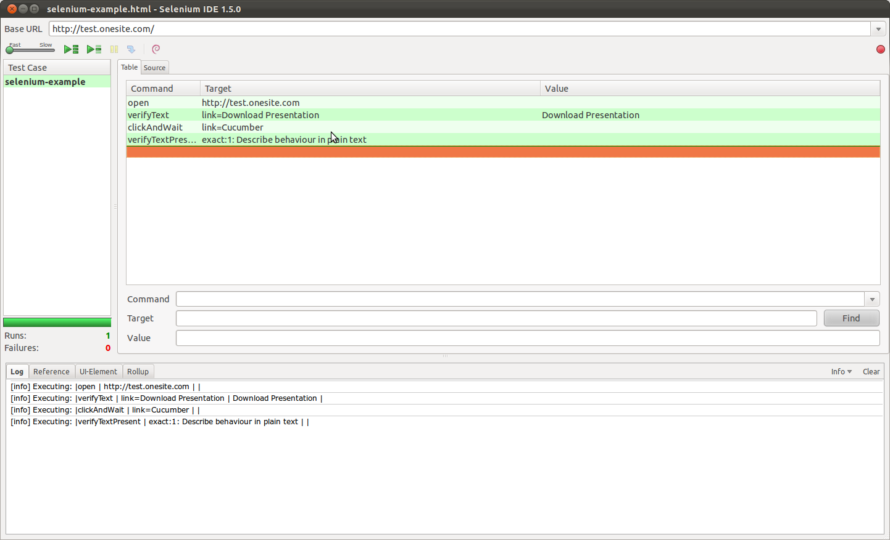
Selenium Example

Slide 15
TDD (Test Driven Development)
TDD changes up the order in which you write unit tests.
Write your tests first. They will fail. Then write your application in order to make those tests pass
  Make sure you do this in small chunks, it is designed for continuous progress.
  http://en.wikipedia.org/wiki/Test-driven_development

Slide 16
Acceptance Testing
Acceptance testing is the corrolary to Unit Testing
Where Unit Testing is designed to ensure you write your code correctly, Acceptance testing is designed to ensure you have written the correct code
  As in, have met the requirements for the project.

Slide 17
Cucumber
Cucumber is a BDD (Behavior Driven Development) tool designed to make acceptance testing awesome
Write domain specific language, that looks like plain english.
Write your application to make those tests pass
Everyone gets exactly what they're expecting

Slide 18
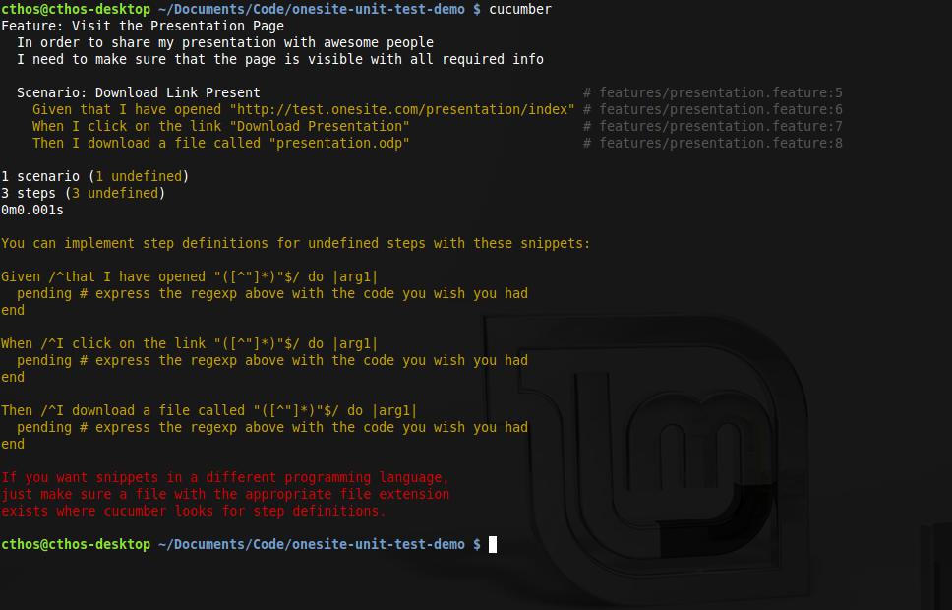
Cucumber

