Slide 1
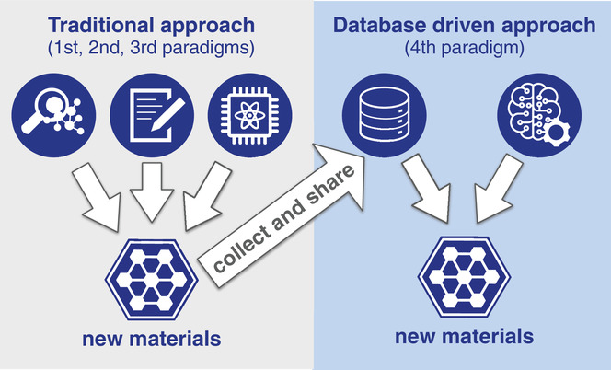

Motivation
Other Interested
Utilization of NLP
Select Paper
Biomedical document retrieval for clinical decision support system
A Novel Approach to Part Name Discovery in Noisy Text
Deep Short Text Classification with Knowledge Powered Attention
Notes:
There is growing interest in the world of material science to use artificial intellegence and
machine learning tools to accelerate the rate of materials discovery
The interest in these applications can also be seen in biomedical
The bottleneck hasnt been the models but lack of data
Due to the difficulty of collecting data from paper, this got me interested in NLP,
specifically short text
After reading I chose this paper

Slide 2
Re-implementing and Improving Short Text Classification Model
David Farache

Slide 3
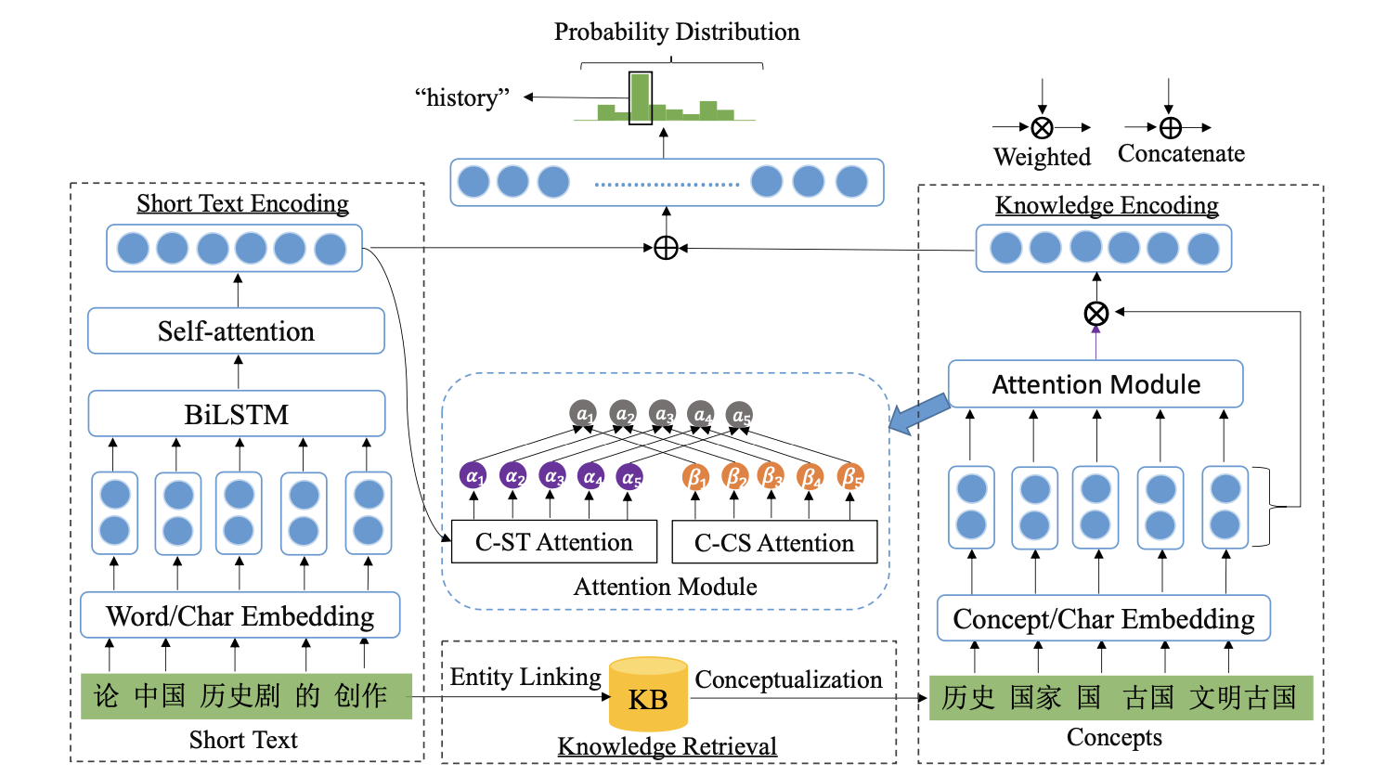
STCKA Model
Explicit
Implicit
Notes:
Short Text Classification with Knowledge Powered Attention
uses attention mechanisms to
Combines Explicit
-Semantic, structure
and Implicit
-Concepts, and deeper meaning of those words
To make predictions

Slide 4

Concept toward Short Text
Short Text Representation: q
Scaled Dot Product
RNN
Input Embedding
Notes:
RNN for capturing context reasoning
text representation

Slide 5
Concept toward Concept
Get Concept Representation:
C
Input Embedding
Transfer Short Text to Concepts
Notes:
short text to word
mel gibbson has concept of actor or male
representation

Slide 6
Network Change

Slide 7
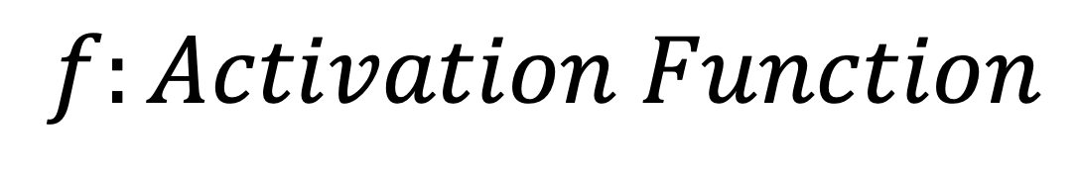
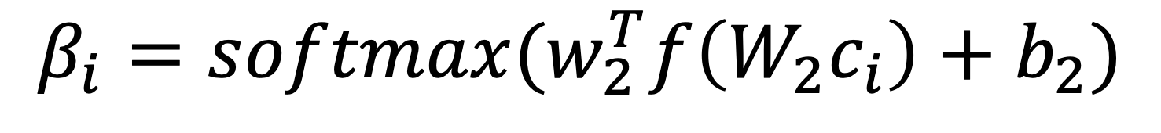
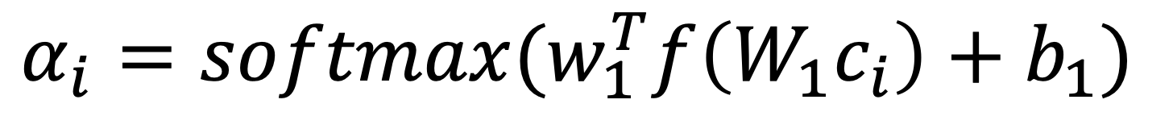
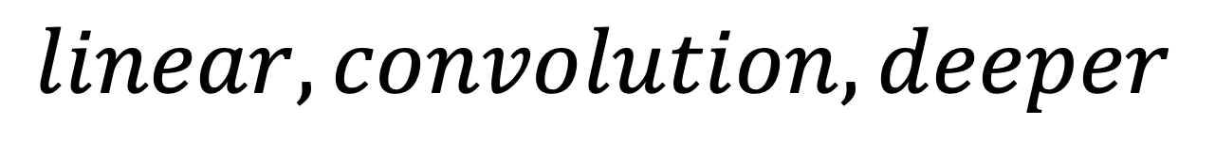
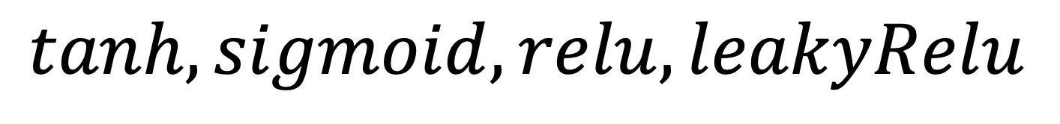
Changes Being Made
$$α_{i}=softmax(w_{1}^{T}f\left(W_{1}c_{i}\right)+b_{1})$$
$$β_{i}=softmax(w_{2}^{T}f\left(W_{2}c_{i}\right)+b_{2})$$
$$f:Activation Function$$
$$tanh, sigmoid, relu, leakyRelu$$
$$W_{1,2,}w_{1,2,}:Architecture Nueral Network$$
$$linear, convolution, deeper$$

Slide 8
Evaluation
CrossEntropyLoss
Accuracy Score
Precision Score
Recall Score
F1 Score
Time Taken

Slide 9
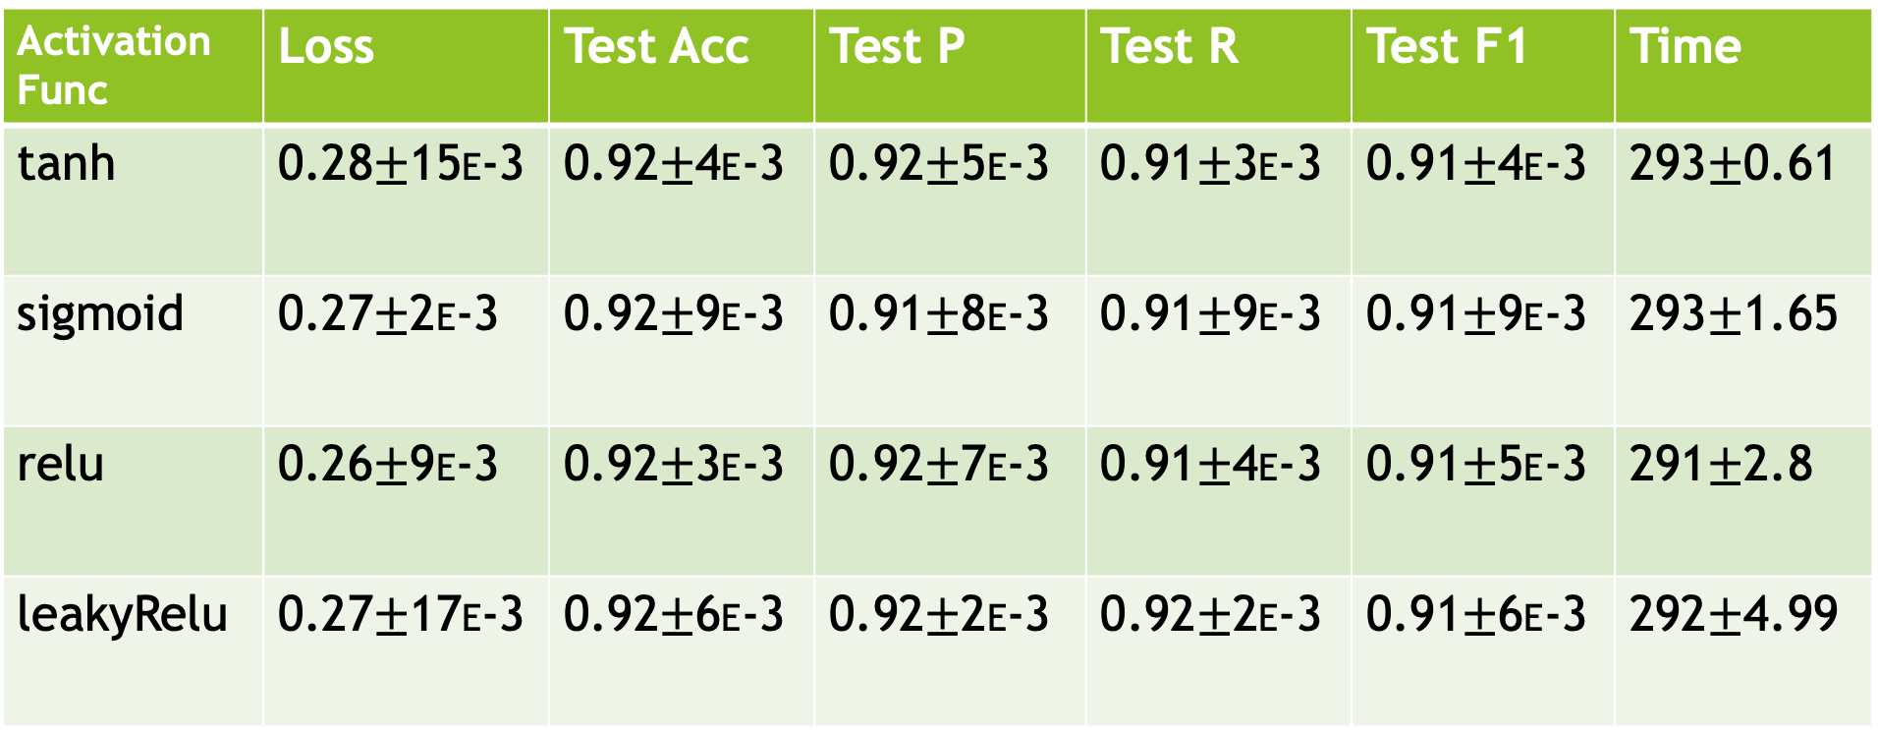
Activation Function
Activation Func | Loss | Test Acc | Test P | Test R | Test F1 | Time
tanh | 0.28$±$15E-3 | 0.92$±$4E-3 | 0.92$±$5E-3 | 0.91$±$3E-3 | 0.91$±$4E-3 | 293$±$0.61
sigmoid | 0.27$±$2E-3 | 0.92$±$9E-3 | 0.91$±$8E-3 | 0.91$±$9E-3 | 0.91$±$9E-3 | 293$±$1.65
relu | 0.26$±$9E-3 | 0.92$±$3E-3 | 0.92$±$7E-3 | 0.91$±$4E-3 | 0.91$±$5E-3 | 291$±$2.8
leakyRelu | 0.27$±$17E-3 | 0.92$±$6E-3 | 0.92$±$2E-3 | 0.92$±$2E-3 | 0.91$±$6E-3 | 292$±$4.99
Relu outperforms with lowest time and loss
Notes:
The results are quite similar across the board except, crossentopyloss and time taken

Slide 10
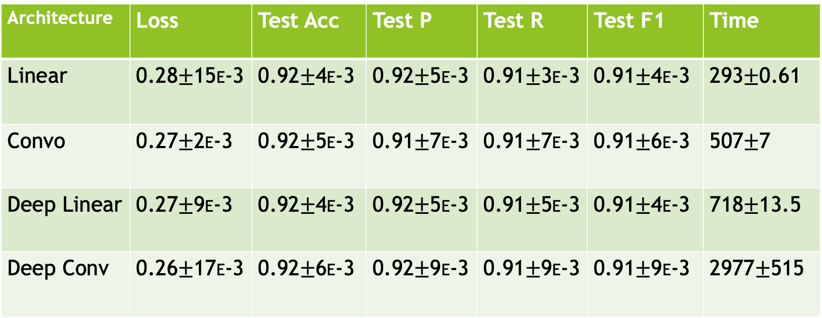
Architecture
Architecture | Loss | Test Acc | Test P | Test R | Test F1 | Time
Linear | 0.28$±$15E-3 | 0.92$±$4E-3 | 0.92$±$5E-3 | 0.91$±$3E-3 | 0.91$±$4E-3 | 293$±$0.61
Convo | 0.27$±$2E-3 | 0.92$±$5E-3 | 0.91$±$7E-3 | 0.91$±$7E-3 | 0.91$±$6E-3 | 507$±$7
Deep Linear | 0.27$±$9E-3 | 0.92$±$4E-3 | 0.92$±$5E-3 | 0.91$±$5E-3 | 0.91$±$4E-3 | 718$±$13.5
Deep Conv | 0.26$±$17E-3 | 0.92$±$6E-3 | 0.92$±$9E-3 | 0.91$±$9E-3 | 0.91$±$9E-3 | 2977$±$515
Convolution and Deep Network Lead to Better Results
Take longer

Slide 11
Important Notes
Relu outperforms other linear activation functions
Convolution and Deep Networks grant better results but take longer

Slide 12
Future Work
Implementing STCKA model to Material Science Application
Create Knowledge Base and Training Set with domain specific data

