Slide 1
Project Part A

Slide 2
Mystery Language Vowels

Slide 3
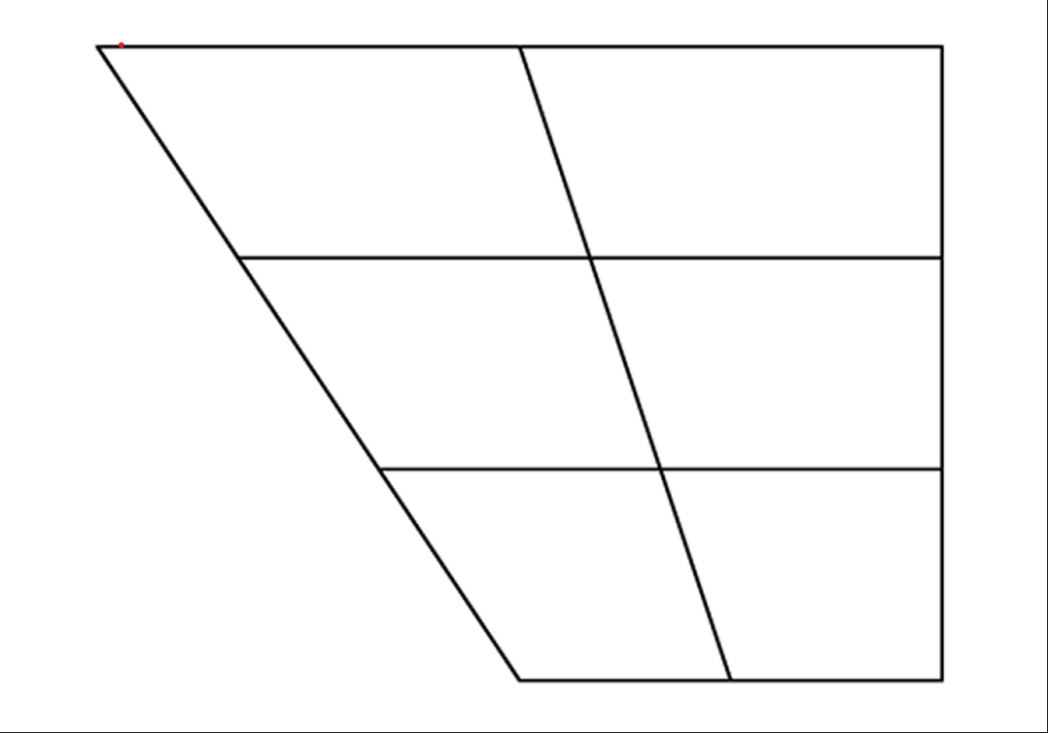
Front
Central
Back
Close
i
u
Unrounded are underlined
ɨ
ʊ
ɘ
ɤ
Close-mid
e
o
Open-mid
ɛ
ɔ
Open
a
ɑ

Slide 4
Mystery Language Diphthong

Slide 5
Front
Central
Back
Close
Close-mid
eu
oi
ia
ua
ɤo
ua
ua
au
Open-mid
oa
Open
aa

Slide 6
Mexican Spanish Language Vowels

Slide 7
Front
Central
Back
Close
i
u
Unrounded are underlined
Close-mid
e
o
Open-mid
Open
a

Slide 8
Mexican Spanish Language Diphthong

Slide 9
Front
Central
Back
Close
ui
iu
ei
oi
ou
Close-mid
eu
ai
au
Open-mid
Open

