Slide 2
Many sounds, including most speech, are caused by vibration.
When objects vibrate in a fluid medium, the resulting pressure fluctuations are periodic
i.e. they fluctuate in a pattern that repeats over time
The Frequency of a wave is a measure of how many times it repeats in a given amount of time
The Amplitude is a measure of the magnitude of the pressure fluctuation.
Notes:
https://www.physicsclassroom.com/mmedia/waves/tfl.cfm

Slide 3
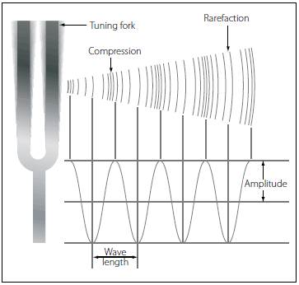
Notes:
https://www.flight-mechanic.com/sound-wave-motion/

Slide 4
In reality, nearly everything vibrates irregularly.
Therfore, sound waves are complex waves
i.e. made up of many waves of different frequencies and amplitudes
Fourier’s Theorem states that complex, periodic waves can be broken down into a sum of simple sine waves of varying amplitudes, frequencies, and phases

Slide 5
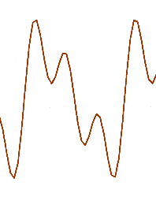
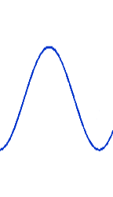
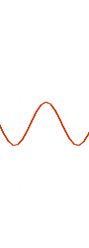
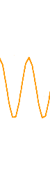
60
40
20
intensity
(dB)
frequency
(Hz)
100
200
300
=
+
+
5
Linguistics 450/550: Introduction to Phonetics Slides by Richard Wright & Dan McCloy, University of Washington

Slide 6
Source-Filter Theory
Source – vocal folds vibrating
Without the vocal tract would sound like a duck call
Frequency of the vocal fold vibration is the fundamental frequency (f₀)
This wave looks simple, but it’s still complex, hence the corresponding power spectrum:
intensity (dB)
pressure (amplitude)
80
40
0
10
20
30
time (ms)
0
2000
4000
frequency (Hz)

Slide 7
Filter – the shape of your vocal tract
Acts a a set of resonators
Certain component frequencies are reinforced (increased amplitude), others are attenuated (decreased amplitude)
(dB)
intensity
(dB)
formants
80
80
40
40
0
0
0
2000
4000
(Hz)
0
2000
4000
(Hz)
0
2000
4000
(Hz)
vocal fold power spectrum
(source)
vocal tract frequency curve
(filter)
resulting power spectrum
7
Linguistics 450/550: Introduction to Phonetics Slides by Richard Wright & Dan McCloy, University of Washington

Slide 8
https://www.phon.ucl.ac.uk/home/mark/vowels/

Slide 9
Spectrograms
Spectrograms are a way of viewing hundreds of sequential power spectra, so we can see how the spectrum of a speech signal changes over time.

Slide 10
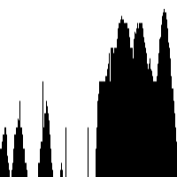
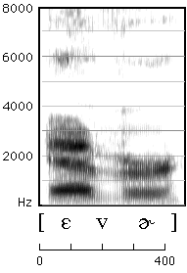
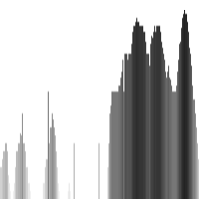
Building a Spectrogram
ANIMATED SLIDE
Power spectrum amplitudes are represented as different shades of grey (taller = darker)
Spectrum is rotated and collapsed to 1-dimension.
Hundreds of spectra are arrayed side by side, allowing us to see changes in formant frequencies over time.

