Slide 1
Learning General Purpose Distributed Sentence Representations via Large Scale Multitask Learning
LING 575
05/06/2019
Elijah Rippeth and Daniel Campos

Slide 2
Background
Transfer learning has shown improvements in many NLP and computer vision tasks.
Visual QA, image classification with ImageNet transfer
Reading comp, sequence labeling with word2vec, GloVe transfer
Systems often need to learn representation of sequences of words.
Pretrained embeddings used and representation learned from scratch.
Supervised signal used in a task-specific manner.
We need transfer learning for sentence representations!

Slide 3
Problem Statement
If we try to learn sentence representations for many tasks and share an encoder, will our network be able to learn better sentence representation?
Yes!

Slide 4
Related work
Kiros, 2015
Skip-Thought; tries to reconstruct the surrounding sentences of an encoded passage.
Wieting, 2015
Supervision from the Paraphrase Database
Hill, 2016
Sequential denoising autoencoders and shallow log-linear models.
Conneau, 2017
Learning sentence representations from natural language inference data
McCann, 2017
Representations learned by state-of-the-art large-scale NMT systems
Nie, 2017
Discourse-based objectives
Pagliardini, 2017
Compositional n-Gram Features

Slide 5
The algorithm: intuition
Training neural nets by way of specific tasks will imbue them with inductive bias.
NMT systems appear to capture morphology
If a model is trained on multiple tasks, we can encode these biases in a single representation.
Potentially allows our representations to generalize better. (Baxter et al. (2000))
Sequence-to-sequence parsers more strongly encode source language syntax.

Slide 6
Tasks
Skip-thought
Previous sentence
Next sentence
NMT
En-Fr
En-De
Constituency parsing
NLI

Slide 7
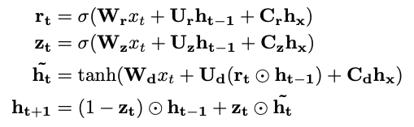
Implementation details
Five of six tasks are sequence-to-sequence tasks
Use encoder-decoder architecture
Encoder is biGRU
Decoder is conditional GRU; parameterization as follows:

Slide 8
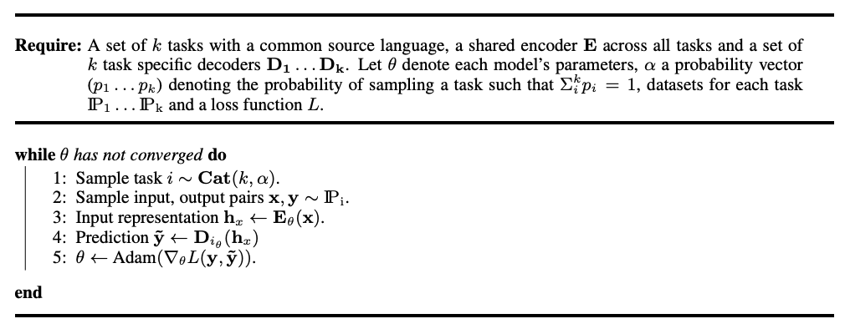
Training Details

Slide 9
Training Details (Continued)
Model takes 7+ days on a P100 GPU
Faster than previous models which needed + 4 weeks
Indicative of trend towards larger and more complex models
BERT
ELMO
GPT
To add a task: add data and a decoder and co train.

Slide 10
Evaluation
Subramanian et al. borrow from Conneau et al. where they test their learned representations on novel domains unseen during training and without any retraining(aka transfer learning).
They also look at an unseen classification problem(Quora Duplicate Questions) to explore how their sentence representations can leverage learning on small data/low resource tasks.
Exploring how well their word embeddings perform they also use the standard word embedding evaluation benchmarks.
Evaluate what sentence representations on sentence characteristics and syntactic properties

Slide 11
Evaluation (Continued)
Since their training framework contains a multitude of task they run ablandation with performance on the entire suite of evaluations with various mixes of multi task learning.
Allows them to observe what tasks bring the most gain to all benchmarks.
E.G. Adding constituency parsing improves performance on sentence relatedness and entailment.
For each dataset, they compare various of their multi task training methods and compare them both to existing sentence embeddings and to task specific SOTAs.
They compare these complex models to MLPs that leverage their sentence representations

Slide 12
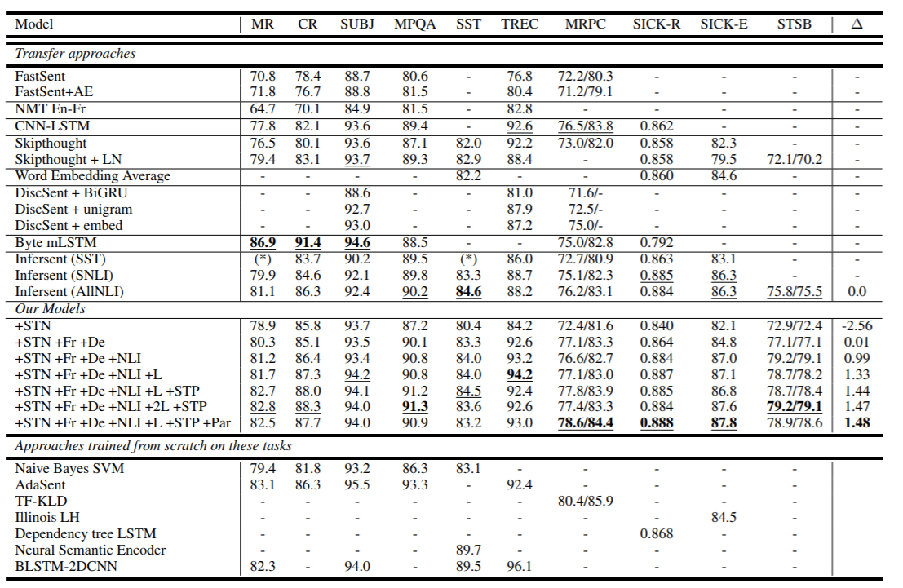
Transfer Learning Benchmarks
Multi Task learning with MLP out performs most previous models by a fair margin.

Slide 13
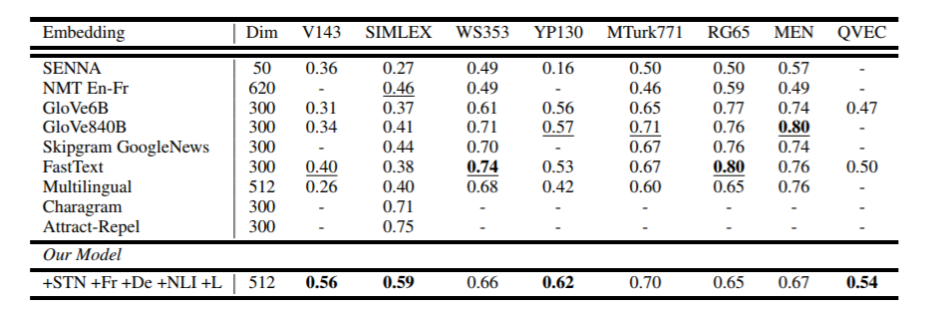
Word Similarity
Per table, multi task representation outperforms other representations and most competitive benchmarks.

Slide 14
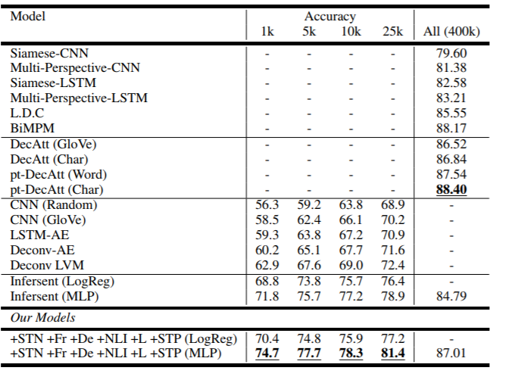
Low Resource Learning
Training method learns very quickly
Scalable to low resource tasks

Slide 15
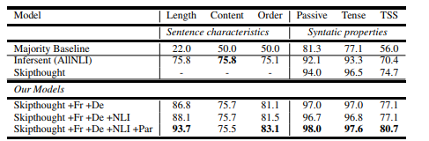
Syntactic and Sentence Characteristics
Scores Based on which models are able to predict certain characteristics

Slide 16
Future Work
Interpret and understand what biases are learned by model in respect to tasks being added.
Use sentence representation + conditional language model to generate coherent text.

Slide 17
Discussion
Sets the stage for larger fully end 2 end multi task learning
Bigger Data/More Tasks ?= Better Model
Longer Training ?= Better Model
Build Complex General Models and Fine tune?
How useful are sentence representations?

Slide 18
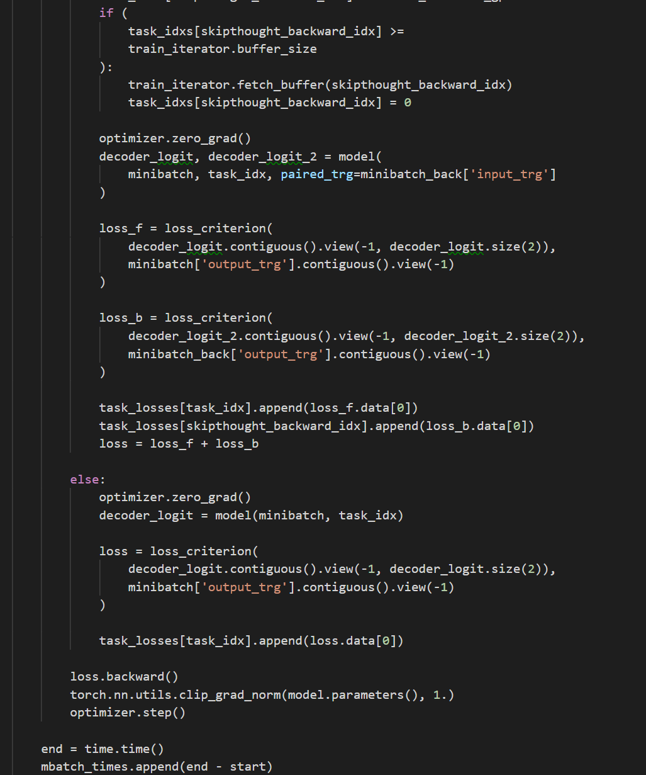
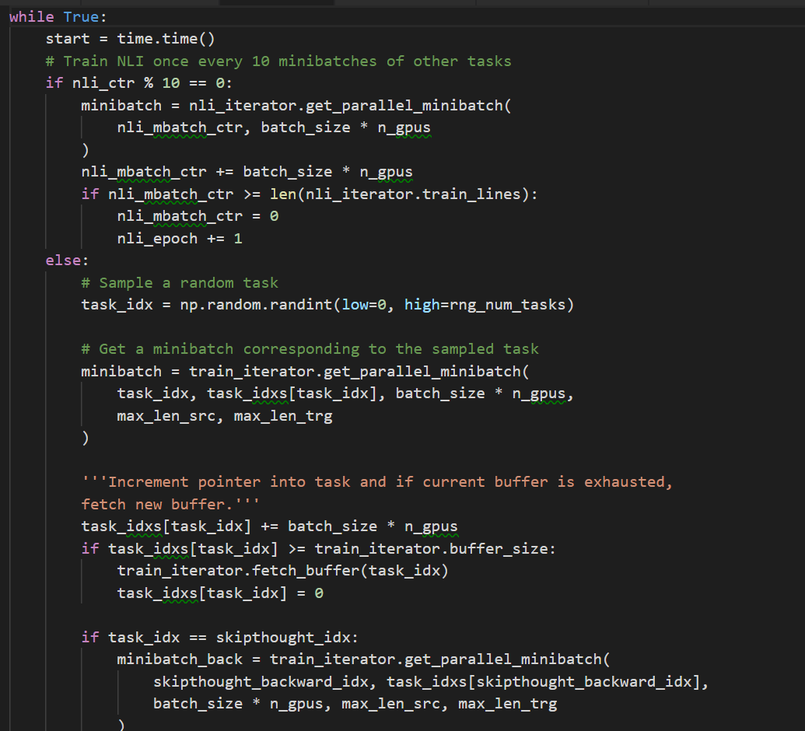
Code Details

Slide 19
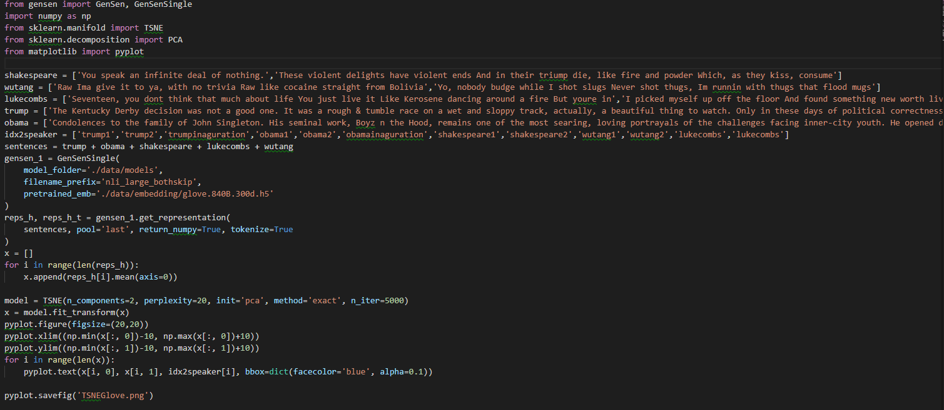
Usage
Use sentence representations in a few lines of code

Slide 20
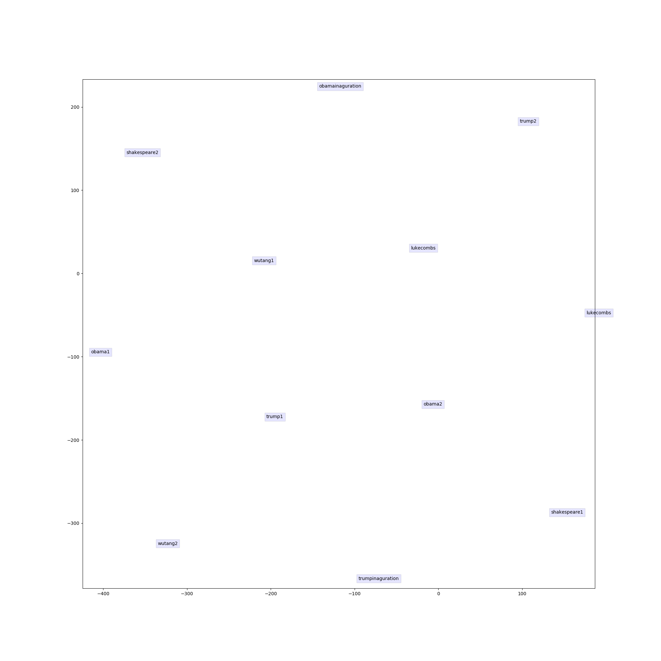
Text Representations Plotted

