Slide 1
Naïve Bayes
LING 572
Advanced Statistical Methods for NLP
January 15, 2019
Adapted from F. Xia ‘18
TexPoint fonts used in EMF.
Read the TexPoint manual before you delete this box.: AAA

Slide 2
Naïve Bayes Model
Naïve Assumption
Training & Decoding
Variants
Issues

Slide 3
ML Questions
Modeling:
What is the model structure?
Why is it called Naïve Bayes?
What assumptions does it make?
What type of parameters are learned?
How many parameters?
Training:
How are model parameters learned from data?
Decoding:
How is model used to classify new data?

Slide 4
Probabilistic Model
Given an instance x with features f₁…f_{k,}
Find the class with highest probability
Formally, x = (f₁,f₂,….,f_{k})
Find c* = argmax_{c} P(c | x)
Applying Bayes’ Rule:
c* = argmax_{c} P(x | c) P(c) / P(x)
Maximizing:
c* = argmax_{c} P(x | c) P(c)

Slide 5
Naïve Bayes Model
So far just Bayes’ Rule
Key question: How do we handle/combine features?
Consider just P(x|c)
P(x|c) = P(f₁,f₂,…,f_{k}|c)
=
Can we simplify? (Remember n-grams)
Assume conditional independence
=

Slide 6
Naïve Bayes Model
C
…
f₂
f_{n}
f₁
Assumption: each f_{i} is conditionally independent from
f_{j} given C.

Slide 7
Model parameters
Choose
c* = arg max_{c} P(c | x)
= arg max_{c} P(c) P(x | c) / P(x)
= arg max_{c} P(c) P(x | c)
= arg max_{c} P(c) ∏_{k} P(f_{k} | c)
Two types of model parameters:
Class prior: P(c)
Conditional probability: P(f_{k} | c)
The number of model parameters:
|priors|+|conditional probabilities|
|C| + |F|*|C|
|C|+|V|*|C|, if features are words in vocabulary V
|C| is the number of classes, |F| is the number of features, |V| is the number of features.

Slide 8
Training stage: Estimating parameters Θ
Maximum likelihood estimation (ML):
Class prior:
Conditional prob:

Slide 9
Training
MLE issues?
What’s the probability of a feature not seen with a c_{i}?
0?
What happens then?
Solutions?
Smoothing
Laplace smoothing, Good-Turing, Witten-Bell
Interpolation, Backoff….

Slide 10
What are Zero Counts?
Some of those zeros are really zeros...
Things that really can’t or shouldn’t happen.
On the other hand, some of them are just rare events.
If the training corpus had been a little bigger, they would have had a count (probably a count of 1!).
Zipf’s Law (long tail phenomenon):
A small number of events occur with high frequency
A large number of events occur with low frequency
You can quickly collect statistics on the high frequency events
You might have to wait an arbitrarily long time to get valid statistics on low frequency events

Slide 11
Laplace Smoothing (add-one smoothing)
Pretend you saw outcome one more than you actually did.
Suppose X has K possible outcomes, and the counts for them are n₁, …, n_{K ,} which sum to N.
Without smoothing: P(X=i) = n_{i} / N
With Laplace smoothing: P(X=i) = (n_{i} + 1) / (N+K)

Slide 12
Testing stage
MAP (maximum a posteriori) decision rule:
Given our model and an instance x=< f₁, .., f_{d}>
classify (x)
= classify (f₁, .., f_{d})
= argmax_{c} P(c|x)
= argmax_{c} P(x|c) P(c)
= argmax_{c} P(c) ∏_{k} P(f_{k} | c)

Slide 13
Naïve Bayes for the text classification task

Slide 14
Features
Features: bag of words (word order information is lost)
Number of feature types: 1
Number of features: |V|
Features: w_{t}, where t {1, 2, …, |V|}

Slide 15

Issues
Is w_{t} a binary feature?
Are absent features used for calculating ?

Slide 16
Two Naïve Bayes Models (McCallum and Nigam, 1998)
Multivariate Bernoulli event model
(a.k.a. binary independence model)
All features are binary: the number of times a feature occurs in an instance is ignored.
When calculating p(d | c), all features are used, including the absent features.
Multinomial event model: “unigram LM”

Slide 17
Multivariate Bernoulli event model

Slide 18
Bernoulli distribution
Bernoulli trial: a statistical experiment having exactly two mutually exclusive outcomes, each with a constant probability of occurrence:
Ex: toss a coin
Bernoulli distribution: has exactly two mutually exclusive outcomes: P(X=1)=p and P(X=0)=1-p.

Slide 19


Multivariate Bernoulli Model
Each document:
Result of |V| independent Bernoulli experiments
i.e., for each word in the vocabulary: does this word appear in the document?
Another way to look at this: (to be consistent with the general NB model)
Each word in the voc corresponds to two features:
In any document, either is present; that is, it is always the case that exactly |V| features will be present in any document.

Slide 20
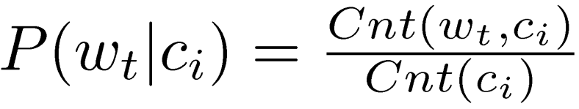
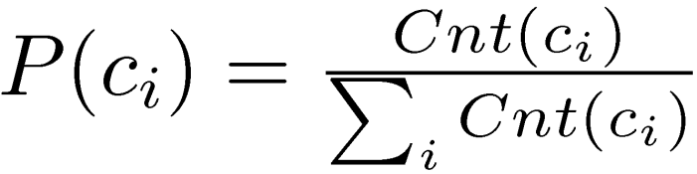
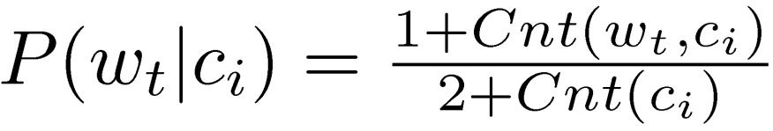
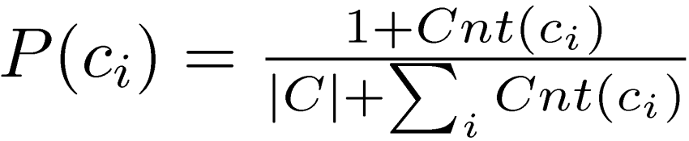
Training stage
ML estimate:
With add-one smoothing:

Slide 21
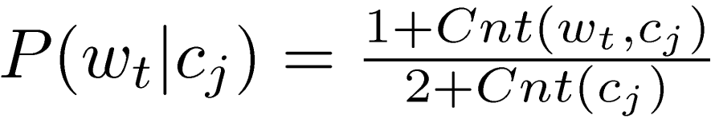
Notation used in the paper
Let B_{it} =1 if w_{t} appears in d_{i}
= 0 otherwise
P(c_{j} | d_{i}) = 1 if d_{i} has the label c_{j}
= 0 otherwise

Slide 22
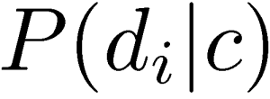
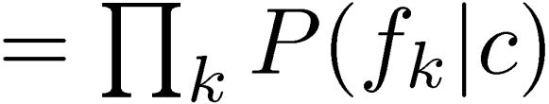
Testing stage

Slide 23
Multinomial event model

Slide 24
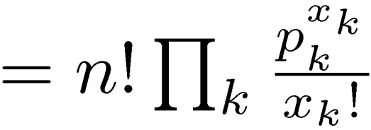
Multinomial distribution
Possible outcomes = {w₁, w₂, …, w_{|v|}}
A trial for each word position:
P(CurWord=w_{i})=p_{i} and ∑_{i} p_{i} = 1
Let X_{i} be the number of times that the word w_{i} is observed in the document.

Slide 25
An example
Suppose
the voc, V, contains only three words: a, b, and c.
a document, d_{i}, contains only 2 word tokens
For each position, P(w=a)=p1, P(w=b)=p2 and P(w=c)=p3.
What is the prob that we see “a” once and “b” once in d_{i}?

Slide 26
An example (cont)
9 possible sequences: aa, ab, ac, ba, bb, bc, cc, cb, cc.
The number of sequences with one “a” and one “b” (ab and ba): n!/(x₁!...x_{v}!)
The prob of the sequence “ab” is p₁*p_{2,}
so is the prob of the sequence “ba”.
So the prob of seeing “a” once and “b” once is:
n! ∏_{k} (p_{k}^{xk} / x_{k}!) = 2 p₁*p₂

Slide 27
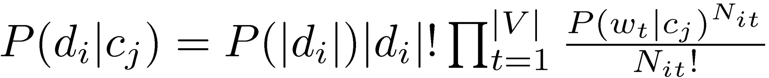
Multinomial event model
A document is seen as a sequence of word events, drawn from the vocabulary V.
N_{it}: the number of times that w_{t} appears in d_{i}
Modeling: multinomial distribution:

Slide 28
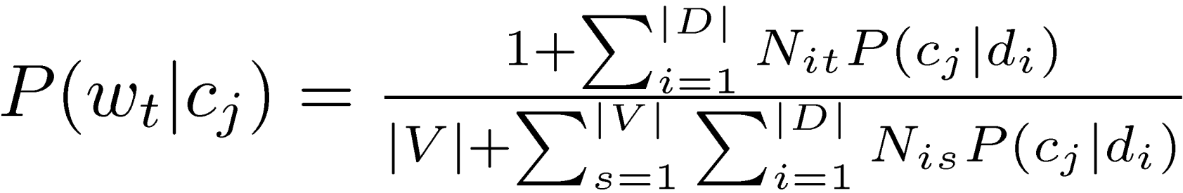
Training stage for multinomial model
Let P(c_{j} | d_{i}) = 1 if d_{i} has the label c_{j}
= 0 otherwise
N_{it}: the number of times that w_{t} appears in d_{i}
Compared with the following in the Bernoulli model:

Slide 29
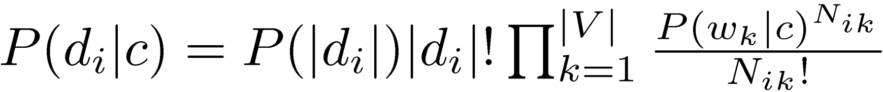
Testing stage

Slide 30
Two models
Multi-variate Bernoulli event model: treat features as binary; each trial corresponds to a word in the voc.
Multinomial event model: treat features as non-binary; each trial corresponds to a word position in the document.

Slide 31
Which model is better?
(McCallum and Nigam, 1998): Multinomial event model usually beats the Bernoulli event model
Chapter 13 in (Manning et al., 2008): The Bernoulli model
is particularly robust w.r.t. concept shift
is more sensitive to noisy features (requiring feature selection)
peaks early for feature selection (see fig)
works well for shorter documents

Slide 32
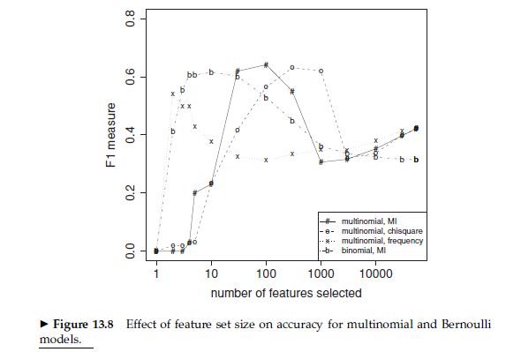
From (Manning et al., 2008)

Slide 33

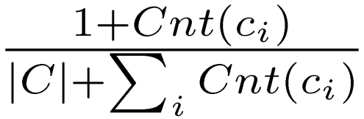

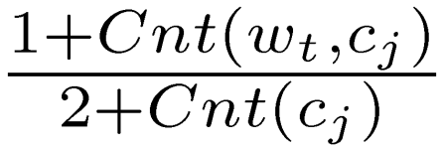
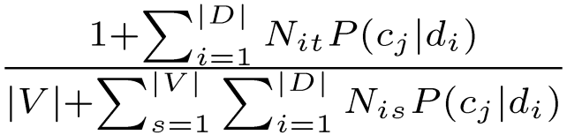
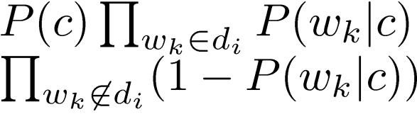
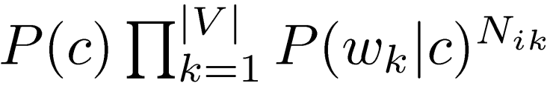

Two models (cont)
 | Multivariate Bernoulli | Multinomial
Features | Binary: present or absent | Real-valued: the occurrence
Each trial | Each word in the voc | Each word position in the doc

Slide 34
Summary of Naïve Bayes
It makes a strong independence assumption: all the features are conditionally independent given the class.
It generally works well despite the strong assumption. Why?
“Correct estimation implies accurate prediction, but accurate prediction does not imply correct estimation.”
Both training and testing are simple and fast.

Slide 35
Summary of Naïve Bayes (cont)
Strengths:
Simplicity (conceptual)
Efficiency at training
Efficiency at testing time
Handling multi-class
Scalability
Output topN
Weaknesses:
Theoretical validity: the independence assumption
Prediction accuracy: might not be as good as MaxEnt etc.

Slide 36
Additional slides

Slide 37
Spam detection
Task: Given an email message, classify it as ‘spam’ or ‘not spam’
Form of automatic text categorization
Features?

Slide 38
Doc1
Western Union Money Transfer office29@yahoo.com.ph One Bishops Square Akpakpa E1 6AO, Cotonou Benin Republic Website: http://www.westernunion.com/ info/selectCountry.asP Phone: +229 99388639 Attention Beneficiary, This to inform you that the federal ministry of finance Benin Republic has started releasing scam victim compensation fund mandated by United Nation Organization through our office. I am contacting you because our agent have sent you the first payment of $5,000 for your compensation funds total amount of $500 000 USD (Five hundred thousand united state dollar) We need your urgent response so that we shall release your payment information to you. You can call our office hot line for urgent attention(+22999388639)

Slide 39
Doc2
Hello! my dear. How are you today and your family? I hope all is good, kindly pay Attention and understand my aim of communicating you today through this Letter, My names is Saif al-Islam al-Gaddafi the Son of former Libyan President. i was born on 1972 in Tripoli Libya, By Gaddafi’s second wive.
I want you to help me clear this fund in your name which i deposited in Europe please i would like this money to be transferred into your account before they find it. the amount is 20.300,000 million GBP British Pounds sterling through a …

Slide 40
What are good features?
Words:
E.g., account, money, urgent
Particular types of words/phrases:
large amount of money
Foreign/fake address/email/phone number
Errors:
Spelling, grammatical errors
…

