Slide 1
K nearest neighbor
LING 572
Advanced Statistical Methods for NLP
January 22, 2019
Adapted from F. Xia, ‘18

Slide 2
The term “weight” in ML
Weights of features
Weights of instances
Weights of classifiers

Slide 3
The term “binary” in ML
Classification problem:
Binary: the number of classes is 2
Multi-class: the number is classes is > 2
Features:
Binary: the number of possible feature values is 2.
Real-valued: the feature values are real numbers
File format:
Binary: human un-readable
Text: human readable

Slide 4
kNN

Slide 5
Instance-based (IB) learning
No training: store all training instances.
➔ “Lazy learning”
Examples:
kNN
Locally weighted regression
Case-based reasoning
…
The most well-known IB method: kNN

Slide 6
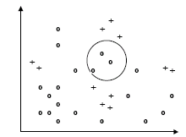
kNN

Slide 7
kNN
Training: record labeled instances as feature vectors
Test: for a new instance d,
find k training instances that are closest to d.
perform majority voting or weighted voting.
Properties:
A “lazy” classifier. No learning in the training stage.
Feature selection and distance measure are crucial.

Slide 8
The algorithm
Determine parameter K
Calculate the distance between the test instance and all the training instances
Sort the distances and determine K nearest neighbors
Gather the labels of the K nearest neighbors
Use simple majority voting or weighted voting.

Slide 9
Issues
What’s K?
How do we weight/scale/select features?
How do we combine instances by voting?

Slide 10
Picking K
Split the data into
Training data (true training data and validation data)
Dev data
Test data
Pick k with the lowest error rate on the validation set
use N-fold cross validation if the training data is small

Slide 11
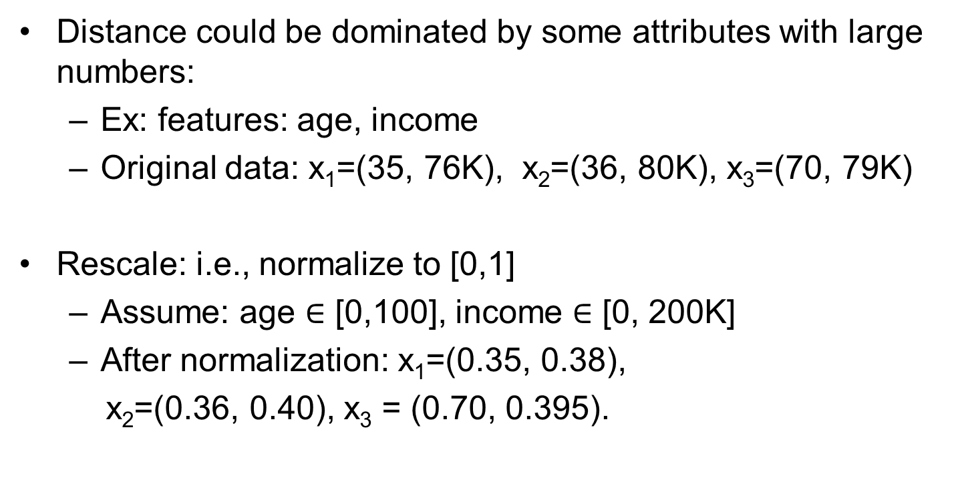
Normalizing attribute values
Distance could be dominated by some attributes with large numbers:
Ex: features: age, income
Original data: x₁=(35, 76K), x₂=(36, 80K), x₃=(70, 79K)
Rescale: i.e., normalize to [0,1]
Assume: age $∈$ [0,100], income $∈$ [0, 200K]
After normalization: x₁=(0.35, 0.38),
x₂=(0.36, 0.40), x₃ = (0.70, 0.395).

Slide 12
The Choice of Features
Imagine there are 100 features, and only 2 of them are relevant to the target label.
Differences in irrelevant features likely to dominate:
kNN is easily misled in high-dimensional space.
Feature weighting or feature selection is key (It will be covered next time)

Slide 13
Feature weighting
Reweighting a dimension j by weight w_{j}
Can increase or decrease weight of feature on that dimension
Setting w_{j} to zero eliminates this dimension altogether.
Use cross-validation to automatically choose weights w₁, …, w_{n}

Slide 14
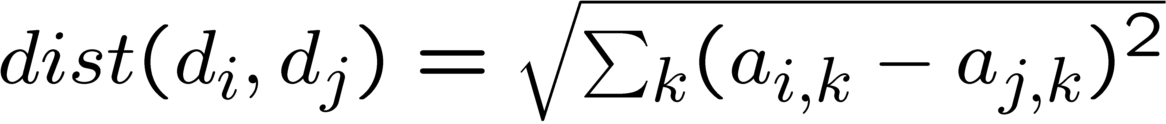
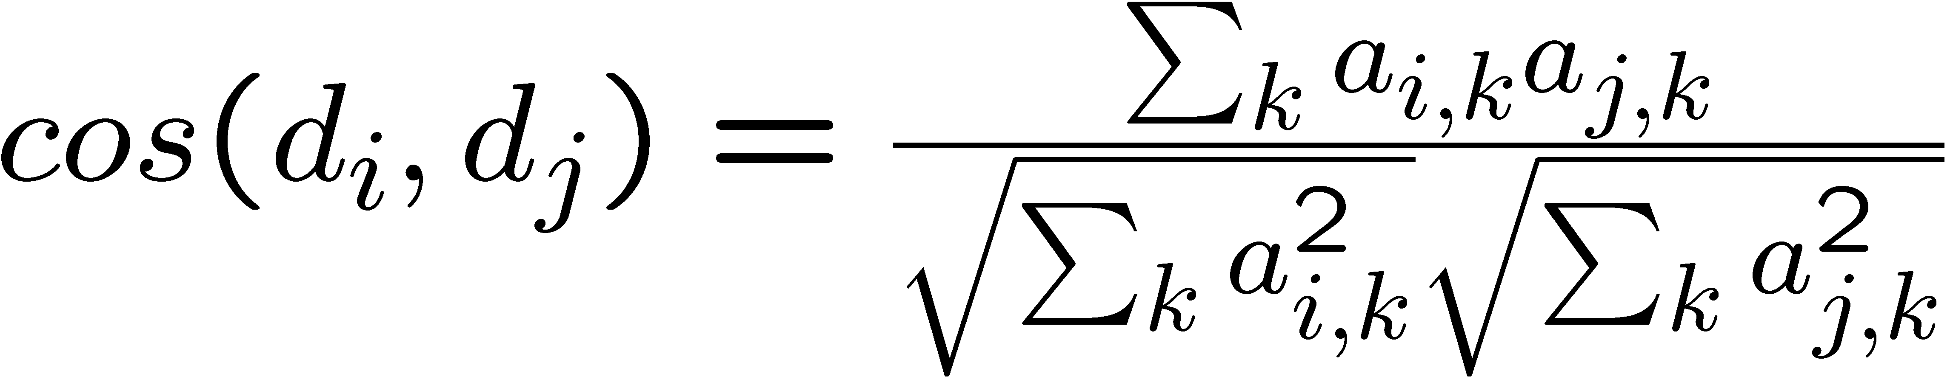
Some similarity measures
Euclidean distance:
Weighted Euclidean distance:
Cosine:

Slide 15
Voting by k-nearest neighbors
Suppose we have found the k-nearest neighbors.
Let f_{i} (x) be the class label for the i-th neighbor of x.
δ(c, f_{i}(x)) is the identity function; that is,
it is 1 if f_{i}(x) = c, and is 0 otherwise.
Let g(c) = ∑_{i} δ(c, f_{i}(x)); that is, g(c) is the number of neighbors with label c.

Slide 16
Voting
Majority voting: c* = arg max_{c} g(c)
Weighted voting: weighting is on each neighbor
c* = arg max_{c} ∑_{i} w_{i} δ(c, f_{i}(x))
Where δ(c,f_{i}(x)) is 1 if f_{i}(x) = c and 0 otherwise
Weighted voting allows us to use more training examples:
e.g., w_{i} = 1/dist(x, x_{i})
➔ We can use all the training examples.

Slide 17
Summary of kNN algorithm
Decide k, feature weights, and similarity measure
Given a test instance x
Calculate the distances between x and all the training data
Choose the k nearest neighbors
Let the neighbors vote

Slide 18
Strengths:
Simplicity (conceptual)
Efficiency at training: no training
Handling multi-class
Stability and robustness: averaging k neighbors
Predication accuracy: when the training data is large
Weakness:
Efficiency at testing time: need to calculate all distances
Better search algorithms: e.g., use k-d trees
Reduce the amount of training data used at the test time: e.g., Rocchio algorithm
Sensitivity to irrelevant or redundant features
Distance metrics unclear on non-numerical/binary values

