Slide 1
Feature selection
LING 572
Advanced Statistical Methods for NLP
January 22, 2019

Slide 2
Create attribute-value table
 | f₁ | f₂ | … | f_{K} | y
x₁
x₂
…
Choose features:
Define feature templates
Instantiate the feature templates
Dimensionality reduction: feature selection
Feature weighting
Global feature weighting: weight the whole column
Local feature weighting: weight for a cell

Slide 3
Feature Selection Example
Task: Text classification
Feature template definition:
Word – just one template
Feature instantiation:
Words from training data
Feature selection:
Stopword removal: remove top K (~100) highest freq
Words like: the, a, have, is, to, for,…
Feature weighting:
Apply tf*idf feature weighting
tf = term frequency; idf = inverse document frequency

Slide 4
The Curse of Dimensionality
Think of the instances as vectors of features
# of features = # of dimensions
Number of features potentially enormous
e.g., # words in corpus continues to increase w/corpus size
High dimensionality problematic:
Leads to difficulty with estimation/learning
Hard to create valid model
Hard to predict and generalize – think kNN
More dimensions → more samples needed to learn model
Leads to high computational cost

Slide 5
Breaking the Curse
Dimensionality reduction:
Produce a representation with fewer dimensions
But with comparable performance
More formally, given an original feature set r,
Create a new set r’ |r’| < |r|, with comparable performance

Slide 6
Outline
Dimensionality reduction
Some scoring functions **
Chi-square score and Chi-square test
In this lecture, we will use “term” and “feature” interchangeably.

Slide 7
Dimensionality reduction (DR)

Slide 8
Dimensionality reduction (DR)
What is DR?
Given a feature set r, create a new set r’, s.t.
r’ is much smaller than r, and
the classification performance does not suffer too much.
Why DR?
ML algorithms do not scale well.
DR can reduce overfitting.

Slide 9
Dimensionality Reduction
Given an initial feature set r,
Create a feature set r’ such that |r| < |r’|
Approaches:
r’: same for all classes (a.k.a. global), vs
r’: different for each class (a.k.a. local)
Feature selection/filtering
Feature mapping (a.k.a. extraction)

Slide 10
Feature Selection
Feature selection:
r’ is a subset of r
How can we pick features?
Extrinsic ‘wrapper’ approaches:
For each subset of features:
Build, evaluate classifier for some task
Pick subset of features with best performance
Intrinsic ‘filtering’ methods:
Use some intrinsic (statistical?) measure
Pick features with highest scores

Slide 11
Feature Selection
Wrapper approach:
Pros:
Easy to understand, implement
Clear relationship between selected features and task performance.
Cons:
Computationally intractable: 2^{|r’|}*(training + testing)
Specific to task, classifier
Filtering approach:
Pros: theoretical basis, less task, classifier specific
Cons: Doesn’t always boost task performance

Slide 12
Feature selection by filtering
Main idea: rank features according to predetermined numerical functions that measure the “importance” of the terms.
It is fast and classifier-independent.
Scoring functions:
Information Gain
Mutual information
chi square
…

Slide 13
Feature Mapping
Feature mapping (extraction) approaches
r’ represents combinations/transformations of features in r
Ex: many words near-synonyms, but treated as unrelated
Map to new concept representing all
big, large, huge, gigantic, enormous → concept of ‘bigness’
Examples:
Term classes: e.g. class-based n-grams
Derived from term clusters
Latent Semantic Analysis (LSA/LSI)
Result of Singular Value Decomposition (SVD) on matrix produces ‘closest’ rank r’ approximation of original

Slide 14
Feature Mapping
Pros:
Data-driven
Theoretical basis – guarantees on matrix similarity
Not bound by initial feature space
Cons:
Some ad-hoc factors:
e.g., # of dimensions
Resulting feature space can be hard to interpret

Slide 15
Quick summary so far
DR: to reduce the number of features
Local DR vs. global DR
Feature extraction vs. feature selection
Feature extraction:
Feature clustering
Latent semantic indexing (LSI)
Feature selection:
Wrapping method
Filtering method: different functions

Slide 16
Feature scoring measures

Slide 17
Basic Notation, Distributions
Assume binary representation of terms, classes
t_{k} : term in T; c_{i}: class in C
P(t_{k}): proportion of documents in which t_{k} appears
P(c_{i}): proportion of documents of class c_{i}
Binary so have

Slide 18
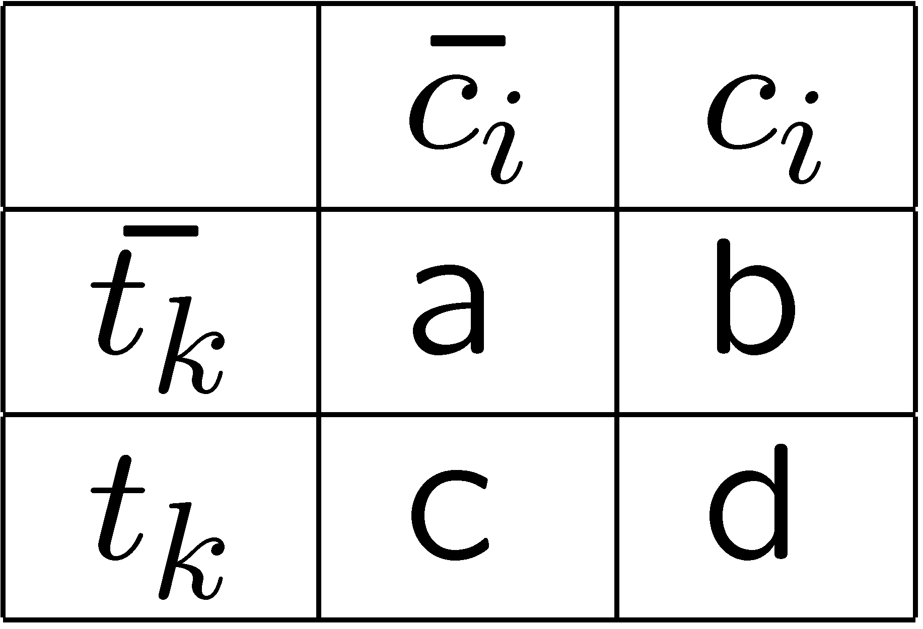
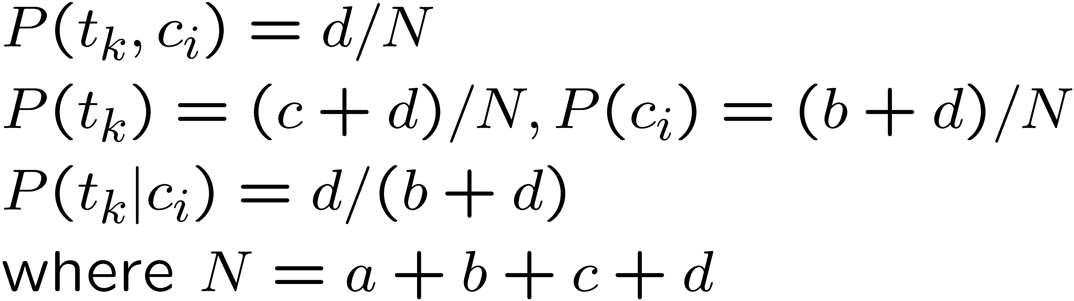
Calculating basic distributions

Slide 19
Feature selection functions
Question: What makes a good feature?
Intuition: for a category c_{i} , the most valuable feature are those that are distributed most differently in the sets of positive and negative examples of c_{i}.

Slide 20
Term Selection Functions: DF
Document frequency (DF):
Number of documents in which t_{k} appears
Applying DF:
Remove terms with DF below some threshold
Intuition:
Very rare terms won’t help with categorization
or not useful globally
Pros: Easy to implement, scalable
Cons: Ad-hoc, low DF terms ‘topical’

Slide 21
Term Selection Functions: MI
Pointwise Mutual Information (MI)
MI(t,c)=0 if t and c are independent
Issue: Can be heavily influenced by marginal probability
Problem comparing terms of differing frequencies

Slide 22
Term Selection Functions: IG
Information Gain:
Intuition: Transmitting Y, how many bits can we save if both sides know X?
IG(Y,X) = H(Y)-H(Y|X)

Slide 23
Global Selection
Previous measures compute class-specific selection
What if you want to filter across ALL classes?
an aggregate measure across classes
Sum:
Average:
Max:
|C| is the number of classes

Slide 24
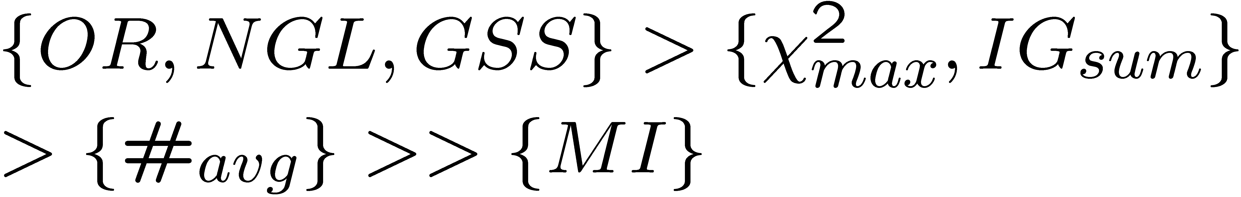
Which function works the best?
It depends on
Classifiers
Type of data
…
According to (Yang and Pedersen 1997):

Slide 25
Feature weighting

Slide 26
Feature weights
Feature weight in {0,1}: same as DR
Feature weight in R: iterative approach:
Ex: MaxEnt
➔ Feature selection is a special case of feature weighting.

Slide 27
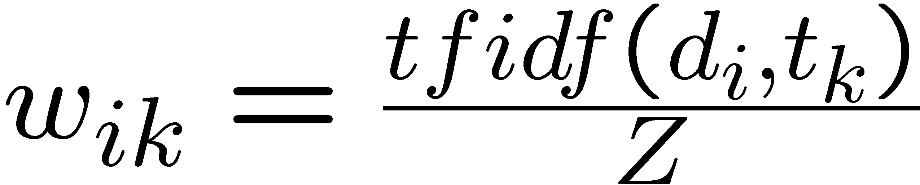
Feature values
Binary features: 0 or 1.
Term frequency (TF): the number of times that t_{k} appears in d_{i}.
Inverse document frequency (IDF): log (|D|/d_{k,}) where d_{k} is the number of documents that contain t_{k}.
TFIDF = TF * IDF
Normalized TFIDF:
Notes:
change d_k,
add () around log
what is Z?
add an example

Slide 28
Summary so far
Curse of dimensionality ➔ dimensionality reduction (DR)
DR:
Feature extraction
Feature selection
Wrapping method
Filtering method: different functions

Slide 29
Summary (cont)
Functions:
Document frequency
Information gain
Gain ratio
Chi square
…

Slide 30
Additional slides

Slide 31
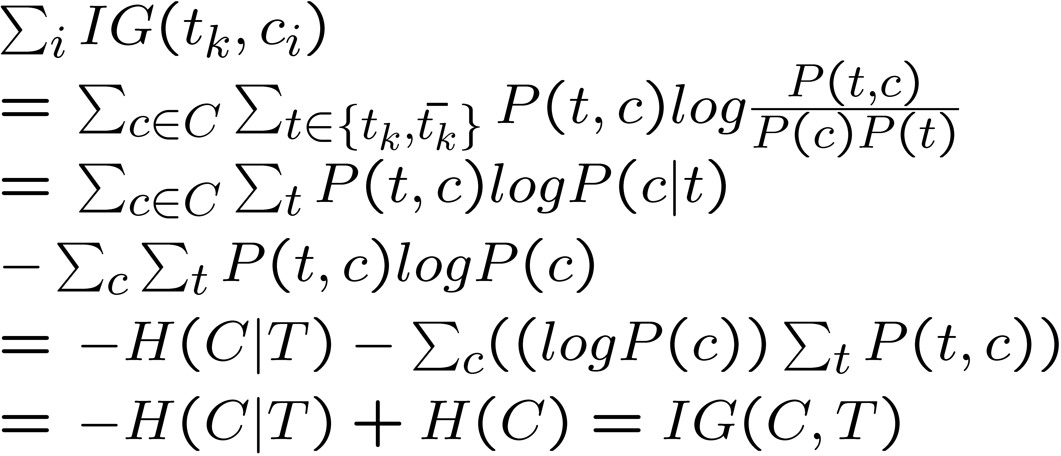
Information gain
Information gain**

Slide 32
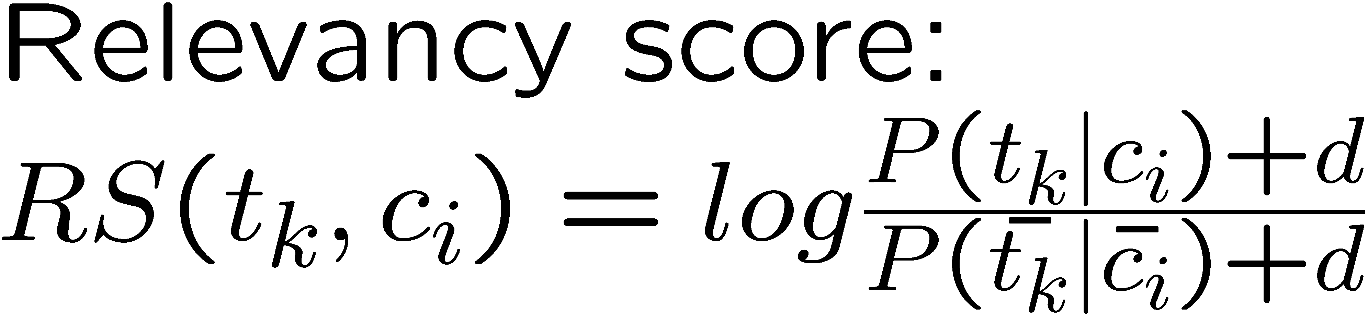
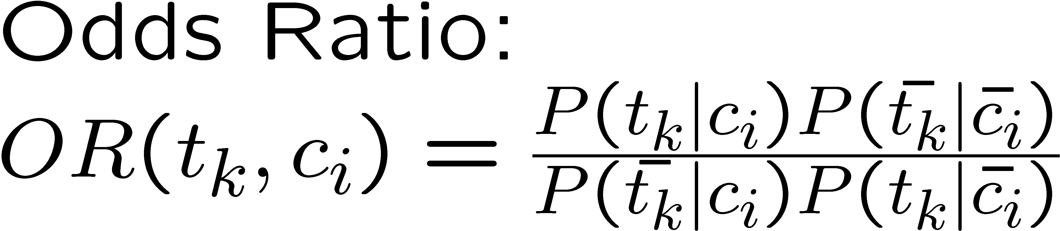
More term selection functions**

Slide 33
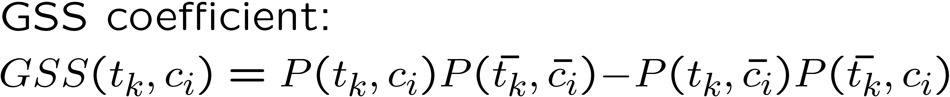
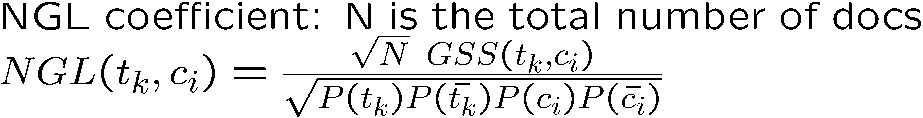
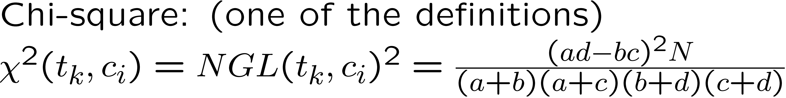
More term selection functions**

