Slide 1
Improving Language Understanding by Generative Pre-Training
HW7
Elijah Rippeth and Daniel Campos
05/20/2019

Slide 2
Background
The Transformer framework performs highly in most NLP tasks
Sentence and word representations have brought huge gains to countless NLP tasks
Semi Supervised Learning has proven effective at leveraging corpus information in downstream tasks
Unsupervised pre-training proved effective in image classification and regression tasks.
Auxiliary Training Objectives leverages a wide variety of objectives to improve many disparate tasks.

Slide 3
Problem Statement
Given a large corpus of unlabeled data can competitive models be trained by building a general model on the larger corpus and fine tuning to the targeted task?
Yes!

Slide 4
Related work
Peters, 2018
Deep contextualized word representations (aka ELMo)
Vaswani, 2017
Attention is all you need
Bowman, 2015
A large annotated corpus for learning natural language inference
Wang, 2018
GLUE: A Multi-Task Benchmark and Analysis Platform for Natural Language Understanding
Lai, 2017
RACE: Large-scale ReAding Comprehension Dataset From Examinations

Slide 5
Algorithm: intuition
Unsupervised pre-training
Adapt parameters to supervised task
Leverage a language modeling objective
Supervised fine-tuning

Slide 6
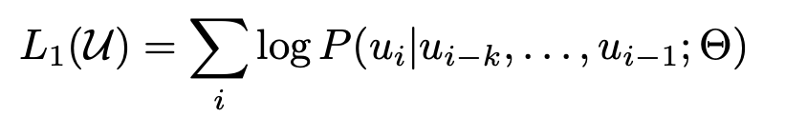
Implementation details: pre-training
Given unsupervised corpus U = {u1, …, uN} and context window k, we want to maximize the following log-likelihood:

Slide 7
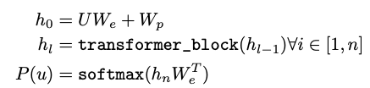
Implementation details: pre-training
Leverages a transformer decoder to model the probability space of inputs tokens
We is the token embedding matrix
Wp is the position embedding matrix
U is the context vector (length k vector)

Slide 8
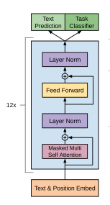
Implementation details: pre-training

Slide 9



Implementation details: fine-tuning
Given labeled corpus C where instances are {x1, x2, …, xm}, predict label:
Objective is to maximize log-likelihood L2 (though L3 is used in practice):

Slide 10
Tasks
Task | Datasets
Natural language inference | SNLI, MultiNLI, Question NLI, RTE, SciTail
Question Answering | RACE, Story Cloze
Sentence similarity | MSR Paraphrase Corpus, Quora Question Pairs, STS Benchmark
Classification | Stanford Sentiment Treebank-2, CoLA

Slide 11
Wait... those task inputs don't look reflective?
Some tasks can be fine-tuned directly by the aforementioned scheme.
e.g., seq2seq tasks will predict next word given context
Others have structured inputs which aren't so clear. What do we do when we aren't predicting the next word?
e.g., QA: document, question and answer pairs
e.g., NLI: premise and hypothesis
How can we transform the inputs to minimize task-specific customization of inputs?
Traversal-style preprocessing (Rocktäschel et al., 2015)

Slide 12
Task-specific input transformations
NLI
Concatenate premise and hypothesis token sequences, delimited by $.
Similarity
Modify the input sequence to contain both possible sentence orderings and process each independently to produce two sequence representations which are added element-wise.
QA
Create a vector of document vector, question vector, a delimiter, and answer vector for each possible answer. Process independently and normalize via softmax for probability of answer correctness.

Slide 13
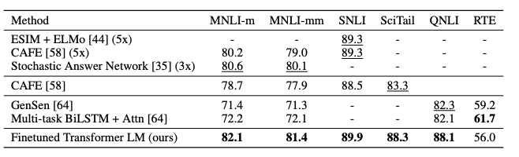
Evaluation (NLI)

Slide 14
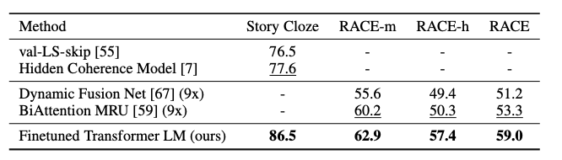
Evaluation (QA)

Slide 15
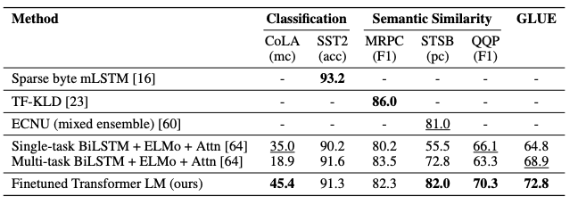
Evaluation (Classification/Similarity)

Slide 16
Discussion
Impact of number of layers transferred
9% gain per layer till 12
Tasks vary in their pretraining iterations required.
Zero shot behavior
Ablation
Larger datasets benefit from auxiliary task (L3 loss function) while smaller do not
LSTM average drop 5.6% vs. transformer
No pre-training average 14.8% drop
Transformer learns faster than LSTM.

Slide 17
Language Models are Unsupervised Multitask Learners

Slide 18
Background
ELMo , GPT, BERT show huge gains on most NLP Tasks
Fine-tuning is great but can we avoid it by making the LM bigger?
How useful is unidirectional text representations such as BERT's?
Are we all Bayesians?
P(Y|X) for everything!

Slide 19
Updates
New Dataset
No longer Unpublished book dataset
40 million documents linked from reddit with Karma + 3
8 Million unique documents after deduping
Remove Wikipedia
4 model sizes explored
117M, 345M, 762M, 1542M parameters
Smallest is equivalent to GPT, second is Large BERT
Transformer block have new normalization
NO MORE FINE-TUNING!

Slide 20
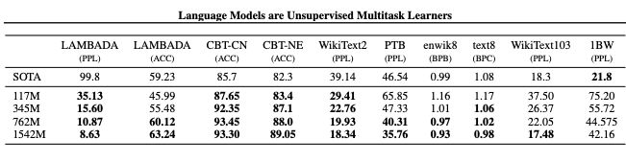
GPT-2 Zero Shot Learning

Slide 21
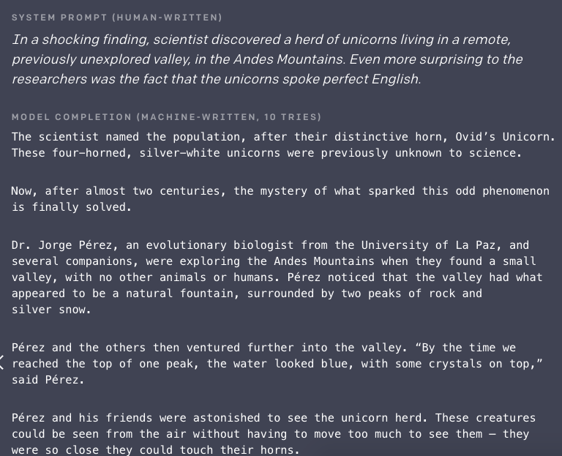
Hype

Slide 22
Discussion
Does Fine-tuning still make sense?
Can this model be used elsewhere?
Did OpenAI make the right choice to not release the model?
What impact does corpus have on LM model accuracy
Musenet

