Slide 1
MaxEnt (II): Modeling and Decoding
LING 572
Advanced Statistical Methods for NLP
January 31, 2019
Based on Xia ‘17

Slide 2
Outline
Overview
The Maximum Entropy Principle
Modeling**
Decoding
Training**
Case study

Slide 3
Modeling

Slide 4
The Setting
From the training data, collect (x, y) pairs:
x in X: observed data
y in Y: thing to be predicted (e.g., a class in a classification problem)
Ex: In a text classification task
x: a document
y: the category of the document
Goal: estimate P(y | x)

Slide 5
Basic Idea
Goal: estimate p(y | x)
Choose p(x, y) with maximum entropy (or “uncertainty”) subject to the constraints (or “evidence”).

Slide 6
Outline for Modeling
Feature function:
Calculating the expectation of a feature function
Forms of P(x, y) and P(y | x)

Slide 7
Feature function

Slide 8
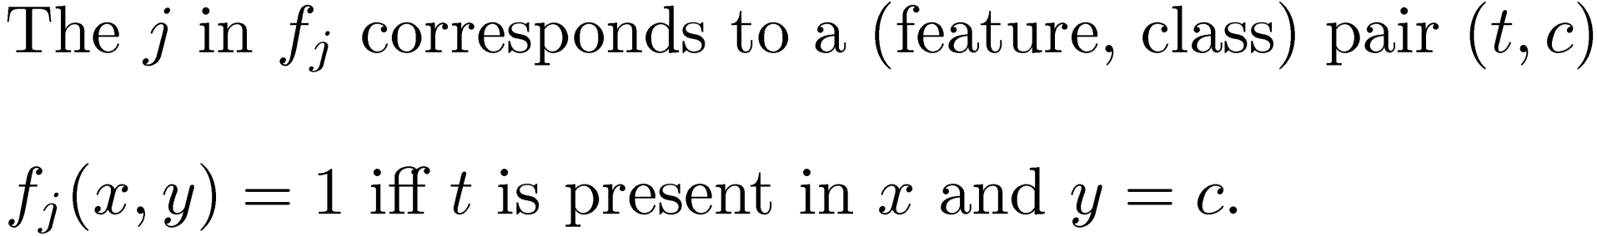
Definition
A feature function is a binary-valued function on events:
Ex:

Slide 9
Weights in NB
 | f₁ | f₂ | … | f_{k}
c₁
c₂
…
c_{i}

Slide 10
Weights in NB
 | f₁ | f₂ | … | f_{j}
c₁ | P(f₁ |c₁) | P(f₂ |c₁) | … | P(f_{j} | c₁)
c₂ | P(f₁ |c₂) | … | … | …
… | …
c_{i} | P(f₁ |c_{i}) | … | … | P(f_{j} | c_{i})
Each cell is a weight for a particular (class, feat) pair.

Slide 11
Matrix in MaxEnt
 | t₁ | t₂ | … | t_{k}
c₁ | f₁ | f₂ | … | f_{k}
c₂ | f_{k+1} | f_{k+2} | … | f_{2k}
… | …
c_{i} | f_{k*(i-1)+1} |  |  | f_{k*i}
Each feature function f_{j} corresponds to a (feat, class) pair.

Slide 12
Weights in MaxEnt
 | t₁ | t₂ | … | t_{k}
c₁ | λ₁ | λ₂ | … | λ_{k}
c₂ | … | … | … | …
… | …
c_{i} | … |  |  | λ_{ki}
Each feature function f_{j} has a weight λ_{j}.

Slide 13
Feature function summary
A feature function in MaxEnt corresponds to a (feat, class) pair.
The number of feature functions in MaxEnt is approximately |C| * |V|.
A MaxEnt trainer learns the weights for the feature functions.

Slide 14
The outline for modeling
Feature function:
Calculating the expectation of a feature function
The forms of P(x,y) and P(y | x)

Slide 15
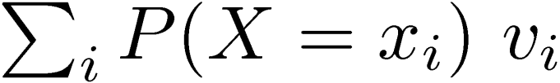
Expected Return
Ex1:
Flip a coin
if it’s heads, you win 100 dollars
if it’s tails, you lose 50 dollars
What is the expected return?
P(X=H) * 100 + P(X=T) * (-50)
Ex2:
If it is x_{i}, you will receive v_{i} dollars?
What is the expected return?

Slide 16
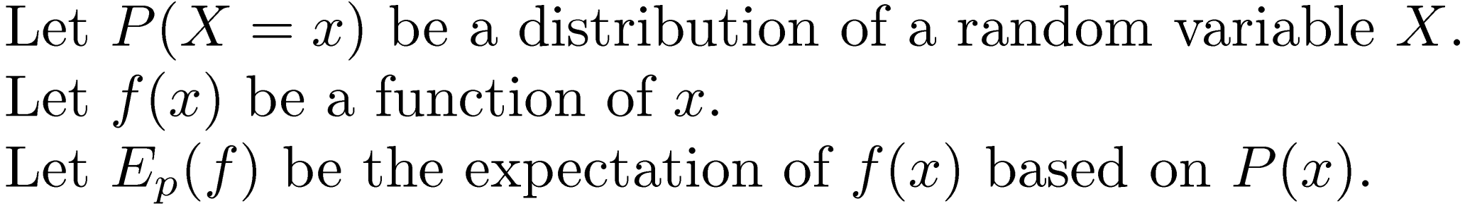
Calculating the expectation of a function

Slide 17
Empirical expectation
Denoted as :
Ex1: Toss a coin four times and get H, T, H, and H.
The average return: (100-50+100+100)/4 = 62.5
Empirical distribution:
Empirical expectation:
¾ * 100 + ¼ * (-50) = 62.5

Slide 18
Model Expectation
Ex1: Toss a coin four times and get H, T, H, and H.
A model:
Assume a fair coin
P(X=H) = P(X=T) = 1/2
Model expectation:
1/2 * 100 + 1/2 * (-50) = 25

Slide 19
Some Notation
Training data:
Empirical distribution:
A model:
The j^{th} feature function:
Empirical expectation of
Model expectation of

Slide 20
Empirical expectation**

Slide 21
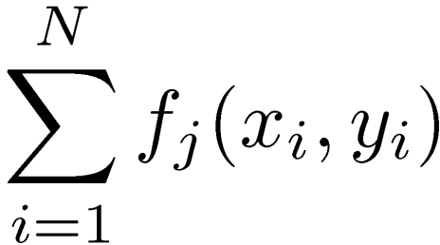
An example
Training data:
x1 c1 t1 t2 t3
x2 c2 t1 t4
x3 c1 t3 t4
x4 c3 t1 t3
Raw counts
 | t1 | t2 | t3 | t4
c1 | 1 | 1 | 2 | 1
c2 | 1 | 0 | 0 | 1
c3 | 1 | 0 | 1 | 0

Slide 22
An example
Training data:
x1 c1 t1 t2 t3
x2 c2 t1 t4
x3 c1 t3 t4
x4 c3 t1 t3
Empirical expectation
 | t1 | t2 | t3 | t4
c1 | 1/4 | 1/4 | 2/4 | 1/4
c2 | 1/4 | 0/4 | 0/4 | 1/4
c3 | 1/4 | 0/4 | 1/4 | 0/4

Slide 23
Calculating empirical expectation
Let N be the number of training instances
for each instance x in the training data
let y be the true class label of x
for each feature t in x
empirical_expect [t] [y] += 1/N

Slide 24
Model expectation**

Slide 25
An example
Suppose P(y | x_{i}) = 1/3
Training data:
x1 c1 t1 t2 t3
x2 c2 t1 t4
x3 c1 t4
x4 c3 t1 t3
“Raw” counts
 | t1 | t2 | t3 | t4
c1 | 3/3 | 1/3 | 2/3 | 2/3
c2 | 3/3 | 1/3 | 2/3 | 2/3
c3 | 3/3 | 1/3 | 2/3 | 2/3

Slide 26
An example
Suppose P(y | x_{i}) = 1/3
Training data:
x1 c1 t1 t2 t3
x2 c2 t1 t4
x3 c1 t4
x4 c3 t1 t3
Model expectation
 | t1 | t2 | t3 | t4
c1 | 3/12 | 1/12 | 2/12 | 2/12
c2 | 3/12 | 1/12 | 2/12 | 2/12
c3 | 3/12 | 1/12 | 2/12 | 2/12

Slide 27
Calculating model expectation
Let N be the number of training instances
for each instance x in the training data
calculate P(y | x) for every y in Y
for each feature t in x
for each y in Y
model_expect [t] [y] += 1/N * P(y | x)

Slide 28
Empirical expectation vs. model expectation

Slide 29
Outline for modeling
Feature function:
Calculating the expectation of a feature function
The forms of P(x, y) and P(y | x)**

Slide 30
Constraints
Model expectation = Empirical expectation
Why impose such constraints?
MaxEnt principle: Model what is known
Maximize the conditional likelihood: see Slides #24-28 in (Klein and Manning, 2003)

Slide 31
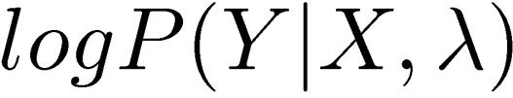
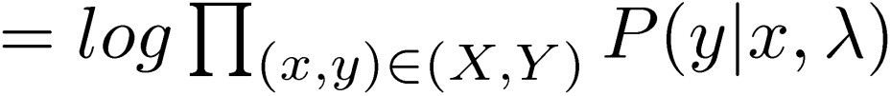

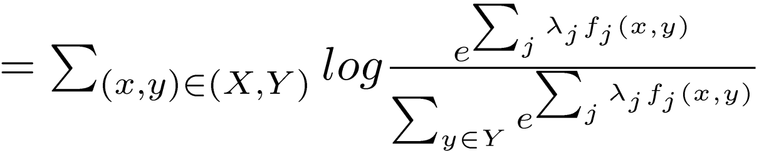
The conditional likelihood (**)
Given the data (X,Y), the conditional likelihood is a function of the parameters ¸

Slide 32
The effect of adding constraints
Bring the distribution closer to the data
Bring the distribution further away from uniform
Lower the entropy
Raise the likelihood of data

Slide 33
Restating the problem
The task: find p* s.t.
where
Objective function: H(p)
Constraints:

Slide 34
Using Lagrange multipliers (**)
Minimize A(p):

Slide 35
Questions
where
Is P empty?
Does p* exist?
Is p* unique?
What is the form of p*?
How can we find p*?

Slide 36
What is the form of p*? (Ratnaparkhi, 1997)
Theorem: if then
Furthermore, p* is unique.

Slide 37
Two equivalent forms

Slide 38
Modeling summary
Goal: find p* in P, which maximizes H(p).
It can be proved that, when p* exists
- it is unique
- it maximizes the conditional likelihood of the training data
- it is a model in Q, where

Slide 39
Outline
Overview
The Maximum Entropy Principle
Modeling**
Decoding
Training**
Case study: POS tagging

Slide 40
Decoding

Slide 41
Decoding
Z is the normalizer.
 | t₁ | t₂ | … | t_{k}
c₁ | λ₁ | λ₂ | … | λ_{k}
c₂ | … | … | … | …
… | …
c_{i} | … |  |  | λ_{ki}

Slide 42
Procedure for calculating P(y | x)
Z=0;
for each y in Y
sum = 0; // or sum = default_weight_for_class_y;
for each feature t present in x
sum += weight for (t, y);
result[y] = exp(sum);
Z += result[y];
for each y in Y
P(y | x) = result[y] / Z;

Slide 43
MaxEnt summary so far
Idea: choose the p* that maximizes entropy while satisfying all the constraints.
p* is also the model within a model family that maximizes the conditional likelihood of the training data.
MaxEnt handles overlapping features well.
In general, MaxEnt achieves good performance on many NLP tasks.
Next: Training: many methods (e.g., GIS, IIS, L-BFGS).

