Slide 1
Chi square
Ling572
Advanced Statistical Methods for NLP
January 24, 2019

Slide 2
Chi square
An example: is gender a good feature for predicting footwear preference?
A: gender
B: footwear preference
Bivariate tabular analysis:
Is there a relationship between two random variables A and B in the data?
How strong is the relationship?
What is the direction of the relationship?

Slide 3
Raw frequencies
 | Sandal | Sneaker | Leather shoe | Boots | Others
Male | 6 | 17 | 13 | 9 | 5
Female | 13 | 5 | 7 | 16 | 9
Feature: Male/Female
Classes: {Sandal, Sneaker, ….}

Slide 4
Two distributions
Observed distribution (O):
 | Sandal | Sneaker | Leather | Boot | Others | Total
Male | 6 | 17 | 13 | 9 | 5 | 50
Female | 13 | 5 | 7 | 16 | 9 | 50
Total | 19 | 22 | 20 | 25 | 14 | 100
Expected distribution (E):
 | Sandal | Sneaker | Leather | Boot | Others | Total
Male |  |  |  |  |  | 50
Female |  |  |  |  |  | 50
Total | 19 | 22 | 20 | 25 | 14 | 100

Slide 5
Two distributions
Observed distribution (O):
 | Sandal | Sneaker | Leather | Boot | Others | Total
Male | 6 | 17 | 13 | 9 | 5 | 50
Female | 13 | 5 | 7 | 16 | 9 | 50
Total | 19 | 22 | 20 | 25 | 14 | 100
Expected distribution (E):
 | Sandal | Sneaker | Leather | Boot | Others | Total
Male | 9.5 | 11 | 10 | 12.5 | 7 | 50
Female | 9.5 | 11 | 10 | 12.5 | 7 | 50
Total | 19 | 22 | 20 | 25 | 14 | 100

Slide 6
Chi square
Expected value =
row total * column total / table total
χ² = ∑_{ij} (Oij - E_{ij})² / E_{ij}
χ² = (6-9.5)²/9.5 + (17-11)²/11+ ….
= 14.026

Slide 7
Calculating χ²
Fill out a contingency table of the observed values ➔ O
Compute the row totals and column totals
Calculate expected value for each cell assuming no association ➔ E
Compute chi square: (O-E)²/E

Slide 8
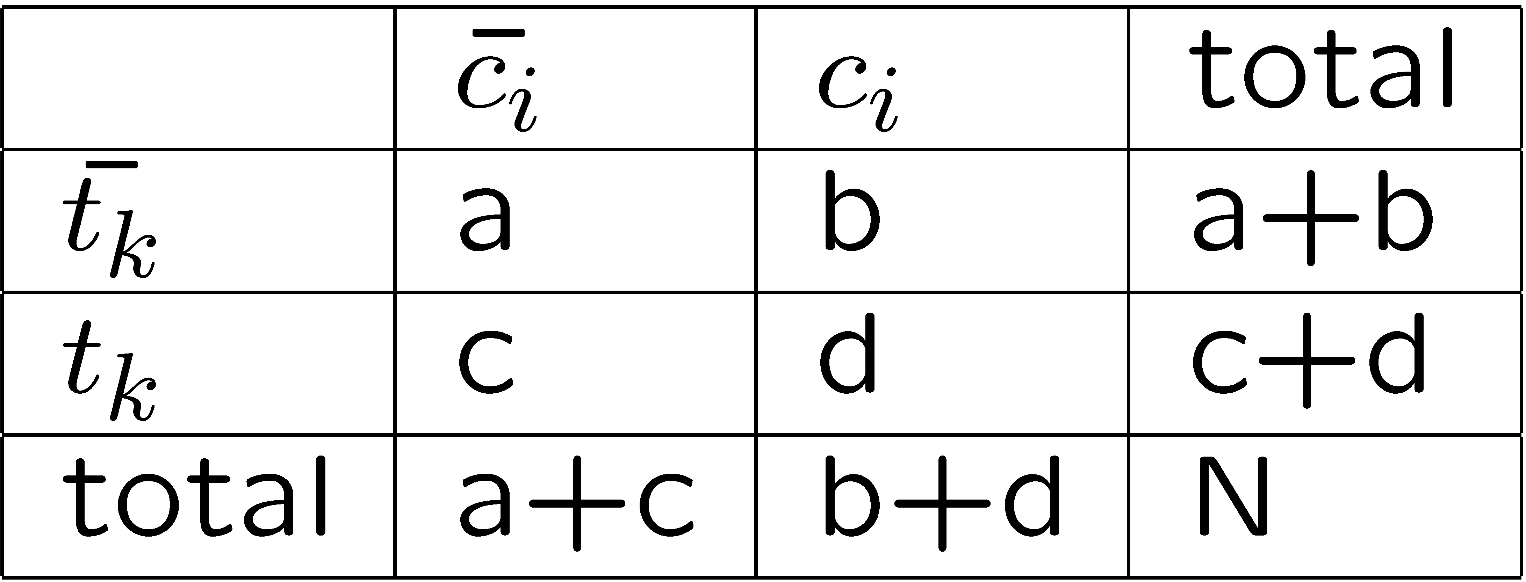
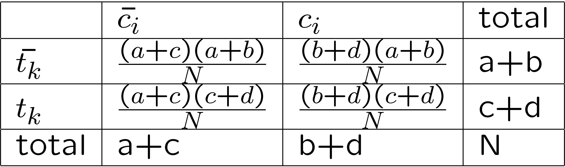
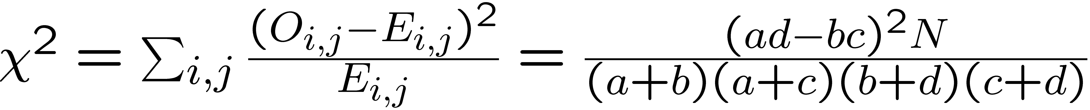
When r=2 and c=2
O =
E =

Slide 9
χ² test

Slide 10
Basic idea
Null hypothesis (the tested hypothesis): no relation exists between two random variables.
Calculate the probability of having the observation with that χ² value, assuming the hypothesis is true.
If the probability is too small, reject the hypothesis.

Slide 11
Requirements
The events are assumed to be independent and have the same distribution.
The outcomes of each event must be mutually exclusive.
At least 5 observations per cell.
Collect raw frequencies, not percentages

Slide 12
Degree of freedom
Degree of freedom df = (r – 1) (c – 1)
r: # of rows c: # of columns
In this Ex: df=(2-1) (5-1)=4

Slide 13
χ² distribution table
 | 0.10 | 0.05 | 0.025 | 0.01 | 0.001
1 | 2.706 | 3.841 | 5.024 | 6.635 | 10.828
2 | 4.605 | 5.991 | 7.378 | 9.210 | 13.816
3 | 6.251 | 7.815 | 9.348 | 11.345 | 16.266
4 | 7.779 | 9.488 | 11.143 | 13.277 | 18.467
5 | 9.236 | 11.070 | 12.833 | 15.086 | 20.515
6 | 10.645 | 12.592 | 14.449 | 16.812 | 22.458
…
df=4 and 14.026 > 13.277
p<0.01
there is a significant relation

Slide 14
χ² to P Calculator
http://vassarstats.net/newcs.html

Slide 15
Steps of χ² test
Select significance level p₀
Calculate χ²
Compute the degrees of freedom
df = (r-1)(c-1)
Calculate p given χ² value (or get the χ²₀ for p₀)
if p < p₀ (or if χ² >χ²₀)
then reject the null hypothesis.

Slide 16
Summary of χ² test
A very common method for determining whether two random variables are independent
Many good tutorials online
Ex: http://en.wikipedia.org/wiki/Chi-square_distribution

Slide 17
Additional slides

Slide 18
χ² example
Shared Task Evaluation:
Topic Detection and Tracking (aka TDT)
Sub-task: Topic Tracking Task
Given a small number of exemplar documents (1-4)
Define a topic
Create a model that allows tracking of the topic
I.e. find all subsequent documents on this topic
Exemplars: 1-4 newswire articles
300-600 words each

Slide 19
Challenges
Many news articles look alike
Create a profile (feature representation)
Find terms that are strongly associated with current topic
Not all documents are labeled
Only a small subset belong to topics of interest
Differentiate from other topics AND ‘background’

Slide 20
Approach
X² feature selection:
Assume terms have binary representation
Positive class term occurrences from exemplar docs
Negative class term occurrences from
other class exemplars, ‘earlier’ uncategorized docs
Compute X² for terms
Retain terms with highest X² scores
Keep top N terms
Create one feature set per topic to be tracked

Slide 21
Tracking Approach
Build vector space model
Feature weighting: tf*idf
Distance measure: Cosine similarity
Select documents scoring above threshold
Result: Improved retrieval

