Slide 1
Recap
LING572
Advanced Statistical Methods for NLP
January 24, 2019

Slide 2
Outline
Summary of the material so far
Reading materials
Math formulas

Slide 3
So far
Introduction:
Course overview
Information theory
Overview of classification task
Basic classification algorithms:
Decision tree
Naïve Bayes
kNN, Feature selection, chi-square test and recap
Hw1-Hw3

Slide 4
Main steps for solving a classification task
Prepare the data:
Reformulate the task into a learning problem
Define features
Feature selection
Form feature vectors
Train a classifier with the training data
Run the classifier on the test data
Evaluation

Slide 5
Comparison of 3 Learners
 | kNN | Decision Tree | Naïve Bayes
Modeling | Vote by your neighbors | Vote by your groups | Choose the c that max P(c | x)
Training | None | Build a decision tree | Learn P(c) and P(f | c)
Decoding | Find neighbors | Traverse the tree | Calculate P(c)P(x | c)
Hyper parameters | K Similarity fn | Max depth Split function Thresholds | Delta for smoothing

Slide 6
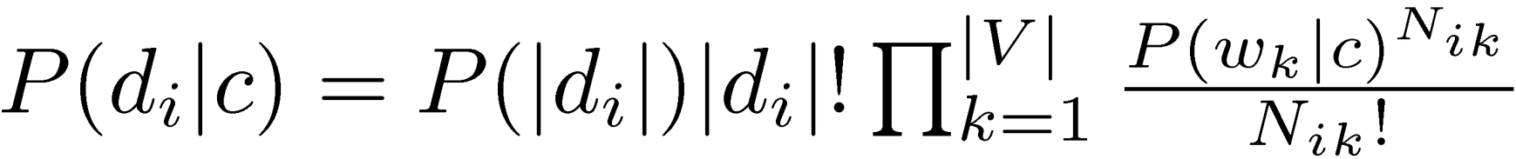
Implementation issues
Taking the log:
Ignoring some constants:
Increasing small numbers before dividing

Slide 7
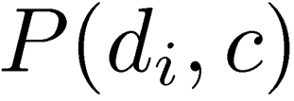
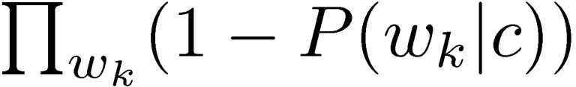
Implementation issues (cont)
Reformulate the formulas: e.g., entropy calc
Store useful intermediate results

Slide 8
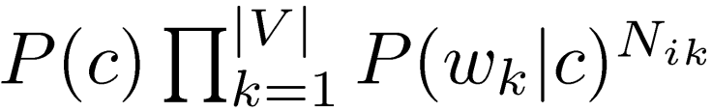
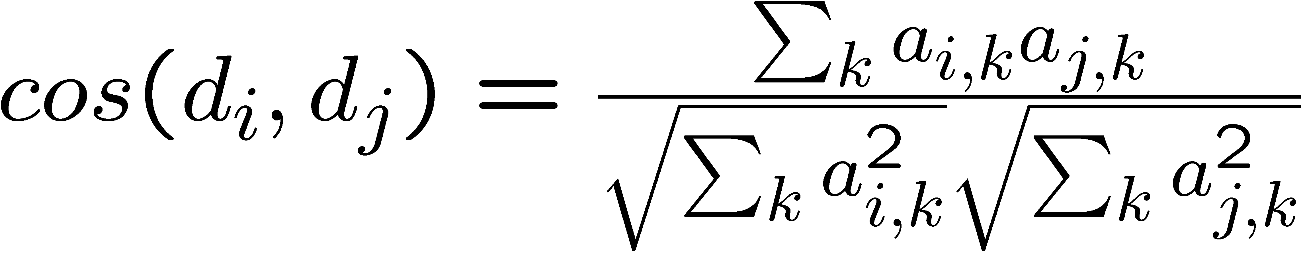
Lessons learned
Don’t follow the formulas blindly.
Ex1: Multinomial NB
Ex2: cosine function for kNN

Slide 9
Next
Next unit (2.5 weeks): two more advanced methods:
MaxEnt
CRF
Focus:
Main intuition, final formulas used for training and testing
Mathematical foundation
Implementation issues

Slide 10
Reading material

Slide 11
The purpose of having reading material
Something to rely on besides the slides
Reading before class could be beneficial
Papers (not textbooks) could be the main source of information in the future

Slide 12
Problems with the reading material
The authors assume that you know the algorithm already:
Little background info
Page limit
Style
The notation problem
➔ It could take a long time to understand everything

Slide 13
Some tips
Look at several papers and slides at the same time
Skim through the papers first to get the main idea
Go to class and understand the slides
Then go back to the papers (if you have time)
Focus on the main ideas. It’s ok if you don’t under all the details in the paper.

Slide 14
Math formulas

Slide 15
The goal of ling572
Understand ML algorithms
The core of the algorithms
Implementation: e.g., efficiency issues
Learn how to use the algorithms:
Reformulate a task into a learning problem
Select features
Write pre- and post-processing modules

Slide 16
Understanding ML methods
1: never heard about it
2: know very little
3: know the basics
4: understand the algorithm (modeling, training, testing)
5: have implemented the algorithm
6: know how to modify/extend the algorithm
➔ Our goal: kNN, DT, NB: 5
MaxEnt, CRF, SVM, TBL: 3-4
Math is important for 4-6, especially for 6.

Slide 17

Why are math formulas hard?
Notation, notation, notation.
Same meaning, different notation:
Calculus, probability, statistics, optimization theory, linear programming, …
People often have typos in their formulas.
A lot of formulas to digest in a short period of time.

Slide 18
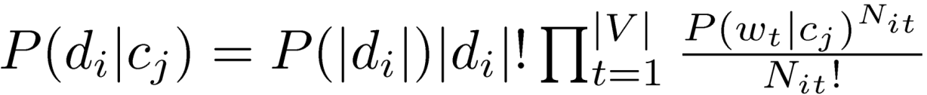
Some tips
No need to memorize the formulas
Determine which part of the formulas matters
It’s normal if you do not understand it the 1st/2nd time around.

Slide 19
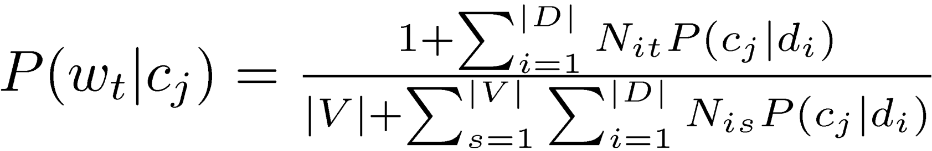
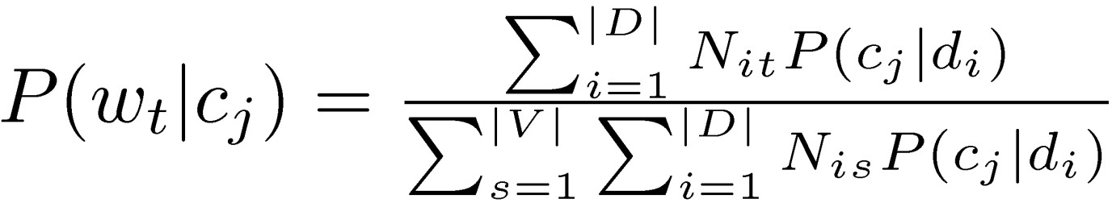
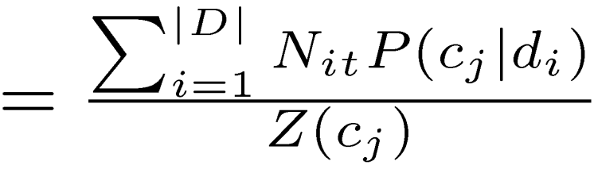
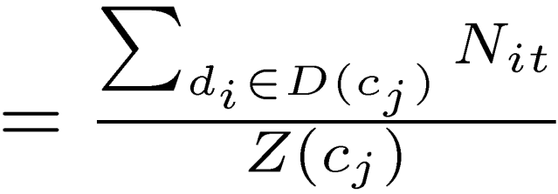
Understanding a formula

