Slide 1
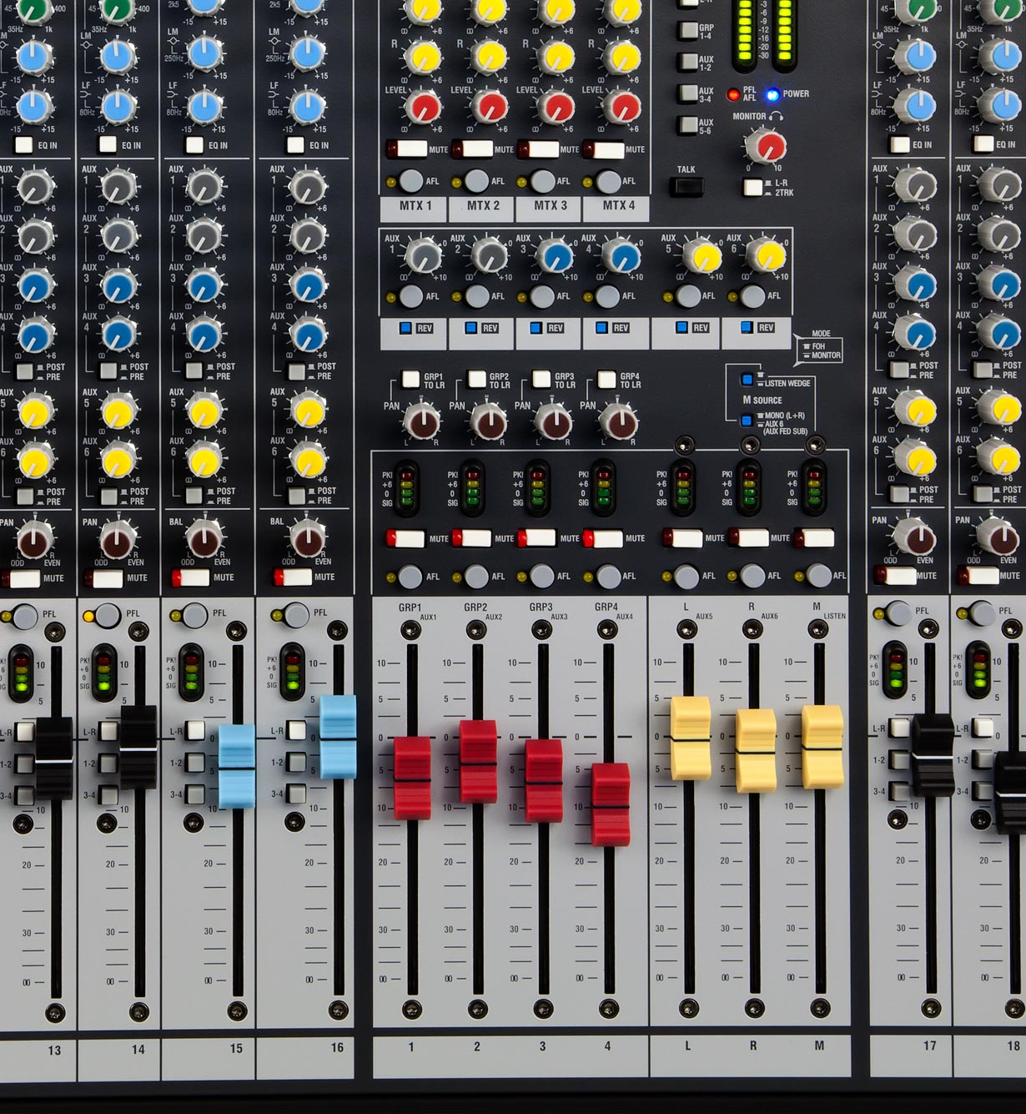
“Sends”
“Faders”

Slide 2
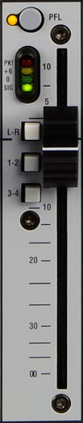
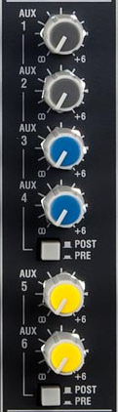
+10 dB
+6 dB
0 dB, no boost, no cut
–30 dB
This range is touchy.
–∞ dB

