Slide 1
Introduction to Laravel Passport
@michaelpeacock
PHP North East, September 2016

Slide 2
@michaelpeacock
Co-organiser of PHP North East & Laravel North East
Software development consultant
Primarily serve as a consultant CTO for a number of early stage startups

Slide 3
Introduction
API Authentication
Uses oAuth
Built on top of the PHP League oAuth 2 Server
Notes:
oAuth has practically become the defacto mechanism for API authentication, and provides a secure mechanism for users to authorise third party developers to programatically access their accounts on certain web services – such as social networks, CRM systems, or other web services – without having to enter their password directly on these third party websites. Because oAuth uses tokens which are completely separate to a users standard login credentials, the user is in control, and can revoke tokens.

Slide 4
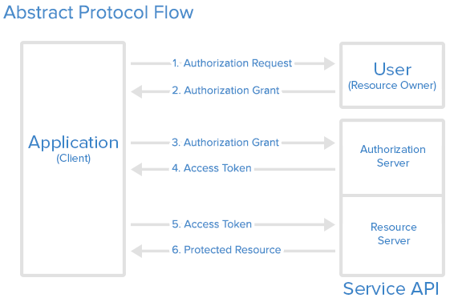
oAuth?
Mitchell Anicas / https://www.digitalocean.com/community/tutorials/an-introduction-to-oauth-2

Slide 5
SSL!
oAuth 2 specification mandates that the authorization server uses SSL
Notes:
Tokens are passed around in plain text, as such the oAuth 2 specification mandates that the authorization server uses SSL to encrypt traffic.

Slide 6
Installation
1. Require laravel passport
composer require laravel/passport
2. Register passport service provider in config/app.php
Laravel\Passport\PassportServiceProvider::class,
3. Migrate: php artisan migrate
4.Install: php artisan passport:install
Notes:
The installation is quite involved with Laravel Passport, as in addition to its own code, it needs to be registered within your application and has a number of setup steps beyond this slide. First, we require the component via composer, then we need to register the passport service provider. Next we need to migrate our database (a nice feature of Laravel 5.3 is that it can look in a number of migration directories, so there is no need to publish migrations from the package). Next we need to run passport:install, this will create a public / private keypair for API authentication, and then it will create two default oAuth clients/apps, one for personal authentication (where we as users authenticate directly with the API, as opposed to authorizing a third party developer) and a password authentication client which lets us exchange a username and password for a token – this again is us authenticating directly, not via a third party, and would be used for your own mobile apps, etc.

Slide 7
Setup
Add Laravel\Passport\HasApiTokens trait to User class
Call Laravel\Passport\Passport::routes() from AuthServiceProvider::boot method
Change the driver for the api authentication guard to passport in config/auth.php
Notes:
First we need to tell the User model that it has API tokens, with the appropriate trait.
Next we call the Passport routes method in our auth service provider, this registers our oAuth and related routes
Finally we tell Laravel that for API authentication we want to use the passport driver, which will defer to checking oAuth tokens

Slide 8
oAuth Routes Out of the box
Method | URL | Description
GET | /oauth/clients | List clients / apps you have created
POST | /oauth/clients | Create a new client / app. Requires name and redirect.
PUT | /oauth/clients/{id} | Update client. Requires both name and redirect
DELETE | /oauth/clients/{id} | Delete a client.
GET | /oauth/authorize | Start the oAuth process, displays the accept / cancel dialogue
POST | /oauth/authorize | Accept the oAuth process
POST | /oauth/token | Exchange a code for a token or refresh a token
GET | /oauth/scopes | List all scopes
GET | /oauth/personal-access-tokens | List all personal access tokens
POST | /oauth/personal-access-tokens | Request a personal access token (name and scopes required)
DELETE | /oauth/personal-access-tokens/{id} | Delete a personal access token
Notes:
There are a range of different routes that come out of the box with Passport.
/oauth/clients let us create edit and delete clients. A client is something a third party developer will create, and tokens are linked to a client.
/oauth/authorize is the request for authorizing a client to access the API on our behalf, and will ask us to confirm, giving access to specific scopes, or cancel. On acceptance we are redirected back to our app.
When redirected our app then needs to call the /oauth/token endpoint to exchange an authorization code for an access token, or to refresh an access token using the refresh token.
There is a /oauth/scopes endpoint which lists scopes that are registered in the aplication
And finally there are personal access tokens which are tokens not linked to a client (i.e. us directly talking to the API)

Slide 9
Publish Vue Components & Views
php artisan vendor:publish --tag=passport-components
php artisan vendor:publish --tag=passport-views
Notes:
Passport provides some Vue components which allow us to manage clients and personal access tokens, and revoke access tokens without writing any code! In order to use these we need to publish the Vue components from the package.
Passport also provides us with some templates for the Approve this client screen. We don’t need to publish these, but if we do, we can customise the look and feel if we wish.

Slide 10
Vue Integration
Vue.component(
'passport-clients', require('./components/passport/Clients.vue')
);
Vue.component(
'passport-authorized-clients', require('./components/passport/AuthorizedClients.vue')
);
Vue.component(
'passport-personal-access-tokens', require('./components/passport/PersonalAccessTokens.vue')
);
Notes:
In order to use the Vue components we need to register them in our app.js file.

Slide 11
…don’t forget to gulp
(requires an npm install first!)
Notes:
In order for these components to be included we need to run gulp, which of course requires an npm install.

Slide 12
Use the Vue components
<passport-clients></passport-clients>
<passport-authorized-clients></passport-authorized-clients>
<passport-personal-access-tokens></passport-personal-access-tokens>
Notes:
Finally, in order to use the vue components, we just add the above tags into a page where we wish to use them. I’ve just put them in the default Laravel authenticated welcome screen.

Slide 13
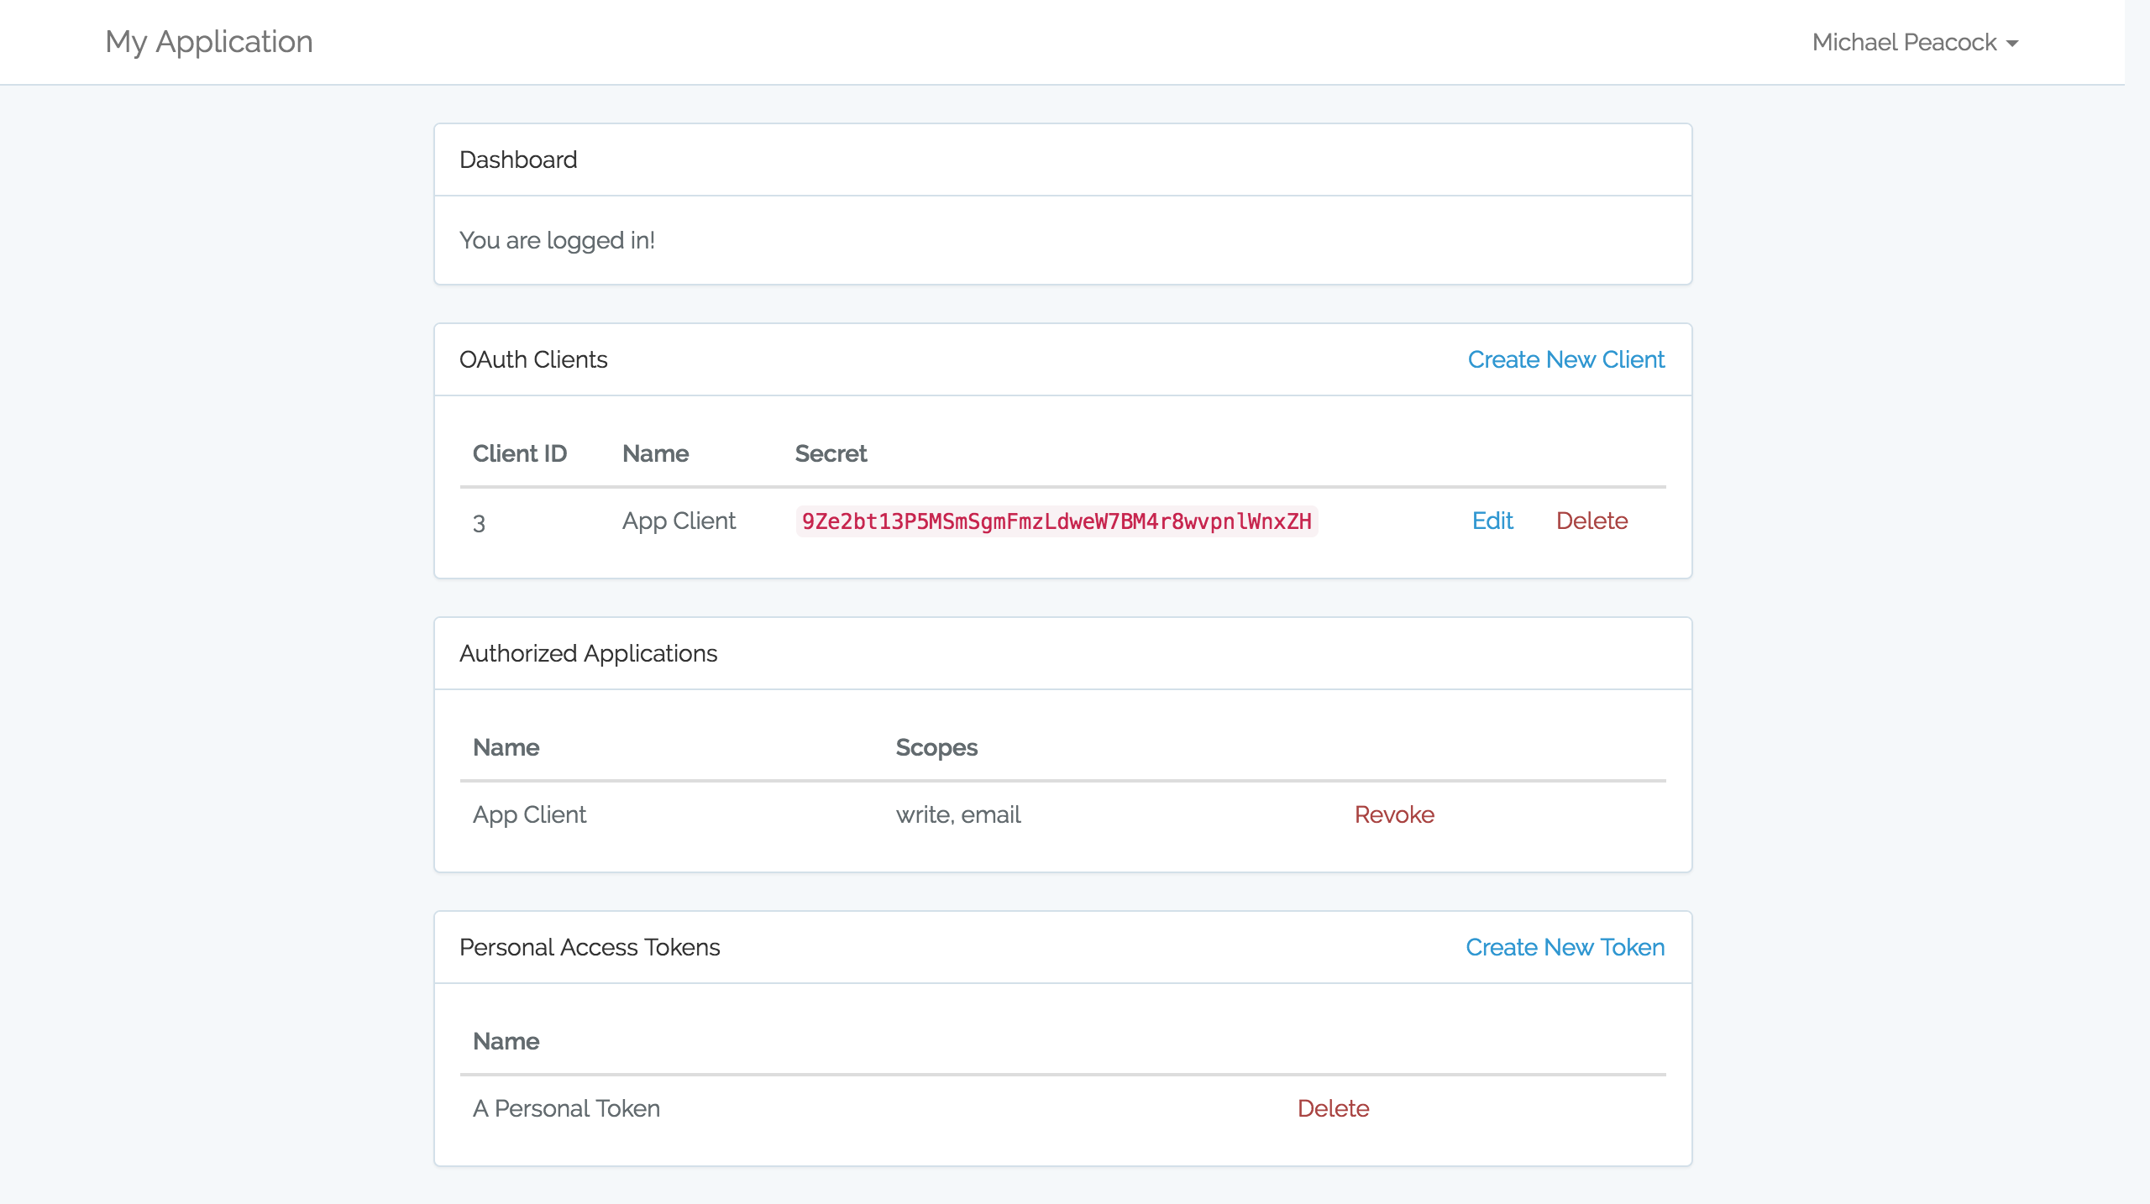

Slide 14
Demo 1
VUE components
Notes:
Uncomment Passport::routes() in AuthServiceProvider

Slide 15
Authorize
Route::get('/connect', function () {
$query = http_build_query([
'client_id' => '3',
'redirect_uri' => 'http://…t.local/redirect',
'response_type' => 'code',
'scope' => '',
]);
return redirect('http://…t.local/oauth/authorize?'.$query);
});

Slide 16
Exchange code for an access token
use Illuminate\Http\Request;
Route::get('/redirect', function (Request $request) {
$http = new GuzzleHttp\Client;
$response = $http->post('http://…t.local/oauth/token', [
'form_params' => [
'grant_type' => 'authorization_code',
'client_id' => '3',
'client_secret' => '9Ze2bt13P5MSmSgmFmzLdweW7BM4r8wvpnlWnxZH',
'redirect_uri' => 'http://…t.local/redirect',
'code' => $request->query->get('code'),
],
]);
return json_decode((string) $response->getBody(), true);
});

Slide 17
DEMO 2
oAuth handshake
Notes:
Uncomment /connect and /redirect from web.php
Login and visit /connect

Slide 18
Authenticate
Accept: application/json
Authorization: Bearer bearer-token

Slide 19
Require A Valid Access Token
->middleware('auth:api')
Notes:
Demo: api/user

Slide 20
Defining Scopes
// AuthServiceProvider
Laravel\Passport\Passport::tokensCan([
'read' => 'Read access to user account',
'write' => 'Write access to user account’,
'email' => 'Send emails',
]);

Slide 21
Register Scope Middleware
// Http/Kernel.php Route Middleware
'scopes' => \Laravel\Passport\Http\Middleware\CheckScopes::class,
'scope' => \Laravel\Passport\Http\Middleware\CheckForAnyScope::class,

Slide 22
Require Any of a list of scopes
->middleware('scope:read,write');
Notes:
Either scope will be fine

Slide 23
Require a number of scopes
->middleware('scopes:write,email');

Slide 24
Demo
Scopes
Notes:
Uncomment read/write scope in routes/api.php
Uncomment write email in routes/web.php
Re-get token
Cocoarest client demo

Slide 25
Password Grant
Enabled out of the box when we did php artisan passport:install
Can be enabled via php artisan passport:client –password
Route::get('/connect-password-grant', function () {
$http = new GuzzleHttp\Client;
$response = $http->post(
'http://laravel-passport.local/oauth/token',
[
'form_params' => [
'grant_type' => 'password',
'client_id' => '2',
'client_secret' => 'xIQoQPimqpdVXQiRU81wyRa78X2mnSxSY9CD38EC',
'username' => 'mkpeacock@gmail.com',
'password' => 'password',
'scope' => 'write email',
],
]);
return json_decode((string) $response->getBody(), true);
});
Notes:
ONLY works on the relevant password client (other oAuth clients will reject it)

Slide 26
Demo
Password grant
Notes:
Uncomment connect password grant in routes/web.php

Slide 27
Automatic Tokens For Web Requests
Laravel can expose tokens (personal tokens) automatically for web users.
Makes it easy for your application to communicate directly with its API
Register to the web middleware group:
\Laravel\Passport\Http\Middleware\CreateFreshApiToken::class,

Slide 28
Demo
Tokens for web users
Notes:
Uncomment \Laravel\Passport\Http\Middleware\CreateFreshApiToken::class, in Kernel.php middleware groups

Slide 29
Conclusion
Getting an oAuth 2 server running with Laravel 5.3 is pretty easy
The install and config is a little clunky and involves a few steps
But with the amount of work that’s done out of the box – its all good!

Slide 30
Thanks, Questions?
https://bitbucket.org/mkpeacock/laravel-passport-demo

