Slide 1
UNIT TESTING DEEP DIVE Updated 26 January 2021

Slide 2
UTDD > Agenda
Big Picture
Integration Testing
Unit Testing
Moq
Q&A

Slide 3
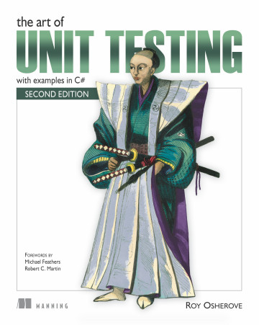
UTDD > Big Picture

Slide 4
UTDD > Big Picture > Pros and Cons
Pros
More reusable code and easier debugging.
Reduced cost for testing and bug-fixing.
Increased efficiency of code improvement and maintenance.
Simplified interaction due to separate and complex modules testing.
Errors can be detected at the early stages of the SDLC.
Cons
It's difficult to write quality unit tests and the whole process can be time-consuming.
Human factor. A developer can make a mistake that will impact the whole system.
Not all errors can be detected, since every module it tested separately and later different integration bugs may appear.

Slide 5
UTDD > Big Picture > Arrange, Act, Assert
Unit Tests are broken into three phases.
Arrange
Set up everything that is needed for the test to be executed.
Act
Invoke the code (typically the specific method) that you wish to test.
Assert
Specify the pass criteria for the test, which fails if not met.

Slide 6

UTDD > UTDD > Live Demo

Slide 7


UTDD > Big Picture

Slide 8

UTDD > Moq

Slide 9
UTDD > Moq
What is Moq?
A mocking framework for C# .Net.
Allows testing on code that may have dependencies.
Replaces the actual dependency that would be used in Production with a test-time-only version to enable easier isolation of the code we want to test.
Why use Mock Objects?
Improves the speed of test execution
Removes possible dependencies on external resource (e.g. Database, Web Service etc.)
Allows parallel development streams
Improves test reliability
Reduces development and testing costs
External dependencies that are billed per call
Developer effort and complexity
Allows non-deterministic dependency testing

Slide 10
UTDD > Moq
Using Moq in Unit Tests
Identify dependencies of the System Under Test
Ensure Mock Objects are created to replace these dependencies
Configure the Mock Objects using the Setup method exposed by Moq.
If not explicitly configured then a default behaviour is utilised.
Moq provides a class known as It which can be used to define a return value based on the parameter type being used when the call is made.
Execute the required elements of the System Under Test as part of the Act section of the test.
Perform assertions using your required logic.

Slide 11
UTDD > Moq > Live Demo (Moq In Action)

Slide 12
UTDD > Moq

Slide 13
UTDD > Unit Testing

Slide 14
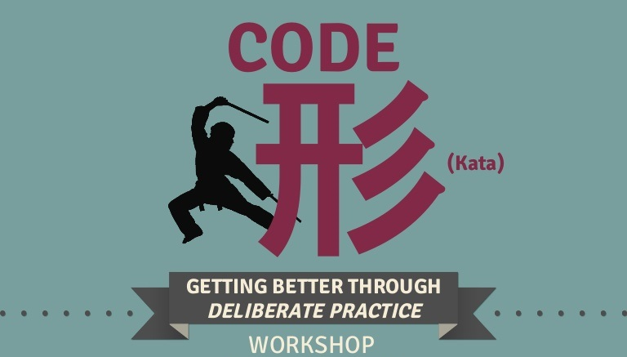
UTDD > Unit Testing > Kata 1

Slide 15
UTDD > Unit Testing > Kata 2

Slide 16
UTDD > Integration Testing

Slide 17
UTDD > Integration Testing > Kata 1

Slide 18
UTDD > Q/A

Slide 19
UTDD > Feedback
https://forms.office.com/Pages/ResponsePage.aspx?id=ZpSpcwWtIUKfkOcUKqL2wTFclz-gNvpNq3THAj1j3ZxUODk1TjlEWVNJNzUxNjAwTFhGQkQ2VkNTWi4u

Slide 20
UTDD > Literature
Manning | The Art of Unit Testing
Quickstart · moq/moq4 Wiki (github.com)

