Slide 1
What is R’s dplyr?
dplyr functions work with pipes and expect tidy data.
“piping” data takes output from one function and feeds it to the next
Key notation: %>%
Can be generated with ctrl+shift+m
Think of it as “then”
In tidy data:
Each variable is in its own column
Each observation, or case, is in its own row
Access:
install.packages("tidyverse")
library("tidyverse")
Notes:
R allows symbols wrapped in % to be defined as functions, > implies a chain

Slide 2
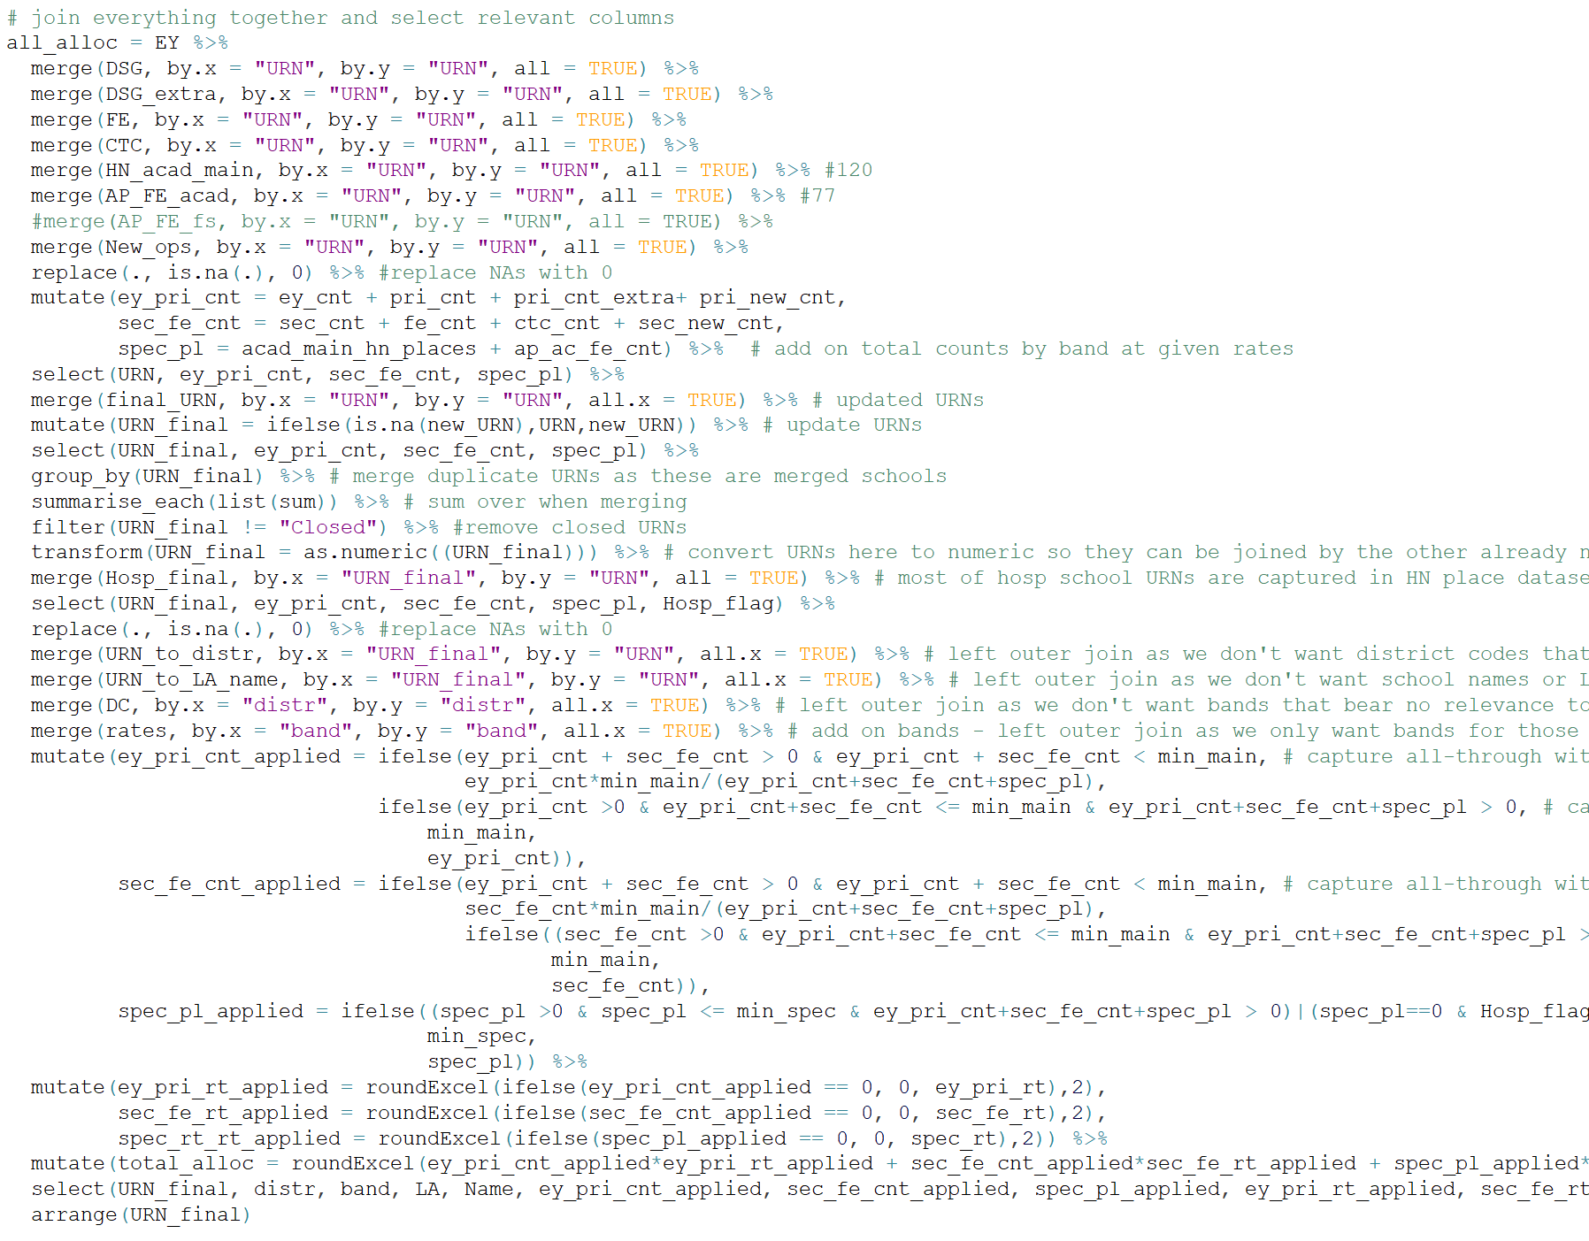
Code snippet
Just 8 unique instructions to do everything here:
merge
replace
mutate
select
group_by/summarise
filter
transform
arrange

Slide 3
Useful dplyr functionality
dplyr reads a bit like a recipe. Some of the most commonly used verbs within dplyr are:
select certain columns of data
filter data to show specific rows
arrange the rows of data into an order
mutate your data frame to include additional columns
summarise (and group) chunks of your data in some way
merge two (or more) datasets together

Slide 4
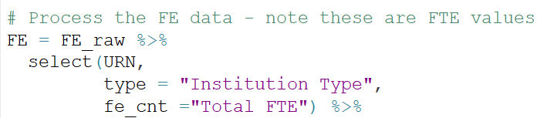
Useful verb: select
This is all about selecting the columns you are interested in keeping (or conversely, binning those you don’t want)
You can also rename whilst selecting
Can be combined with other useful instructions, eg:
contains()
starts_with()
ends_with()

Slide 5
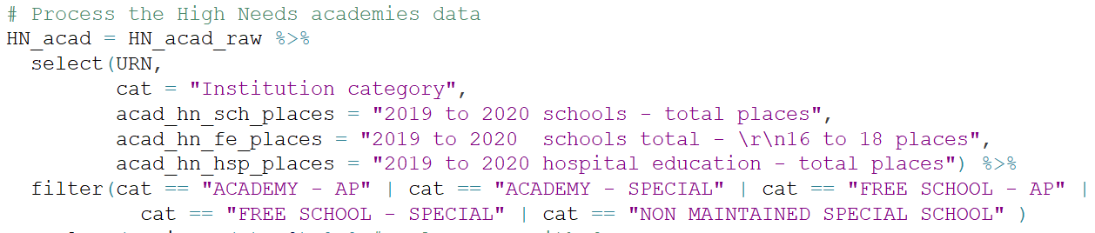
Useful verb: filter
Lets you produce subsets of the data by rows
You can use any valid logical arguments
Example:
Notes:
Logical argument could be < / > / <= / >=

Slide 6

Useful verb: arrange
Lets you order rows by any field
e.g.

Slide 7
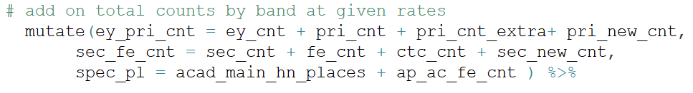
Useful verb: mutate
Used to create new columns

Slide 8
Useful verb: summarise (with group_by)
Not useful on its own, but very useful when combined with group_by
e.g.

Slide 9
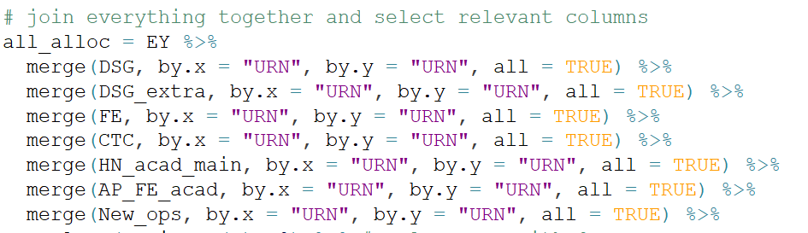
Useful verb: merge
Used to create join dataframes together, e.g.
This is an outer join (returns all rows from both tables, join records from the left which have matching keys in the right table)
You can also do left outer (all.x = TRUE), right outer (all.y = TRUE) etc
Similarly, there is a left_join, right_join function

Slide 10
Some other useful tidbits
read_excel / read_csv
write_csv
rename #rename columns
grep
transform
replace
filter between
You can run snippets of code within dplyr section (ctrl+enter)

