Slide 1
Statistics Development Workshop A quick intro to Git
Whilst everyone’s arriving, please could you go to the links below and download and install both git and GitHub desktop:
https://git-scm.com/downloads
https://desktop.github.com/
And create yourself a GitHub account if you haven’t already got one!

Slide 2
Intros
Who are we?
Who are you?

Slide 3
Aims of this workshop
A quick (and maybe fun) intro to using Git:
What is a repository?
What’s the difference between local and remote repositories and Git, GitHub and Dev Ops?
Working with Git
Cloning a repository
Staging and committing changes
Branching and merging

Slide 4
What is Git?
Git is a piece of software designed for version control, i.e.
Tracking changes;
Undoing changes;
Maintaining parallel variants of code.
Git works with repositories:
A repository (or repo) is simply a folder containing all the version controlled files of a given project.
It can have multiple sub-folders that will can also be tracked.

Slide 5
And GitHub and Dev Ops…
GitHub and Dev Ops provide a space to store and interact with a repository.
View the files;
View the history;
Create and view different branches (variants) of the code;
Management tools such as Issues logs (GitHub) or Kambam board (Dev Ops)
Create pull requests, review code and get feedback from collaborators;
Perform automated QA and deployment of code (e.g. sending a dashboard live).
GitHub and Dev Ops are generally not a place to:
Run your code;
Edit your code (although there is some basic text editing functionality you can use).

Slide 6
What are the key blockers to you using Git?
Never heard of it before now!
Team or personal expertise/knowledge/capability
Not enough support in the department
Challenges in setting it (and RStudio) up on work machines
Don’t see how it benefits us compared to what we already do just on shared drives
Just don’t get the concept!
Overwhelmed by too much to learn alongside R and SQL learning.

Slide 7
What are the key benefits of using Git?
Collaboration
Get support from team and wider community by easily sharing code (our team find it much easier to support you if we can just go and clone your repo…)
Code QA via reviews and automated checks
Continuity
Can undo changes
Can try different methodologies in a properly controlled way

Slide 8
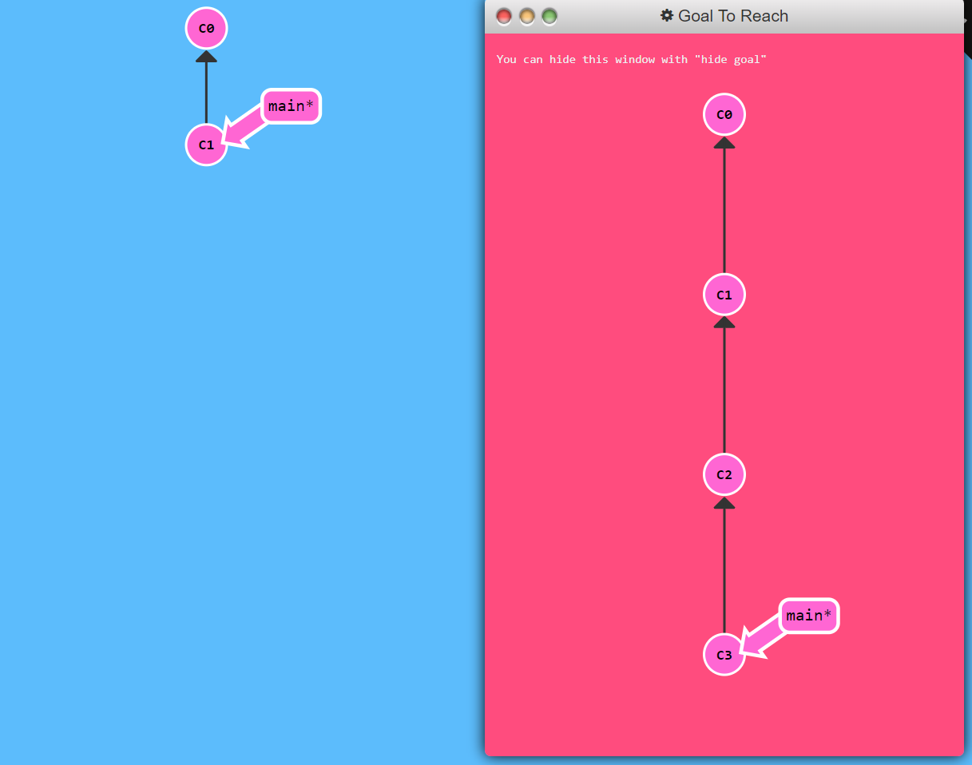
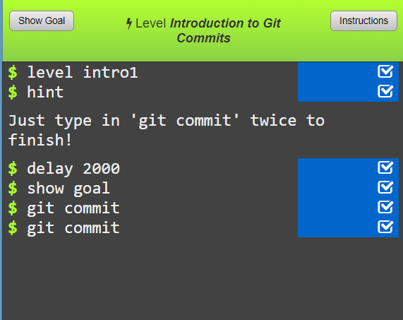
Let’s play!
This is a live coding session, but we’re going to try and keep it as simple as possible…
Go to https://learngitbranching.js.org/
Try task 1 - commiting!

Slide 9
git commit
The command git commit saves the progress of your work in a repo.
In real life, you’ll need to include a commit message:
git commit –m “I changed something”
The message will act as a marker so that if you want to undo your changes to a given point in your save history, you know where to find it.
Commit often (e.g. twice an hour), you can only revert changes to commits.

Slide 10
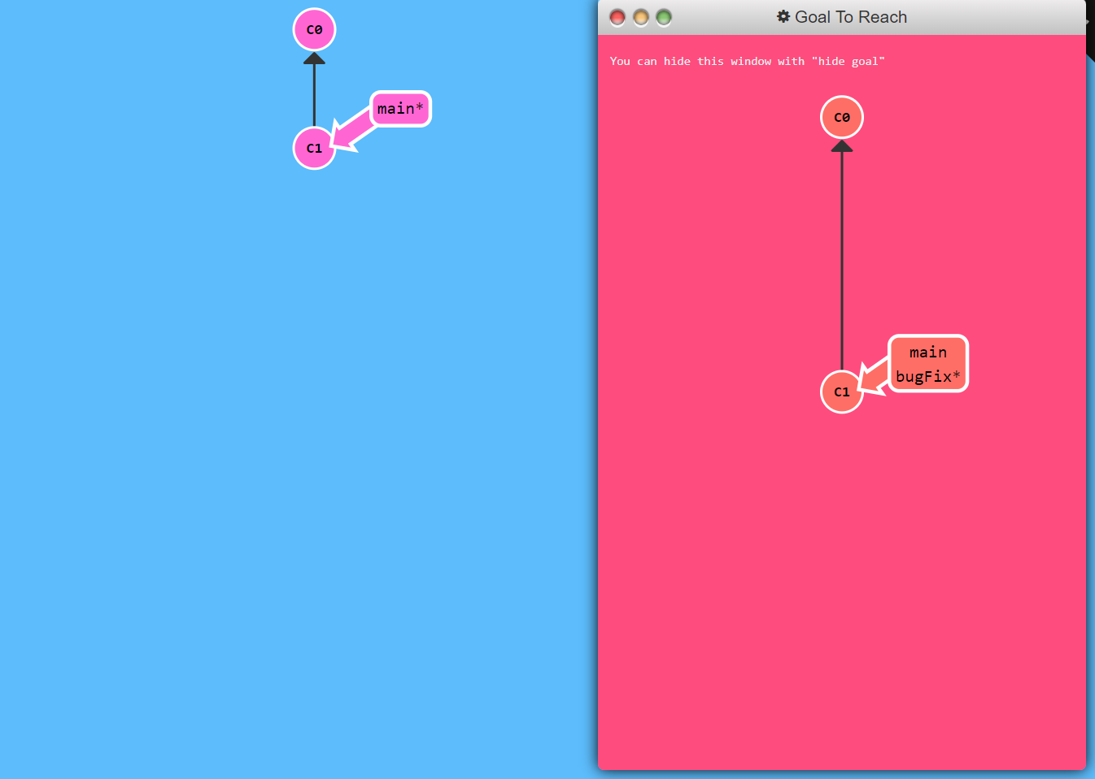
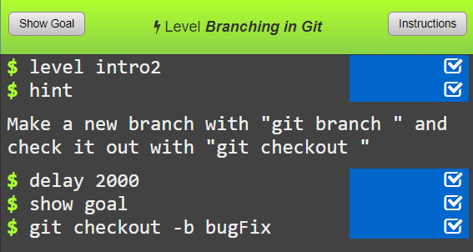
Branches
Now try task 2 on branching

Slide 11
git checkout branchname
In git, we use branches to maintain parallel changes to files.
This can be useful for example of two people are making independent changes to files at the same time
One person can work on one branch on the other on another branch
Usually the branch containing the most trustworthy copy of the files or code would be called main
We can switch between branches using either:
git checkout branchname
git switch branchname
Branch names should be meaningful and informative, for example:
geography-fix
data-update-2023
adding-automated-qa
It’s best to keep branches short lived with just specific changes and not use ambiguous branch names like:
richs-branch
new-analysis

Slide 12
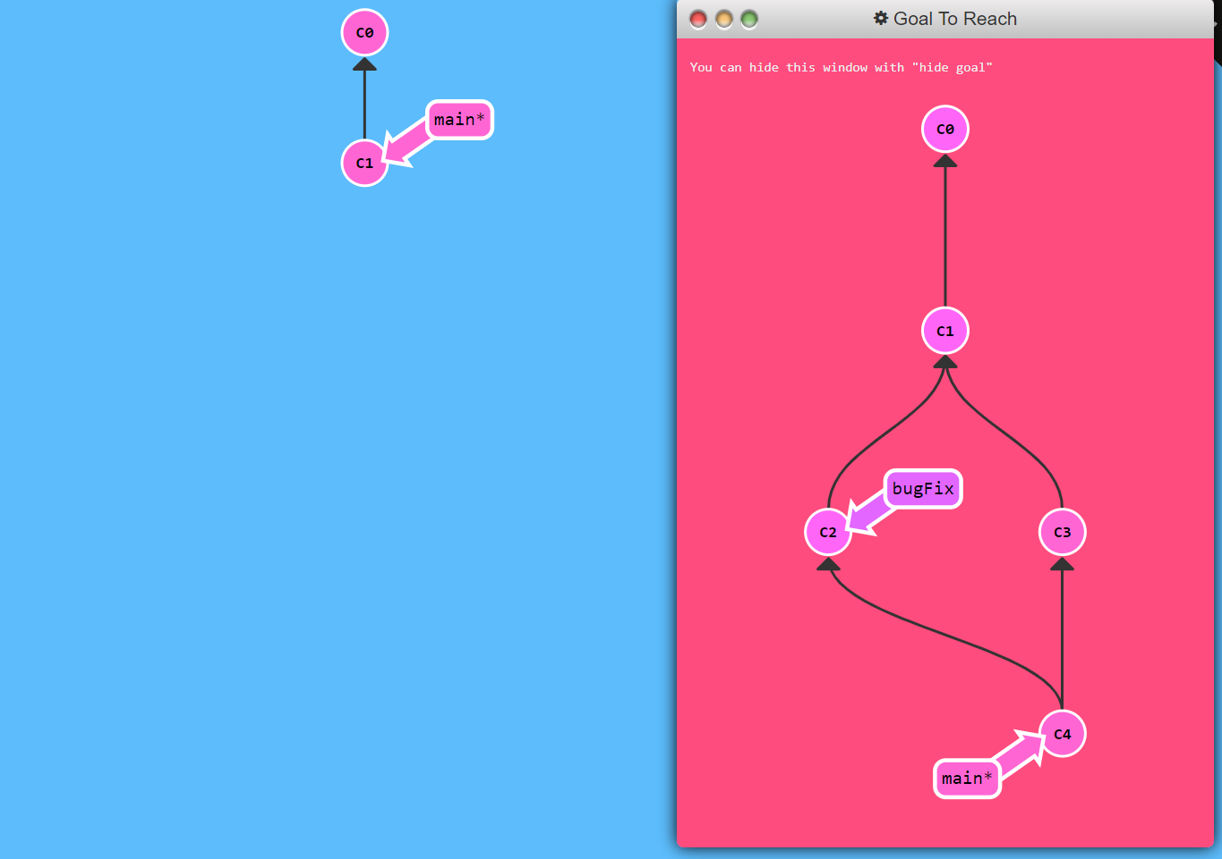
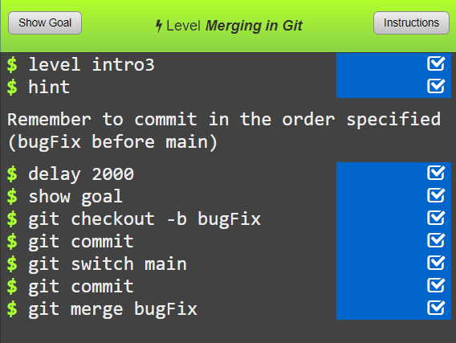
Merging branches
Now try task 3 on merging branches

Slide 13
git merge branchname
When we’re finished with the changes to a set of files on a given branch, we’d then likely want to join those changes into the main branch (or potentially any another branch in a repository).
The simplest wat to do this is with the command:
git merge branchname
git merge creates a repository history that looks something like the diagram to the right.

Slide 14
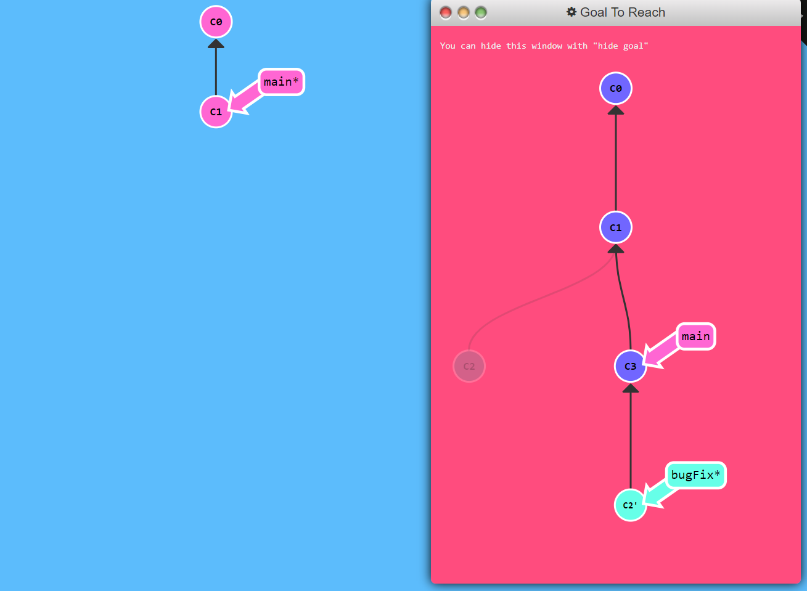
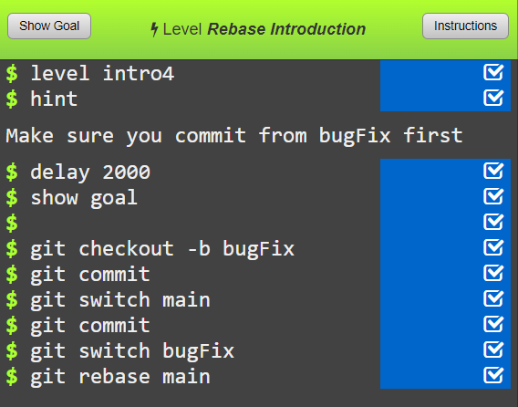
Rebasing branches
Now try task 4 on rebasing branches

Slide 15

rebase vs merge
Rebase and merge both join two branches together, but result in a slightly different history tree.
git rebase will create a linear path along the history
git merge will leave the parallel paths in the history
The main impact this can have is how you’ll handle undoing changes. With rebase you have a clearer lineage of what changes will be undone if you go back to a given commit.

Slide 16
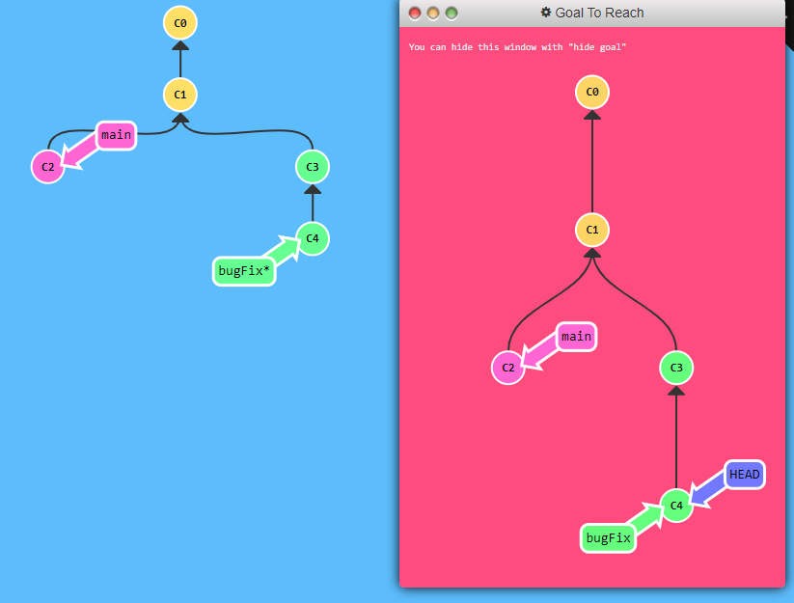
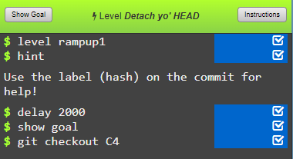
Navigating around commits
Try working through tasks 5-7 quickly:
Task 5 (rampup1) - “Detach yo’ HEAD”

Slide 17
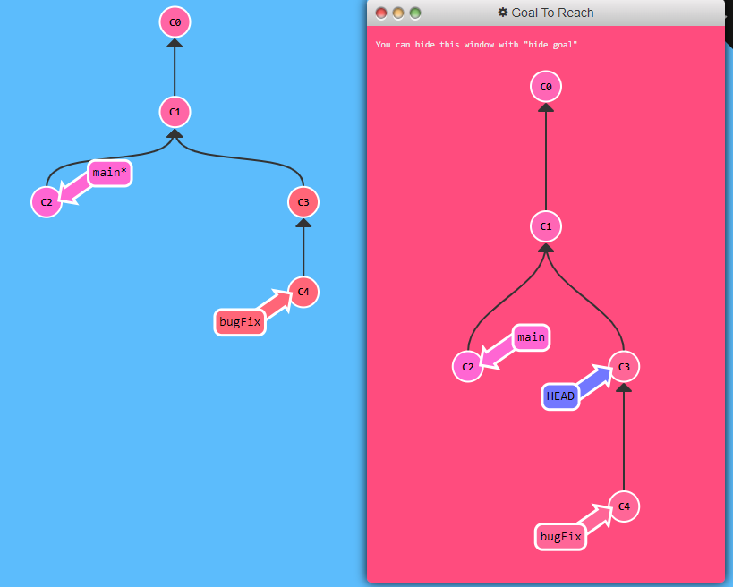
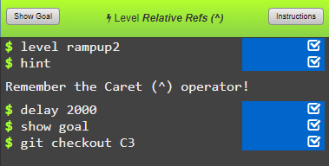
Navigating around commits
Try working through tasks 5-7 quickly:
Task 6 (rampup2) - “Relative Refs #1 (^)”

Slide 18
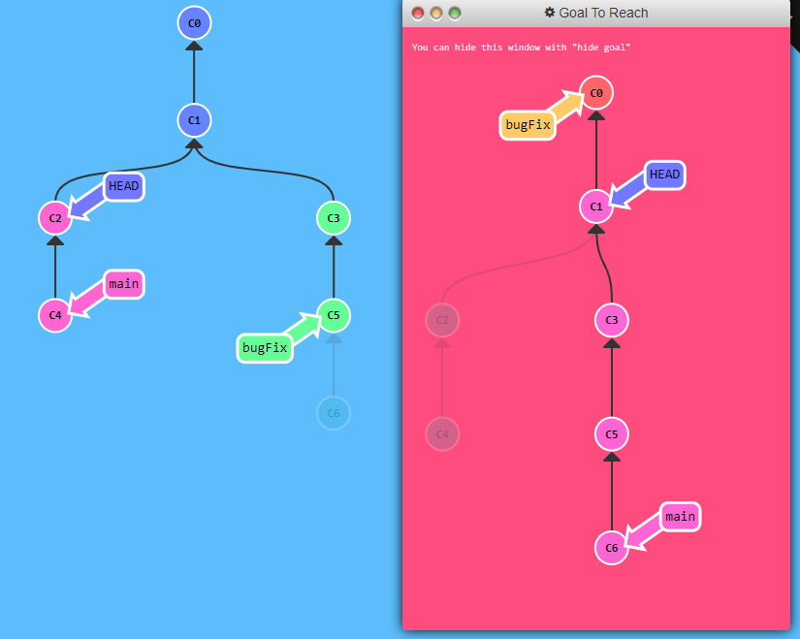
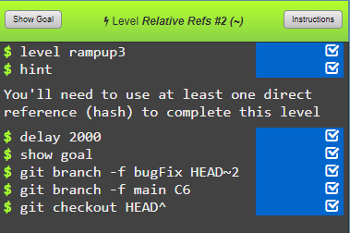
Navigating around commits
Try working through tasks 5-7 quickly:
Task 7 (rampup3) - “Relative Refs #2 (~)”

Slide 19
Navigating and undoing changes
Now that we’ve had some experience of moving around between commits up and down the history tree and between branches, we’re in a place where we can take a look at undoing changes…
This can be with either of:
git reset
git revert
Have a go at the next level on git branching…

Slide 20
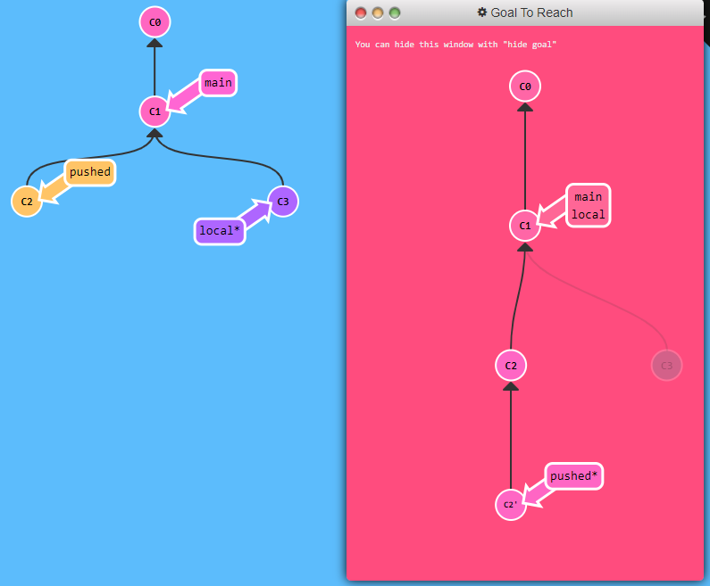
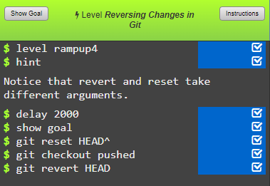
Undoing your changes
Last task we’ll do today:
Task 8 (rampup4) - “Reversing changes in Git”

Slide 21
git reset and git revert
git reset can remove past changes entirely from the history tree (useful for if you’ve made something visible that you shouldn’t have!)
But, you’ll need to push –f (force push) to apply that reset to the remote
And anyone else with a local copy of the repo will need to perform the same reset to remove the commit (otherwise their next push will just add it back into the remote again).
git revert keeps the changes in the history tree, but just undoes them as part of a new commit.
Full transparency of what’s been done
Other local repos will just need to pull to get the same effect.

Slide 22


Remote and local repositories
DfE Dev Ops (private)
DfE GitHub (public)
Remote
repository
Local
clones
Geoff
Caroline
Sue
Lou
Sam
David

Slide 23
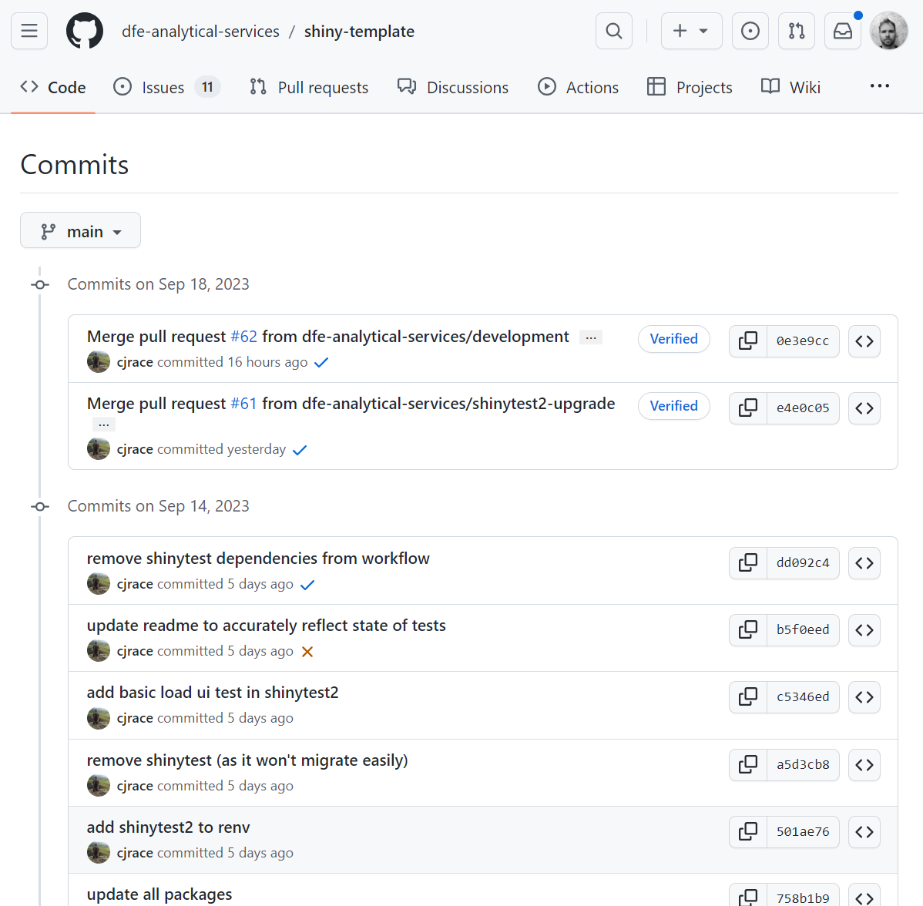
What does this look like IRL though?
To the right is the git history of our DfE R-Shiny template on GitHub.
DfE R-Shiny template history on GitHub
This is the remote (central back-up) of the repository.
Each commit lists:
A clear commit message explaining what it does
The username of the person who created the commit
A commit code which can be used to undo changes back to the point of that commit

Slide 24
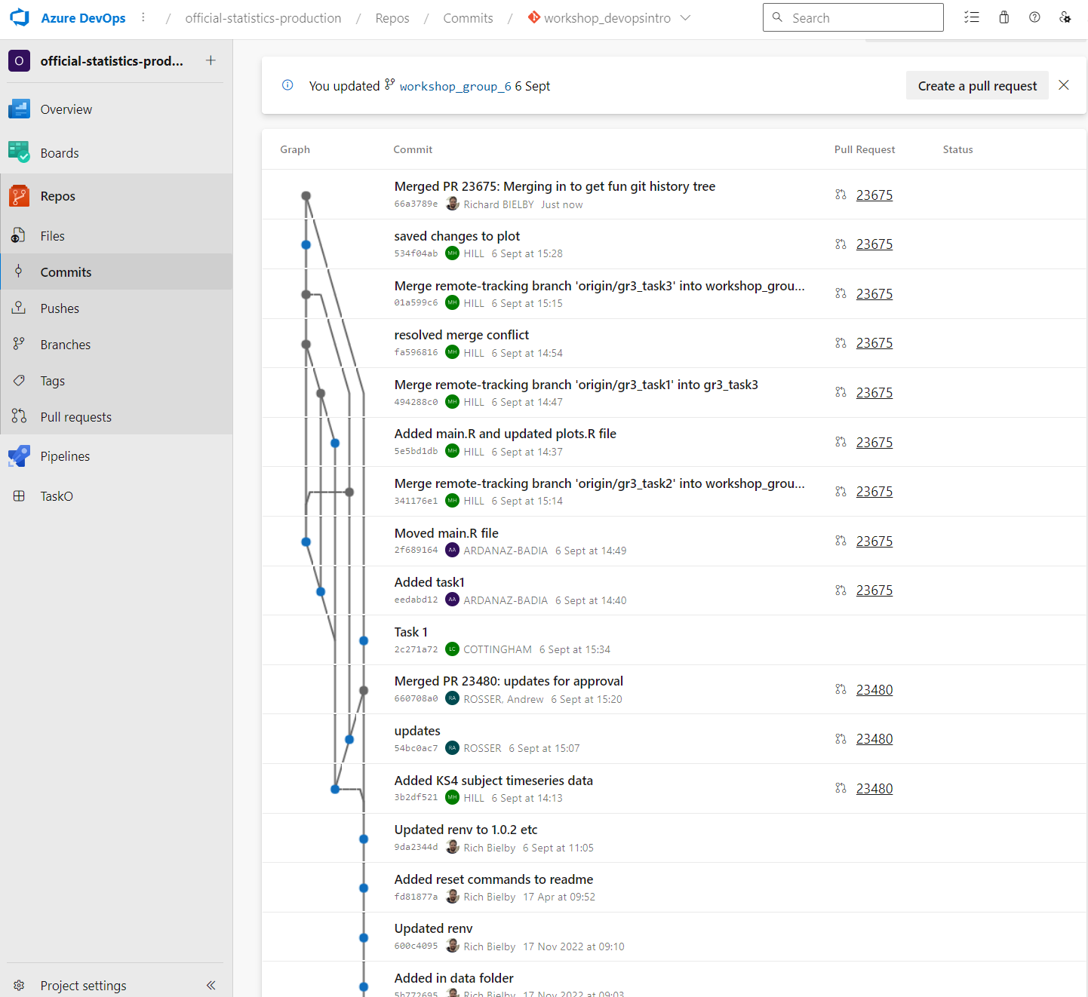
What does this look like IRL though?
To the right is the git history of our DfE git workshop repo on DevOps.
DfE DevOps Workshop sandbox repository
This is the remote (central back-up) of the repository.
Each commit lists:
A clear commit message explaining what it does
The username of the person who created the commit
A commit code which can be used to undo changes back to the point of that commit

Slide 25
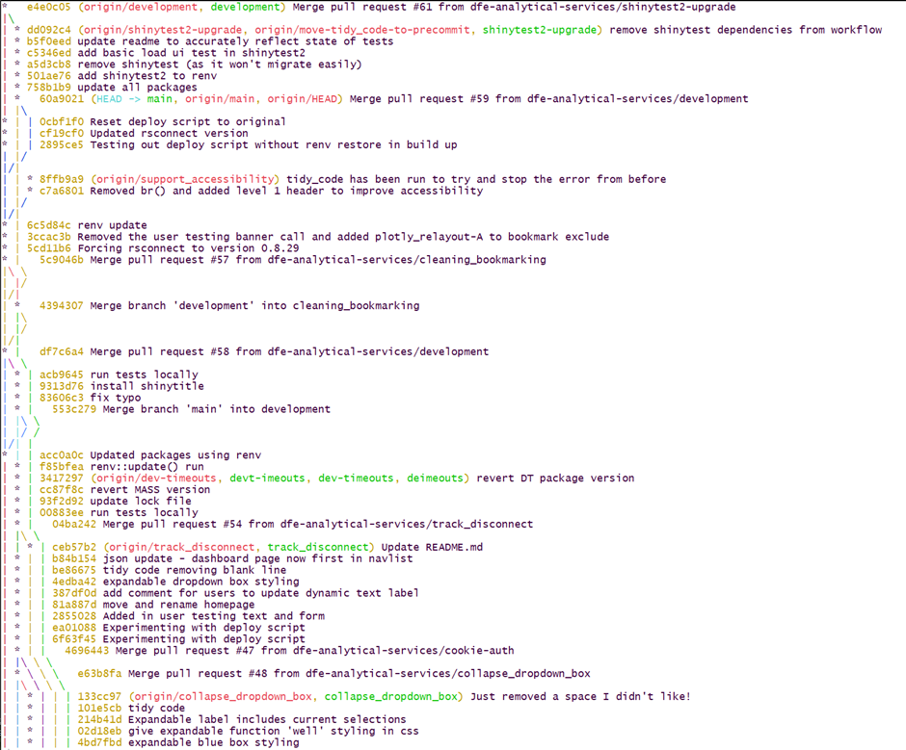
What does this look like IRL though?
To the right is the git history of our DfE R-Shiny template in git bash.
git log --oneline --graph --color --all --decorate
This is the on the local (working copy) of the repository.
Each commit lists:
A clear commit message explaining what it does
The username of the person who created the commit
A commit code which can be used to undo changes back to the point of that commit

Slide 26
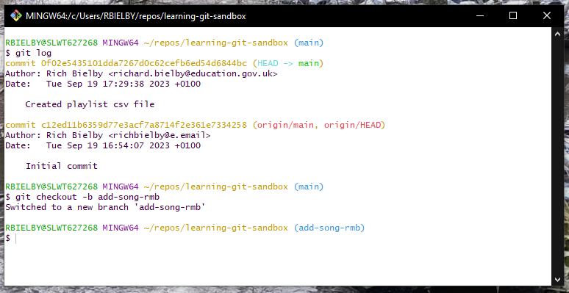
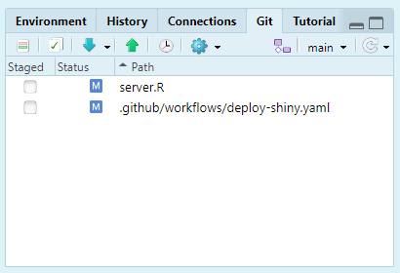
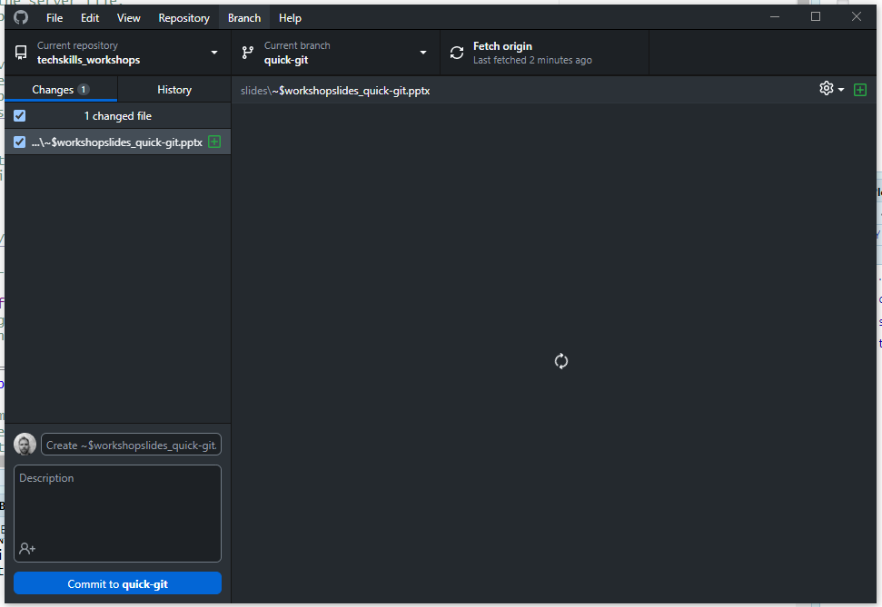
How do I use git on my DfE laptop?
Lots of software can be used to run the git commands:
The git download comes with the git bash terminal where you can run git commands like the ones that we’ve seen in this session.
For day-to-day coding, most IDEs will have built in git functionality, e.g. R-Studio, PyCharm, Visual Studio Code, etc. Most will have GUI and command line (bash) options.
GitHub Desktop can be used with GitHub and configured to communicate with the DevOps platform.

Slide 27
How do I create a repository?
If you just want to have a local repo without creating a remote, then you can create a new repo on your laptop in git bash, R-Studio, GitHub Desktop etc.
If you want a remote repo on DevOps, you’ll need your team, unit or division to have it’s own DevOps Project set up and then ask an admin of that Project to create a new repo for you.
If you want a remote repo on GitHub for official (public facing) DfE purposes, then get in touch with us and we can create you one on DfE-Analytical-Services (provided appropriate assurances are provided around suitability for the repo contents to be in the public domain).

Slide 28
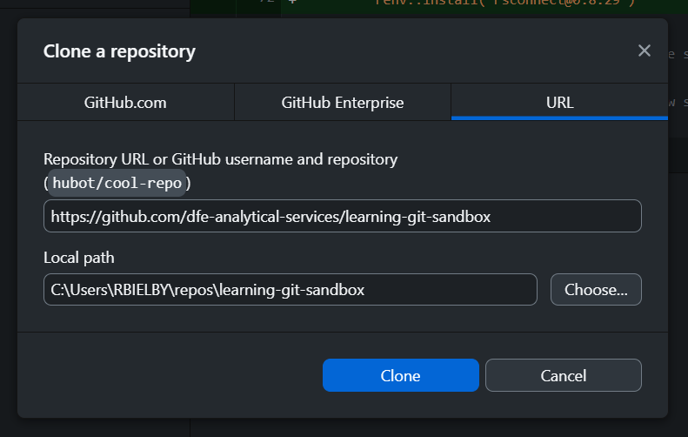
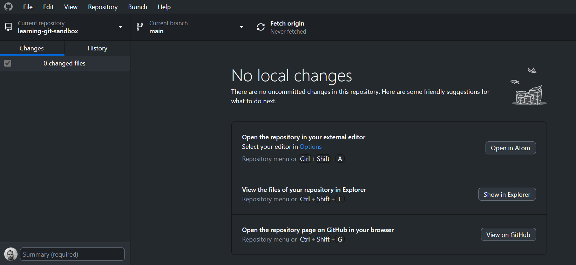
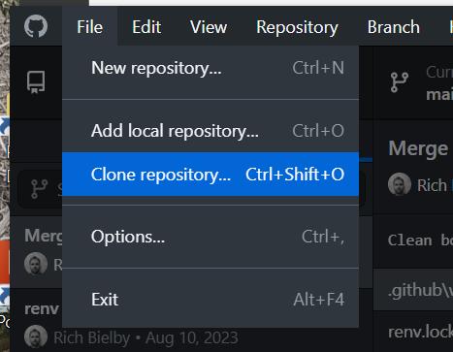
How do I work in a repository?
Once you’ve got a remote repository, you can create a local working copy by cloning a repository using its URL.
If you managed to install git and GitHub Desktop, then give one of the following methods a try with this url:
https://github.com/dfe-analytical-services/learning-git-sandbox
git bash
cd
mkdir repos/
cd repos/
git clone https://github.com/dfe-analytical-services/learning-git-sandbox
cd learning-git-sandbox
GitHub Desktop

Slide 29
How do I make changes in a repository?
git bash
Start by making a new branch in the learning-git-sandbox repo:
git checkout –b add-song-YOURINITIALS
Open the file playlist.csv in whatever editor you choose.
Add a song and artist separated by a comma.
Now stage and commit the file:
git add playlist.csv
git commit –m “Added my song to the playlist”
Now, provided you’ve told us your GitHub username and we’ve given you write access, you can push to the remote repo:
git push
Then go to the repo on GitHub in the browser and have a look for your branch and the updated file.
If you want to merge your changes into the main branch, you can either create a pull request on GitHub or run the following commands in git bash:
git switch main
git merge add-song-YOURINITIALS
git pull
git push
(Although those last steps may get a little messy if there’s a few of you trying it simultaneously!)

Slide 30
The wrap up!
Thanks for joining the session!
Any questions?!
For anything at all you want to check with us post-workshop;
statistics.development@education.gov.uk
Typical queries we get:
Can you host a repository for me?
Can my team members join your next workshop?
I think I broke something; how do I fix it?

