Slide 1
Statistics Development Workshop A quick intro to git
Whilst everyone’s arriving, please could you go to the links below and download and install both git and GitHub desktop:
https://git-scm.com/downloads
https://desktop.github.com/

Slide 2
Intros
Who are we?
Who are you?

Slide 3
Aims of this workshop
A quick (and maybe fun) intro to using git:
What is a repository?
What’s the difference between local and remote repositories and git, GitHub and Dev Ops?
Working with git
Cloning a repository
Staging and committing changes
Branching and merging

Slide 4
What are the key blockers to you using git?
Team or personal expertise/knowledge/capability
Not enough support in the department
Challenges in setting it (and RStudio) up on work machines
Don’t see how it benefits us compared to what we already do just on shared drives
Just don’t get the concept!
Overwhelmed by too much to learn alongside R and SQL learning.

Slide 5
What is git?
Git is a piece of software designed for version control, i.e.
Tracking changes;
Undoing changes;
Maintaining parallel variants of code.
Git works with repositories:
A repository (or repo) is simply a folder containing all the version controlled files of a given project.
It can have multiple sub-folders that will can also be tracked.

Slide 6
And GitHub and Dev Ops…
GitHub and Dev Ops provide a space to store and interact with a repository.
View the files;
View the history;
Create and view different branches (variants) of the code;
Management tools such as Issues logs (GitHub) or Kambam board (Dev Ops)
Create pull requests, review code and get feedback from collaborators;
Perform automated QA and deployment of code (e.g. sending a dashboard live).
GitHub and Dev Ops are generally not a place to:
Run your code;
Edit your code (although there is some basic text editing functionality you can use).

Slide 7
What are the key benefits of using git?
Collaboration
Get support from team and wider community by easily sharing code (our team find it much easier to support you if we can just go and clone your repo…)
Code QA via reviews and automated checks
Continuity
Can undo changes
Can try different methodologies in a properly controlled way

Slide 8
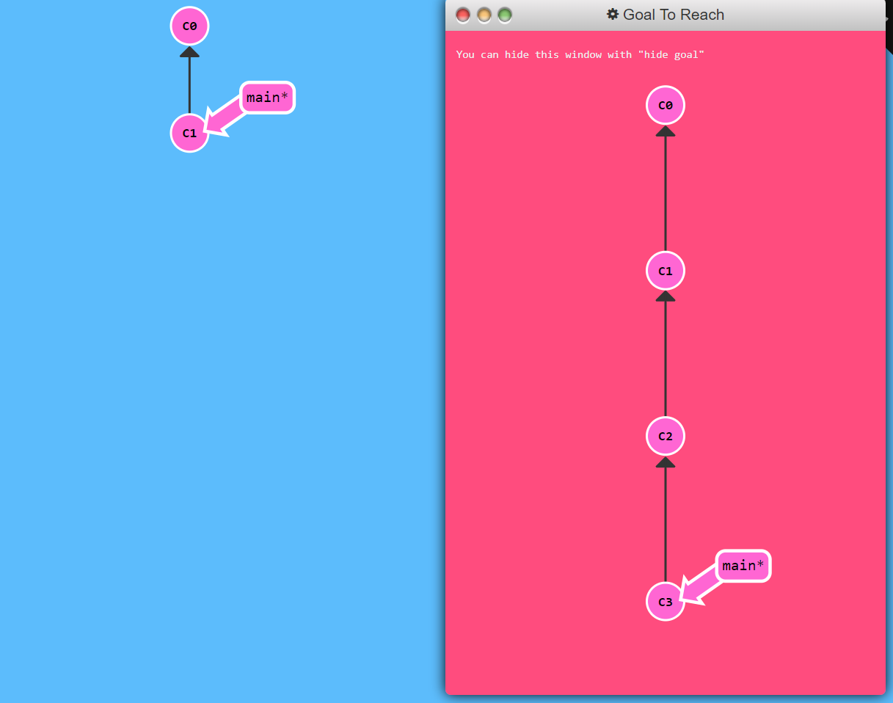
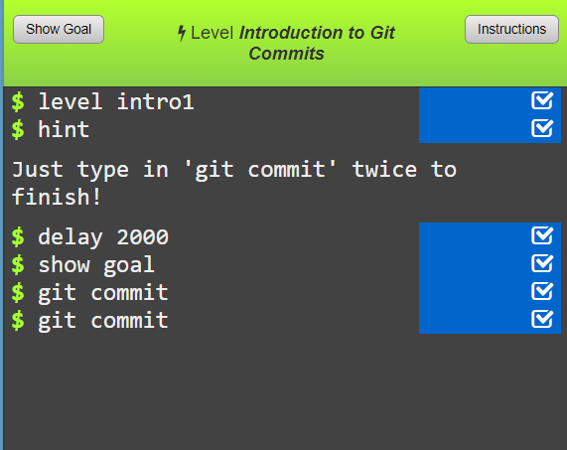
Let’s play!
This is a live coding session, but we’re going to try and keep it as simple as possible…
Go to https://learngitbranching.js.org/
Try task 1 - commiting!

Slide 9
git commit
The command git commit saves the progress of your work in a repo.
In real life, you’ll need to include a commit message:
git commit –m “I changed something”
The message will act as a marker so that if you want to undo your changes to a given point in your save history, you know where to find it.
Commit often (e.g. twice an hour), you can only revert changes to commits.

Slide 10
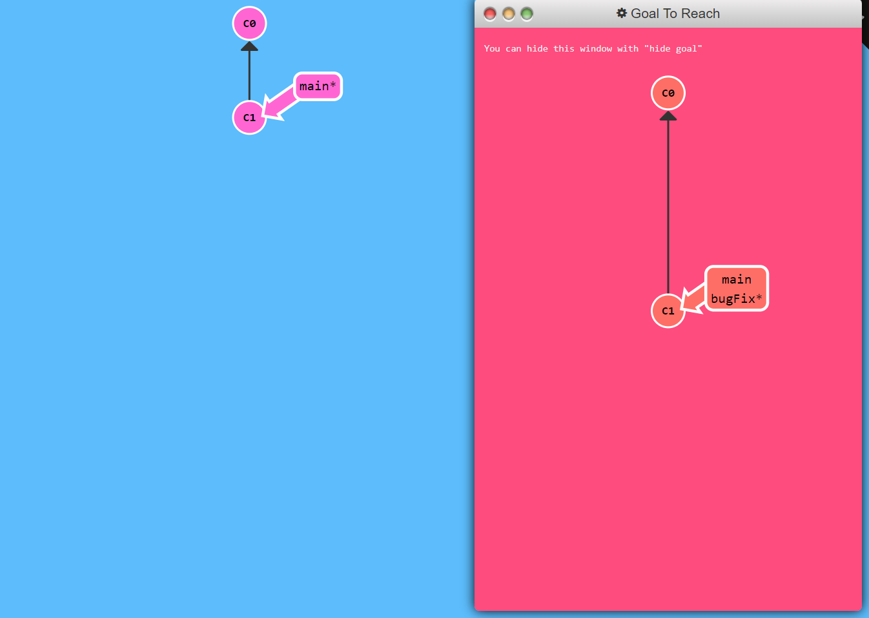
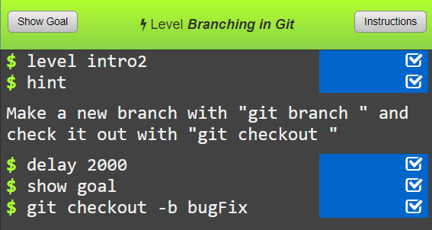
Branches
Now try task 2 on branching

Slide 11
git checkout branchname
In git, we use branches to maintain parallel changes to files.
This can be useful for example of two people are making independent changes to files at the same time
One person can work on one branch on the other on another branch
Usually the branch containing the most trustworthy copy of the files or code would be called main
We can switch between branches using either:
git checkout branchname
git switch branchname
Branch names should be meaningful and informative, for example:
geography-fix
data-update-2023
adding-automated-qa
It’s best to keep branches short lived with just specific changes and not use ambiguous branch names like:
richs-branch
new-analysis

Slide 12
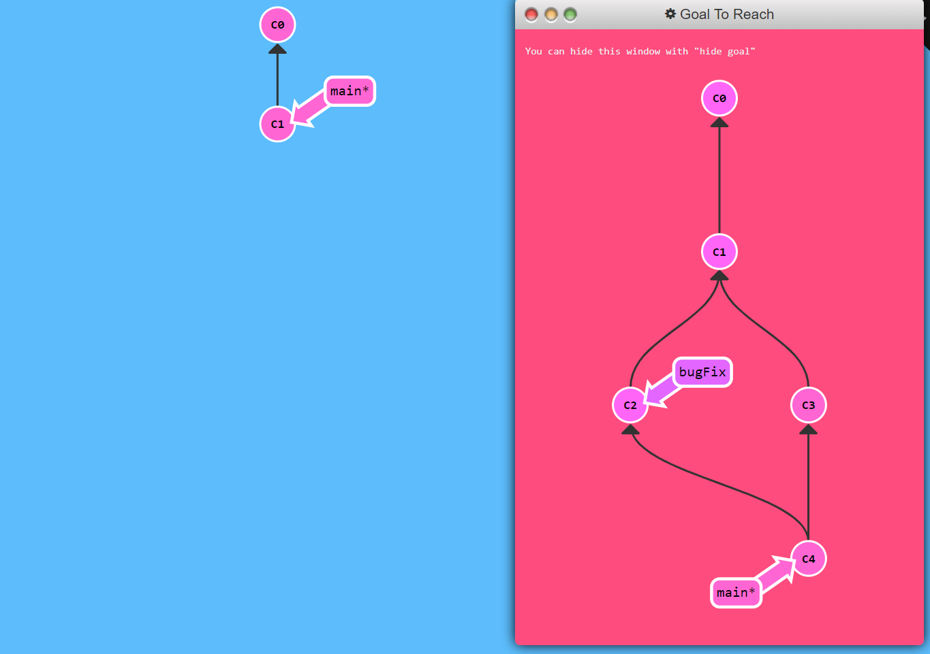
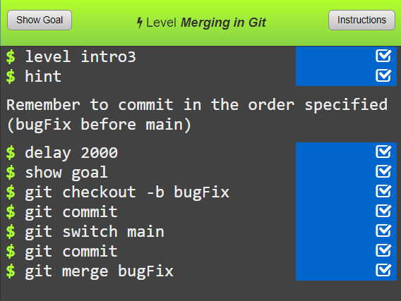
Merging branches
Now try task 3 on merging branches

Slide 13
git merge branchname
When we’re finished with the changes to a set of files on a given branch, we’d then likely want to join those changes into the main branch (or potentially any another branch in a repository).
The simplest wat to do this is with the command:
git merge branchname
git merge creates a repository history that looks something like the diagram to the right.

Slide 14
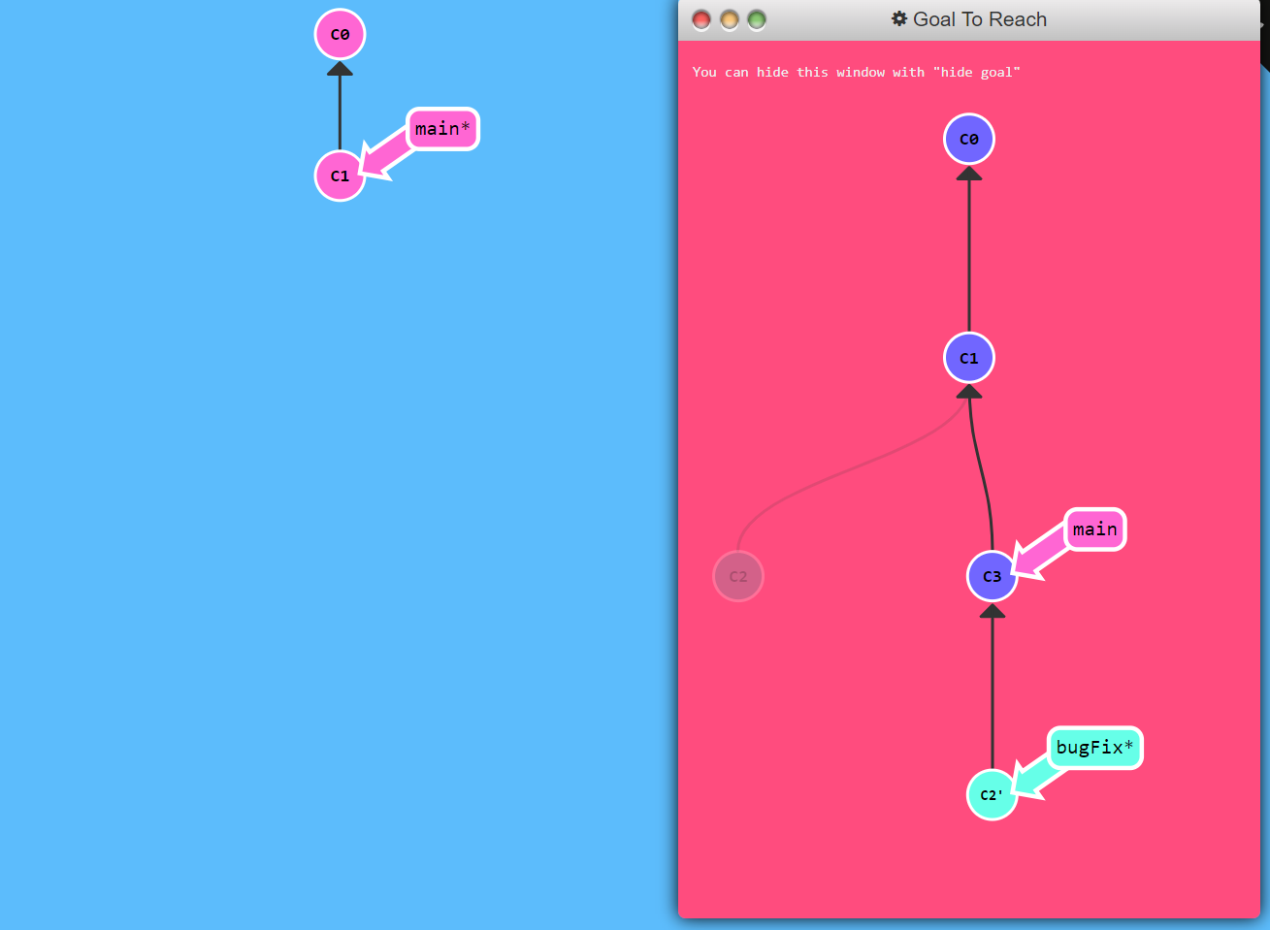
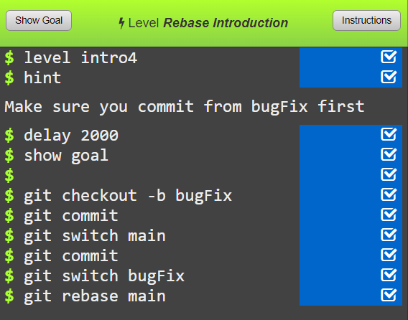
Rebasing branches
Now try task 4 on rebasing branches

Slide 15

rebase vs merge
Rebase and merge both join two branches together, but result in a slightly different history tree.
git rebase will create a linear path along the history
git merge will leave the parallel paths in the history
The main impact this can have is how you’ll handle undoing changes. With rebase you have a clearer lineage of what changes will be undone if you go back to a given commit.

Slide 17
What is Azure Dev Ops?
A place to manage projects involving code development, e.g.
Reproducible analytical pipelines
R-Shiny dashboards
This includes:
Team task/Kambam boards
Remote repository storage
Remote repository management – create branches, pull requests, change tracking, collaboration…
Deployment pipelines (e.g. for deploying R-Shiny apps to rsconnect)
Plenty more besides, but the above are probably the extent of what you’re likely to need
The above has a lot of overlap with GitHub. The key benefit of Dev Ops over GitHub is that it’s private.
The Statistics Development Team manages the Official Statistics Production project on Dev Ops where many of the department’s publication oriented repositories (i.e. RAP and dashboards) are kept. We can help you get set up and manage your repo.

Slide 18

Interactive session on Dev Ops…

Slide 19
Git basic concepts
A repository can be created locally (i.e. on your laptop or desktop) or remotely (on GitHub or Dev Ops).
Most of the work you do on a repository, i.e. developing your code, will be done within the local copy.
The remote repo is effectively your reliable back-up of your code and somewhere where collaborators can view and get access your code.
You’re only going to have a single remote copy of the repo, but you (and collaborators) can have multiple local copies.
Syncing back and forth between the remote and local copies of a repo is done by Pushing (local to remote) and Pulling (remote to local).
Recording the changes in your repo is performed using commits.
Commits record the current state of the repo to log files.
Commits should be made regularly (think of them as being like saving a file in Word – once saved, you’re less likely to lose your progress).
Commits by themselves do not log changes to the remote or other local repos, only the on that you’re working on.
After making a commit, it’s often worth making a Push to the remote so everything’s backed up.
You can undo changes by reseting to older commits.

Slide 20
How to work with git
You’ll likely have two main ways you might work with git on your DfE laptop:
Git BASH terminal:
text driven
Offers the full range of git commands
R-Studio git interface
graphical user interface
Generally limited to commands around committing, pushing and pulling and viewing the history.

Slide 21
Start working with git
Get in to working groups of about 3
Go to the Setting up the repository section of the pdf and start working through the walkthrough…
Ask questions!

