Slide 1
Statistics Development Workshop Introduction to coding in R for RAP processes

Slide 2
Aims of this workshop
Understand the benefits of RAP
What does RAP mean?
What is the point?
Why invest the time to change things?
More confidence coding in R
Understanding format and syntax of R
R vs SQL, what’s the difference?
Understanding clearly how this applies to your own work.
An understanding of the ways we can use R for RAP processes
Functions
If statements
Wildcards/regex

Slide 3
What are your key pain points/struggles with R at the moment?

Slide 4
What are the key blockers to you using R for RAP?
Team or personal expertise/knowledge/capability
Not enough support in the department
Challenges in setting it (RStudio) up on work machines and getting it to work (for example, package issues, connecting to databases…).
Don’t see how it benefits us compared to what we already do (i.e. on SQL or excel)
Overwhelmed by too much to learn alongside other things (i.e. SQL, Git)
The leap from the learning to the real-life applications is too big.

Slide 5
What is R?
R is a coding language. There are many different languages of code, some others include SQL, python, JavaScript and many more. They all have benefits, and the difference is often the syntax used (literally like learning new languages!)
R is open-source, meaning it is free, anyone can use it and anyone can contribute to developing new ‘packages’.
A package is a set of functions someone else has written and tied together in a nice neat bow, ready for you to use! You simply install the package, and then you have all of the functions available.
A function is a chunk of code that has been grouped together, given a name, and often has ‘place holders’ you can change, such that you can use that name to run that code, and apply it to different data.
(for example, mean(x) is a function that calculates the arithmetic mean of x. You replace x with any numeric data.)

Slide 6
R vs SQL
R and SQL are two different coding languages, but if you already know one, it can make it easier to learn the other as the logic tends to be similar even if the syntax is different.
SQL runs processes on the database server, whereas R runs processes on your device. Therefore we recommend doing large scale processing on the SQL/database side, and then only bring the data you need for manipulation/ complicated processing into R.
There’s a grey area in the middle where you can do some things in either tool, sometimes you’ll need to test yourself which way is faster. Remember that SQL code can be run through R, so you can have a mixture of scripts, you should still have a ‘centralised’ R script that will run and source both your SQL and R scripts, in order!

Slide 7
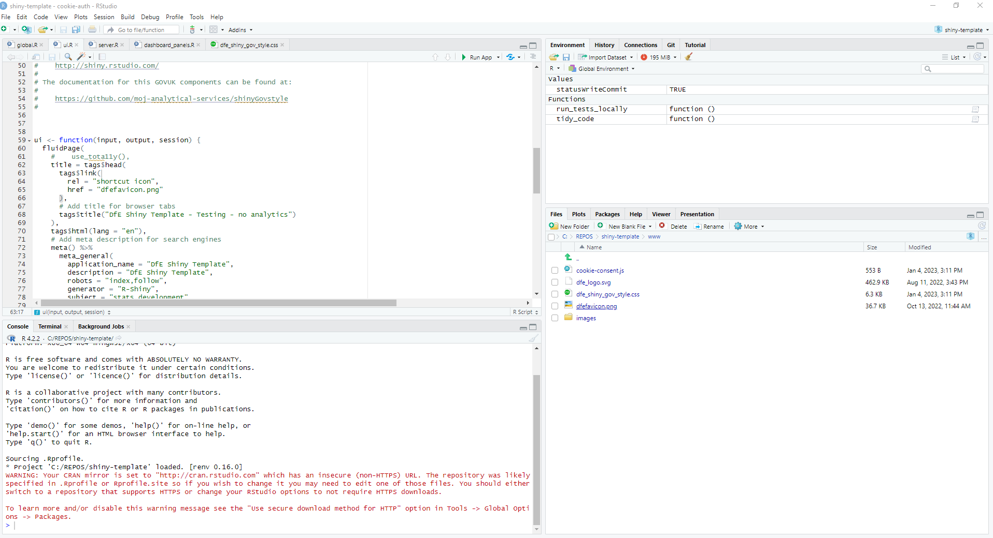
R studio
R studio is a programme that enables us to code in the R coding language, while also providing a visual and interactive interface. It has useful areas and windows that enable you to see what tables you have loaded, charts you have created, Git user interface, file explorer, help windows and many more!
Normally you will see the screen split into 3 or 4 windows:
1: Source pane. Open and view your code scripts, tables, data sets, functions.
3: Environment/History/Connections/Git (if you have it)
The environment shows you what data, functions, objects etc you have.
4: File explorer/plots/packages/Viewer.
2: Console. Shows what you have run, and you can type and run commands directly into the console.

Slide 8
What is RAP?
RAP stands for Reproducible Analytical Pipeline. The full words still hide the true meaning behind buzzwords and jargon though. What it actually means is using automation to our advantage when analysing data (this is as simple as writing code such as an R script that we can click a button to execute and do the job for us), and ensuring we are transparent.
Using R (the coding language) really helps us to put the R in RAP ('reproducible'). Ask yourself,
If someone else picked up your work, could they easily reproduce your exact outputs?
When the time comes around to update your analysis with new data, how easy is it for you to reproduce the analysis you need?
Can the public reproduce your analysis?
In an ideal RAP, it would be as simple as plugging the new data in and clicking 'go', with no need to manually scroll through multiple scripts updating the year in every file name or the variable name that's changed from using _ to -.

Slide 9
What are the benefits?
We already have ‘analytical pipelines’ and have done for many years. The aim of RAP is to;
Automate the parts of these pipelines that can be automated,
Increase efficiency and accuracy,
Create a clear audit trail to allow analyses to easily be re-run if needed.
This will free us up to focus on the parts of our work where our human input can really add value.
RAP is something we can use to reduce the burden on us by getting rid of some of the boring stuff, what’s not to like!

Slide 10
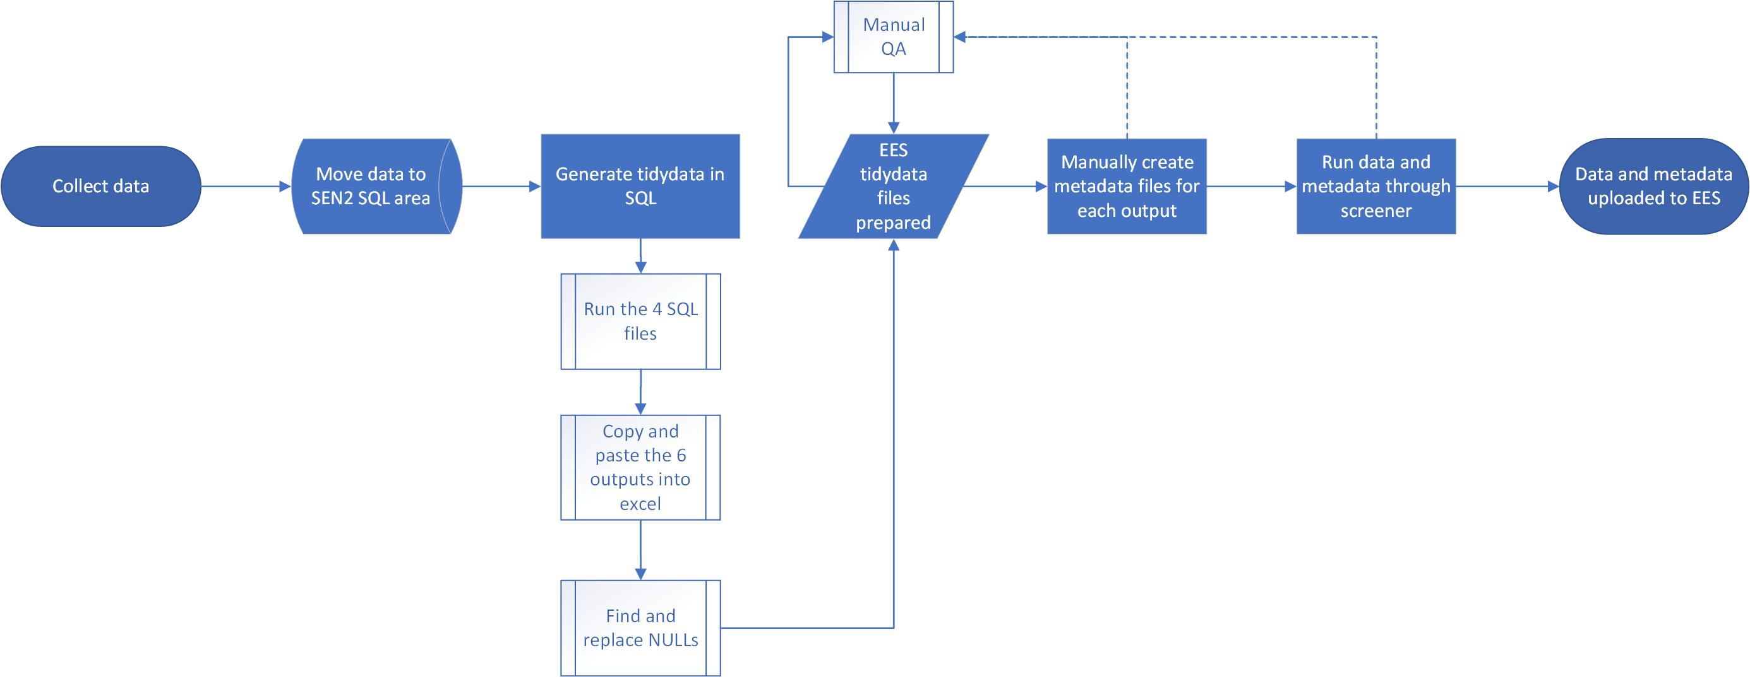
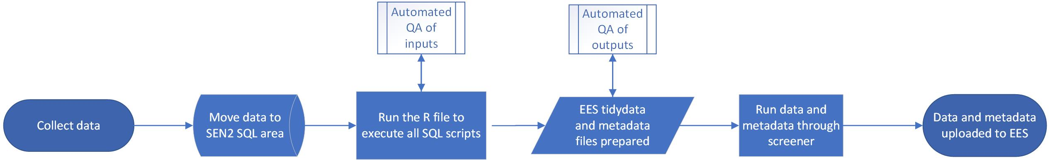

Slide 11
Getting set up
This is a live coding session, so we need you set up with git and RStudio installed…
Open up the pdf that we’ve shared for this session or go to the following link:
Add the link Charlotte!
Go to pre-workshop requirements section and check you’ve got everything from that list sorted (copied below). Get help from us if anything didn’t work!
Create a DfE Dev Ops account via the Service Portal;
Install git on your laptop: https://git-scm.com/downloads;
Install R-Studio on your machine: Download R for Windows (x64) and RStudio from the Software Centre on your DfE laptop.
Set up the path to the git.exe in RStudio global settings.

Slide 12
Today’s topics…
Introduction & Pre-workshop requirements (everyone)
Creating a project (everyone)
Using renv (optional)
Your initial script
Comments and headings (optional)
Adding and running code (optional)
Data types and objects (optional - standalone)
Loading in the data
Reading in CSVs (everyone)
Reading in from SQL (optional)
Cleaning data (optional)
Descriptive statistics (optional - standalone)
Manipulating data (everyone)
Writing functions (optional – standalone)
Running a SQL query (Optional)
Creating plots (everyone)
Creating functions for plots (optional)
Using online resources
Google questions and errors (everyone)
Using ChatGPT (optional - standalone)
w-RAP it up (everyone)
Unit testing in R (optional – standalone)
dplyr vs. data.table (supplementary)
Troubleshooting (supplementary)
Excel functions in R (supplementary)
SQL functions in R (supplementary)

Slide 13
Lets get started!
Everyone, open the R project.
Navigate to your team’s branch.
Begin working through the tasks.

