Slide 1
Introduction to R for Reproducible Analytical Pipelines
Statistics Services Unit

Slide 2
Aims of this workshop
Understand the benefits of Reproducible Analytical Pipelines (RAP)
What does RAP mean?
What is the point of RAP?
Why invest time to apply RAP principles?
Gain confidence with coding in R
Understand what R is, its format and syntax
Learn how to read in data; clean, manipulate and join datasets; plot charts
Understand how R can be applied to your work
Gain understanding of how we can use R for RAP processes
Connecting to databases
Writing functions
Using “if” and “if else” statements

Slide 3
Do you have any blockers or pain points with using R?

Slide 4
Do you have any blockers or pain points with using R?
Limited team or personal knowledge/capability
Not enough support within the department
Challenges in setting up R / RStudio on work laptops and getting it to work, e.g., package issues, connecting to databases…
Don’t see any benefit compared to existing processes, i.e. using SQL or Excel
Not enough time to learn it alongside other important skills
The leap from the learning to the real-life applications is too big

Slide 5
What is R?
R is a coding language. There are many different languages of code, some others include SQL, python, JavaScript and many more. They all have benefits, and the difference is often the syntax used (literally like learning new languages!)
R is open-source, meaning it is free, anyone can use it and anyone can contribute to developing new ‘packages’
A package is a set of functions someone else has written and tied together in a nice neat bow, ready for you to use. By installing the package you’ll have all of those functions available
A function is a chunk of code that has been grouped together, given a name, and often has ‘place holders’ you can change to apply it to different data
E.g., mean(x) is a function that calculates the arithmetic mean of x, where x can be replaced with any numeric data

Slide 6
R vs SQL
R and SQL are two different coding languages, but if you already know one, it can make it easier to learn the other as the logic tends to be similar even if the syntax is different
SQL runs processes on a database server, whereas R runs processes on your computer. We recommend doing large scale processing on SQL and then bringing only the data you need for complicated manipulation into R
There’s a grey area in the middle where you can do some things in either tool, sometimes you’ll need to test yourself which way is faster. SQL code can be run through R so you can have a mixture of scripts across the two languages. You should have a ‘centralised’ R script that will run and source both your SQL and R scripts in order

Slide 7
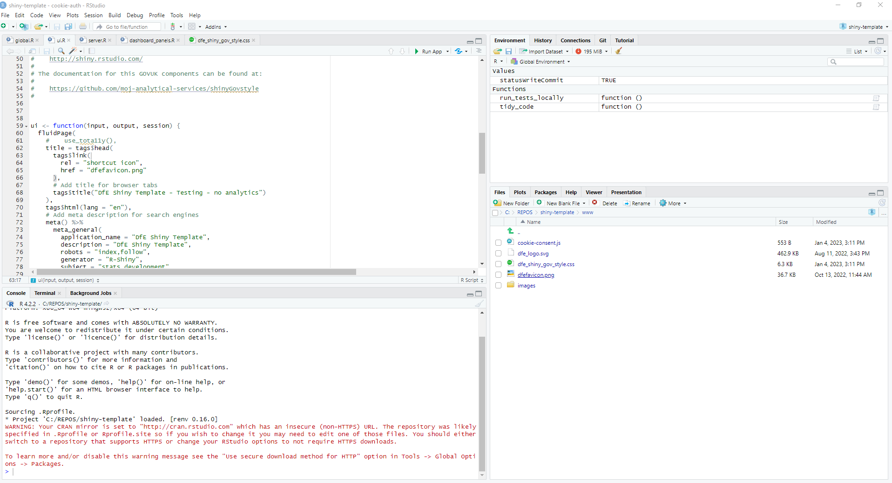
RStudio
RStudio is a programme that enables us to code in the R coding language, while also providing a visual and interactive interface.
It has useful windows that enable you to see the tables you have loaded, charts you have created, Git user interface, file explorer, help windows and more!
Normally you will see the screen split into 3 or 4 windows:
3: Environment / History / Connections / Git (if you have it): the environment shows you what data, functions, objects etc you have.
1: Source pane: open and view your code scripts, tables, data sets, functions.
2: Console: shows what you have run, and you can type and run commands directly into the console.
4: File explorer / plots / packages / viewer.

Slide 8
What is RAP?
RAP stands for Reproducible Analytical Pipeline
This really means using automation to our advantage when analysing data (this could mean writing an R script that carries out analysis at just the click of a button), and ensuring we are transparent
Using R really helps us to put the R (for reproducible) in RAP. Ask yourself:
Could someone new to your work easily reproduce your exact outputs?
How easy is it to reproduce your analysis using new data?
Can the public reproduce your analysis?
In an ideal RAP, it would be as simple as plugging the new data in and clicking 'go', with no need to manually scroll through multiple scripts updating year, file names or variable names

Slide 9
What are the benefits?
We’ve had analytical pipelines for years, but the aim of RAP is to:
Automate the parts of these pipelines that can be
Increase efficiency and accuracy
Create a clear audit trail to allow analyses to easily be re-run if needed
This allows us to focus on the parts of our work where our human input can really add value
RAP is something we can use to reduce the burden on us by getting rid of some of the boring stuff - what’s not to like!

Slide 10
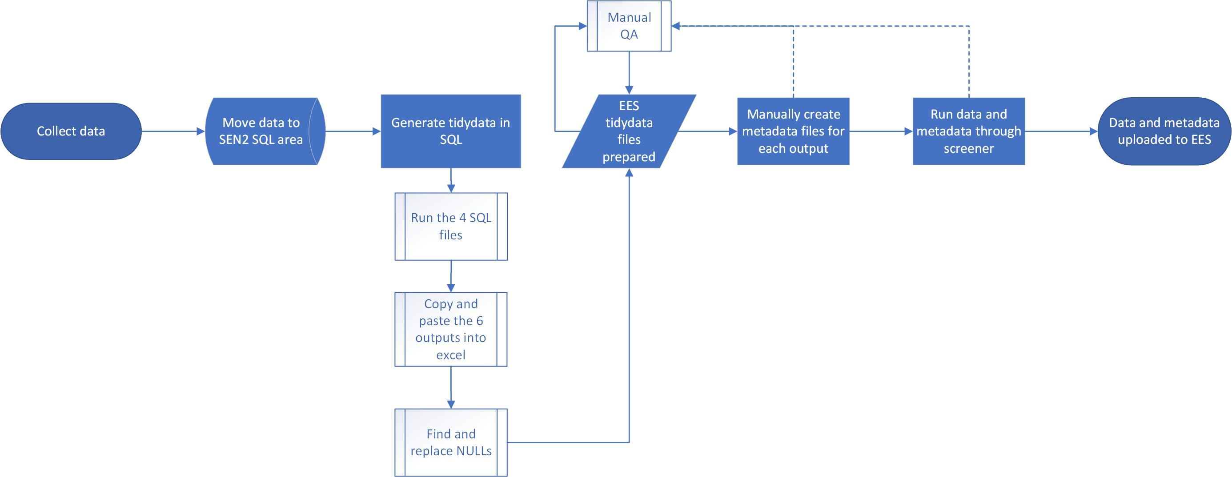
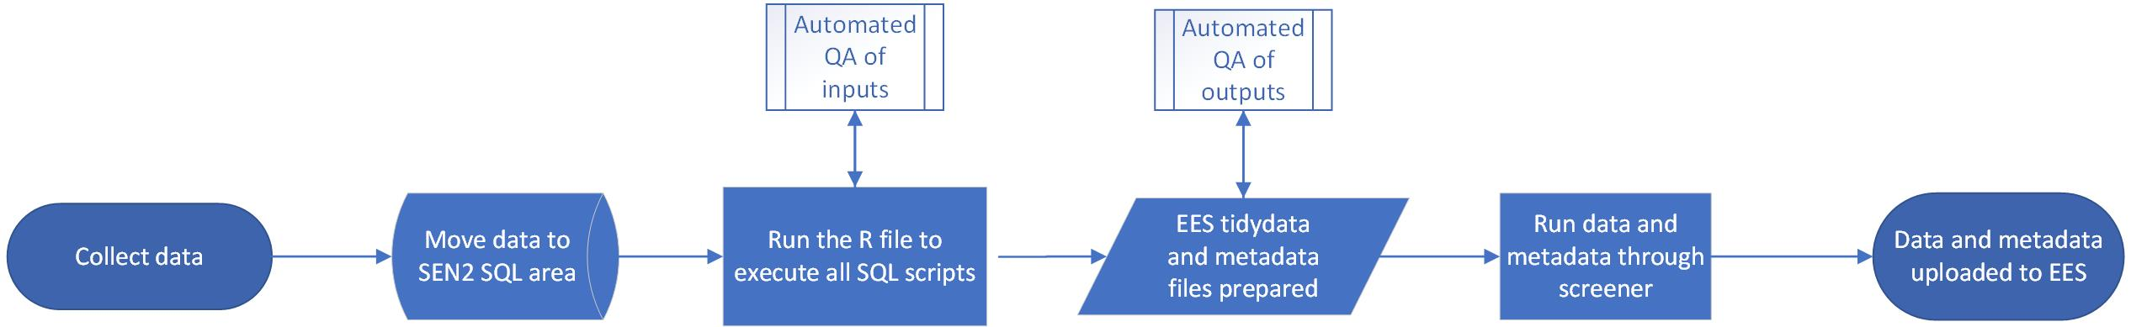

Slide 11
Getting set up
This is a live coding session, so you’ll need to have R & RStudio installed
Open the workshop PDF file: https://github.com/dfe-analytical-services/techskills_workshops/blob/main/workshop_R.pdf
Check you’ve got everything in the pre-workshop requirements. Get help from us if anything didn’t work!
Download R for Windows (x64) and RStudio from the Software Centre on your DfE laptop.

Slide 12
Workshop topics
Introduction & pre-workshop requirements
Creating a project
Using renv (optional)
Your initial script
Comments and headings
Adding and running code
Data types and objects
Loading in the data
Cleaning data
Missing values
Duplicates
Descriptive statistics
Manipulating data
Aggregating
Filtering
Reordering & renaming
Writing functions & if / ifelse statements
Joining data
Creating plots
Creating functions for plots
Using online resources
Google questions and errors
Using Copilot
w-RAP it up
Unit testing in R (optional)
Accessing remote data (optional)
dplyr vs. data.table (supplementary)
Troubleshooting (supplementary
Excel functions in R (supplementary)

