Slide 1
Introduction to using R-Shiny and the DfE Template
Statistics Development Workshop

Slide 2
Aims of this workshop
Gain some familiarity with the basics of creating apps in R-Shiny:
What’s the purpose of an R-Shiny app?
What can we achieve with an R-Shiny app?
What are the roles of global.R, ui.R and server.R
Creating the page layout
Creating responsive/dynamic elements
Using the DfE R-Shiny template
What’s the timeline and what are the key things you need to do?
What do you need the Statistics Development Team to do for you?

Slide 3
Why do you want to produce an R-Shiny app?

Slide 4
What is an R-Shiny dashboard?
Shiny is a package within R that contains elements that can be used to create an interactive browser-based application.
Uses javascript alongside html and css to produce something that displays in the browser
Usually interactive
Can have multiple tabbed pages
Can contain dynamic charts, text, tables
Can take user input: radio buttons, free text, drop down menus…
Can be modified with user created javascript, html and css, so can be useful to know these to varying degrees, but not necessarily essential!

Slide 5
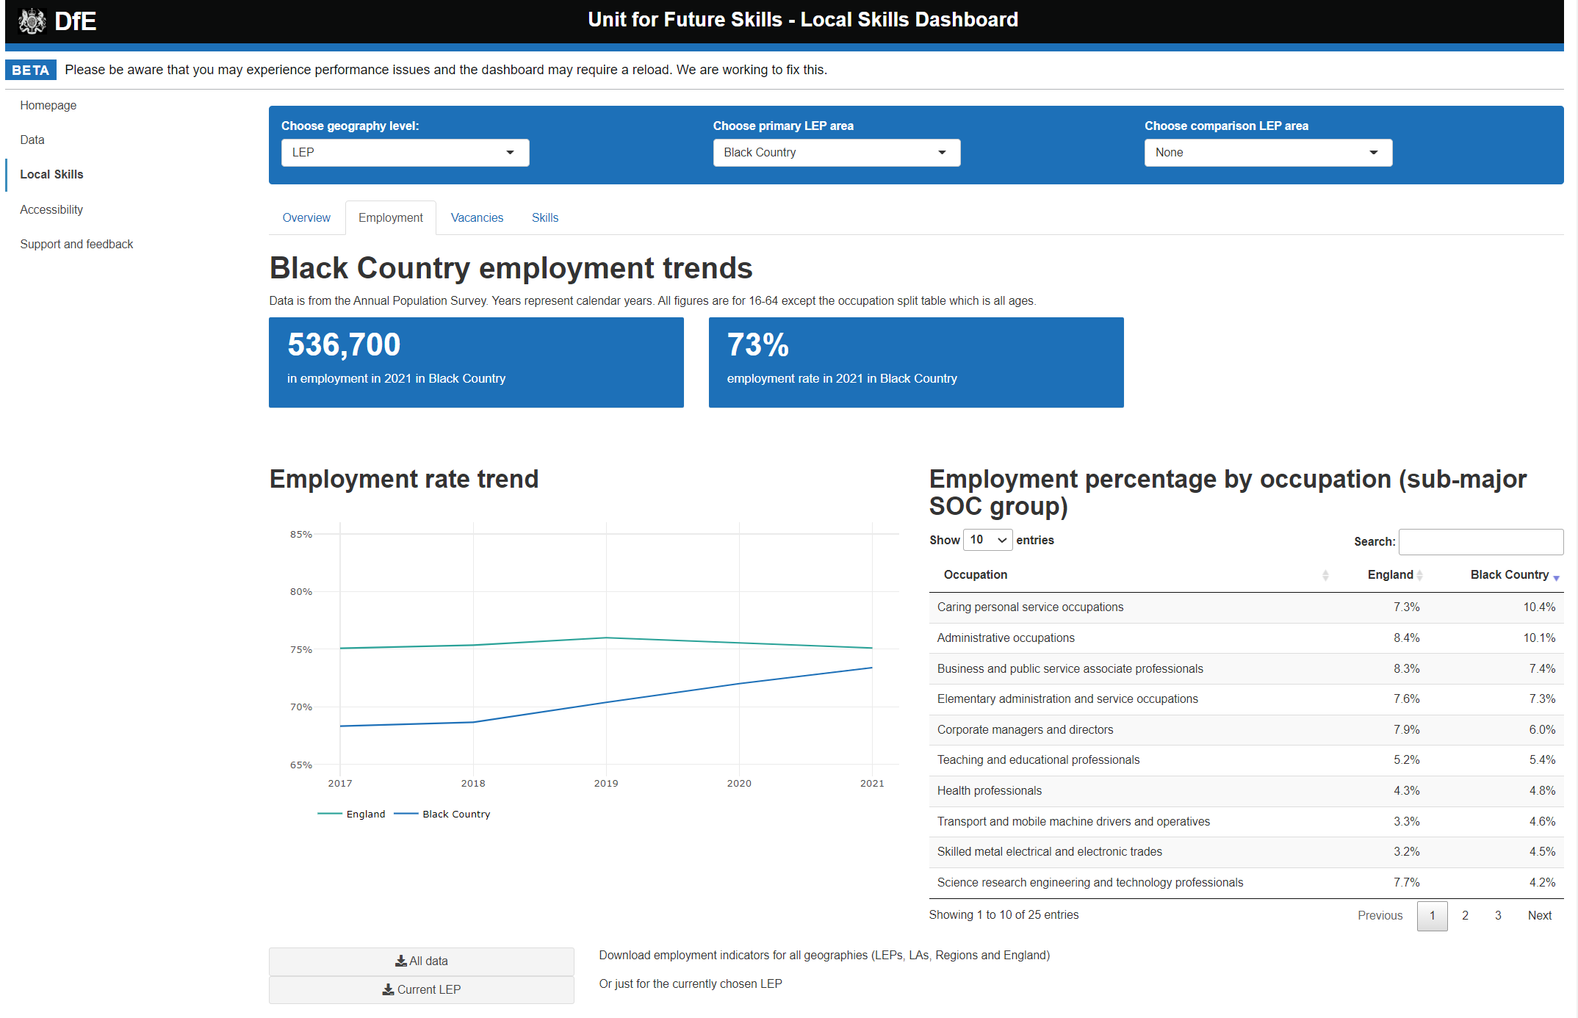
Example R-Shiny dashboard: Local Skills

Slide 6
Components of the R-Shiny code dashboard
a) global.R
b) ui.R
c) server.R
Read in when the app starts
Contains any code that’s required throughout the dashboard
Suited to reading in data, setting fixed variables, etc
Mostly functions and code that you’re used to from normal data manipulation use of R (e.g. dplyr etc)
Contains all the code required for setting the layout of the app.
Places objects such as tables, charts, input elements, text in the appropriate places.
Provides the input and output points for objects rendered in the server.R
Shiny specific code in here likely to be things like fluidRow(), column(), *****Input() and *****Output().
Code that may be required repeatedly whilst the app us running.
Controls dynamic responses, updating inputs, charts, text, tables etc as needed.
Provides the underlying code for elements placed in the ui.R script.
Familiar things in here likely to be ggplot/plotly and dplyr filter() function.
Shiny specific code in here likely to be things like observe(), reactive(), render*****().

Slide 7
How do ui.R and server.R work together?
This is a live coding session, so we need you set up with git and RStudio installed…
Open up the pdf that we’ve shared for this session or go to the following link:
Add the link Rich!
Go to pre-workshop requirements section and check you’ve got everything from that list sorted (copied below). Get help from us if anything didn’t work!
Create a DfE Dev Ops account via the Service Portal;
Install git on your laptop: https://git-scm.com/downloads;
Install R-Studio on your machine: Download R for Windows (x64) and RStudio from the Software Centre on your DfE laptop.
Set up the path to the git.exe in RStudio global settings.

